Slide 1
LAB 2 CS4085
Planar Data
Classification with
One Hidden Layer

Slide 2
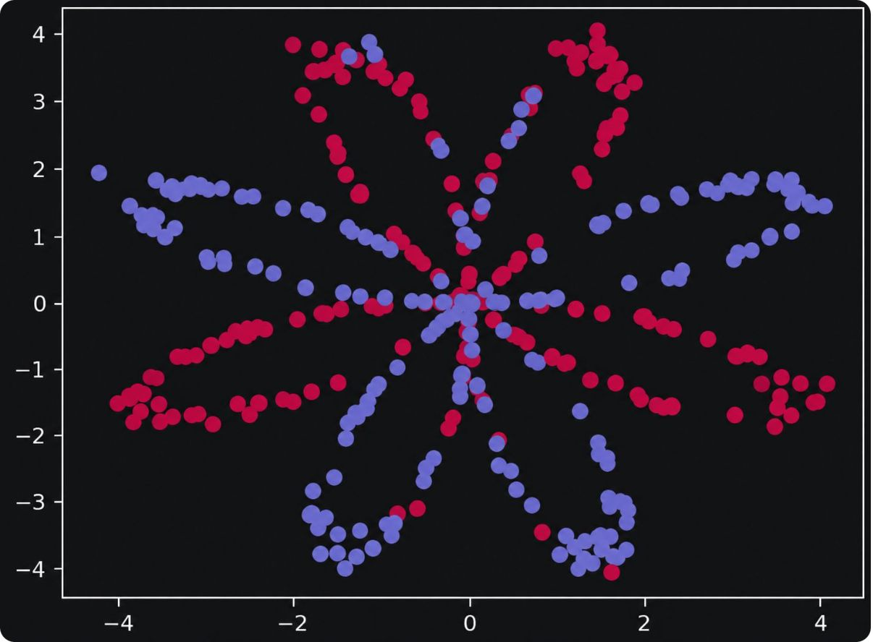
A neural network, built from scratch
CS4085 Deep Learning · Effat University · Dr. Naila Marir
A 2-class classifier with one hidden layer, compared with logistic regression. Given the following dataset:
The dataset is a flower with some red (y=0) and some blue (y=1) points
tanh units
Propagation
Optimization
Cross-entropy loss
Forward and backward propagation
Gradient descent

Slide 3
Logistic regression reaches only 47% on the flower dataset
47% Accuracy
EXERCISE 1
The pattern is not linearly separable, so a straight boundary fails.
400 examples
Red is label 0
Blue is label 1
Since the dataset is non-linear, a neural network is a much better approach
tanh units
Propagation
Optimization
Cross-entropy loss
Forward and backward propagation
Gradient descent

Slide 4
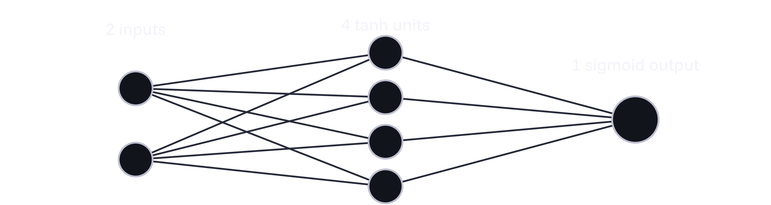

The Neural Network Model: 2 inputs, 4 tanh hidden units, 1 sigmoid output
Predict 1 when , otherwise 0.

Slide 5
Exercises 2 to 4: structure, initialization, forward propagation
2
3
4
Structure
Initialization
Forward pass
layer_sizes
initialize_parameters
Weights are randn * 0.01; biases are zeros.
forward_propagation
n_x = X.shape[0]
n_h = 4
n_y = Y.shape[0]
Z1
A1 = np.tanh(Z1)
Z2
A2 = sigmoid(Z2)
All cached.
Exercise 5: cross-entropy cost (cost function)
Vectorized with np.multiply, np.log and np.sum, no loops.

Slide 6





Exercise 6: backpropagation in six equations
OUTPUT LAYER
HIDDEN LAYER
The tanh derivative is .

Slide 7
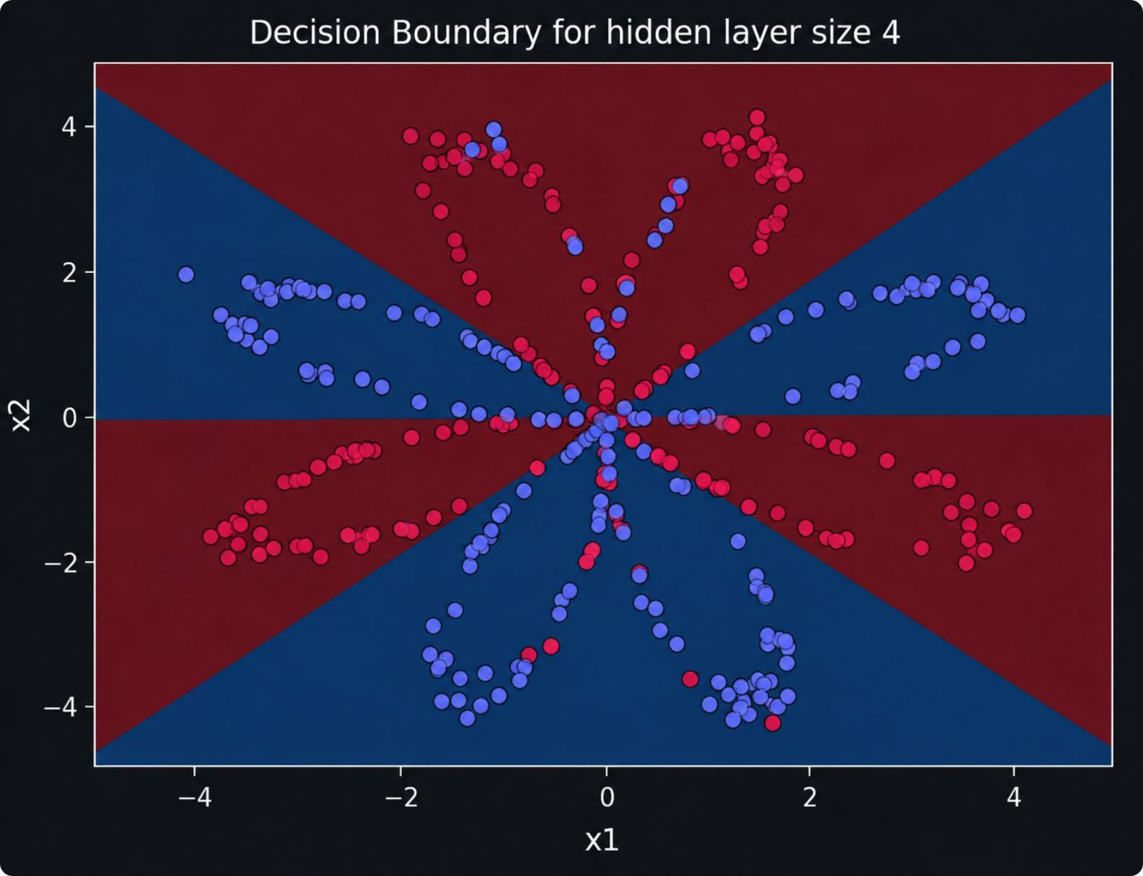

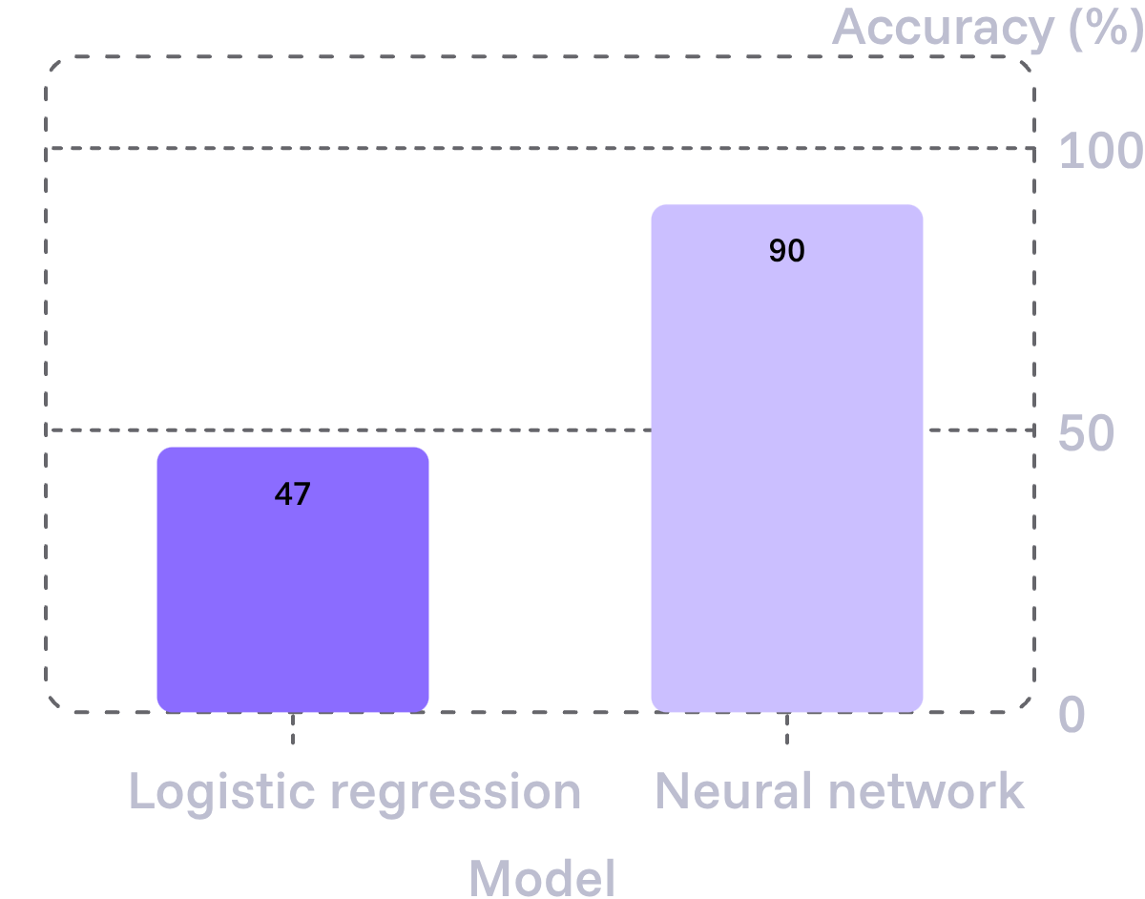
Exercises 7 to 9: train and predict, reaching 90% accuracy
nn_model loops:
01
02
03
04
Forward
Cost
Backward
Update
Cost falls from 0.693 to about 0.218 over 10,000 iterations.
predict thresholds at 0.5.

Slide 8
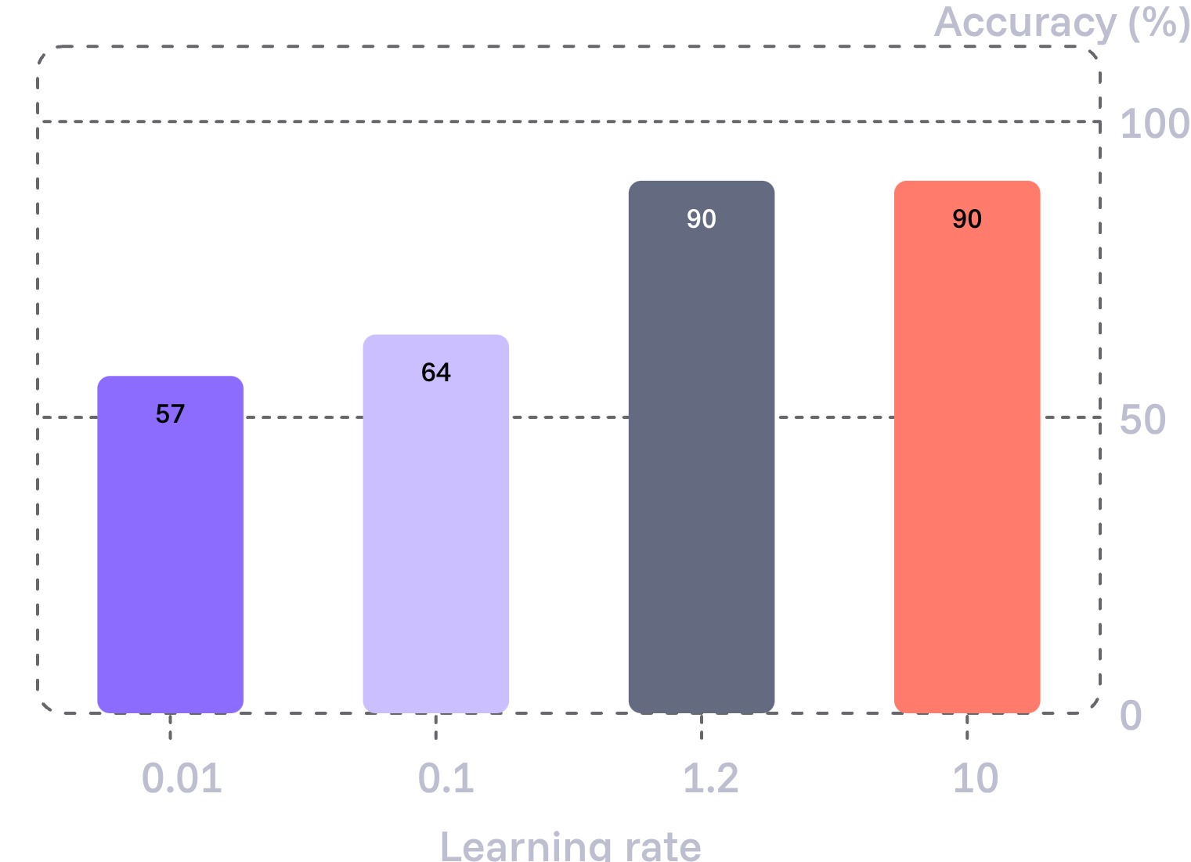
Hidden size and learning rate both shape the result
Hidden size
Learning rate
HIDDEN UNITS | RESULT
1 or 2 | About 67%
3 to 5 | About 90 to 91%
20 and 50 | Risk overfitting
Best size here is about 5 units.

Slide 9
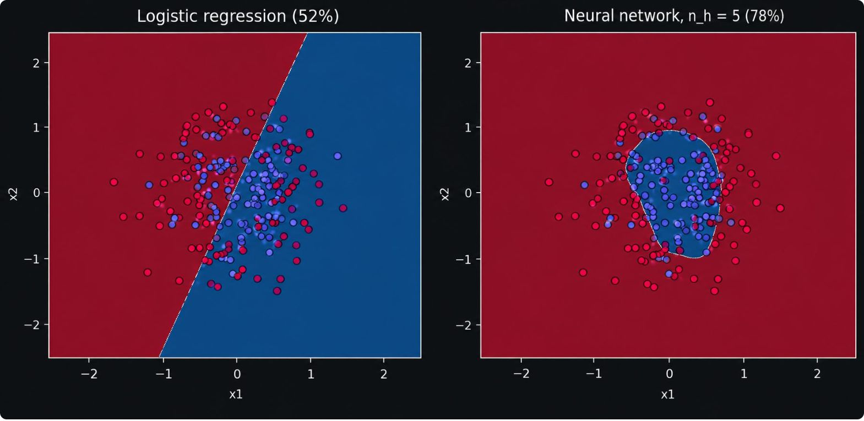
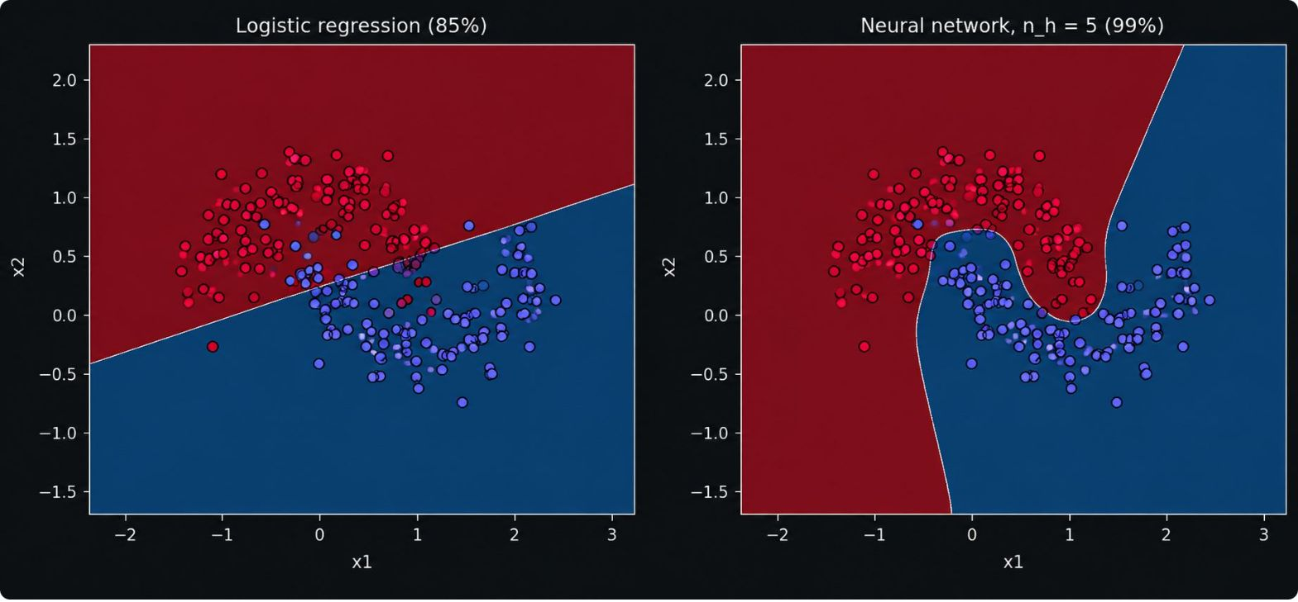
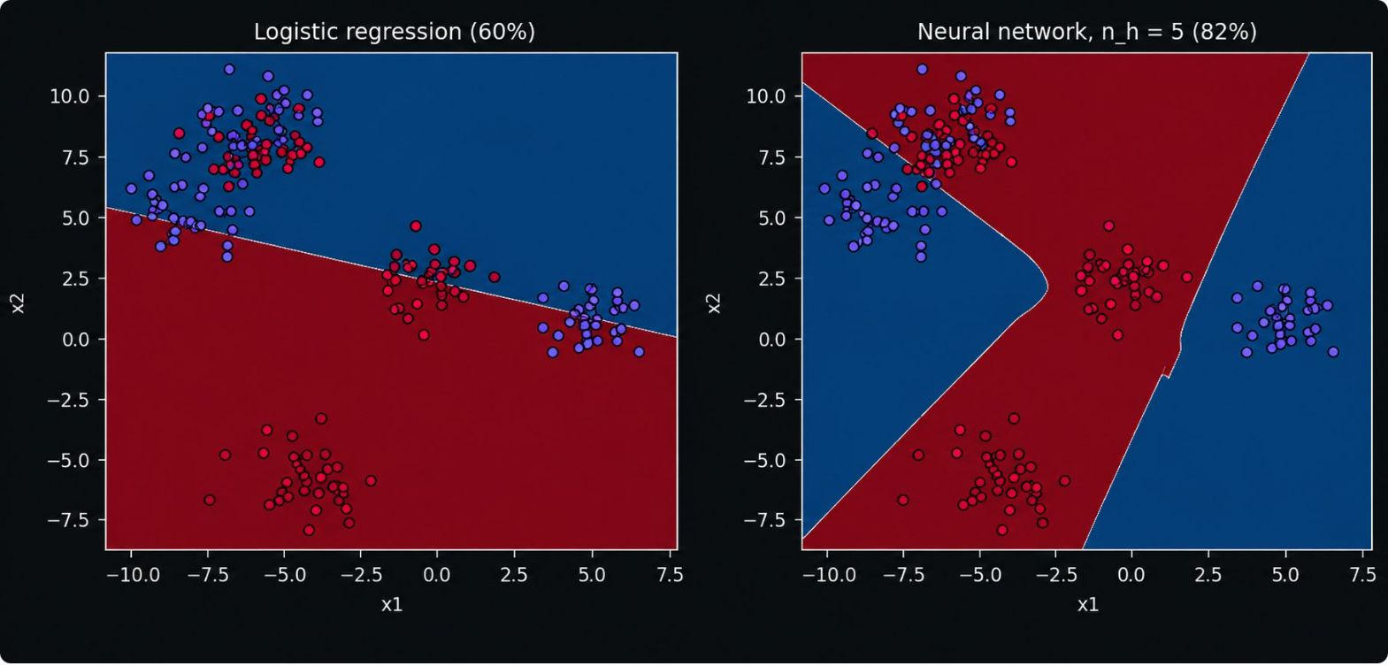
Comparing Logistic Regression and Neural Networks performance in different datasets
Noisy Circles
Noisy Moons
Blobs

Slide 10
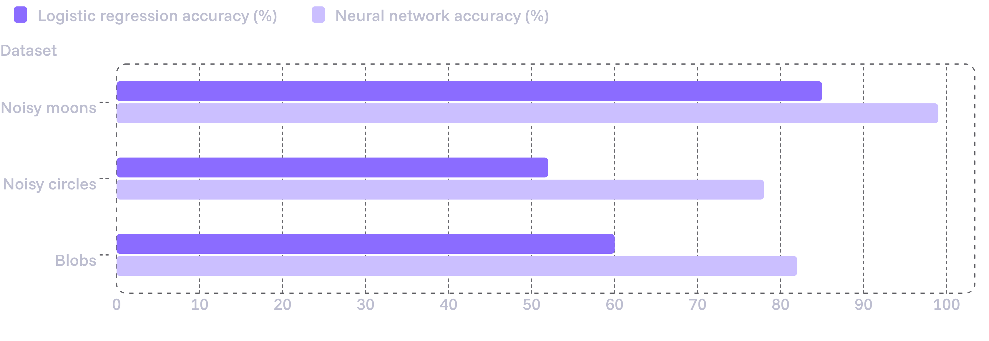
The network beats logistic regression on other datasets
One hidden layer learns non-linear boundaries; next we'll try ReLU and regularization.

