Slide 1
Integrated Project-II
Readify
Supervisor
Under the Guidance Of- Mr. Himanshu Sharma
Designation- Program Incharge
Department of Computer Science & Engineering
Submitted By- Anmoldeep Singh
University ID- 2111981041
Department of Computer Science & Engineering
Chitkara University, Himachal Pradesh

Slide 2
CONTENT
Introduction
Objectives and Features
Requirement Analysis
Design
Coding
Conclusion & Future Scope

Slide 3
INTRODUCTION
In today's fast-paced world, access to quality literature is essential for personal growth and enrichment. With READIFY, we're revolutionizing the way readers discover and purchase books. Our project is a comprehensive MERN stack application that offers users a vast collection of books across various categories, ensuring that everyone can find something that piques their interest.
By simply browsing through our intuitive interface, users can explore a plethora of books spanning genres such as fiction, non-fiction, self-help, and more. With a dedicated paid book section, readers can access premium content and support their favourite authors while indulging in their literary pursuits.

Slide 4
In this project, we'll dive deep into the intricacies of building a robust bookstore application. From integrating payment gateways for secure transactions to implementing algorithms for personalized book recommendations, we'll cover it all. Our goal is to create a seamless and enjoyable experience for book enthusiasts, allowing them to easily navigate through our extensive library and find their next literary adventure.

Slide 5
OBJECTIVES
The “Readify” project represents a pioneering endeavor in the realm of e-commerce and digital libraries, designed to elevate the reading experience for users through a sophisticated bookstore website. Leveraging the capabilities of the MERN stack, Readify offers a seamlessly integrated platform where book enthusiasts can effortlessly explore, purchase, and immerse themselves in a diverse array of literary works. With an extensive selection of categories and a dedicated paid book section, Readify caters to the varied interests and preferences of readers, ensuring that every individual discovers content that resonates with them.

Slide 6
FEATURES
Readify enables users to explore a wide range of books across various genres and categories. Facilitates seamless navigation through the bookstore website, allowing users to discover, preview, and access detailed information about each book. Offers a dedicated paid section for premium books, providing exclusive content and supporting authors.
Utilization of Advanced Technologies: Incorporates cutting-edge technologies to optimize book recommendations, improve search functionalities, and enhance overall website performance.
Promoting Literary Engagement: Aims to foster a culture of reading and literary appreciation by providing access to a vast library of books and encouraging exploration and discovery within the literary world.

Slide 7
REQUIREMENT & ANALYSIS
SOFTWARE
Operating System: Window 8 and later versions.
GUI internet browser (Like Microsoft Edge)
Visual studio 2020

Slide 8
CONTINUED
2. HARDWARE
Minimum Hardware Requirement that can support GUI Internet browser and Window 10 Operating System.
233 MHz Processor
1 GB RAM

Slide 9
3. DATABASE
MongoDB

Slide 10
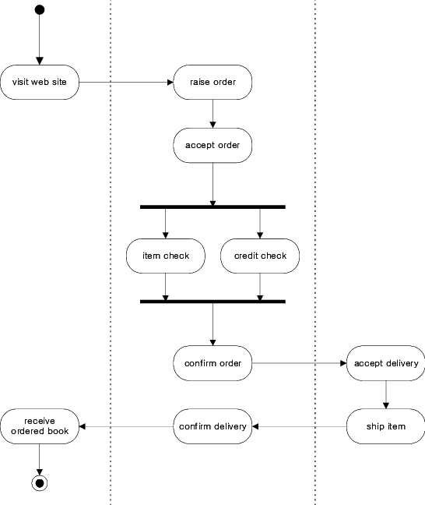
Activity Diagram
10

Slide 11
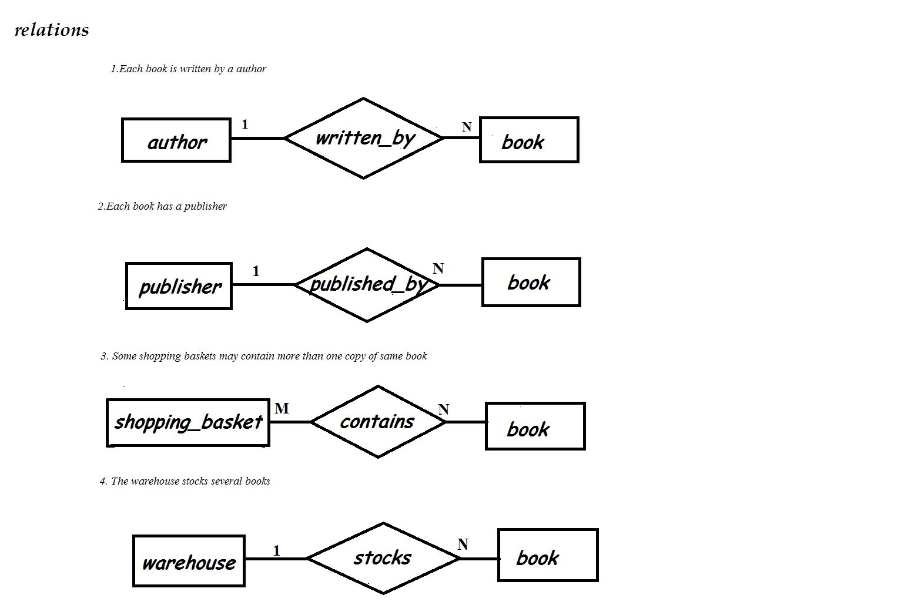
ER Diagram

Slide 12
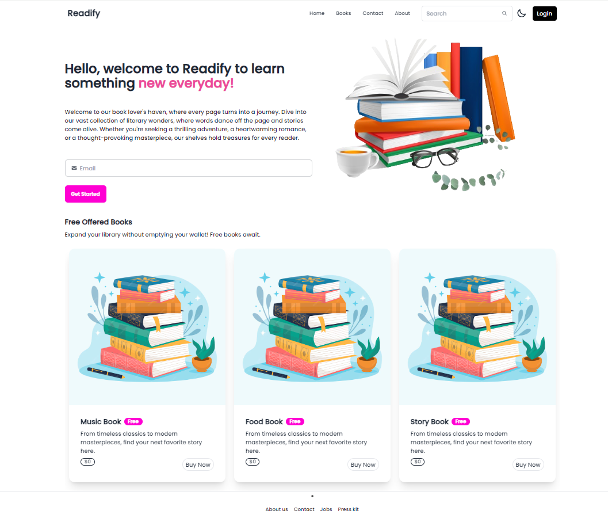
HOMEPAGE

Slide 13
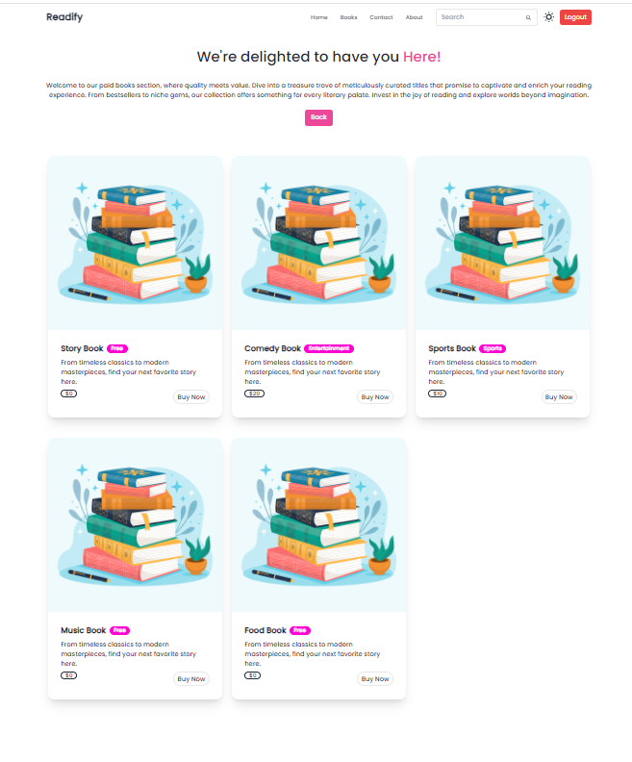
Books Page

Slide 14
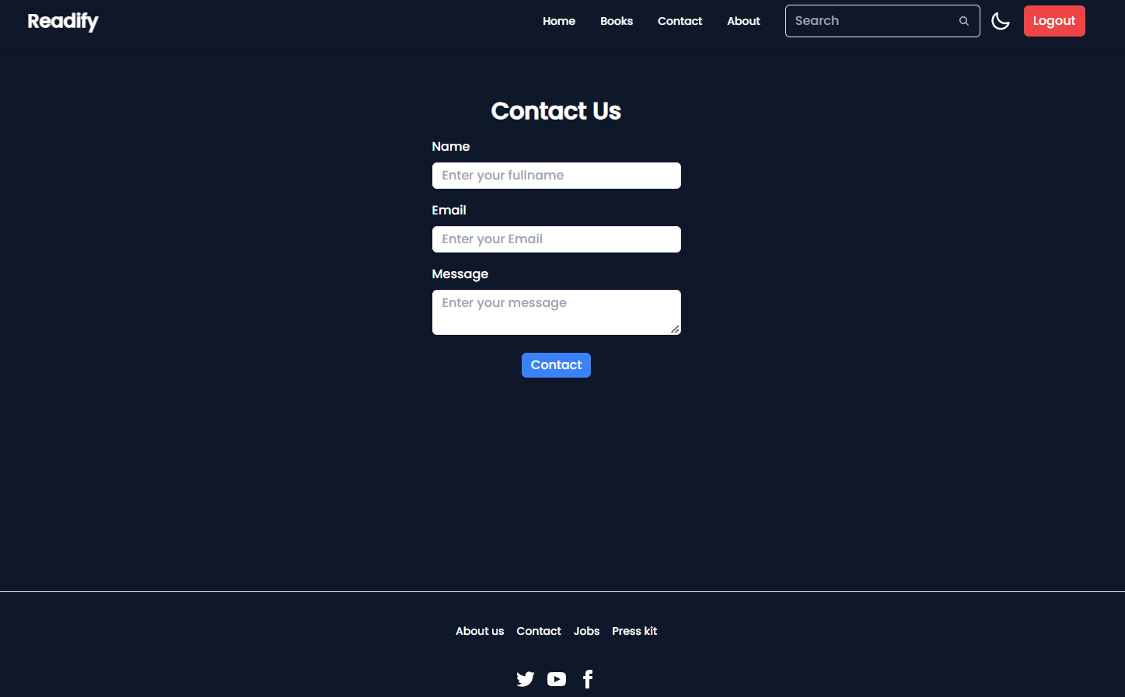
Contact Us Page

Slide 15
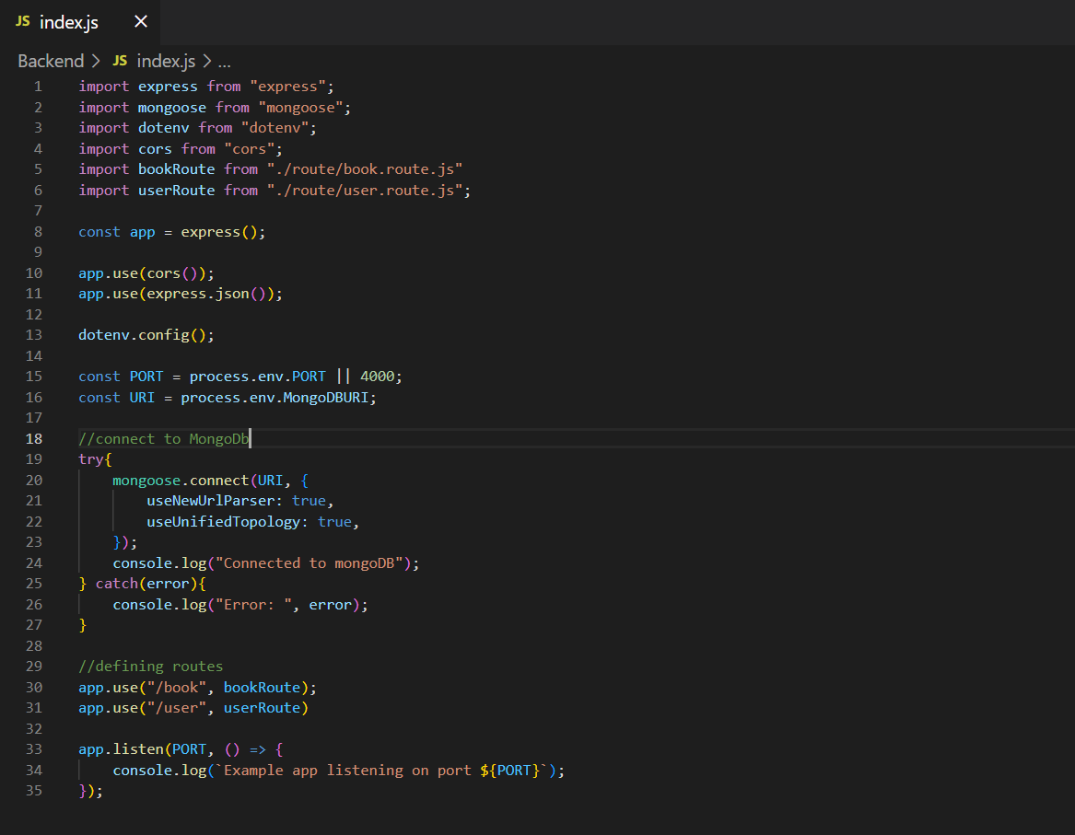
CODING

Slide 16
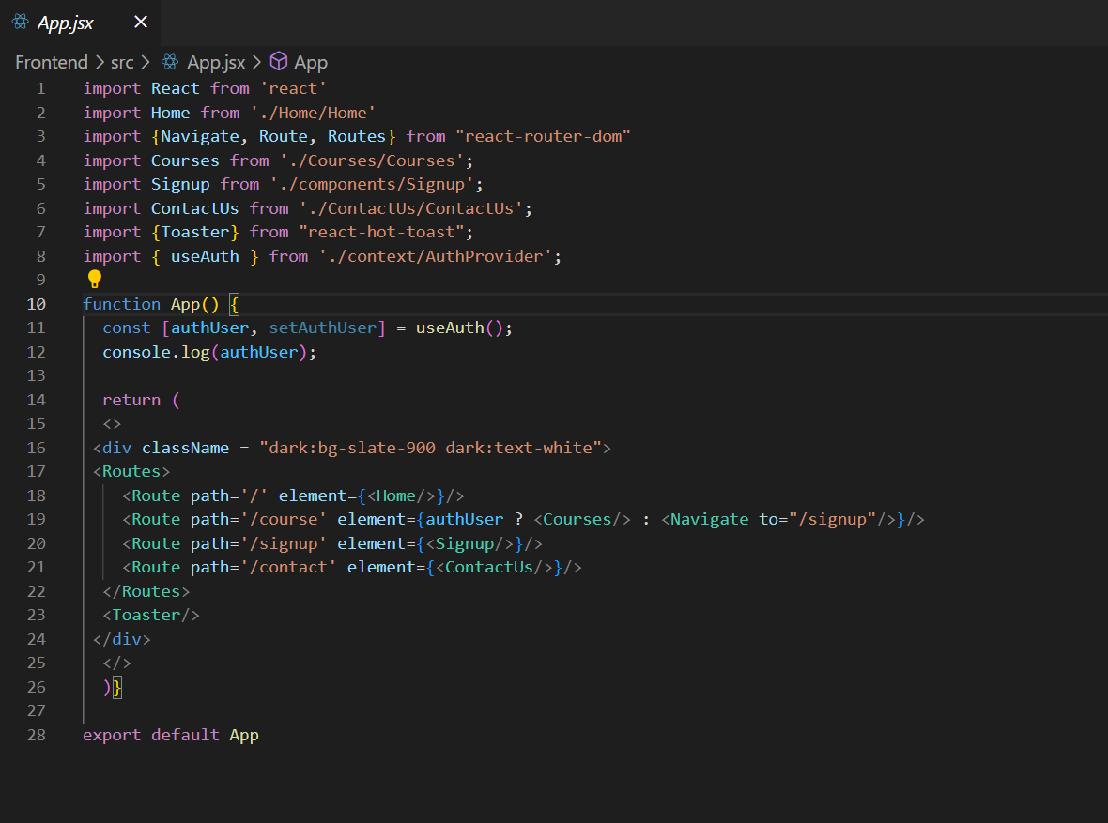
CONTINUED

Slide 17
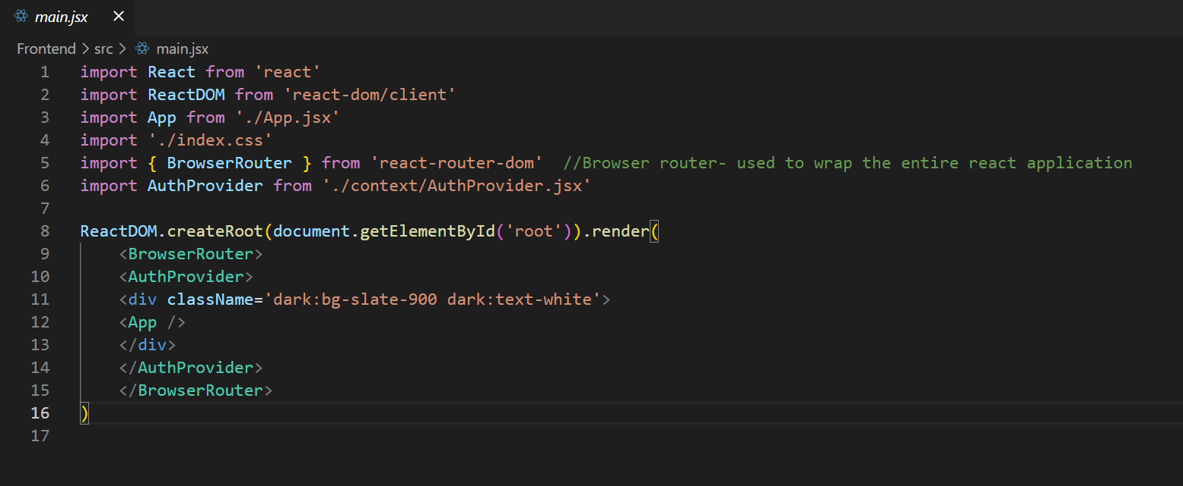
CONTINUED

Slide 18
CONCLUSION
Captivating User Experience:
Successfully created a captivating and user-centric bookstore website.
Seamlessly blended e-commerce functionalities with digital library features.
Diverse Book Collection:
Offered users a rich and diverse collection of books across various genres.
All books accessible for free, promoting inclusivity and accessibility.
Premium Book Section:
Introduced a dedicated paid section for premium books, adding value to the platform.
Provided users with access to exclusive content and the opportunity to support favorite authors.
Impact on Literature:
Fostered a love for literature and enhanced the reading experience for individuals worldwide.

Slide 19
FUTURE SCOPE
Expanding Data Sources: The project can explore integrating with additional data sources to provide users with a more comprehensive and diverse range of Books collection.
Personalized Features: The application can introduce personalized features, such as allowing users to create and manage a Wishlist of their favorite books. Additionally, users can enjoy the convenience of adding books to their cart for seamless purchasing.
Mobile Integration: Developing a mobile application or integrating the "Readify" project with popular mobile reading apps can further enhance the accessibility and convenience for users on the go.

Slide 20
REFERENCES
daisyUI — Tailwind CSS Components
https://www.w3schools.com

Slide 21
THANK YOU

