Slide 1


Out of Service(OOS) Alarm Prediction​
NKU-Excavator
Tianyu Zheng，Chao Zhou， Meijun Jiang
Notes:
0图；6+文

Slide 2
Outline
1
2
3
4
Background
Data Processing
Model Optimization
Conclusion

Slide 3
PART 01
Background

Slide 4

01
Background
BS investment is increasing year by year.
The three major operators of China have more than 6.8 million base stations.
China Mobile's total revenue in 2019 was 700 billion, of which 1/3 was used for base station operation and maintenance.
In 2021, China will have a 400 billion operation and maintenance market, and the global market will be nearly 1 trillion.
Construction cost
Operating cost
Maintenance cost

Slide 5
01
Background
The Traditional Maintenance Method
STEP1
STEP3
The base station is out of service, affecting the normal communication of users.
Workers go to the base station to solve the fault.
1
2
3
4
STEP2
STEP4
The system issues maintenance instructions.
The base station resumes operation and records the cause of the failure.
Lack of real-time performance
High maintenance cost
Low efficiency
Passive

Slide 6



01
Background
The Intelligent Network Maintenance
The intelligent network operation and maintenance achieves fault prediction through data analysis and continuous self-learning, which can effectively improve processing efficiency and accuracy
Big Data
Artificial Intelligence
Maintenance Experience

Slide 7

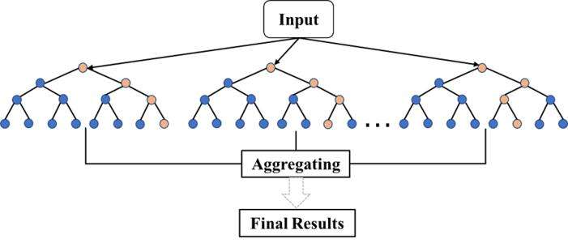

01
Background
Base Station Out-of-Service Alarm Prediction
When the network base station malfunctions, an alarm will be generated, which will cause network interruption and affect normal communication of users.
We can build an AI model to predict the probability of out-of-service alarms in the future through minor alarms, which will benefit maintenance personnel to deal with faults in advance and effectively avoid the base station from out-of-service.
Predict
Minor Alarms
AI Model
Out-of-Service Alarms

Slide 8
PART 02
Data Processing

Slide 9
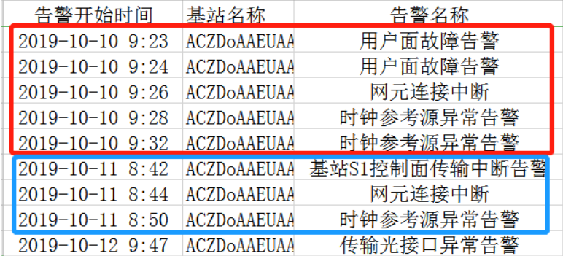
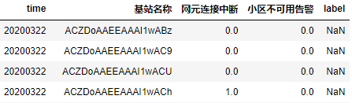
02
Data Processing
Table 1. Original data
Complex and disordered
target
Succinct and clear
Table 2. Train data
ID：Distinguish base station
Feature：Training samples
Label：Prediction target
ID
Feature
Label

Slide 10

02
Data Processing
Innovation 1: Generate labels accurately
2. Shift up the alarm columns
Judging by the warnings of the next day,
Use Shift(-1) function to shift up。
4. Eliminate forecast data
Exclude the data of March 22nd and March 30th.
1. Fill in missing dates
Fill in all time range data:
2019.10.01-2020.03.30
3. Generate label
Add the two columns and determine whether it is non-zero, then label=1
Label=1
Fill in 20200317

Slide 11
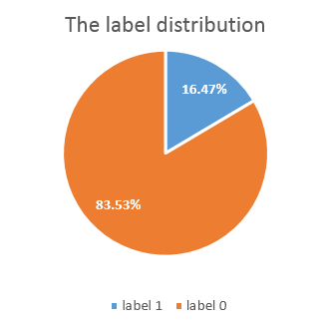
02
Data Processing
Innovation 2: Threshold adjustment
Unbalanced data set——label 0 : label 1 ≈ 5 : 1
Oversampling
Repeat the sampling of the data sample with label 1.
Threshold adjustment
Adjust the threshold for dividing label according to the ratio of 0 to 1.
datum：0.165
Undersampling
Randomly sample the data samples with label 0.

Slide 12
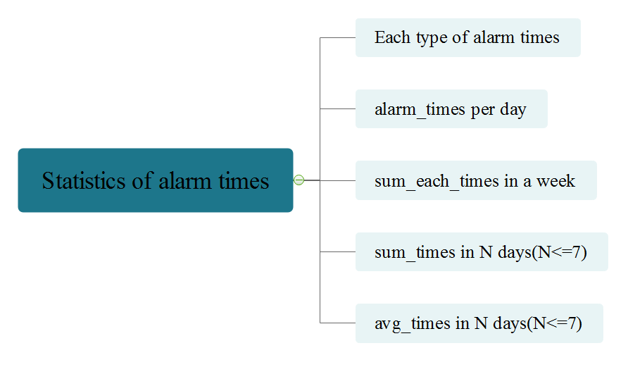
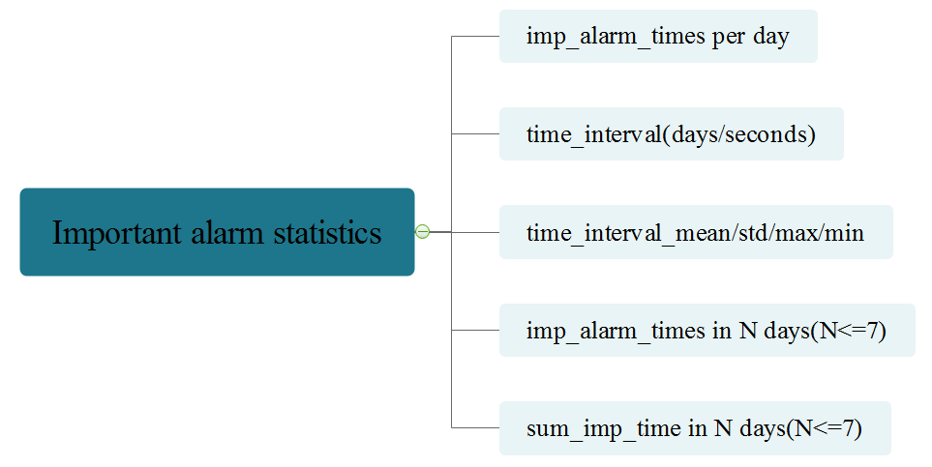
02
Data Processing
Innovation 3: Multi-dimensional features
Basic features

Slide 13
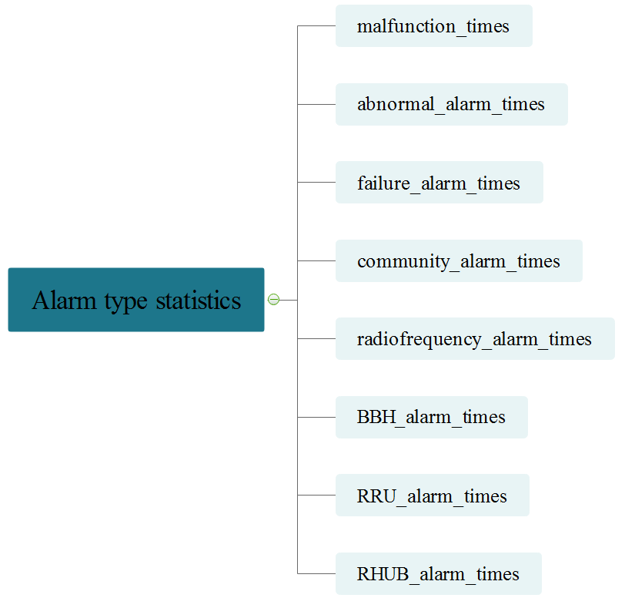
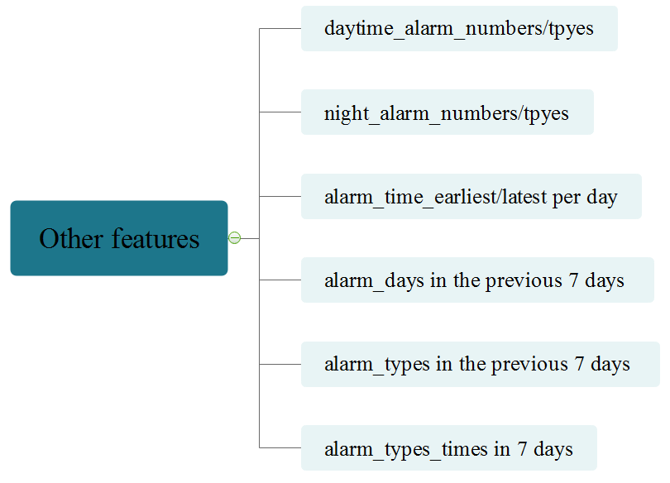
02
Data Processing
Innovation 3: Multi-dimensional features

Slide 14
PART 03
Model Optimization

Slide 15
03
Model Optimization
Gradient Boosting Decision Tree（GBDT）
Negative gradient
LightGBM is one of the implementation frameworks of the GBDT model.
Training fast.
High accuracy
Low memory usage.
Original prediction
Residual prediction
Gradient
Boosting
Superposition model
Residual prediction(new)
...
Linear superposition
GBDT

Slide 16
03
Model Optimization
Cross-validation
ITU 5G
5-fold cross-validation improves model stability and prevents overfitting
AIIA
2020
Grid Search
Find the optimal parameters of the model by grid search
Whether offline AUC is improved
Whether the feature importance increases
Whether the category ratio is consistent
Model Merging
Through the integration of the advantages of each sub-model, the optimal model is generated by superposition.

Slide 17
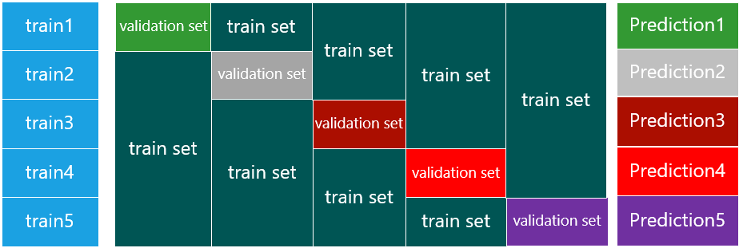
03
Model Optimization
Cross-validation
The 5-fold cross-validation method can make full use of the data set to prevent overfitting.
mean
Result

Slide 18
03
Model Optimization
Grid Search
It traverses the parameter matrix to find the optimal parameters of the model.
Parameters | Grid search range | Optimal parameters
max_depth | -1、6、8、10 | -1
n_estimators | 100、500、1000 | 1000
num_leaves | 16、32、51、61 | 32
learning_rate | 0.01、0.02、0.05 | 0.02
feature_fraction | 0.7 | 0.7
bagging_fraction | 0.7 | 0.7
bagging_freq | 5 | 5
feature_fraction_seed | 7 | 7

Slide 19
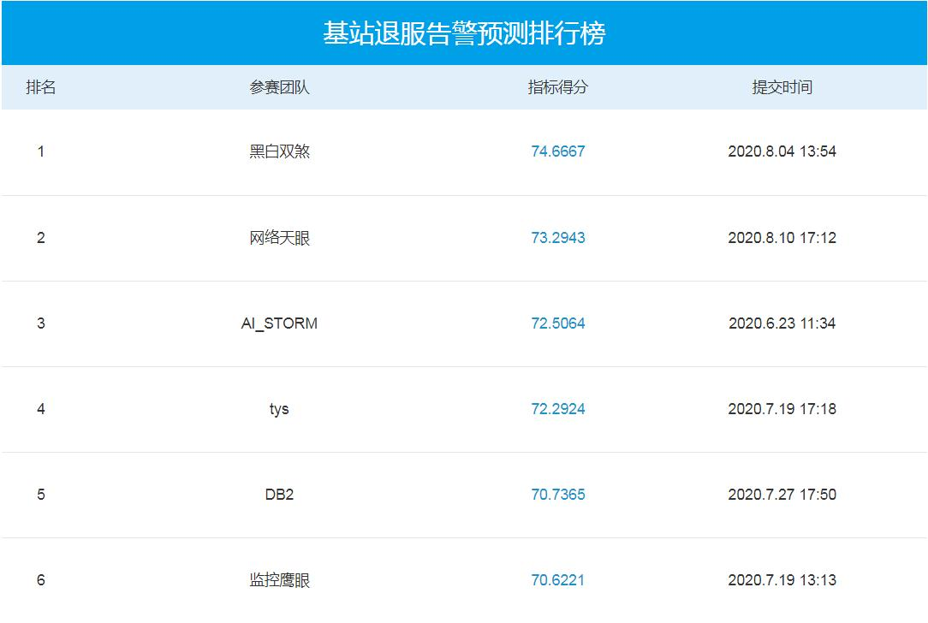

03
Model Optimization
Final F1-score
74.6667

Slide 20
PART 04
Conclusion and

Slide 21
04
Conclusion
High prediction accuracy
Training fast
Generalization ability
Strong expandability
Online F1-score is 0.747, 1% higher than the second place.
Model training only takes 3-5 minutes, which is much faster than LSTM model.
Collect two-year operating data of thousands of base stations to train the model.
Multi-dimensional predictions can be made by adding features such as power consumption.

Slide 22
04
Conclusion
Feedback
What are the benefits of BS out of service alarm prediction? why is it so important?
1)Background: The base station maintenance cost is huge and needs to be solved urgently.
2)Strength：Reduce maintenance costs by 25%-35%.
Equipment life can be extended by 10%-15%.
How to improve the generalization ability of the model?
1)Add more base station alarm data for model training.
2)Model merging: stacking merging and weighted merging.
What are the advantages of your scheme?
1)Generate labels accurately and automatically------achieve accurate prediction.
2)Training fast------real-time prediction capability.
3)Strong expandability

Slide 23
04
Conclusion
Future Development Direction
Dynamic model optimization
Alarm root cause location
Comparing real-time data and prediction results. Achieve model self-optimization through continuous loop self-detection.
Integrate AI algorithms with expert experience to realize intelligent fault location and improve the accuracy of root cause identification.
Base station energy saving
Build a cloud database
Add features such as power and throughput to predict future network traffic. Energy saving can be realized by means such as carrier sleep.
Gather fault data and algorithm parameters from various places to form a cloud sharing model to improve model accuracy and generalization capabilities.

Slide 24
Thanks
Notes:
0图；6+文

