Slide 1
FINAL PROJECT Password Manager (SEN10)
David, Pacito Robert Ian
Guevarra, John Lenard
Mendoza, Achim Jonah
Nastor, Ericksson

Slide 2
Introduction
Password managers are applications that store your passwords in a safe place
The passwords are encrypted when you use this software
You need one master password to access them
Password manager tool can also offer a variety of other useful features
Password manager saves information on the local computer
You may lose all of your passwords if the computer is reformatted
In order to stay safe online, you must create strong passwords

Slide 3
Background of the Study
Forgetting a password
Using a password that is so basic that you won't forget it
A hacker, for example, can quickly guess or brute-force a trivial password
A data breach
Use a separate password

Slide 4
Methodology
waterfall approach
The requirements are gathered and analyzed by the team
Planning phase
After this build iteration has been coded and implemented
This allows the entire team, as well as clients or other external parties, to assess where the project is, where it needs to go, what can or should change, and so on.

Slide 5
Functionalities
Master Password
Password Generator
Copy Password and Username
Update, Remove and Add new data

Slide 6
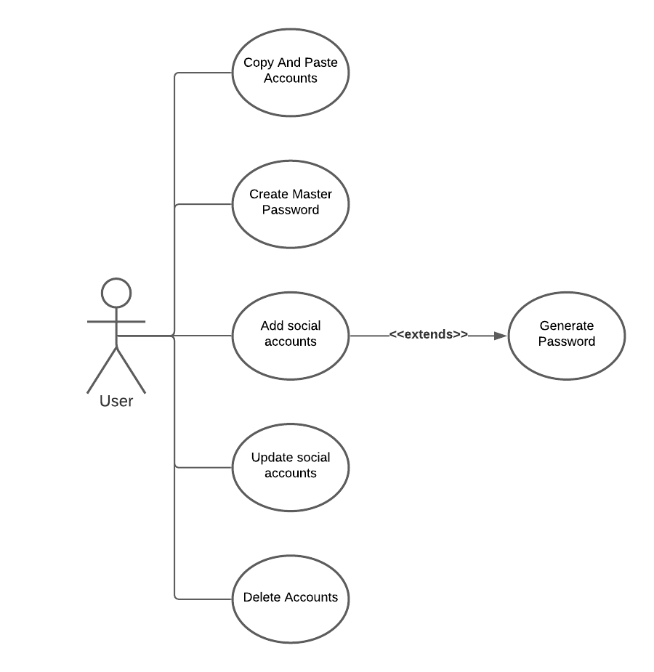
Software Development Models
Figure 1: Use Case Diagram

Slide 7
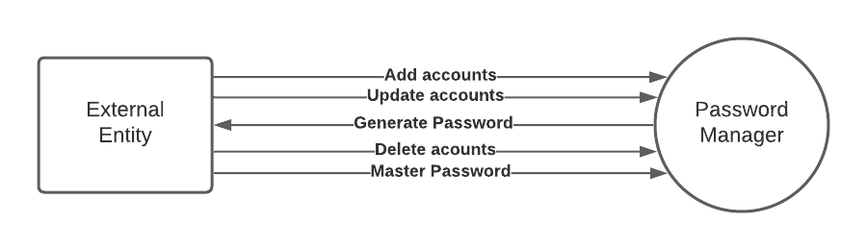
Context diagram
Figure 2: Context Diagram

Slide 8
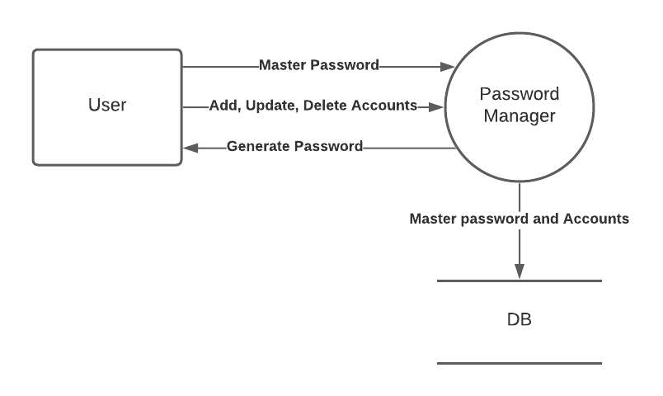
Data flow diagram
Figure 3: Data Flow Diagram

Slide 9
User Stories
As a user, I’d want to have my own password and account manager
As a user, I want to create my own master password
As a user, I’d want to be able to generate a password
As a user, I should have an option to store accounts as many as I like
As a user, I want to have an option to update and delete account

Slide 10
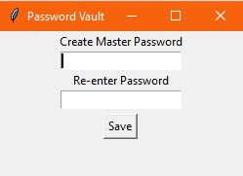
Screenshot Of the Program
Figure 3: Master Password Creation

Slide 11
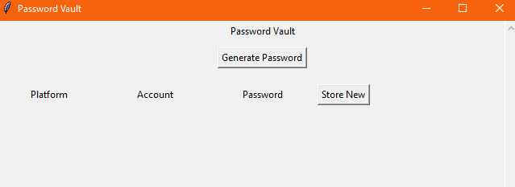
Figure 4: Password Vault Window

Slide 12
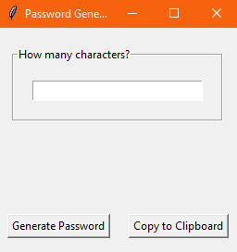
Figure 5: Password Generator Window

Slide 13
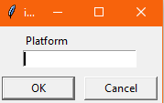
Figure 6: Platform Window

Slide 14
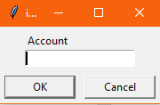
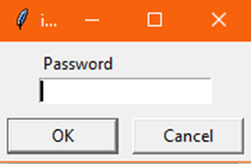
Figure 7: Account Window
Figure 8: Password Window

Slide 15
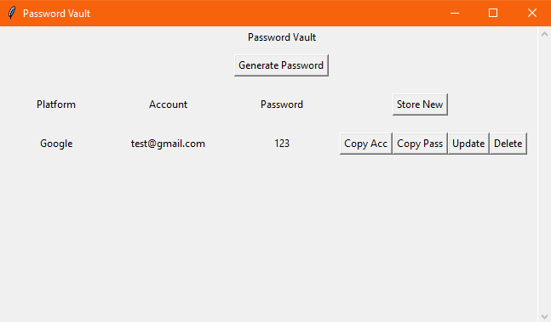
Figure 9: Updated Password Vault

Slide 16
Thank you!!!!

