Slide 1
Starting on Microsoft.com/learn
Browse Experience
Select Learning Path
Certification Recommendation
Learn more about a
Certification

Slide 2
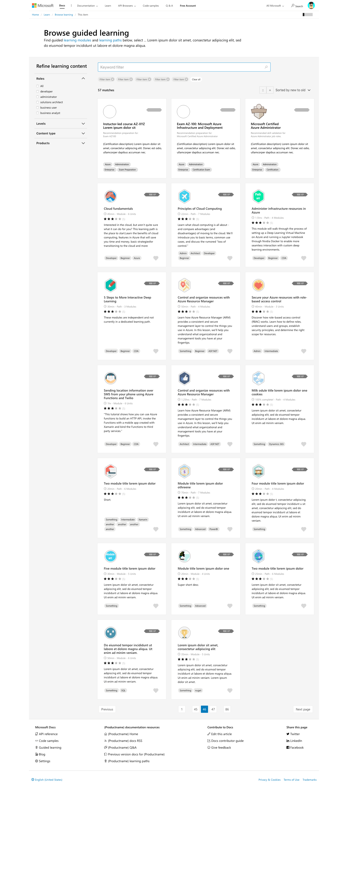
microsoft.com/learn Browse Experience

Slide 3
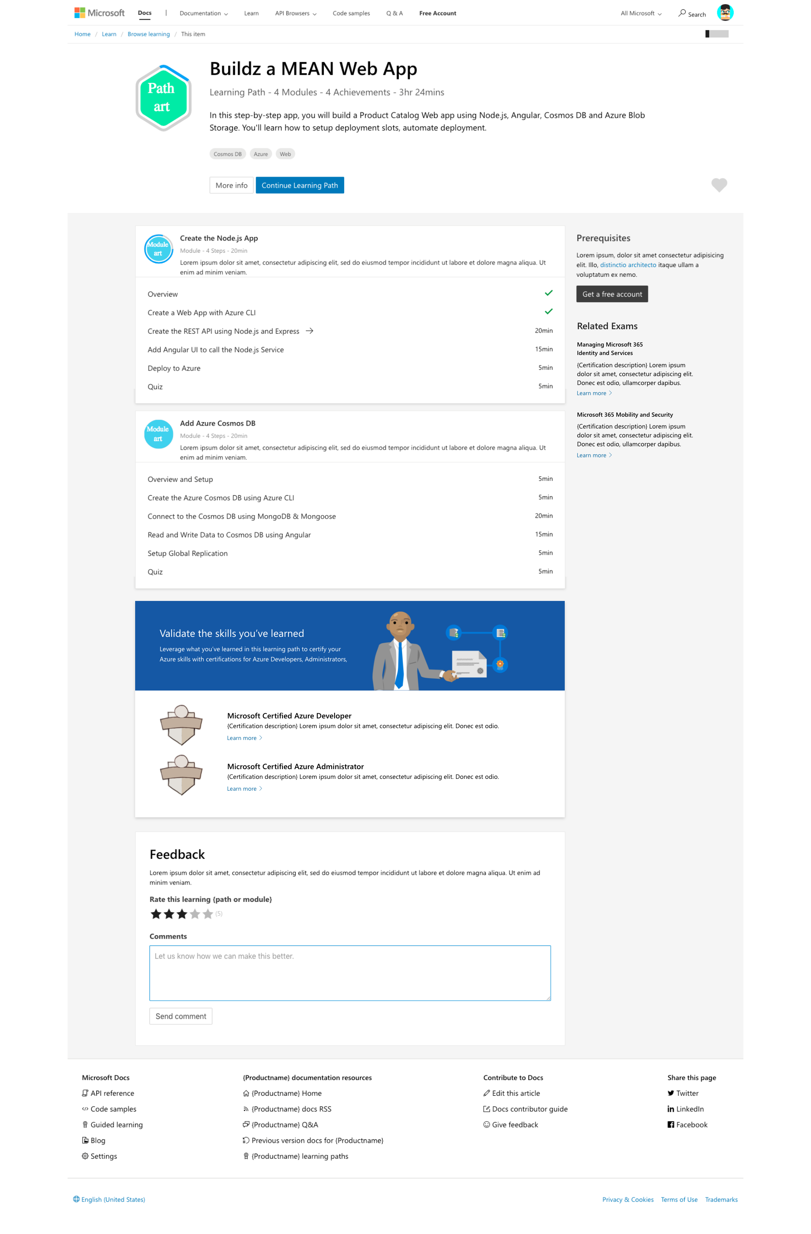
microsoft.com/learn Learning Path

Slide 5
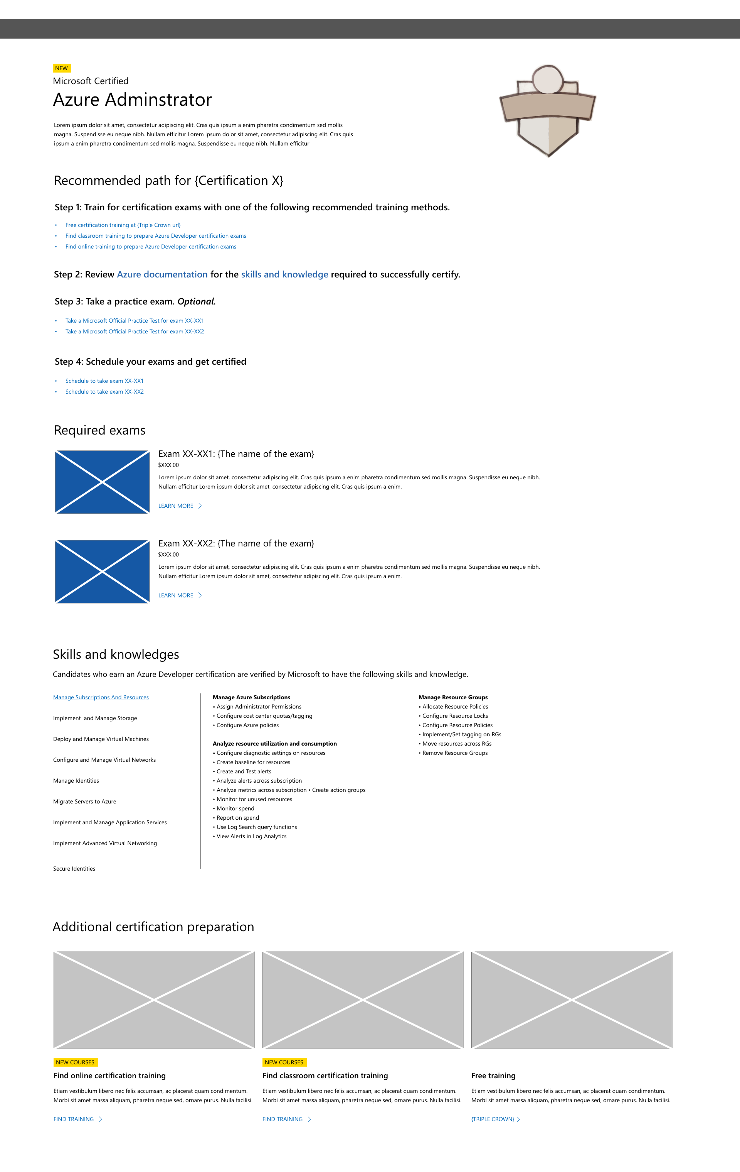
microsoft.com/learning Certification details

Slide 6
Starting on Microsoft.com/learning
About technical
certification
Learn about Role-based
Certifications
Learn more about a
Certification

Slide 7
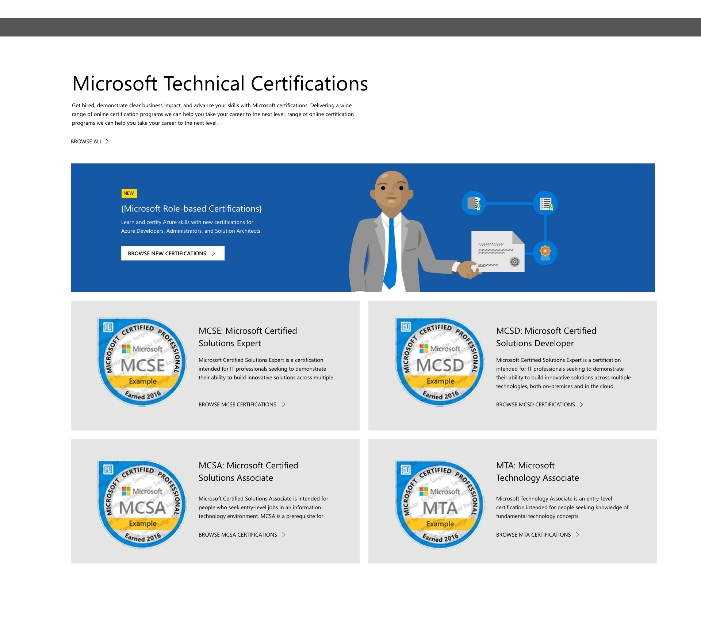
microsoft.com/learning Certification details

Slide 8
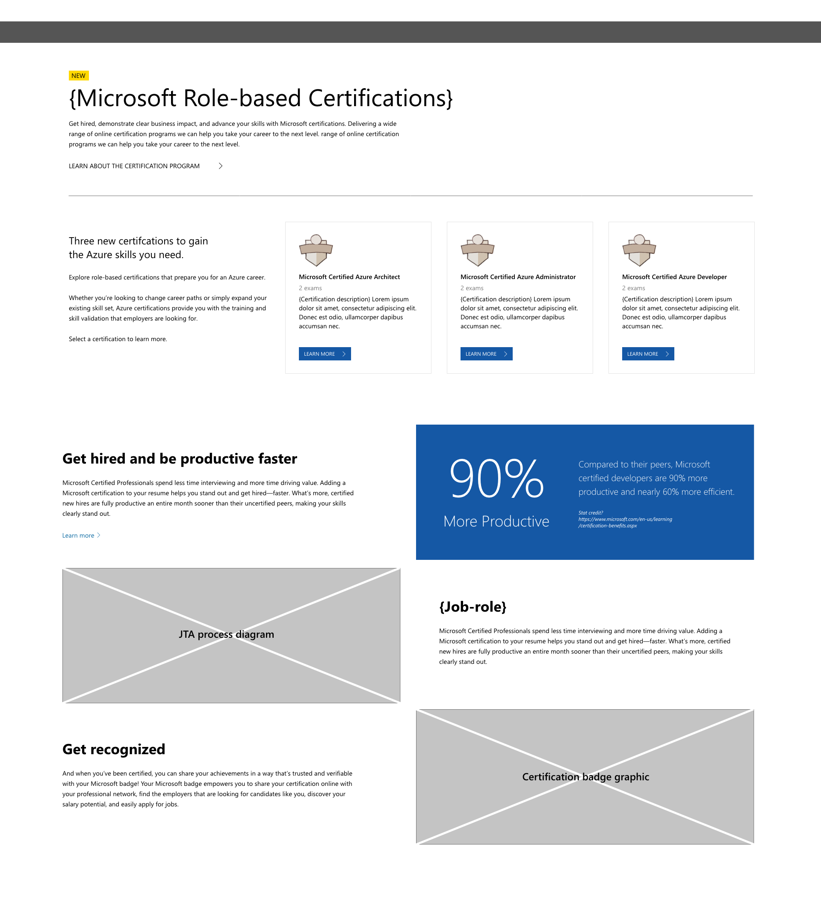
microsoft.com/learning Role-based Certifications

Slide 9
microsoft.com/learning Certification details

