Slide 1
Mini-Homework 1
https://www.airbnb.it/
Stefano Caramagno
1000038343
CRMSFN02R13I754M@studium.unict.it

Slide 2
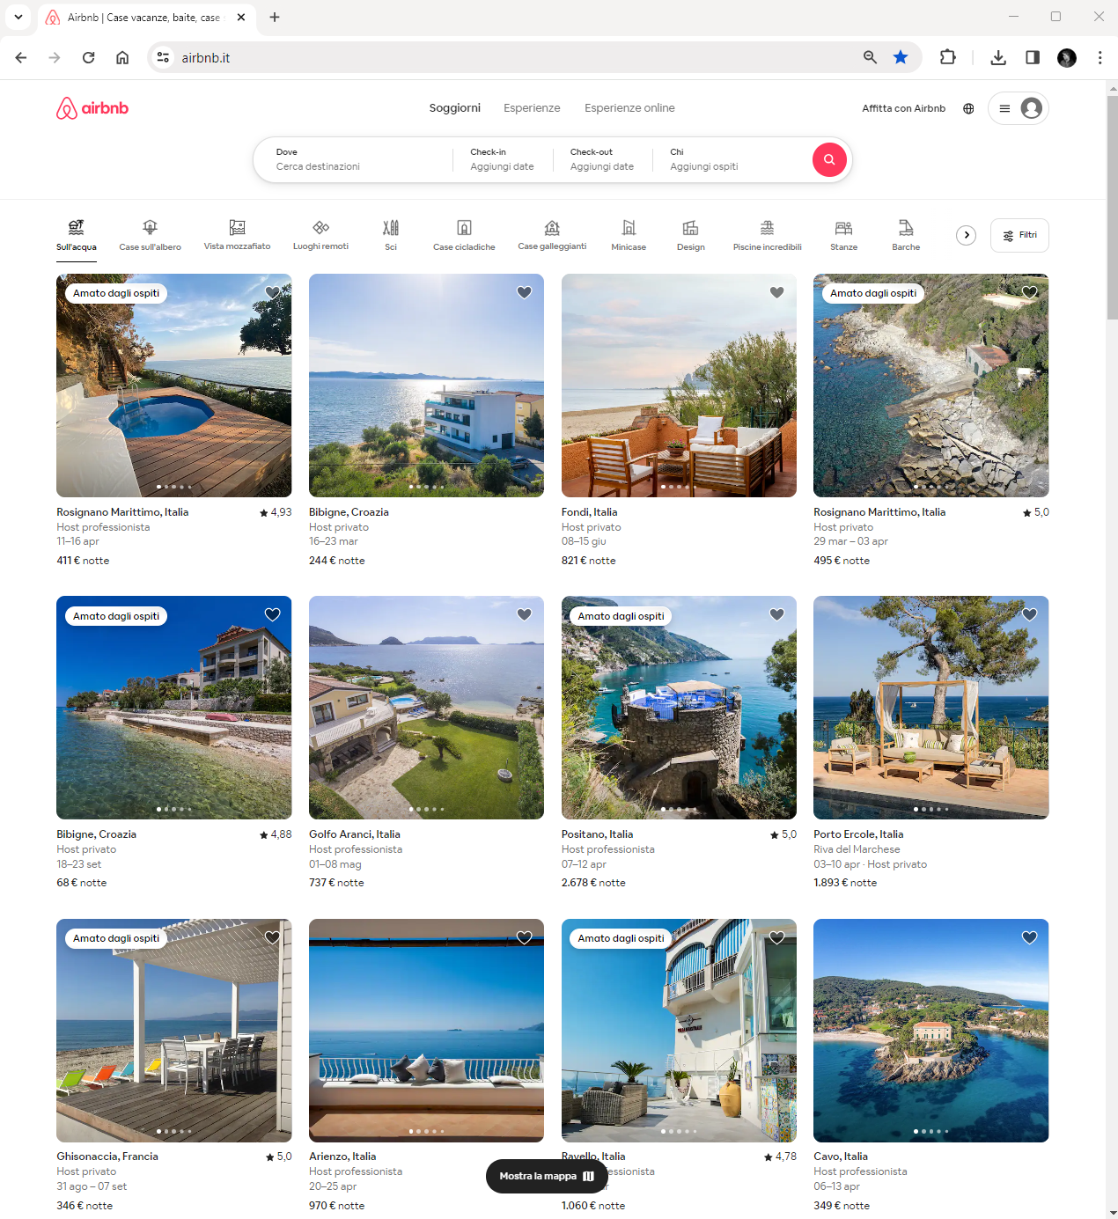

Slide 3
