Slide 1
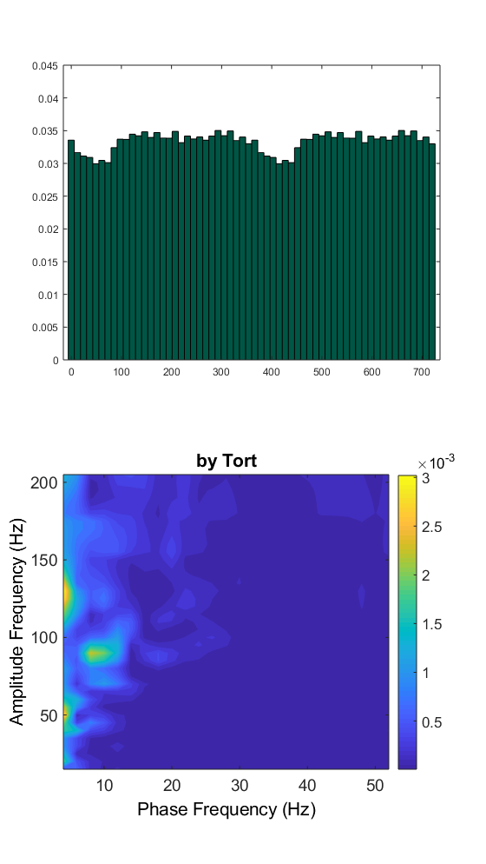
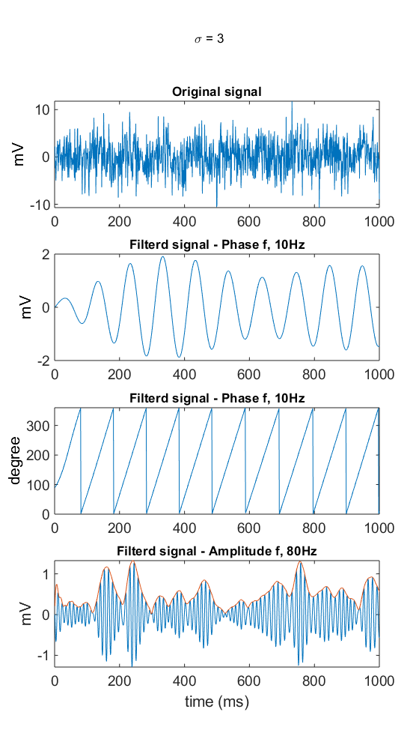
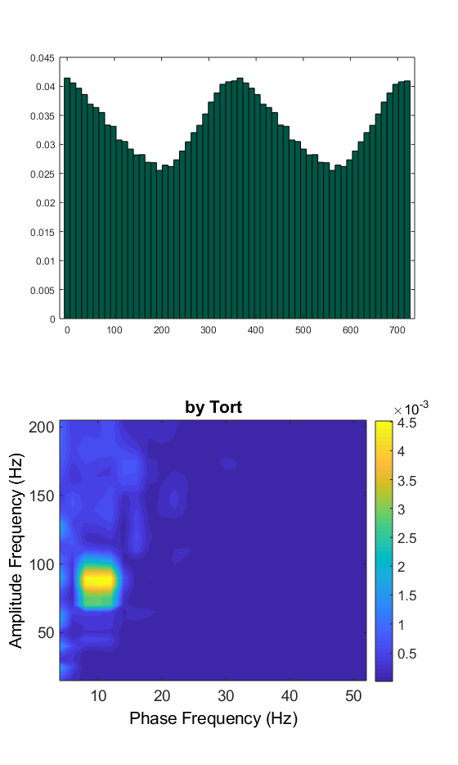
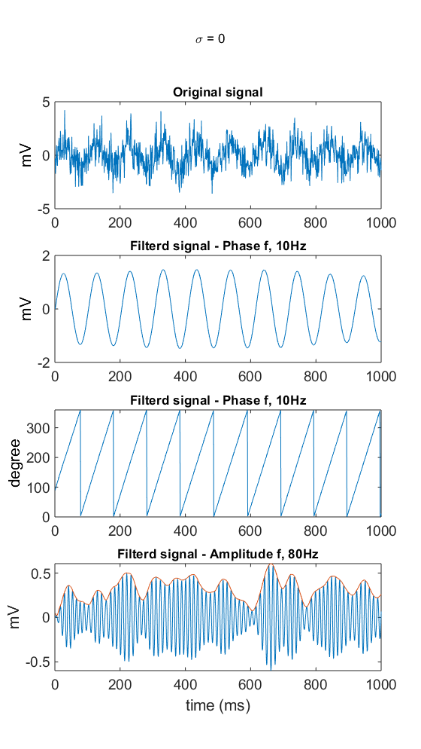
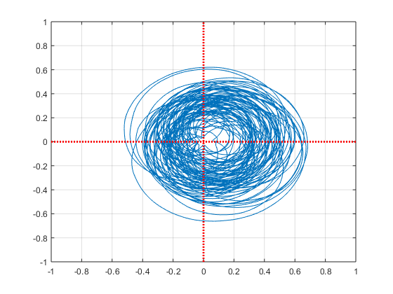
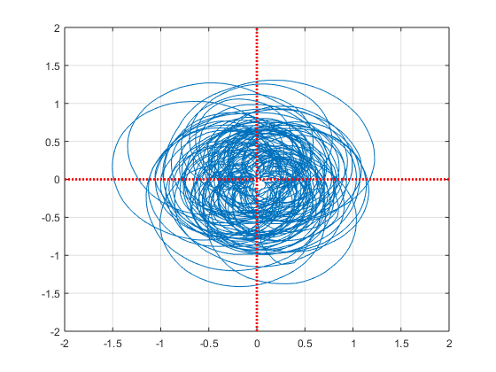



Cross-frequency coupling
Phase amplitude coupling (PAC)
Raw signal
Band-pass filtering
Low-freq. band
High-freq. band
Hilbert transform
Angle
Amplitude envelope
$$\left(A_{f_{h}}, φ_{f_{l}}\right)=A_{f_{h}}e^{1j∗φ_{f_{l}}}$$
Analytic signal
Phase-sorted amplitude plot
Existence of PAC
Modulation index (MI by tort, correlation, linear model, …)
Intensity of PAC

Slide 2
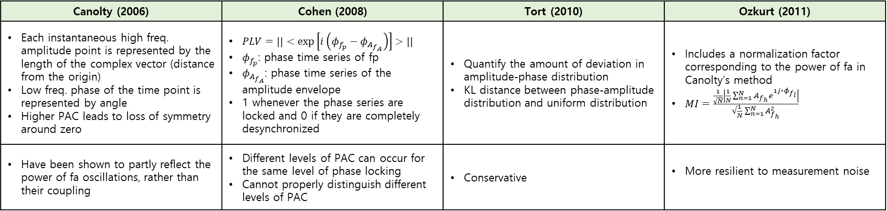
Cross-frequency coupling
Phase amplitude coupling (PAC)
Canolty (2006) | Cohen (2008) | Tort (2010) | Ozkurt (2011)
Each instantaneous high freq. amplitude point is represented by the length of the complex vector (distance from the origin) Low freq. phase of the time point is represented by angle Higher PAC leads to loss of symmetry around zero | $PLV=||<\exp\left[i\left(φ_{f_{p}}−φ_{A_{f_{A}}}\right)\right]>||$ $φ_{f_{p}}$: phase time series of fp $φ_{A_{f_{A}}}$: phase time series of the amplitude envelope 1 whenever the phase series are locked and 0 if they are completely desynchronized | Quantify the amount of deviation in amplitude-phase distribution KL distance between phase-amplitude distribution and uniform distribution | Includes a normalization factor corresponding to the power of fa in Canolty’s method $MI=\frac{\frac{1}{\sqrt{N}}\left|\frac{1}{N}\sum_{n=1}^{N}{A_{f_{h}}e^{1j∗φ_{f_{l}}}}\right|}{√\frac{1}{N}\sum_{n=1}^{N}{A_{f_{h}}^{2}}}$
Have been shown to partly reflect the power of fa oscillations, rather than their coupling | Different levels of PAC can occur for the same level of phase locking Cannot properly distinguish different levels of PAC | Conservative | More resilient to measurement noise

Slide 3
PAC – statistics workflow
Data preprocessing
Cleaned data
Calculate PAC – permutation test normalization (uncorrected, n permute = 1,000)
for condition1 and condition2
Paired/un-paried t-test between condition1 / condition2, 1000 times permutation test
Cluster based on significant t-value (calculating the largest cluster-level t-value for each permutation) cluster-level t-value: sum of t-values within clusters
Bonferrnoi correction: re-define threshold as significance level divided into feature dimension
Pixel-based min-max correction: calculating the biggest/smallest t-value for each permutation Generate 2-tailed distribution using min-max val

