Slide 1
Co1111se Review
软件体系结构（SA）

Slide 2
课程主要内容
软件体系结构定义
软件体系结构风格
建模和文档化软件体系结构
理解质量属性
软件体系结构设计
软件体系结构评估

Slide 3
软件体系结构定义
软件体系结构定义
  不存在一个统一的定义
  各个流派对软件体系结构的定义
  重点关注
    Garlan and Shaw的定义：
    体系结构 = 组件 + 连接件 + 约束
    Software Architecture =
Components + Connectors + Constrains

Slide 4
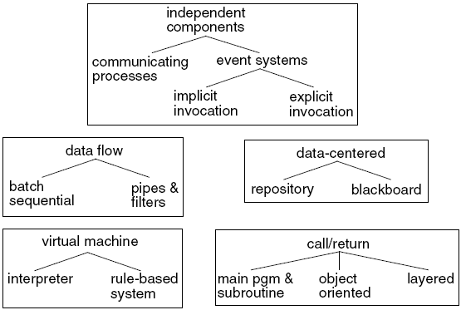
软件体系结构风格
软件体系结构风格定义
软件体系结构风格的描述
常见的软件体系结构风格
  数据流
    顺序的批处理
    管道过滤器
    控制环路
  调用/返回
    主程序/子程序
    面向对象
    层次结构
    客户端/服务器

Slide 5
软件体系结构风格
以数据为中心（数据共享）
  数据存储（编译器的演化）
  黑板
虚拟机
  解释器、基于规则的系统
  其它
独立组件
  通信进程、事件（隐式调用）
  其它
其它风格
  C2、HMB、DSSA

Slide 6
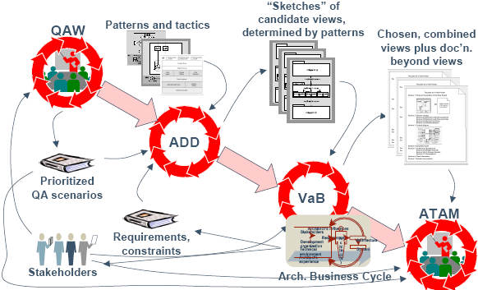
建模和文档化软件体系结构
基于软件体系结构的开发（ABD）

Slide 7
软件架构文档化
如何文档化软件架构
好文档的评价准则
采用视图描述软件架构
  IEEE 1471
  “4+1”视图
体系结构语言ADL
UML
  熟练掌握并理解所有UML的图和适用场合

Slide 8
软件质量属性
软件质量属性定义
软件质量属性与功能、非功能性需求的关系
软件质量属性情景
  定义、如何描述
常见的质量属性
  可用性（ Availability ）
  可修改性（ Modifiability ）
  性能（ Performance ）
  安全性（ Security ）
  可测试性（ Testability ）
  易用性（ Usability ）
其它质量属性

Slide 9
软件质量属性场景
什么是质量属性场景？为什么要使用质量属性场景？
刻画质量属性的手段，6部分组成：
  source – an entity that generates a stimulus
  stimulus – a condition that affects the system
  artifact – the part of that was stimulated by the stimulus
  environment – the condition under which the stimulus occurred
  response – the activity that results because of the stimulus
  response measure – the measure by which the system’s response will be evaluated
以一种统一规范的方式来表达“质量属性”的需求。

Slide 10
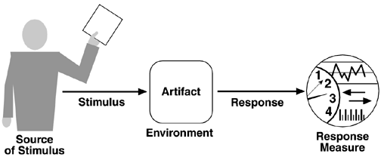
软件质量属性场景

Slide 11
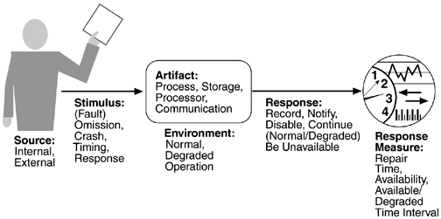
Availability general scenarios

Slide 12
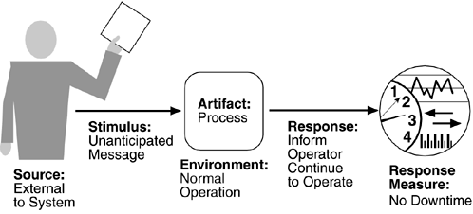
Sample availability scenario

Slide 13
Modifiability General Scenario
Portion of Scenario | Possible Values
Source | End user, developer, system administrator
Stimulus | Wishes to add/delete/modify/vary functionality, quality attribute, capacity
Artifact | System user interface, platform, environment; system that interoperates with target system
Environment | At runtime, compile time, build time, design time
Response | Locates places in architecture to be modified; makes modification without affecting other functionality; tests modification; deploys modification
Response Measure | Cost in terms of number of elements affected, effort, money; extent to which this affects other functions or quality attributes

Slide 14
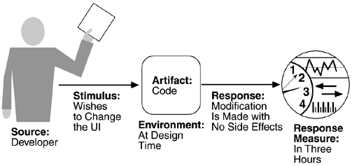
Sample modifiability scenario

Slide 15
Performance General Scenarios
Portion of Scenario | Possible Values
Source | One of a number of independent sources, possibly from within system
Stimulus | Periodic events arrive; sporadic events arrive; stochastic events arrive
Artifact | System
Environment | Normal mode; overload mode
Response | Processes stimuli; changes level of service
Response Measure | Latency, deadline, throughput, jitter, miss rate, data loss

Slide 16
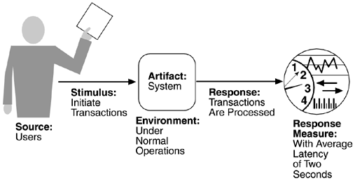
Sample performance scenario

Slide 17
Security General Scenarios
Portion of Scenario | Possible Values
Source | Individual or system that is correctly identified, identified incorrectly, of unknown identity who is internal/external, authorized/not authorized with access to limited resources, vast resources
Stimulus | Tries to display data, change/delete data, access system services, reduce availability to system services
Artifact | System services; data within system
Environment | Either online or offline, connected or disconnected, firewalled or open

Slide 18
Security General Scenarios
Portion of Scenario | Possible Values
Response | Authenticates user; hides identity of the user; blocks or allow access to data and/or services; grants or withdraws permission to access data and/or services; records access/modifications or attempts to access/modify data/services by identity; stores data in an unreadable format; recognizes an unexplainable high demand for services, and informs a user or another system, and restricts availability of services

Slide 19
Security General Scenarios
Portion of Scenario | Possible Values
Response Measure | Time/effort/resources required to circumvent security measures with probability of success; probability of detecting attack; probability of identifying individual responsible for attack or access/modification of data and/or services; percentage of services still available under denial-of-services attack; restore data/services; extent to which data/services damaged and/or legitimate access denied

Slide 20
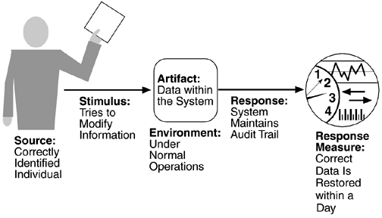
Sample security scenario

Slide 21
Testability General Scenarios
Portion of Scenario | Possible Values
Source | Unit developer, Increment integrator System verifier, Client acceptance tester System user
Stimulus | Analysis, architecture, design, class, subsystem integration completed; system delivered
Artifact | Piece of design, piece of code, complete application
Environment | At design time, at development time, at compile time, at deployment time

Slide 22
Testability General Scenarios
Portion of Scenario | Possible Values
Response | Provides access to state values; provides computed values; prepares test environment
Response Measure | Percent executable statements executed Probability of failure if fault exists Time to perform tests Length of longest dependency chain in a test Length of time to prepare test environment

Slide 23
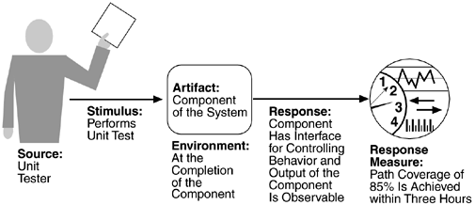
Sample testability scenario

Slide 24
Usability General Scenarios
Portion of Scenario | Possible Values
Source | End user
Stimulus | Wants to learn system features; use system efficiently; minimize impact of errors; adapt system; feel comfortable
Artifact | System
Environment | At runtime or configure time

Slide 25
Usability General Scenarios
Portion of Scenario | Possible Values
Response | to support "learn system features": help system is sensitive to context; interface is familiar to user; interface is usable in an unfamiliar context to support "use system efficiently": aggregation of data and/or commands; reuse of already entered data and/or commands; support for efficient navigation within a screen; distinct views with consistent operations; comprehensive searching; multiple simultaneous activities to "minimize impact of errors": undo, cancel, recover from system failure, recognize and correct user error, retrieve forgotten password, verify system resources

Slide 26
Usability General Scenarios
Portion of Scenario | Possible Values
Response | to "adapt system": customizability; internationalization to "feel comfortable": display system state; work at the user's pace
Response Measure | Task time, number of errors, number of problems solved, user satisfaction, gain of user knowledge, ratio of successful operations to total operations, amount of time/data lost

Slide 27
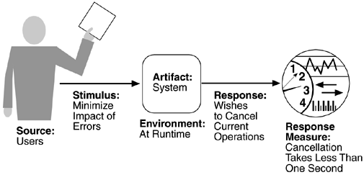
Sample usability scenario

Slide 28
Quality Attribute Stimuli
Quality Attribute | Stimulus
Availability | Unexpected event, nonoccurrence of expected event
Modifiability | Request to add/delete/change/vary functionality, platform, quality attribute, or capacity
Performance | Periodic, stochastic, or sporadic
Security | Tries to display, modify, change/delete information, access, or reduce availability to system services
Testability | Completion of phase of system development
Usability | Wants to learn system features, use a system efficiently, minimize the impact of errors, adapt the system, feel comfortable

Slide 29
Other System Quality Attributes
Quality Attribute | Stimulus
Availability | Unexpected event, nonoccurrence of expected event
Modifiability | Request to add/delete/change/vary functionality, platform, quality attribute, or capacity
Performance | Periodic, stochastic, or sporadic
Security | Tries to display, modify, change/delete information, access, or reduce availability to system services
Testability | Completion of phase of system development
Usability | Wants to learn system features, use a system efficiently, minimize the impact of errors, adapt the system, feel comfortable

Slide 30
Other System Quality Attributes
Scalability is often an important attribute, but in our discussion here scalability is captured by modifying system capacity—the number of users supported, for example.
Portability is captured as a platform modification.
If some quality attribute—say interoperability—is important to your organization, it is reasonable to create your own general scenario for it.

Slide 31
软件体系结构设计
架构模式的应用
常见质量属性的设计
  可用性（ Availability ）
  可修改性（ Modifiability ）
  性能（ Performance ）
  安全性（ Security ）
  可测试性（ Testability ）
  易用性（ Usability ）

Slide 32
可用性战术
可用性战术阻止错误发展成为故障或者把错误的影响限制在一定范围内，从而使修复成为可能。
  fault detection（错误检测）
    Ping/echo（命令/响应）, Heartbeat（心跳）, Exceptions
  fault recovery（错误恢复）
    Fault recovery consists of preparing for recovery and making the system repair.
    Voting（表决）, Active redundancy（主动冗余）, Passive redundancy（被动冗余）, Spare（备件）, Shadow operation, State resynchronization（状态再同步）, Checkpoint/rollback（检查点回滚）
  fault prevention（错误阻止）
    Removal from service, Transactions, Process monitor

Slide 33
Modifiability Tactics
Localize Modifications（局部化修改）
  Maintain semantic coherence （维持语义的一致性）
  Anticipate expected changes（预期期望的变更）
  Generalize the module （泛化模块）
  Limit possible options （限制可能的选择）
Prevent Ripple Effects
  Hide information
  Maintain existing interfaces
  Restrict communication paths
  Use an intermediary（中间层）
Defer Binding Time

Slide 34
Performance Tactics
Resource demand
Resource management
  Introduce concurrency
  Maintain multiple copies of either data or computations
  Increase available resources
Resource arbitration（仲裁）
  First-in/First-out
  Fixed-priority scheduling
  Dynamic priority scheduling
  Static scheduling

Slide 35
Security Tactics
Those concerned with resisting attacks（抵抗攻击）
Those concerned with detecting attacks（检测攻击）
Those concerned with recovering from attacks（从攻击中恢复）

Slide 36
Testability Tactics
Record/playback
Separate interface from implementation
Specialize access routes/interfaces
Built-in monitors

Slide 37
Usability Tactics
Design-time Tactics
  Maintain a model of the task
  Maintain a model of the user
  Maintain a model of the system
Runtime Tactics
  Separate the user interface from the rest of the application

Slide 38
软件体系结构评估
常见的体系结构评估方法
  重点掌握ATAM
  ATAM的过程
质量属性评估效用树（Utility Tree）
风险/非风险、敏感点和权衡点的理解与应用

Slide 39
关于考试
闭卷考试，英文试卷。
考试题型：
  简答题（Explanations）
  单项选择题（Multiple Choice）
  案例分析题
    软件体系结构分析与设计
    软件体系结构评估
      效用树
      Risk, Non-risk, Sensitivity point, Tradeoff

Slide 40




预祝大家考试取得
好成绩！

