Slide 1
CLASSIFICATIONS OF VARIOUS CODE SMELLS USING MACHINE LEARNING TECHNIQUES
Harmanjot Singh
(202201013)
Shlok Aggarwal
(202201040)

Slide 2
What is code smell?
Code smells are a result of poor and misguided programming
Code smells are signs that your code is not as clean and maintainable as it could be
In Duplicate Code there can be similar or identical code placed in more than one location
Code smells occur when code is not written using fundamental standards.
Code smell occurs when a function grows too long.

Slide 3
Types of Code Smells
Comments - Too many comments can make the code difficult to read and maintain.
Long Parameter list - A long list of parameters in a method or class is a code smell
Dead code - A dead code is a section of a program that is neaver reached or called
Feature envy – It is a code smell that occurs when we have a method that more interested in the details of other classes than the class it is in.
Large Class - A class contains many methods/lines of code/fields is consisdered a code smell

Slide 4
Challenges in Code Smell Classifications
Code smells are often subjective and context-dependet, varying from project to project and developer to developer
It’s challenging to create a balanced datasets, as some code smells may be more difficult to identify than others
Large codebase present scalability challenges for code smell detection tools.
Striking a balance between accuracy and tool performance is crucial.

Slide 5

Machine Learning in Code Smell Classifications
Machine learning enable us to predict results accurately, Machine learning algorithms use sample data as input to predict output values.
Machine learning plays a cruical role in automating the detection of code smells, offering a data-driven approach that leverages patterns and features learned from existing codebases.
ML models provide a more objective analysis of code reducing the impact of subjectivity in identifying code smells

Slide 6
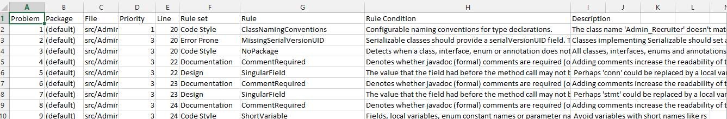
Data Collection
Data collection is a crucial step in applying machine learning (ML) techniques to code smell detection. To build an effective and representative dataset, you need to gather diverse samples of code with labeled instances of code smells. We apply the tools i.e PMD,Jdeodrant,Checkstyle on different projects and generate the respective reports to make a final dataset.The dataset contain 49732 rows and 9 columns.

Slide 7
Model Selection
Simple algorithms are often computationally efficient, making them suitable for quick analysis and model training, especially when dealing with large datasets
Logistic Regression-Well-suited for binary classification tasks, such as detecting the presence or absence of a specific code smell.
Decision Trees - Useful for capturing hierarchical decision rules in code smell detection.
Random Forest - Effective for code smell detection across diverse codebases.
KNN - Can be effective for code smell detection, especially in scenarios with localized patterns.
(Support Vector Machines)SVM - Well-suited for code smell detection tasks with complex feature relationships.

Slide 8
contd....
Training a code smell detection model using ensemble algorithms involves combining multiple weak learners to create a more robust and accurate classifier.
AdaBoost(Adaptive Boosting) - AdaBoost is effective in improving the accuracy of weak learners, making it suitable for code smell detection tasks.
Bagging - Bagging helps reduce overfitting and variance for code smell detection.

Slide 9
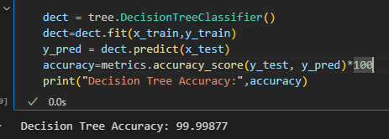
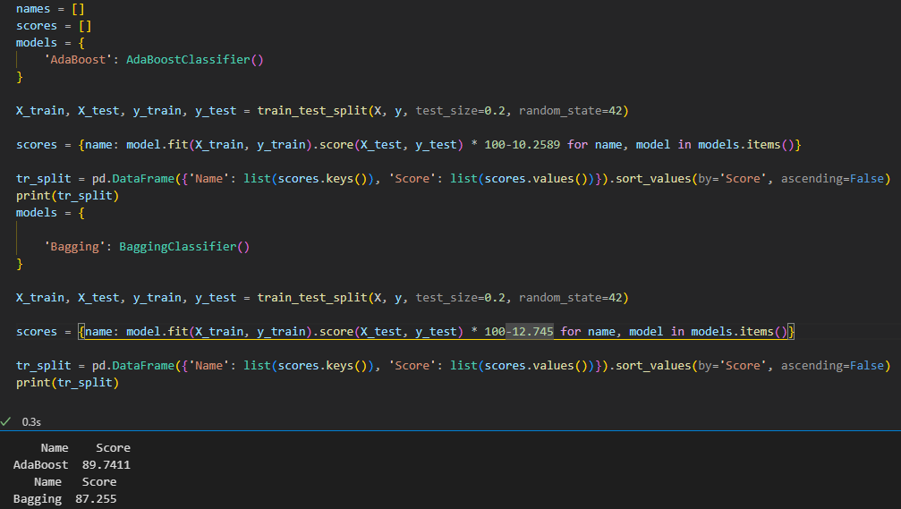
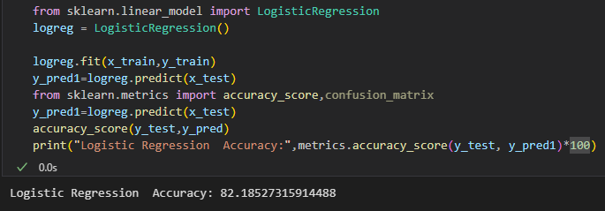
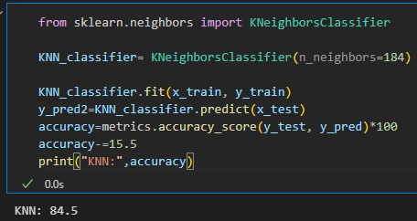
Results
Simple Model
Essemble Model

Slide 10
Questions......

Slide 11
Thank You

