Slide 1
高级计算机体系结构
陈文智 浙江大学计算机学院
chenwz@zju.edu.cn

Slide 2
课程现状
课程性质
本科/硕士/博士
课程衔接
本科体系/相关课程
课程目的
掌握计算机系统的设计思想、设计原理、设计技术。能够分析、设计计算机的相关功能部件及处理器，掌握现代计算机处理器中流水线技术、指令级并行性开发技术、多处理器计算机设计技术。

Slide 3
改革中的课程体系
以系统设计为统一视图，建立层次化、循序递进、开放式课程群的课程体系
扩展课程群
逻辑与计算机
设计基础
高级数字系统
设计
核心
课程群
计算机组成
计算机接口
计算机体系结构
SOC设计
操作系统-OS
嵌入式系统设计
计算机系统设计
编译技术
计算机高级
体系结构设计
DB、。。。
多核系统设计
系统课程群
Notes:
逻辑与计算机设计基础，4.0， 3.0-2.0， 二秋冬
计算机组成，4.5，3.5-2.0，二春夏
计算机体系结构，3.5， 2.5-2.0， 三春夏
汇编与接口， 3.0，3.0-0.0，三秋冬
接口实验， 1.5， 0-3.0，三秋冬
编译原理，2.0， 2.0-0， 三春
编译系统设计， 2.0， 1.0-2.0，三夏
操作系统原理，3.0，3.0-0，三秋冬
操作系统实验， 2.0，1-2.0，三冬
Soc／计算机系统设计，3.0， 1.0-4.0， 三夏

Slide 4
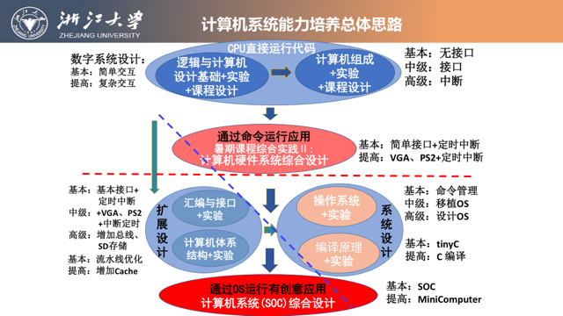

Slide 5





改革中的实验体系
自主研发统一的实验平台，建立实验成果库，构建系列化、递进式的实验体系
渐近的计算机硬件系统
Simple but Rich
CACHE
MMU
动态流水
ISA扩展
中断处理
数字逻辑→计算机组成(CPU) →体系结构(流水CPU) →简易计算机系统
高级数字系统设计→计算机接口 →SOC设计→计算机系统设计→多核系统设计
→嵌入式系统设计
操作系统 + 编译系统 + 应用软件

Slide 6
课程内容
教学内容 | 备注
☆ 绪论：计算机分类, 计算机体系结构定义, 实现技术的发展趋势, 集成电路功耗的发展趋势, 成本、价格的走势, 可靠性, 性能测量与分析报告, 计算机量化设计原则. ☆ 基本流水线技术:流水线竞争, 流水线是如何实现的, 流水线实现难点, 多周期操作的指令流水线, MIPS R4000流水线 | 第1、A章 复习
☆ 指令级并行性及其开发技术：指令级并行概念和挑战, 数据相关和数据冲突,控制相关,开发ILP的基本编译技术,动态转移预测技术. | 第A、2章 复习
★ 指令级并行性及其开发技术：动态调度技术,动态调度实例及算法. | 第2章
★ 指令级并行性及其开发技术：基于硬件的投机技术，多发射和静态调度技术，用动态调度、多发射和投机技术开发. | 第2章
★ ILP的局限性：硬件和软件投机技术，多线程技术，多发射处理器的性能。 | 第3章
★ 多处理器和线程级并行性：多处理器计算机结构分类，共享存储器结构及其Cache监听协议，分布存储结构及其基于目录的协议 | 第4章
☆ 多处理器和线程级并行性：多处理器同步技术，存储器连贯性模型，实例：Sun T1 多处理器计算机 | 第4章
☆ 向量处理器技术 ☆ VLIW和EPIC的硬件和软件技术 | 第F、G章

Slide 7
教材
英文（主要）：
《Computer Architecture--A Quantitative Approach》，4th，机械工业出版社原版影印，￥78。
中文（参考）：
《计算机体系结构－一种定量的方法》， 清华出版社，￥72

Slide 8
教材作者介绍
•John L. Hennessy
Standford University校长、IEEE和ACM会员，美国国家工程研究院院士及美国科学艺术研究院院士，2001获Eckert-Mauchly奖（RISC），2001年Seymour Cray计算机工程奖得主，2000年获IEEE John von Neumann奖。
• David A. Patterson
University of California, Berkeley教授，美国国家工程研究院院士， IEEE和ACM会员，获IEEE James H.Muligan教育奖章，1995获IEEE技术成就奖(RISC)，1999年IEEE Reynold Johnson信息存储奖，2000年获IEEE John von Neumann奖。

Slide 9
Eckert-Mauchly Award
2010 Bill Dally 2009 Joel Emer 2008 David Patterson 2007 Valero, Mateo 2006 Pomerene, James H 2005 Colwell, Robert P. 2004 Brooks, Frederick P. 2003 Fisher, Joseph A. (Josh) 2002 Rau, B. Ramakrishna (Bob) 2001 Hennessy, John 2000 Davidson, Edward 1999 Smith, James E. 1998 Watanabe, T. 1997 Tomasulo, Robert 1996 Patt, Yale 1995 Crawford, John | 1994 Thornton, James E. 1993 Kuck, David J 1992 Flynn, Michael J. 1991 Smith, Burton J. 1990 Batcher, Kenneth E. 1989 Cray, Seymour 1988 Siewiorek, Daniel P. 1987 Amdahl, Gene M. 1986 Cragon, Harvey G 1985 Cocke, John 1984 Dennis, Jack B. 1983 Kilburn, Tom 1982 Bell, C. Gordon 1981 Clark, Wesley A. 1980 Wilkes, Maurice V. 1979 Barton, Robert S.

Slide 10
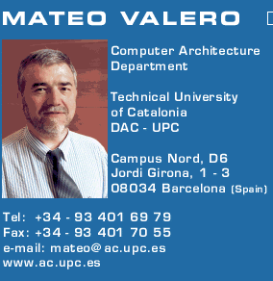
Big Men in Architecture(1)
2007Mateo Valero
http://personals.ac.upc.edu/mateo/
For important contributions to instruction level parallelism and superscalar processor design.

Slide 11
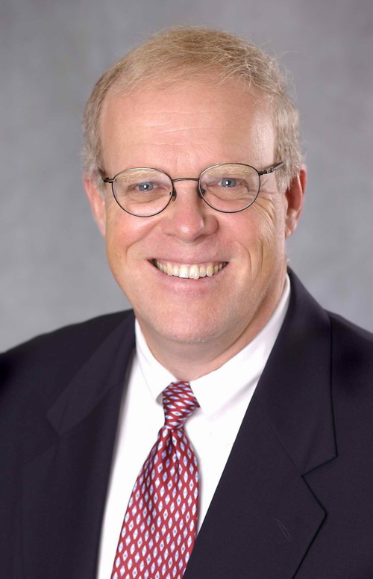
Big Men in Architecture(2)
2001 Hennessy, John
For being the founder and chief architect of the MIPS Computer Systems and contributing to the development of the landmark MIPS R2000 microprocessor.

Slide 12
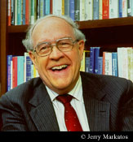
Big Men in Architecture(3)
2004 Eckert-Mauchly Award
"For the definition of computer architecture and contributions to the concept of computer families and to the principles of instruction set design; for seminal contributions in instruction sequencing, including interrupt systems and execute instructions; and for contributions to the IBM 360 instruction set architecture."
Frederick P. Brooks
http://www.cs.unc.edu/~brooks/
1999 ACM Turing Award
landmark contributions to computer architecture, operating systems, and software engineering."

Slide 13
Big Men in Architecture(4)
1997 Robert Tomasulo For the ingenious Tomasulo's algorithm, which enabled out-of-order execution processors to be implemented.
January 30 2008, Tomasulo spoke at the College of Engineering at the University of Michigan about his career and the history and development of out-of-order execution
http://inst-tech.engin.umich.edu/media/index.php?sk=tomasulo

Slide 14
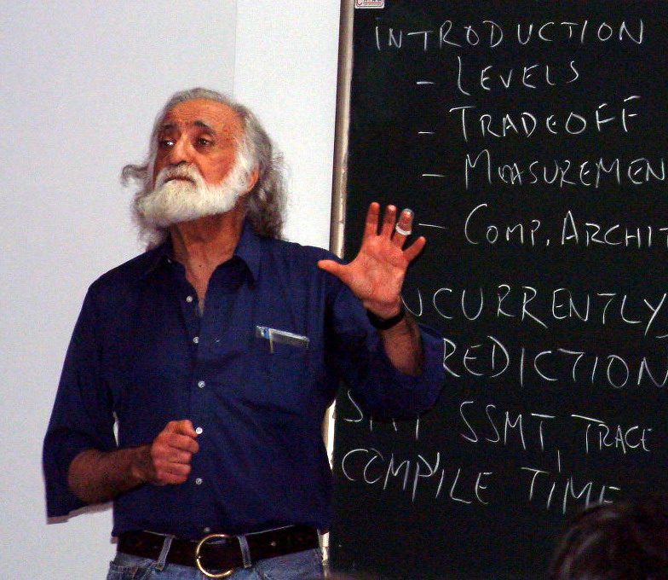
Big Men in Architecture(5)
1996 Yale Patt
For important contributions to instruction level parallelism and superscalar processor design.

Slide 15
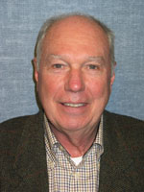
Big Men in Architecture(6)
1992 Michael J. Flynn
http://www.cpe.calpoly.edu/IAB/flynn.html
For his important and seminal contributions to processor organization and classification, computer arithmetic and performance evaluation.

Slide 16
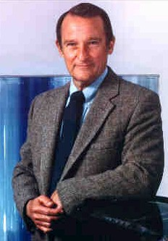
Big Men in Architecture(7)
1989 Cray, Seymour
For a career of achievements that have advanced supercomputing design.

Slide 17
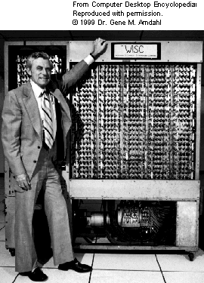
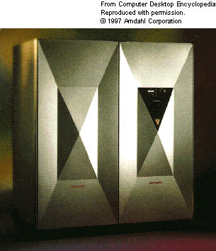
Big Men in Architecture(8)
1987 Amdahl, Gene M. For outstanding innovations in computer architecture, including pipelining, instruction look-ahead, and cache memory.
In 1975, Dr. Amdahl stands beside the Wisconsin Integrally Synchronized Computer (WISC), which he designed in 1950. It was built in 1952. (Image courtesy of Dr. Gene M. Amdahl.)

Slide 18
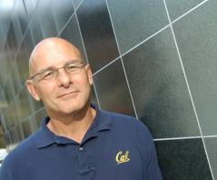
David A. Patterson （UC Berkeley）
He led the design and implementation of RISC I (the foundation of the SPARC architecture )
Leader of RAID
involved in the Network of Workstations (NOW) project
Research Accelerator for Multiple Processors (RAMP)

Slide 19
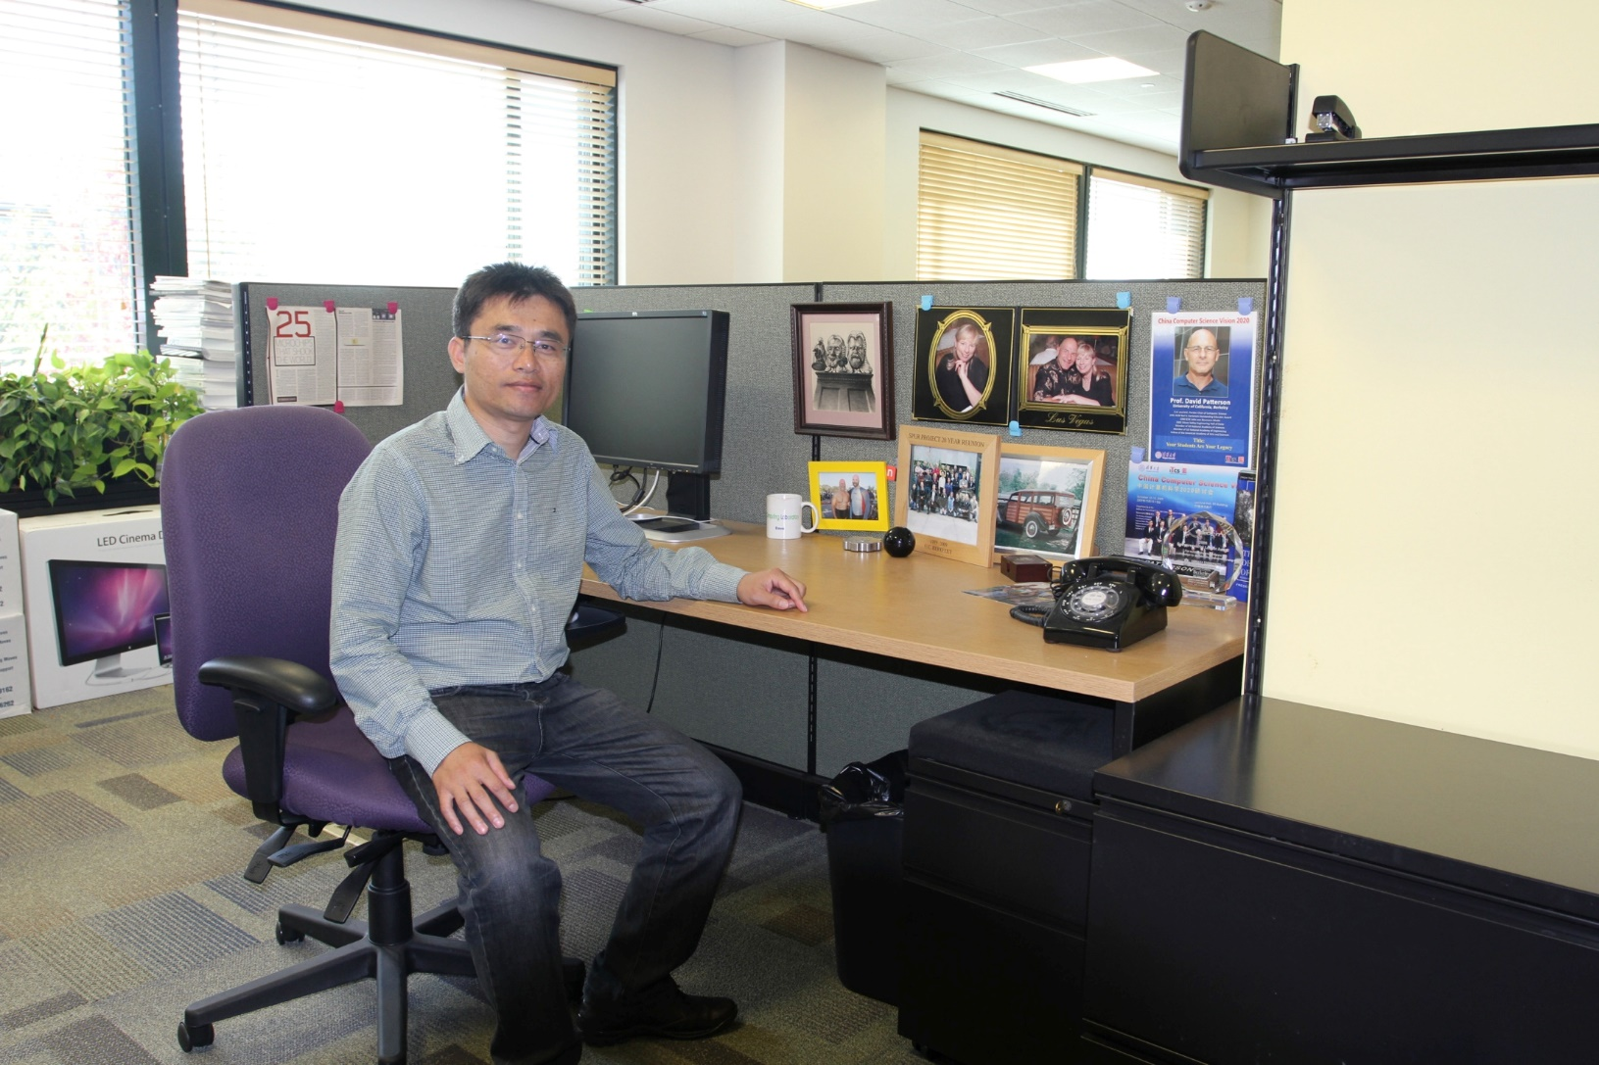

Slide 20
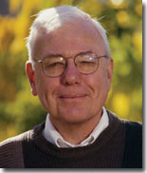
A. M. Turing Award-2009
Charles P Thacker
For the pioneering design and realization of the first modern personal computer -- the Alto at Xerox PARC -- and seminal inventions and contributions to local area networks (including the Ethernet), multiprocessor workstations, snooping cache coherence protocols, and tablet personal computers.

Slide 21
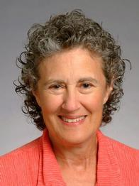
A. M. Turing Award-2008
Liskov, Barbara
For contributions to practical and theoretical foundations of programming language and system design, especially related to data abstraction, fault tolerance, and distributed computing.

Slide 22
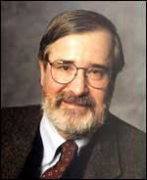
A. M. Turing Award-2007
Clarke, Edmund M
For his role in developing Model-Checking into a highly effective verification technology, widely adopted in the hardware and software industries.

Slide 23
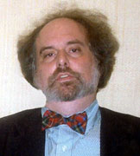
A. M. Turing Award-2007
Emerson, E Allen
For his role in developing Model-Checking into a highly effective verification technology, widely adopted in the hardware and software industries.

Slide 24

A. M. Turing Award-2007
Sifakis, Joseph
For his role in developing Model-Checking into a highly effective verification technology, widely adopted in the hardware and software industries.

Slide 25
课程考核
方式：
笔试
报告
随堂测验
My class：Gem5 Academic Program ？？？

Slide 26
课程要求
1、每个学生查找近三年的国际期刊或国际会议上计算机体系结构相关论文，每篇论文篇幅在6页以上。撰写一篇字数不少于5000字的读书报告。读书报告的参考文献要求在10篇以上，并且引用的参考文献必须在文中加以引用标注。
2、其他

Slide 27
Top conference in CA
ISCA: The International Symposium on Computer Architecture
MICRO: Intl Symp on Microarchitecture
ASPLOS: Architectural Support for Prog Lang and OS
HPCA: IEEE Symp on High-Perf Comp Architecture
OSDI: USENIX Symposium on Operating Systems Design and Implementation
SOSP: The ACM Symposium on Operating Systems Principles ……

Slide 28
Top10 HPC，2008
Rank | Site | Computer
1 | DOE/NNSA/LANL United States | Roadrunner - BladeCenter QS22/LS21 Cluster, PowerXCell 8i 3.2 Ghz / Opteron DC 1.8 GHz , Voltaire Infiniband IBM
2 | Oak Ridge National Laboratory United States | Jaguar - Cray XT5 QC 2.3 GHz Cray Inc.
3 | NASA/Ames Research Center/NAS United States | Pleiades - SGI Altix ICE 8200EX, Xeon QC 3.0/2.66 GHz SGI
4 | DOE/NNSA/LLNL United States | BlueGene/L - eServer Blue Gene Solution IBM
5 | Argonne National Laboratory United States | Blue Gene/P Solution IBM
6 | Texas Advanced Computing Center/Univ. of Texas United States | Ranger - SunBlade x6420, Opteron QC 2.3 Ghz, Infiniband Sun Microsystems
7 | NERSC/LBNL United States | Franklin - Cray XT4 QuadCore 2.3 GHz Cray Inc.
8 | Oak Ridge National Laboratory United States | Jaguar - Cray XT4 QuadCore 2.1 GHz Cray Inc.
9 | NNSA/Sandia National Laboratories United States | Red Storm - Sandia/ Cray Red Storm, XT3/4, 2.4/2.2 GHz dual/quad core Cray Inc.
10 | Shanghai Supercomputer Center China | Dawning 5000A - Dawning 5000A, QC Opteron 1.9 Ghz, Infiniband, Windows HPC 2008 Dawning

Slide 29
Fastest computer in China
2008 ShuGuang5000A
180.6 TeraFlops
122.88TB RAM, 30720 computing Cell
2004 ShuGuang4000A
11 TeraFLOPS
rank 10 in top 500 in June, 2004
2003 ShenTeng6800
5.324 TeraFLOPS
2002 ShenTeng1800
2.04 TeraFLOPS
2000 YinHe IV
1024 CPU
1 TeraFLOPS
ShuGuang 6000 ?

Slide 30
TOP 10, 11/2009
1 | Jaguar - Cray XT5-HE Opteron Six Core 2.6 GHz
2 | Roadrunner - BladeCenter QS22/LS21 Cluster, PowerXCell 8i 3.2 Ghz / Opteron DC 1.8 GHz, Voltaire Infiniband
3 | Kraken XT5 - Cray XT5-HE Opteron Six Core 2.6 GHz
4 | JUGENE - Blue Gene/P Solution
5 | Tianhe-1 - NUDT TH-1 Cluster, Xeon E5540/E5450, ATI Radeon HD 4870, Infiniband
6 | Pleiades - SGI Altix ICE 8200EX, Xeon QC 3.0 GHz/Nehalem EP 2.93 Ghz
7 | BlueGene/L - eServer Blue Gene Solution
8 | Blue Gene/P Solution
9 | Ranger - SunBlade x6420, Opteron QC 2.3 Ghz, Infiniband
10 | Red Sky - Sun Blade x6275, Xeon X55xx 2.93 Ghz, Infiniband

Slide 31
Top10 HPC，June, 2010
Rank | Site | Computer
1 | Oak Ridge National Laboratory United States | Jaguar - Cray XT5-HE Opteron Six Core 2.6 GHz Cray Inc.
2 | National Supercomputing Centre in Shenzhen (NSCS) China | Nebulae - Dawning TC3600 Blade, Intel X5650, NVidia Tesla C2050 GPU Dawning
3 | DOE/NNSA/LANL United States | Roadrunner - BladeCenter QS22/LS21 Cluster, PowerXCell 8i 3.2 Ghz / Opteron DC 1.8 GHz, Voltaire Infiniband IBM
4 | National Institute for Computational Sciences/University of Tennessee United States | Kraken XT5 - Cray XT5-HE Opteron Six Core 2.6 GHz Cray Inc.
5 | Forschungszentrum Juelich (FZJ) Germany | JUGENE - Blue Gene/P Solution IBM
6 | NASA/Ames Research Center/NAS United States | Pleiades - SGI Altix ICE 8200EX/8400EX, Xeon HT QC 3.0/Xeon Westmere 2.93 Ghz, Infiniband SGI
7 | National SuperComputer Center in Tianjin/NUDT China | Tianhe-1 - NUDT TH-1 Cluster, Xeon E5540/E5450, ATI Radeon HD 4870 2, Infiniband NUDT
8 | DOE/NNSA/LLNL United States | BlueGene/L - eServer Blue Gene Solution IBM
9 | Argonne National Laboratory United States | Intrepid - Blue Gene/P Solution IBM
10 | Sandia National Laboratories / National Renewable Energy Laboratory United States | Red Sky - Sun Blade x6275, Xeon X55xx 2.93 Ghz, Infiniband Sun Microsystems

Slide 32
TOP 10, 11/2010
1 | Tianhe-1A - NUDT TH MPP, X5670 2.93Ghz 6C, NVIDIA GPU, FT-1000 8C
2 | Jaguar - Cray XT5-HE Opteron 6-core 2.6 GHz
3 | Nebulae - Dawning TC3600 Blade, Intel X5650, NVidia Tesla C2050 GPU
4 | TSUBAME 2.0 - HP ProLiant SL390s G7 Xeon 6C X5670, Nvidia GPU, Linux/Windows
5 | Hopper - Cray XE6 12-core 2.1 GHz
6 | Tera-100 - Bull bullx super-node S6010/S6030
7 | Roadrunner - BladeCenter QS22/LS21 Cluster, PowerXCell 8i 3.2 Ghz / Opteron DC 1.8 GHz, Voltaire Infiniband
8 | Kraken XT5 - Cray XT5-HE Opteron 6-core 2.6 GHz
9 | JUGENE - Blue Gene/P Solution
10 | Cielo - Cray XE6 8-core 2.4 GHz

Slide 33
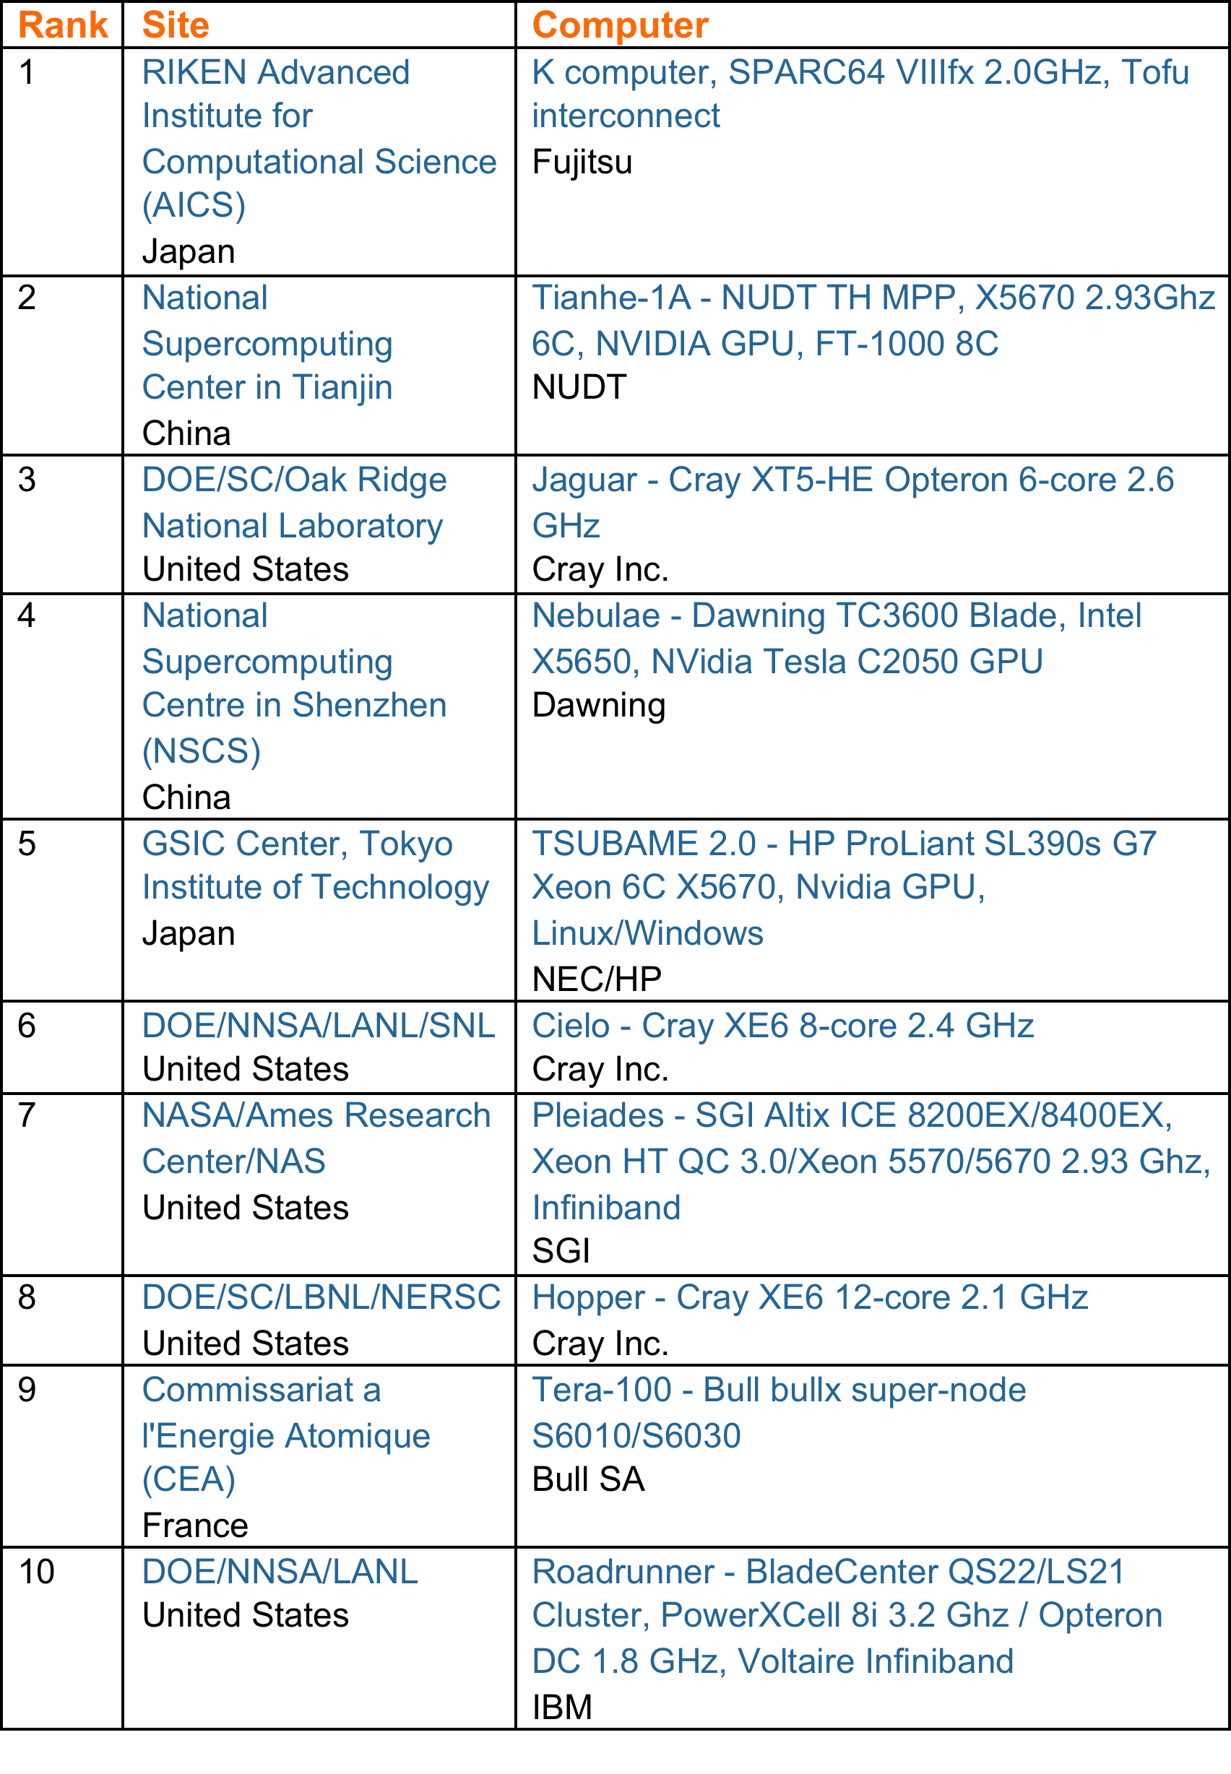
TOP 10 Sites for June 2011

Slide 34
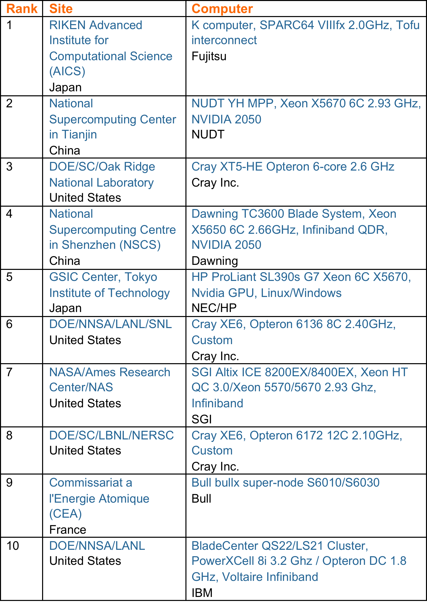
TOP 10 Sites for November 2011

Slide 35
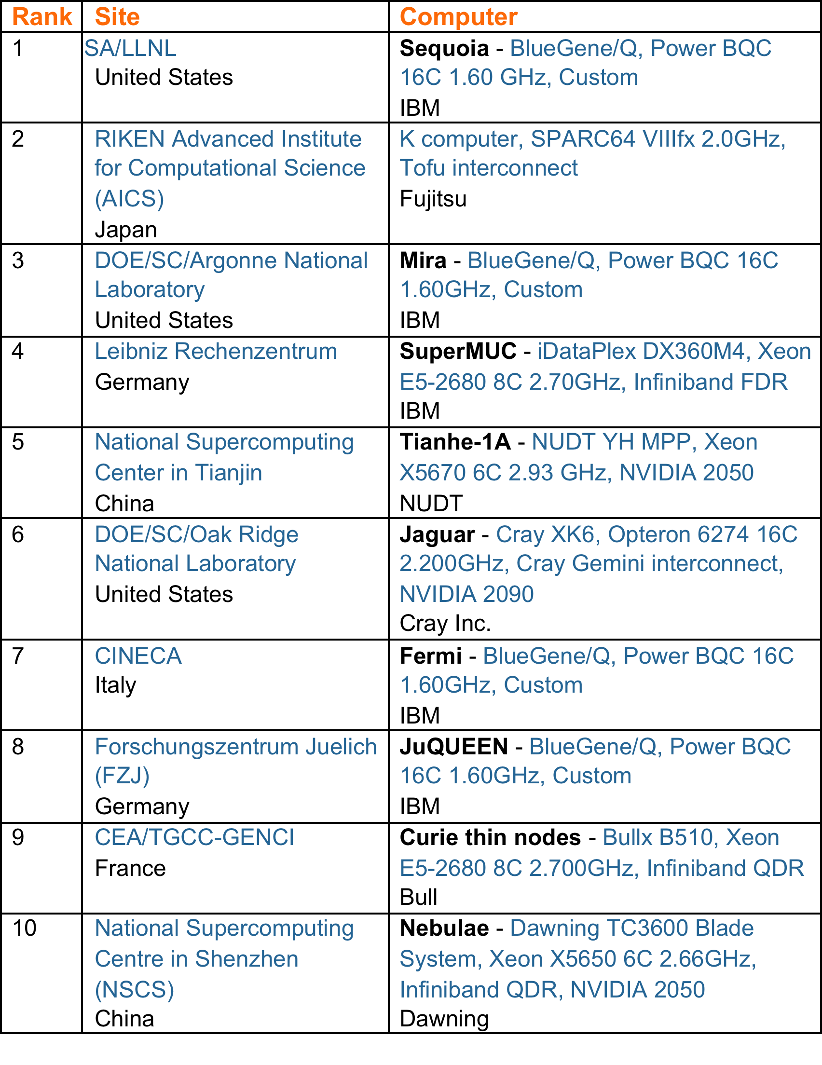
TOP 10 Sites for June 2012

Slide 36
TOP 10 Sites for November 2017
Rank | System | Cores | Rmax (TFlop/s) | Rpeak (TFlop/s) | Power (kW)
1 | Sunway TaihuLight - Sunway MPP, Sunway SW26010 260C 1.45GHz, Sunway , NRCPC | 10,649,600 | 93,014.6 | 125,435.9 | 15,371
2 | Tianhe-2A - TH-IVB-FEP Cluster, Intel Xeon E5-2692 12C 2.200GHz, TH Express-2, Intel Xeon Phi 31S1P , NUDT | 3,120,000 | 33,862.7 | 54,902.4 | 17,808
3 | Piz Daint - Cray XC50, Xeon E5-2690v3 12C 2.6GHz, Aries interconnect , NVIDIA Tesla P100 , Cray Inc. | 361,760 | 19,590.0 | 25,326.3 | 2,272
4 | Gyoukou - ZettaScaler-2.2 HPC system, Xeon D-1571 16C 1.3GHz, Infiniband EDR, PEZY-SC2 700Mhz , ExaScaler | 19,860,000 | 19,135.8 | 28,192.0 | 1,350
5 | Titan - Cray XK7, Opteron 6274 16C 2.200GHz, Cray Gemini interconnect, NVIDIA K20x , Cray Inc. | 560,640 | 17,590.0 | 27,112.5 | 8,209
6 | Sequoia - BlueGene/Q, Power BQC 16C 1.60 GHz, Custom , IBM | 1,572,864 | 17,173.2 | 20,132.7 | 7,890
7 | Trinity - Cray XC40, Intel Xeon Phi 7250 68C 1.4GHz, Aries interconnect , Cray Inc. | 979,968 | 14,137.3 | 43,902.6 | 3,844
8 | Cori - Cray XC40, Intel Xeon Phi 7250 68C 1.4GHz, Aries interconnect , Cray Inc. | 622,336 | 14,014.7 | 27,880.7 | 3,939
9 | Oakforest-PACS - PRIMERGY CX1640 M1, Intel Xeon Phi 7250 68C 1.4GHz, Intel Omni-Path , Fujitsu | 556,104 | 13,554.6 | 24,913.5 | 2,719
10 | K computer, SPARC64 VIIIfx 2.0GHz, Tofu interconnect , Fujitsu | 705,024 | 10,510.0 | 11,280.4 | 12,660

Slide 37
Outlook
Open-source Architecture
RISC-V
Security Risks
Spectre and Meltdown
Intel ME
Domain Specific Architectures
ZTE Import Ban

Slide 38

Open Source Architecture
RISC-V
A completely open ISA based on RISC principles
Freely available to academia and industry
Simple and extendable modular design
A small base integer ISA (RV32I, etc.)
Optional standard extensions
Free implementations & commercial implementations
Free: Rocket, PULPino, Hummingbird…
Commercial: SiFive
Notes:
https://riscv.org/risc-v-cores/

Slide 39
Security Risks
Spectre & Meltdown
Complicated techniques are widely used on modern processors to improve performance
However, these widely-used techniques may cause security risks
Out-of-order execution
Meltdown
Branch predication & speculative execution
Spectre
Intel Management Engine
Notes:
https://meltdownattack.com/
https://en.wikipedia.org/wiki/Intel_Management_Engine
Intel Management Engine
A ”secret” microprocessor built in all Intel processors since 2008
Runs proprietary firmware while computer is running, asleep or even turned off

Slide 40
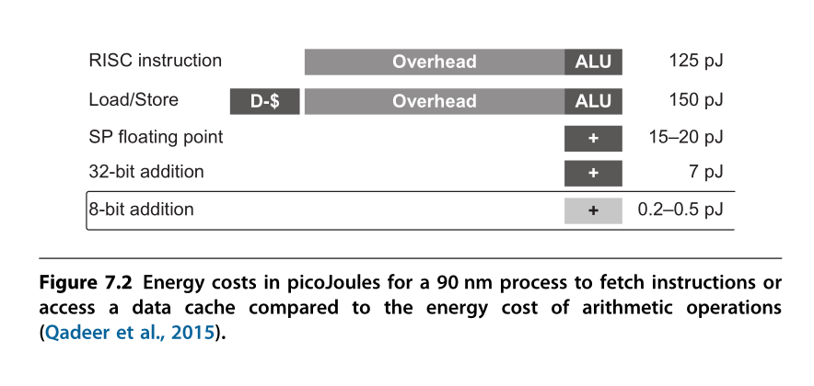
Domain Specific Architectures
General processors are not efficient when solving specific problems
Performance & Energy
To achieve a higher level of efficiency, we need a drastic change in computer architecture from general-purpose cores to domain-specific architectures (DSAs).

Slide 41
Domain Specific Architectures
Google TPU
Data center ASIC
Google Pixel vCore
Mobile device ASIC
寒武纪 NPU
Mobile/Data center IP

Slide 42
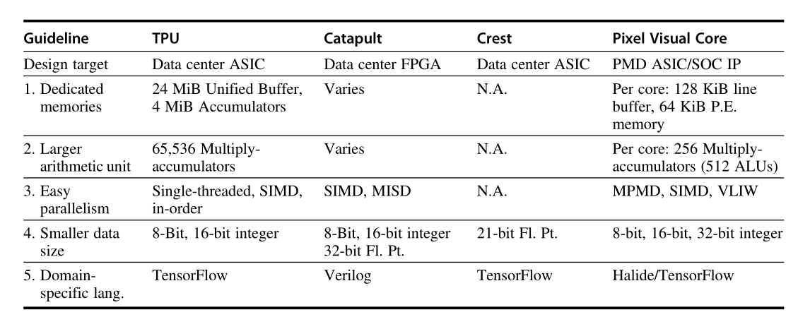

Slide 43
再见，谢谢!

