Slide 1

高级计算机体系结构
陈文智
浙江大学计算机学院
chenwz@zju.edu.cn

Slide 2

课程网站说明
课程网站：
https://c.zju.edu.cn
使用浙大通行证登录
如果还没有浙大通行证，需要先激活通行证：
https://zuinfo.zju.edu.cn
请各位同学在下周上课之前登录一次平台，以便之后将大家添加至班级

Slide 3
内容提要及各节间的关系(1)
3.1 流水线技术基础
3.2 How Is Pipelining Implemented?
3.3 The Major Hurdle of Pipelining—Pipeline Hazards
3.4 Extending the MIPS Pipeline to Handle Multicycle Operations
(本科回顾 Appendix A)
流水线技术就是指令重叠执行技术，达到加快运算速度的目的
由于存在三种流水线竞争：结构竞争、数据竞争、控制竞争，导致流水线性能降低，不能运作在理想的重叠状态，需要插入停顿周期，从而使流水线性能降低。

Slide 4
内容提要及各节间的关系(2)
3.5 Instruction-Level Parallelism: Concepts and Challenges
(CPI=1)
指令之间可重叠执行性称为指令级并行性（Instruction Parallelism-ILP)。因此进一步研究和开发指令之间的并行性，等于拓宽指令重叠执行的可能性，从而能进一步提高流水线的性能。

Slide 5
内容提要及各节间的关系(３)
3.6 Overcoming Data Hazards with Dynamic Scheduling (2.4)
针对流水线数据竞争的动态调度
3.7 Reducing Branch Costs with Dynamic Hardware Prediction (2.3)
针对流水线控制竞争的预测技术

Slide 6
内容提要及各节间的关系(4)
3.8 Hardware-Based Speculation (2.6)
进一步开发指令级并行性的动态技术
跨控制流的动态调度:数据竞争+控制竞争
3.9 Taking Advantage of More ILP with Multiple Issue(2.7)
进一步开发指令级并行性(CPI<1)
采用单位时钟发射多条指令

Slide 7
3.1流水线技术基础
本科回顾------- Appendix A.1
3.1.1 What is pipelining?
3.1.2 Why pipelining ?
3.1.3 Ideal Performance for Pipelining

Slide 8
3.1.1 What is pipelining?
Pipelining:
“A technique designed into some computers to increase speed by starting the execution of one instruction before completing the previous one.”
----Modern English-Chinese Dictionary
implementation technique whereby different instructions are overlapped in execution at the same time.
implementation technique to make fast CPUs

Slide 9
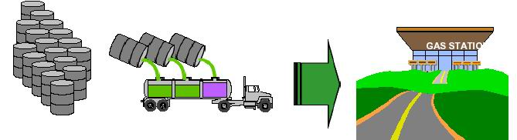
Trucking gas from depot to gas station
The steps:
Get the barrels
Load them into the truck
Drive to the gas station
Unload the gas
Return for more oil
Let’s do the math
Each truck can carry 5 barrels
Can load a truck with 5 barrels in 1 hour
It takes each truck 1 day to drive to and from gas station
How many barrels per week are delivered?

Slide 10
Like a Multi-cycle Processor
What are similar in the steps ?
Fetch an instruction (Get the barrels)
Decode the instruction (Load them into the truck)
ALU OP (Drive to the gas station)
Memory Access (Unload the gas)
Write-back (Return for more oil)

Slide 11
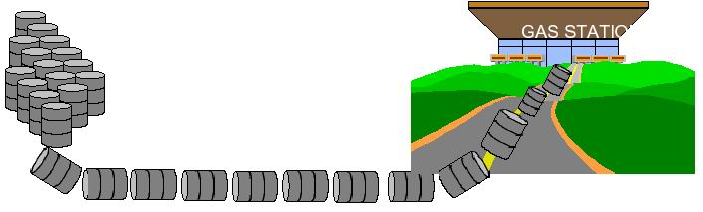
A better way, but dangerous
Roll the barrels down the road
Big fire hazard

Slide 12
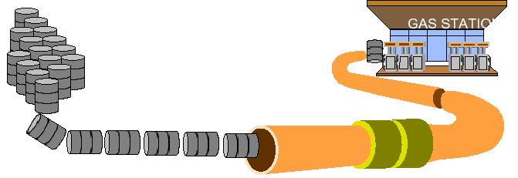
Big idea: Build a pipeline
Now let’s do the math
Pipeline can accept 1 barrel every hour
How many barrels get delivered to the gas station per day?

Slide 13
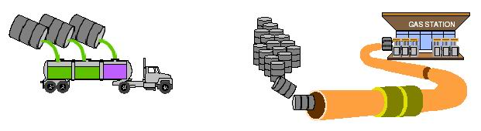
Trucking vs. Pipelines
Trucks
Truck with 5 barrels takes 1 day to drive to and from gas station, while need 2 hours for loading and unloading
LOTS of TIME when loading area,gas station, and pieces of the road are unused
Pipelines
Pipeline can accept 1 barrel every hour
Resources (loading area, gas station,pipelines) are always in use

Slide 14
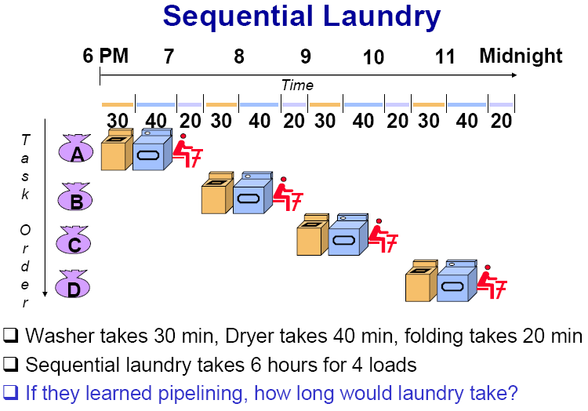

Slide 15
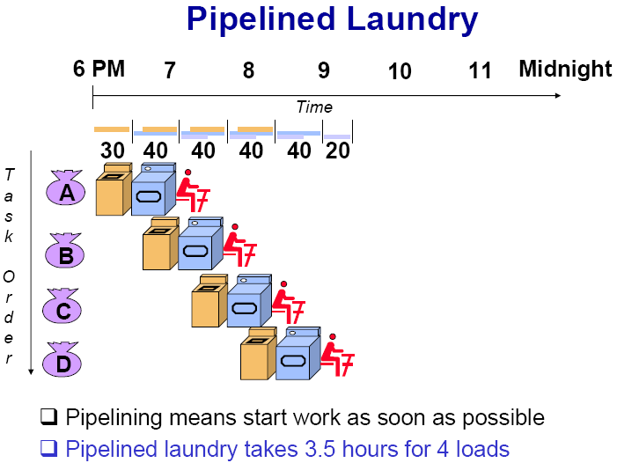

Slide 16
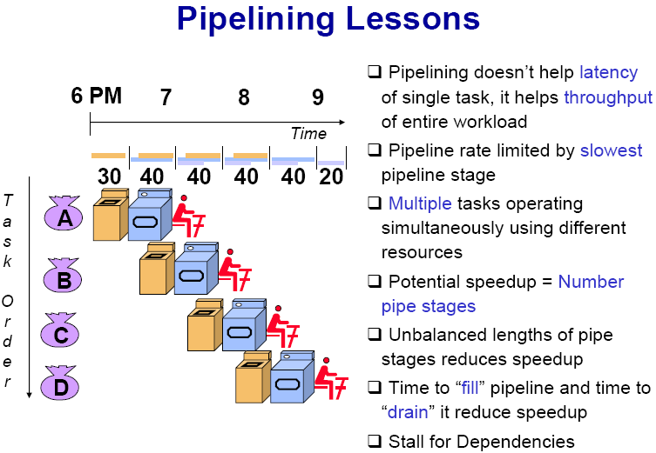

Slide 17
What is Pipelining
A pipeline is like an auto assemble line
A pipeline has many stages
Each stage carries out a different part of instruction or operation
The stages, which cooperates at a synchronized clock, are connected to form a pipe
An instruction or operation enters through one end and progresses through the stages and exit through the other end
Pipelining is an implementation technique that exploits parallelism among the instructions in a sequential instruction stream

Slide 18
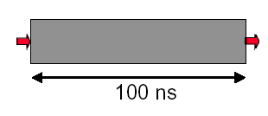
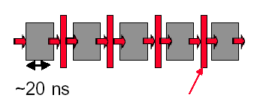
3.1.2 Why pipelining : save time and high utilization factor
Only deal one task each time.
This task takes
“ such a long time”
Latches, called pipeline registers’ break up computation into 5 stages
Deal 5 tasks at the same time.

Slide 19
Why pipelining: How faster
Can “launch” a new computation every 100ns in this structure
Can finish 10⁷ computations per second
Can launch a new computation every 20ns in pipelined structure
Can finish 5×10⁷ computations per second

Slide 20
Conclusion
The key implementation technique used to Make fast CPU: decrease CPUtime.
Improving of Throughput ( rather than individual execution time)
Improving of efficiency for resources (functional unit)

Slide 21
3.1.3 Ideal Performance for Pipelining
Time tasks on unpipelined machine
Speedup
Assume: stages: k tasks: n
T_{k}＝(k+(n-1))τ_{p}
T₁＝ n kτup
＝
Time same tasks on pipelined machine
T
τ
nk up
S
=
1
=
peedup
T
τ
τ
k p
+
(n
−
1) p
k
n—→∞ Speedup—→K

Slide 22
Ideal Performance for Pipelining
If the stages are perfectly balanced, The time per instruction on the pipelined processor equal to:
Time per instruction on unpipelined machine
Number of pipe stages
So, Ideal speedup equal to
Number of pipe stages.

Slide 23
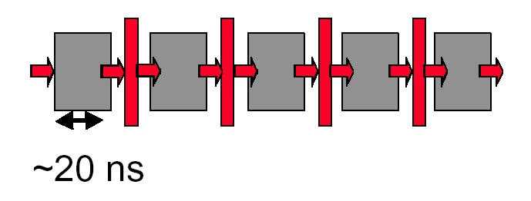
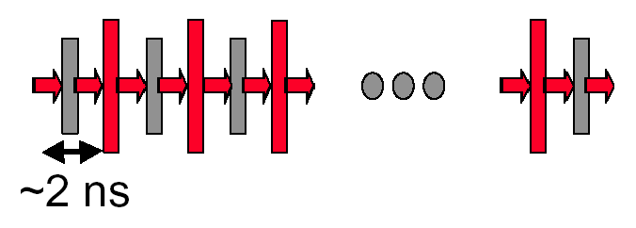
Why not just make a 50-stage pipeline ?
Some computations just won’t divide into any finer (shorter in time) logical implementation.
5 stages OK
50 stages NO. Sorry!

Slide 24
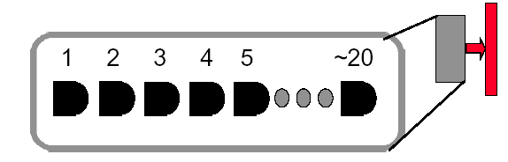
Why not just make a 50-stage pipeline ?
Those latches are NOT free, they take up area, and there is a real delay to go THRU the latch itself.
Machine cycle > latch latency + clock skew
In modern, deep pipeline (10-20 stages), this is a real effect
Typically see logic “depths” in one pipe stage of 10-20 “gates”.
At these speeds, and with this few levels of logic, latch delay is important

Slide 25
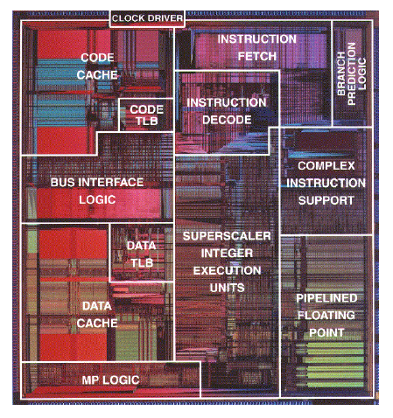
How Many Pipeline Stages?
E.g., Intel
Pentium III, Pentium 4: 20+ stages
More than 20 instructions in flight
High clock frequency (>1GHz)
High IPC
Too many stages:
Lots of complications
Should take care of possible dependencies among in-flight instructions
Control logic is huge

Slide 26
3.2 How Is Pipelining Implemented?
本科回顾------- Appendix A.3
3.2.1 How does instruction Work in the MIPS 5 stage pipeline?
3.2.2 5-stage Version of MIPS Datapath
3.2.3 The MIPS pipelining and some Problems

Slide 27
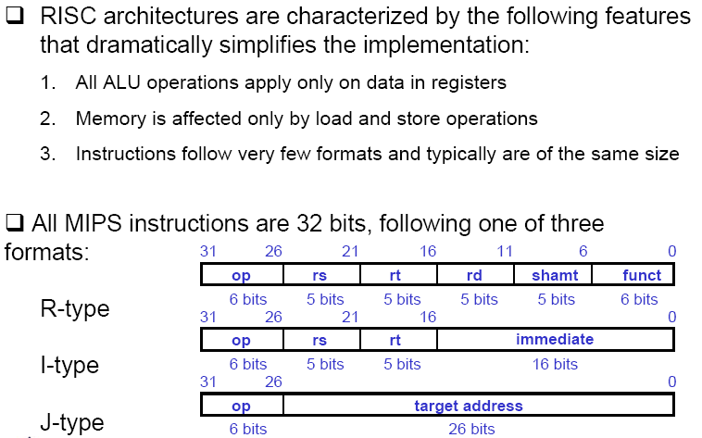
Basic of RISC Instruction Set

Slide 28
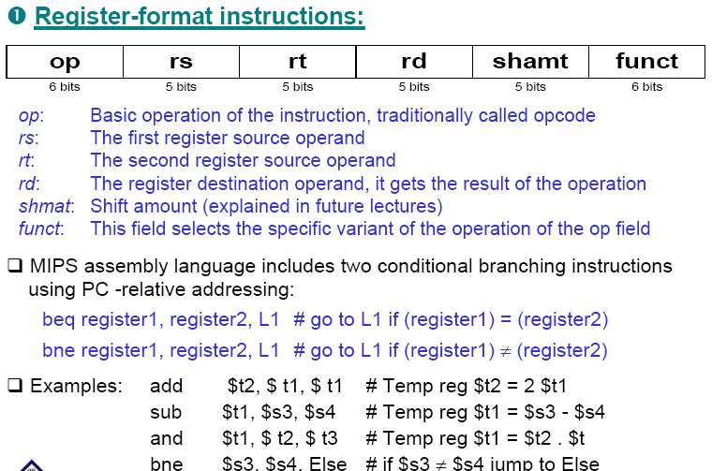
MIPS Instruction Format

Slide 29
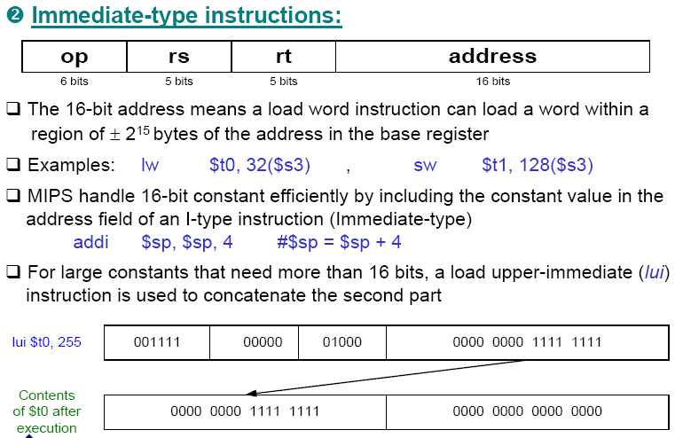
MIPS Instruction Format

Slide 30
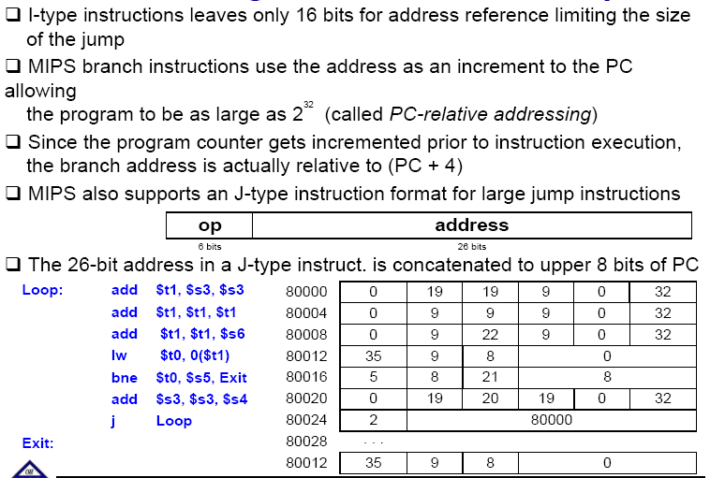
Addressing in Jumps and Branches

Slide 31
3.2.1 MIPS 5 stage pipeline (1)
The first two stages of MIPS pipeline
IF (Instruction fetch cycle)
IR←Mem[PC];
NPC ←PC=PC+4;
ID (Instruction decode/register fetch cycle)
A ←Regs[rs];
B ←Regs[rt];
Imm ←sign-extended immediate field of IR;
Note: The first two stages of MIPS pipeline do the same functions for all kinds of instructions.

Slide 32
MIPS 5 stage pipeline (2)
EX (Execution/effective address cycle)
Memory reference:
ALUoutput ←A+Imm
Register-Register ALU instruction:
ALUoutput ←A func B;
Register-Immediate ALU instruction:
ALUoutput ←A op Imm;
Branch:
ALUoutput ←NPC+(Imm <<2 );
Cond ←(A==0)

Slide 33
MIPS 5 stage pipeline (2)
MEM(Memory acces/branch completion cycle)
Memory reference:
LMD ←Mem[ALUoutput] or
Mem[ALUoutput] ←B
Branch:
If (cond) PC ←ALUoutput
WB (Write back cycle)
Register-Register ALU instruction
Regs[rd] ← ALUoutput;
Register-Immediate ALU instruction
Regs[rt] ←ALUoutput;
Load Instruction:
Regs[rt] ←LMD;

Slide 34
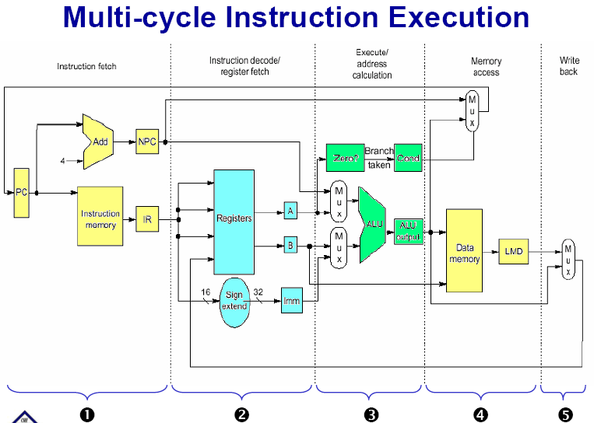

Slide 35
3.2.3 The MIPS pipelining

Slide 36
Table: Events on every stage
Stage | Any instruction
IF | IF/ID.IR←Mem[PC]; IF/ID.NPC, PC ←(if ((EX/MEM.opcode==branch)&EX/MEM.cond) { EX/MEM.ALUoutput} else {PC+4});
ID | ID/EX.A ←Regs[IF/ID.IR[rs]]; ID/EX.B ←Regs[IF/ID.IR[rt]]; ID/EX.NPC ←IF/ID.NPC; ID/EX.IR ←IF/ID.IR; ID/EX.Imm ←sign-extend(IF/ID.IR[immediate field]);
 | ALU instruction | Ld/st instruction | Branch instruction
EX | EX/MEM.IR ←ID/EX.IR; EX/MEM.ALUoutput ←ID/EX.A func ID/EX.B; or EX/MEM.ALUoutput ←ID/EX.A op ID/EX.Imm; | EX/MEM.IR ←ID/EX.IR; EX/MEM.ALUoutput ←ID/EX.A + ID/EX.Imm; EX/MEM.B ←ID/EX.B; | EX/MEM.ALUoutput ←ID/EX.NPC + (ID/EX.Imm<<2); EX/MEM.cond ←(ID/EX.A==0);
MEM | MEM/WB.IR ← EX/MEM.IR; MEM/WB.ALUoutput ←EX/MEM.ALUoutput; | MEM/WB.IR ← EX/MEM.IR; MEM/WB.LMD ←Mem[EX/MEM.ALUoutput]; Or MEM/WB.LMD ←Mem[EX/MEM.ALUoutput];
WB | Regs[MEM/WB.IR[rd]] ←MEM/WB.ALUoutput; or Regs[MEM/WB.IR[rt]] ←MEM/WB.ALUoutput; | For Load only; Regs[MEM/WB.IR[rt]] ←MEM/WB.LMD

Slide 37
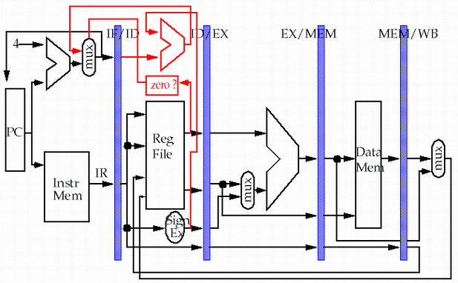
Advanced pipeline
store
pipeline
registers or
latches
load
Why need to add this line?

Slide 38
Problems that pipelining introduces
一、There is conflict about the memory !
Time (clock cycles)
I
n
s
t
r.
O
r
d
e
r
Ld/St
Mem
Reg
ALU
Mem
Reg
Instr 1
Mem
Reg
ALU
Mem
Reg
Instr 2
Mem
Reg
ALU
Mem
Reg
Instr 3
Mem
Reg
ALU
Mem
Reg

Slide 39
Separate instruction and data memories
use split instruction and data cache
the memory system must deliver 5 times the bandwidth over the unpipelined version.
Time (clock cycles)
I
n
s
t
r.
O
r
d
e
r
Ld/St
IM
Reg
ALU
DM
Reg
Instr 1
IM
Reg
ALU
DM
Reg
Instr 2
IM
Reg
ALU
DM
Reg
Instr 3
IM
Reg
ALU
DM
Reg

Slide 40
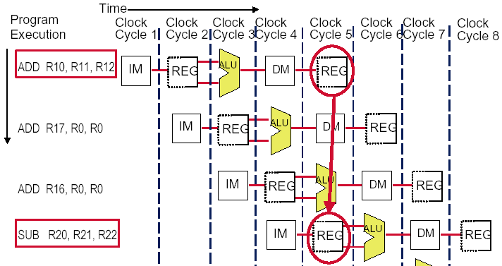
The conflict about the registers !

Slide 41
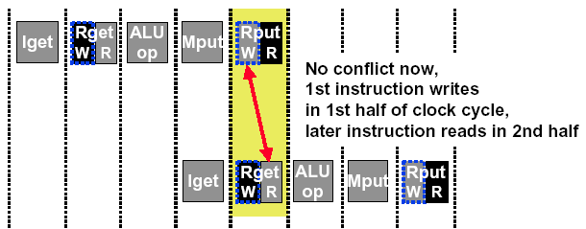
Sometimes we can redesign the resource
Allow WRITE-then-READ in one clock cycle (double pump)
Two reads and one write required per clock.
Need to provide two read port and one write port.

Slide 42
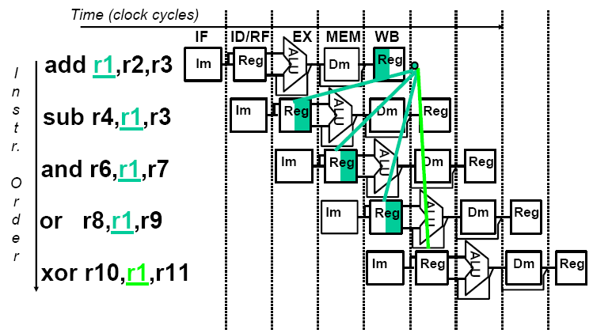
The conflict about the data

Slide 43
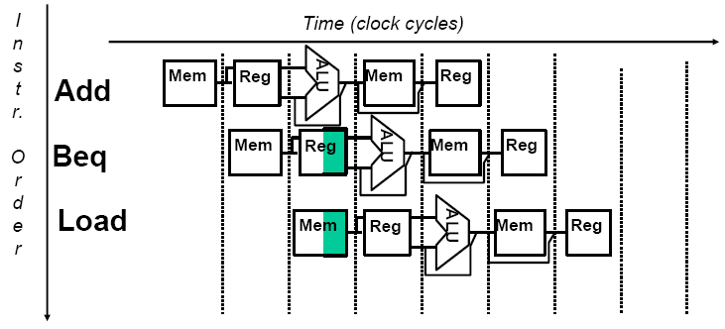
Conflict occurs when PC update

Slide 44
Must latches be engaged ? Yeah !
Ensure the instructions in different stages do not interfere with one another .
Through the latches, can the stages be combined one by one to form a pipeline.
The latches are the pipeline registers , which are much more than those in multi-cycle version
IR: IF/ID.IR; ID/EX.IR; EX/DM.IR; DM/WB.IR
B: ID/EX.B; EX/DM.B
ALUoutput: EX/DM.ALUoutput, DM/WB.ALUoutput

Slide 45
3.3 The Major Hurdle of Pipelining—Pipeline Hazards
本科回顾------- Appendix A.2
3.3.1 Taxonomy of hazard
3.3.2 Performance of pipeline with Hazard
3.3.3 Structural hazard
3.3.4 Data Hazards
3.3.5 Control Hazards

Slide 46

THANK YOU
THANK YOU

