Slide 1

高级计算机体系结构
陈文智
浙江大学计算机学院
chenwz@zju.edu.cn

Slide 2
1.1 计算机技术发展综述(1)
1946年: 在二次世界大战期间研制成功的世界上第一台电子计算机ENIAC (Electronic Numerical Intergrator and Calculator)正式对外宣布。
用途：军用；
体积：100英尺长×8.5英尺高×n英尺宽； 组成：18000真空管；
指令数：不足10条，加法，数据传输与转移

Slide 3
计算机技术发展综述(2)
60多年来计算机技术有了惊人的发展
性能：（加法）速度提高了>5个数量级
价格：今天$500的机器相当于80年代中$10⁷的机器，这里同性能计算机的价格比，改善了近5个数量级。

Slide 4
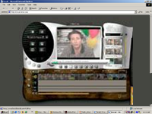
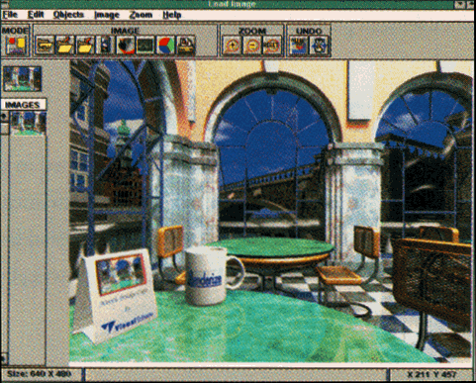
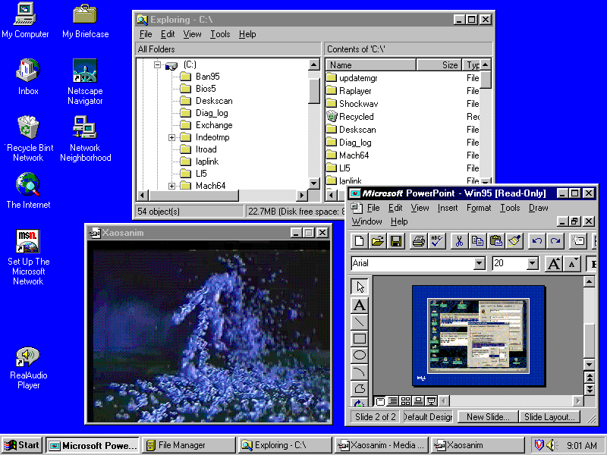
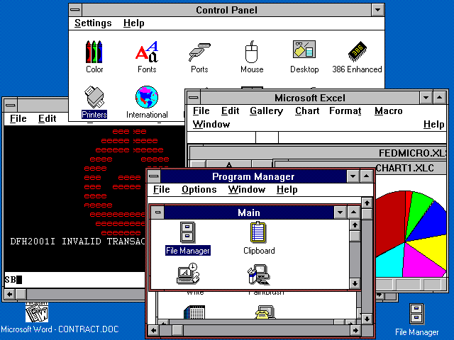
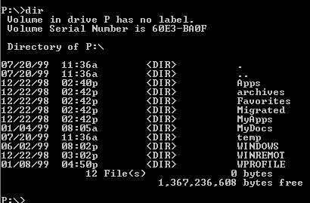
处理能力 → 新的应用
MIPS
10,000
奔腾® 4 处理器
奔腾® III 处理器
1,000
奔腾® II 处理器
100
奔腾® 处理器
i486
10
i386
80286
1
8086
0.1
1975
1980
1985
1990
1995
2000

Slide 5
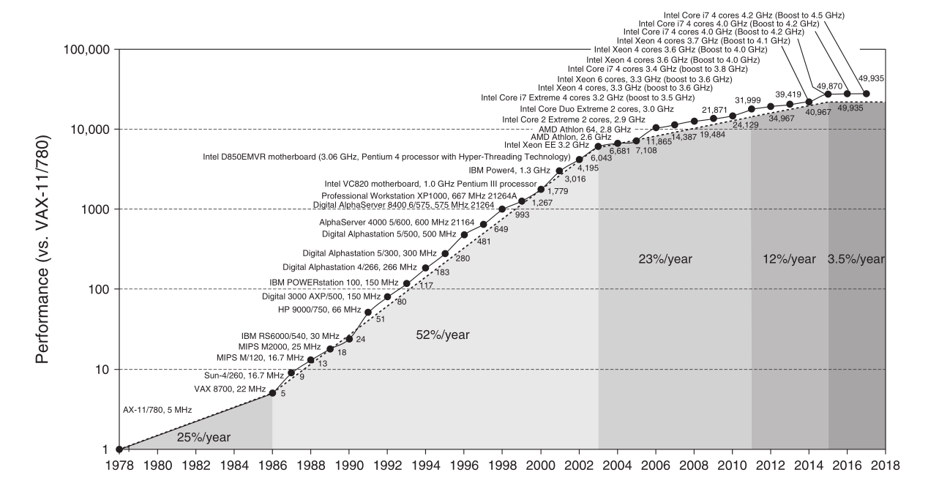
Incredible performance improvement

Slide 6
计算机技术发展综述(3)
计算机技术快速发展进步的原因之一
技术进步－－集成电路技术的进步，还有存储器（包括内外存）和各类外设的进步。
特点：稳定快速发展，即按Moore定律发展，即微处理器性能（按芯片上晶体管数定义）每18个月翻一番，即每年提高58%。

Slide 7
计算机技术发展综述(4)
计算机技术快速发展进步的原因之二
计算机设计创新，即计算机体系结构的不断创新。
经历了由简单→复杂→极其复杂→简单→复杂→极其复杂的经历
有时快，有时慢(1977年的VAX/780为１MIPS机器，1985年VAS/785仅为1.5 MIPS，几乎停止不前。
有很多技术，经不起时间考验，已退出历史舞台。

Slide 8
计算机技术发展综述(5)
今天计算机体系结构的研究内容
进一步提高单个微处理器的性能。(光速极限问题)
基于微处理器的多处理器体系结构。
全面提高计算机的系统性能：可用性，可维护性，可缩放性。
新型器件的处理器：如光计算机；新原理的计算机（生物，分子，又提出了DNA计算机)。

Slide 9
1.2 计算机体系结构定义(1)
定义1：
“计算机体系结构设计就是指令集设计”
早期：指令集设计具有至关重要的作用
今天：指令集趋向于相同（差别很小）。
甚至：指令集几乎相同的不同机器，其性能差异很大。
定义存在问题：与计算机的功能设计，逻辑设计以及实现技术分割开来，是不科学的。

Slide 10
计算机体系结构定义(2)
定义2：
计算机体系结构应包括指令集设计，计算机组成设计与硬件（硬件与逻辑设计）实现。
体系结构不同的例子：
指令集相同，组成不同：
VAX11/780-- SPARC2;
VAX8600--SPARC20;
指令集相同，组成也相同，实现不同： VAX11/780--VAX11/785（IC工艺不同）；
不同型号的Indy(时钟和Cache不同）

Slide 11
1.3 计算机系统结构的分类
一、当前计算机的种类
1989IEEE电气与电子工程师委员会提出的计算机分类：
．个人计算机 Personal Computer (PC)
．工作站 WorkStation (WS)
．小型机 Mini Computer
．中型机 Mainframe
．小巨型机 Minisupercomputer
．巨型机 Supercomputer
*服务器
*桌面计算
*嵌入式系统
*网络并行计算机(Cluster、Grid Computer)
*云计算、智慧地球
界线模糊

Slide 12
二、Flynn分类法
根据指令流和数据流的多倍性对计算机系统结构进行分类，
基本思想是计算机工作过程是指令流的执行和数据流的处理。
指令流：机器执行的指令序列
数据流：由指令流调用的数据序列（包括输入数 据和中间结果）
多倍性：在系统性能的瓶颈部件上处于同一执行 阶段的指令或数据的最大个数。

Slide 13
Flynn分类一
１.单指令流----单数据流 SISD 传统的顺序计算机
CU：控制部件 IS：指令流
PU：处理部件 DS：数据流
MU：存储部件
IS
IS
DS
CU
PU
MU
I/O

Slide 14
典型结构：传统的顺序计算机
冯·诺依曼结构
主存
输入设备
运算器
输出设备
控制器

Slide 15
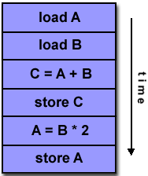
SISD

Slide 16
Flynn分类二
2．单指令流----多数据流 SIMD 超级计算机
单控制器、多处理单元和多对数据进行处理
PE：处理单元
LM：本地存储器（分布存储器）
DS
DS
PE₁
LM₁
IS
IS
从主机加载数据组
CU
从主机加载程序
DS
DS
PE_{n}
LM_{n}

Slide 17
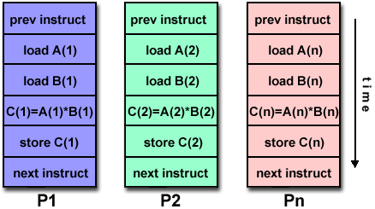
SIMD

Slide 18
典型结构:阵列式计算机
H.J. Siegel 1979 提出的操作模型
控制器
Proc.0
Proc.1
Proc.2
P.n-1
……
Mem.0
Mem.1
Mem.2
M.n-1
互 连 网 络
M = < N ， C ， I ， M ， R>
数功
据能
通
信
屏
蔽
方
案
C
U
指
令
集
C 的
U 指
送 令
PE集
P
E
个
数

Slide 19
阵列式结构作矩阵相乘(SIMD)
例：矩阵运算 PE器件
b
d=
a ·b+c
a a
c
b
⎡
a
c
⎤
⎡
e
g
⎤
A
=
⎢
⎥
B
=
⎢
⎥
⎣
b
d
⎦
⎣
f
h
⎦
C
＝
A
•
B

Slide 20
例：阵列计算机矩阵运算过程
0
f
e
h
g
0
0
f
h
g
0
0
a
0ca
0c
a e
0
1
2
e
0
0
0
0
db0
0
h
db
0
0
0
c
ae+cf
ag+ch
0
ae+cf
a g
3
4
0
h
f
g
d
b
be+df
bg
d
b e
0

Slide 21
Flynn分类三
3. 多指令流----单数据流 MISD 多个处理器，对同一数据流进行处理
MM主存贮模块，SM共享存储器
DS₁
IS₁
CU₁
PE₁
SM
……
MM₁
I/O
…
…
MM_{n}
IS_{n}
CU_{n}
PE_{n}
DS_{n}
……
ISn
IS₁

Slide 22
典型结构：脉动阵列计算机
这类计算机的实际机器并不多，一般认为超标量计算机、长指令字计算机（VLIW）和退耦（Decounted）计算机和专用脉动阵列（Systoic arrays）计算机可以作为此类计算机。
存 储 器
PE
PE
PE
PE
PE
PE

Slide 23
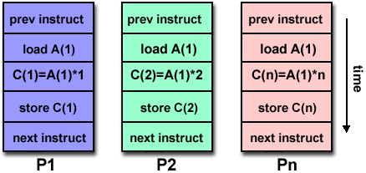
MISD

Slide 24
Flynn分类四
4．多指令流一多数据流 MIMD 多机系统----多个处理器系统或多计算机系统
每个处理机可以独立执行指令和处理数据
一般并行计算机大多采用这种结构。
IS₁
SM
IS₁
共享存储器为：紧耦合
分布存储器为：松耦合
CU₁
PE₁
MM₁
I/O
…
…
…
I/O
IS_{n}
CU_{n}n
PE_{n}
MM_{n}
IS_{n}

Slide 25
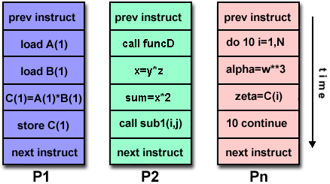
MIMD

Slide 26
1.4 Measuring Suits
Real applications
i.e. C compilers, TeX and Spice.
Modified (or scripted) applications
To enhance portability or to focus on one particular aspect of system performance.
Kernels
Small key pieces (usually small) of real programs. i.e. Livermore Loops and Linpack.
Used to isolate performance of individual features and help explain behavior of real programs.

Slide 27
Toy benchmarks
Small programs (10-100) lines that produce a known result. i.e. QuickSort Sieve of Eratosthenes,Puzzle,
Synthetic benchmarks
synthetic benchmarks try to match the average frequency of operations and operands of a large set of programs. i.e. Whetstone and Dhrystone.
Similar to kernels but are NOT real programs !

Slide 28

1.5 Comparing and Summarizing
(一）Total Execution Time: A Consistent Summary Measure
Arithmetic mean:

Slide 29

(二）Weighted Execution Time
The question arises: What is the proper mixture of programs for the workload?
weighted arithmetic mean:
where Weighti is the frequency of the ith program in the workload and Timei is the execution time of that program.

Slide 30


(三）Normalized Execution Time and the Pros and Cons of Geometric Means
the geometric mean
where Execution time ratioi is the execution time, normalized to the reference machine, for the ith program of a total of n in the workload.

Slide 31
1.6 Quantitative Principles
一、Make the Common Case Fast
If a design trade-off is necessary, favor the frequent case (which is often simpler) over the infrequent case.
Perhaps it is the most important and pervasive principle of computer design.
For example, given that overflow in addition is infrequent, favor optimizing the case when no overflow occurs.
Simple is fast! Small is fast!

Slide 32
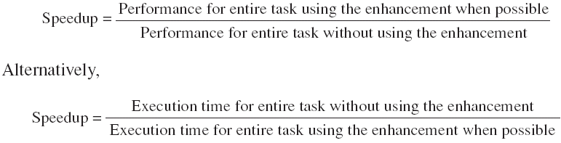
二、Amdahl’s Law
The performance improvement to be gained from using some faster mode of execution is limited by the fraction of the time the faster mode can be used.
Amdahl's law defines the speedup obtained by using a particular feature:

Slide 33

Fraction _{enhanced} Always <= 1.
The fraction of the computation time in the original machine that can be converted to take advantage of the enhancement
Speedup _{enhanced}
The improvement gained by the enhanced execution mode; that is, how much faster the task would run if the enhanced mode were used for the entire program

Slide 34
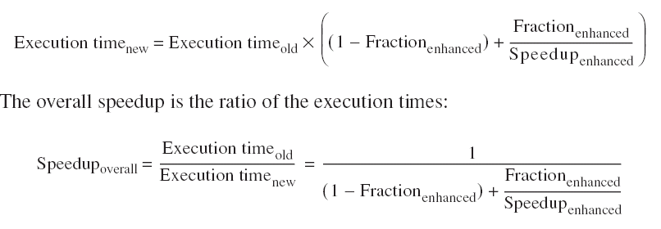

Slide 35
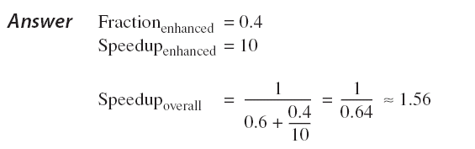
Example
Suppose that we are considering an enhancement to the processor of a server system used for Web serving. The new CPU is 10 times faster on computation in the Web serving application than the original processor. Assuming that the original CPU is busy with computation 40% of the time and is waiting for I/O 60% of the time, what is the overall speedup gained by incorporating the enhancement?

Slide 36
Example
A common transformation required in graphics engines is square root. Implementations of floating-point (FP) square root vary significantly in performance, especially among processors designed for graphics. Suppose FP square root (FPSQR) is responsible for 20% of the execution time of a critical graphics benchmark.One proposal is to enhance the FPSQR hardware and speed up this operation by a factor of 10. The other alternative is just to try to make all FP instructions in the graphics processor run faster by a factor of 1.6; FP instructions are responsible for a total of 50% of the execution time for the application. The design team believes that they can make all FP instructions run 1.6 times faster with the same effort as required for the fast square root. Compare these two design alternatives.

Slide 37
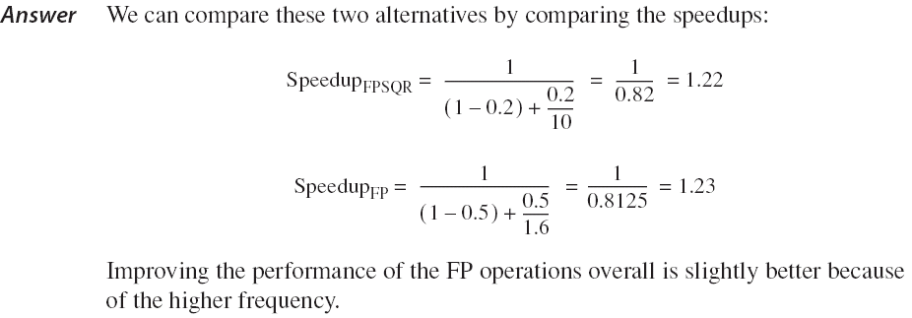

Slide 38

三、The CPU Performance Equation

Slide 39


CPI

Slide 40
CPU performance is dependent upon three characteristics:
clock cycle (or rate)
clock cycles per instruction
and instruction count.
It is difficult to change one parameter in complete isolation from others
Because the basic technologies involved in changing each characteristic are interdependent:

Slide 41
Clock cycle time—Hardware technology and organization
CPI—Organization and instruction set architecture
Instruction count—Instruction set architecture and compiler technology

Slide 42


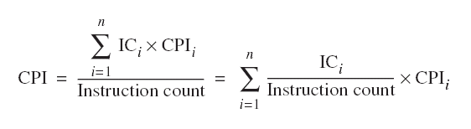

Slide 43
Example1.4: Suppose we have made the following measurements:
Frequency of FP = 25%
Average CPI of FP = 4.0
Average CPI of other instructions = 1.33
Frequency of FPSQR= 2%
Average CPI of FPSQR = 20
Assume that the two design alternatives are to decrease the CPI of FPSQR to 2 or to decrease the average CPI of all FP operations to 2.5. Compare these two design alternatives using the CPU performance equation.

Slide 44
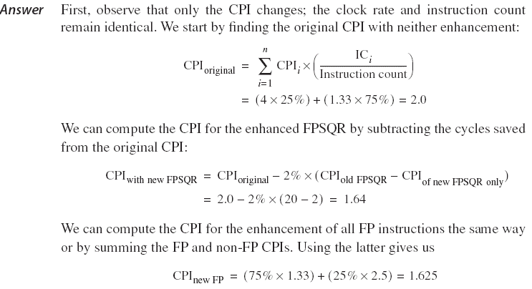
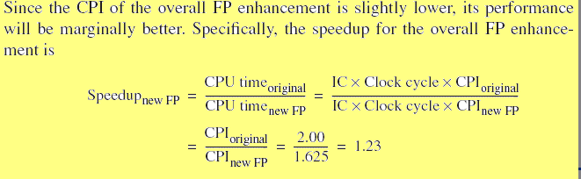

Slide 45
四、Principle of Locality
Programs tend to reuse data and instructions they have used recently.
a program spends 90% of its execution time in only 10% of the code.
Temporal locality
states that recently accessed items are likely to be accessed in the near future.
Spatial locality
says that items whose addresses are near one another tend to be referenced close together in time.

Slide 46
五、Take Advantage of Parallelism
Taking advantage of parallelism is one of the most important methods for improving performance.

Slide 47
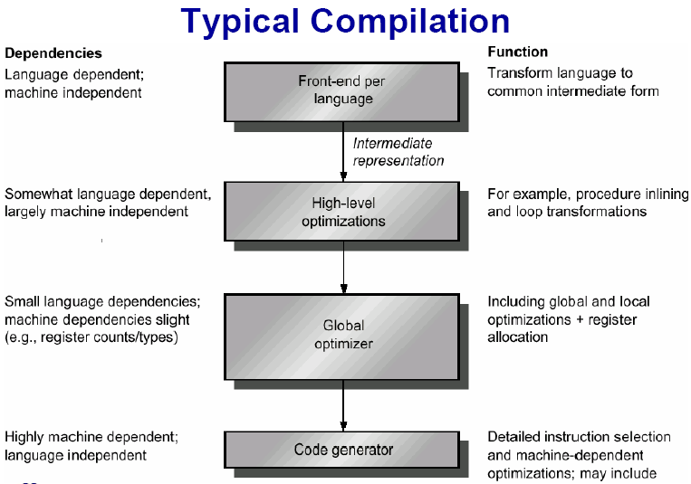
1.7 Compilers and Architecture

Slide 48

THANK YOU
THANK YOU

