Slide 1

高级计算机体系结构
陈文智
浙江大学计算机学院
chenwz@zju.edu.cn

Slide 2
3.3.5 Pipelining Control Hazards
Taxonomy of Hazards
Structural hazards
These are conflicts over hardware resources.
Data hazards
Instruction depends on result of prior computation which is not ready (computed or stored) yet
OK, we did these, Double Bump, Forwarding path,
software scheduling, otherwise have to stall
Control hazards
branch condition and the branch PC are not available in time to fetch an instruction on the next clock

Slide 3
The Control hazard
一、Cause
branch condition and the branch PC are not available in time to fetch an instruction on the next clock
The next PC takes time to compute
For conditional branches, the branch direction takes time to compute.
Control hazards can cause a greater and greater performance loss for MIPS pipeline than do data hazards.

Slide 4
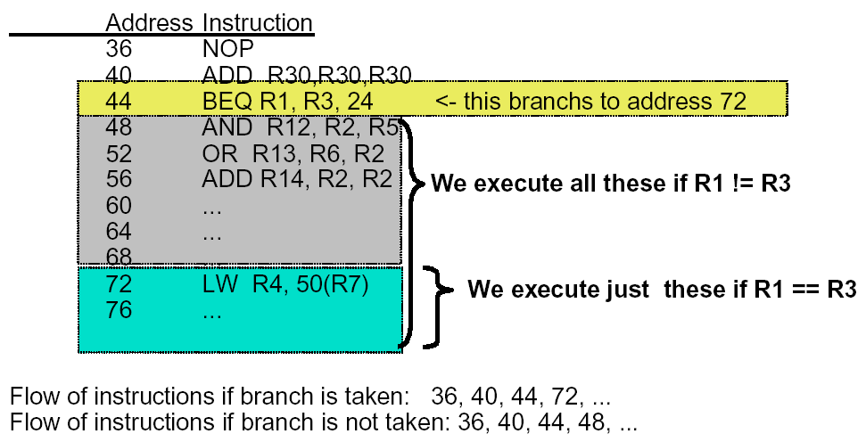
Example: Branches

Slide 5
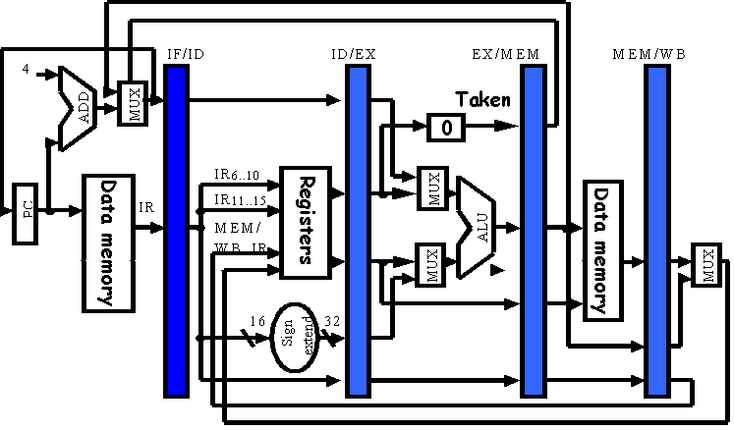
Branches of Basic Pipelined Datapath

Slide 6
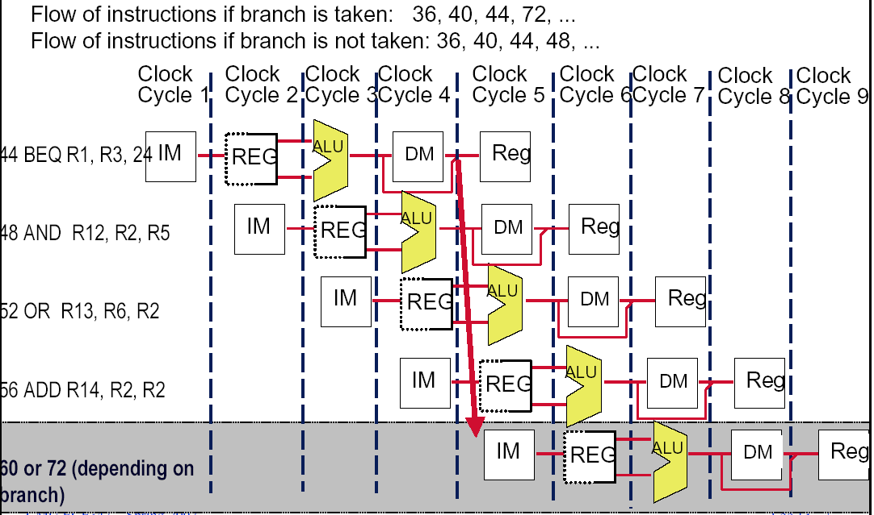
二、The Penalty of Control hazard
b=3

Slide 7
三、Dealing with the control hazard
Four simple solutions
Freeze or flush the pipeline
Penalty is fixed.
Can not be reduced by software.
Predict-not-taken (Predict-untaken)
Treat every branch as not taken
Predict-taken
Treat every branch as taken
Delayed branch
Note:
Fixed hardware
Compile time scheme using knowledge of hardware scheme and of branch behavior

Slide 8
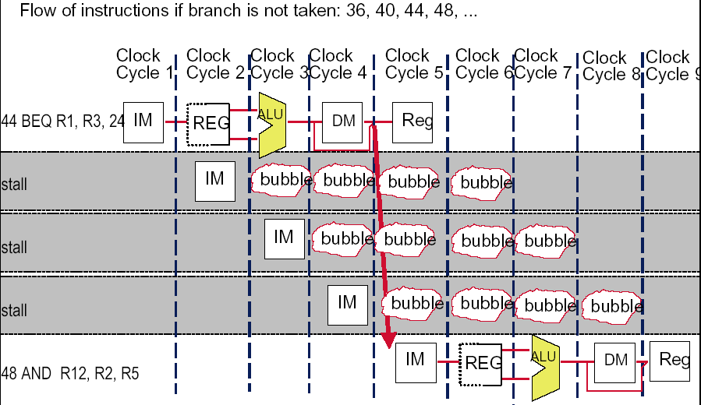
(1)Freeze or flush the pipeline

Slide 9
(2)Predict not-taken
Hardware:
Treat every branch as not taken (or as the formal instruction)
When branch is not taken, the fetched instruction just continues to flow on. No stall at all.
If the branch is taken, then restart the fetch at the branch target, which cause 3 stall.(should turn the fetched instruction into a no-op)
Compiler:
Can improve the performance by coding the most frequent case in the untaken path.

Slide 10
(3)Predict –taken
Most branches(60%) are taken, so we should make the taken branch more faster. Why not try assuming the branch always taken?
Hardware
Treat every branch as taken (evidence: more than 60% branches are taken)
As soon as the branch target address is computed, assume the branch to be taken and begin fetching and executing at the target.
Only useful when the target is known before the branch outcome.
No advantage at all for MIPS 5-stage pipeline.
Compiler
Can improve the performance by coding the most frequent case in the taken path.

Slide 12
Pipeline status for predict-taken
Branch is taken: 1 stall
44 BEQ R1, R3, 24 | IF | ID | EX | MEM | WB
48 AND R12, R2, R5 |  | IF | idle | idle | idle | idle
72 LW R4, 50(R7) |  |  | IF | ID | EX | MEM | WB
76 |  |  |  | IF | ID | EX | MEM
80 |  |  |  |  | IF | ID | EX
Branch is not taken: 3 stall
44 BEQ R1, R3, 24 | IF | ID | EX | MEM | WB
48 AND R12, R2, R5 |  | IF | idle | idle | idle | idle
72 LW R4, 50(R7) |  |  | IF | ID | idle | idle | idle
76 |  |  |  | IF | idle | idle | idle
48 AND R12, R2, R5 |  |  |  |  | IF | ID | EX

Slide 13
Modify MIPS Datapath Move the Branch Computation Forward

Slide 14
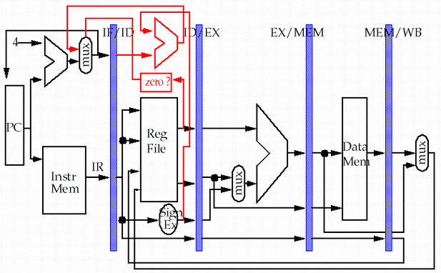
Move the Branch Computation more Forward
store
load

Slide 15
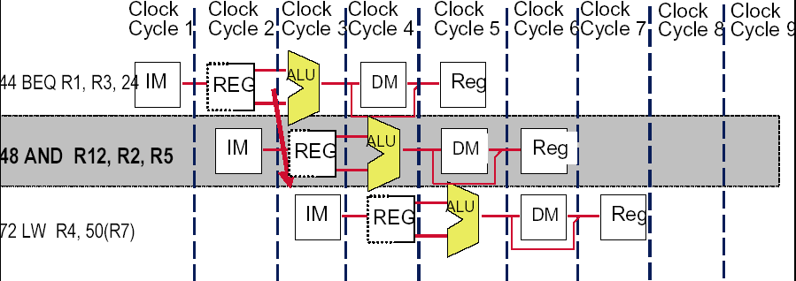
Result: New & Improved MIPS Datapath
Need just 1 extra cycle after the BEQ branch to know right address
On MIPS, its called - the branch delay slot
48 or 72

Slide 16
(4)Delayed branch
Good information
Just 1 cycle to figure out what the right branch address is
So, not 2 or 3 cycles of potential NOP or stall
Strange news
OK, it’s always 1 cycle, and we always have to wait
And on MIPS, this instruction always executes, no matter whether the branch taken or not taken. (hardware scheme)

Slide 17
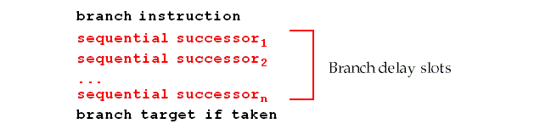
Branch delay slot
Hence the name: branch delay slot
The instruction cycle after the branch is used for address calculation , 1 cycle delay necessary
SO…we regard this as a free instruction cycle, and we just DO IT
Consequence
You (or your compiler) will need to adjust your code to put some useful work in that “slot”, since just putting in a NOP is wasteful (compiler scheme)

Slide 18
How to adjust the codes?

Slide 19
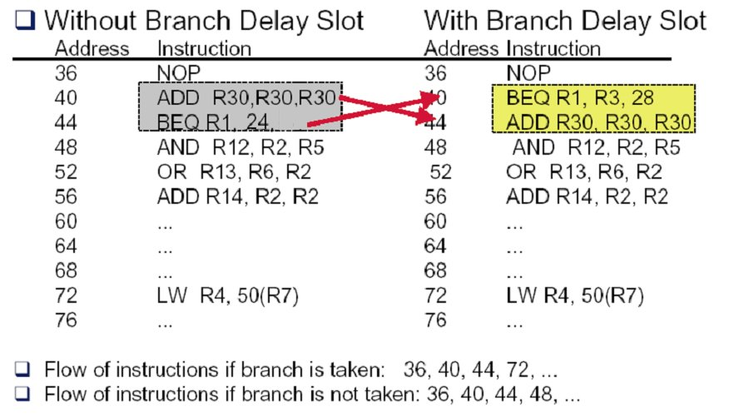
Example: rewrite the code (a)

Slide 20
Example: rewrite the code (b-1)
Loop: LW R2, 0(R1)
ADD R3, R2, R4
SW R3, 0(R1)
……
SUB R1, R1, #4
BNEZ R1, Loop
LW R2, 0(R1)
Loop: ADD R3, R2, R4
SW R3, 0(R1)
……
SUB R1,R1, #4
BNEZ R1, Loop
LW R2, 0(R1)

Slide 21
Example: rewrite the code (b-2)
Loop: LW R2, 0(R1)
ADD R3, R2, R4
SW R3, 0(R1)
DIV …..
……
SUB R1, R1, #4
BNEZ R1, Loop
Loop: LW R2, 0(R1)
ADD R3, R2, R4
DIV …...
…...
SUB R1, R1, #4
BNEZ R1, Loop
SW R3, +4(R1)

Slide 22
Schedualing strategy vs. performance improvement

Slide 23
Constrains of the delayed branch
There are restrictions on the instructions that are scheduled into the delay slots
The compiler's ability to predict accurately whether or not a branch is taken determines how much useful work is actually done.
For scheduling scheme b and c,
It must be O.K. to execute the SUB instruction if the prediction is wrong.
Or the hardware must provide a way of cancelling the instruction.

Slide 24
About delayed branch
Delayed branch are adopted in most RISC processors.
In general, the length of branch delay is more than 1 . However, always just one slot is used due to the compiler complexity.

Slide 25
Summary for control hazard
Control hazards can cause a greater performance loss than do data hazards.
In general, the deeper the pipeline, the worse the branch penalty in clock cycles.
A higher CPI processor can afford to have more expensive branches.
The efficiency of the three schemes greatly depends on the branch prediction.

Slide 26
3.4 Extending the MIPS Pipeline to Handle Multicycle Operations

Slide 27
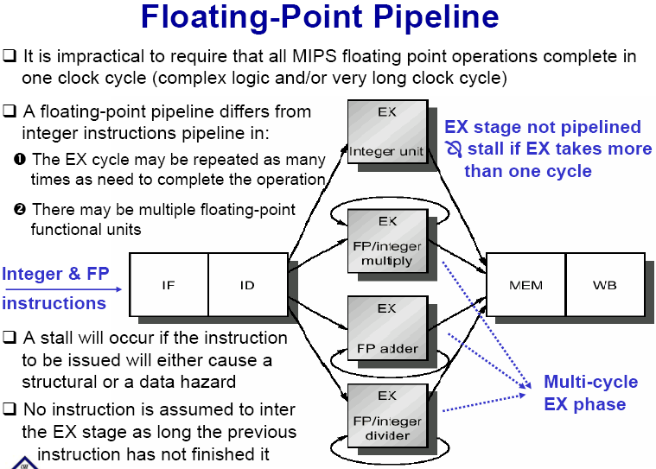

Slide 28
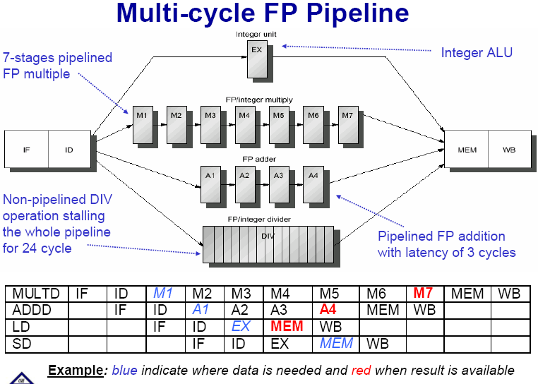

Slide 29
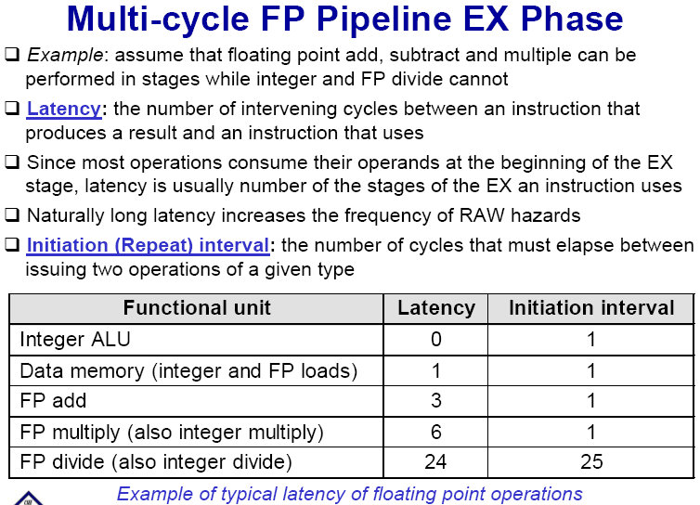

Slide 30
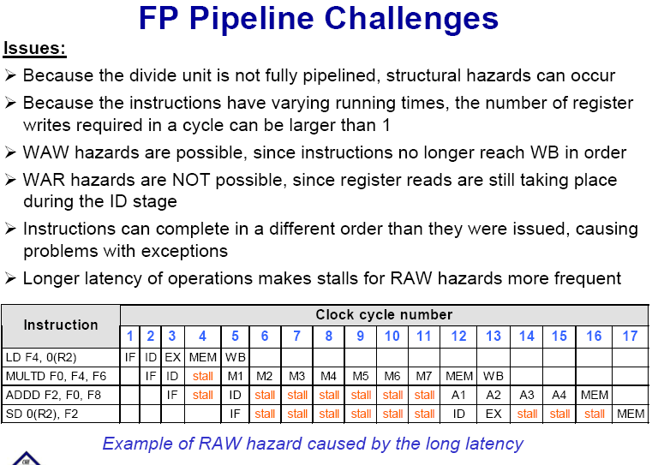

Slide 31
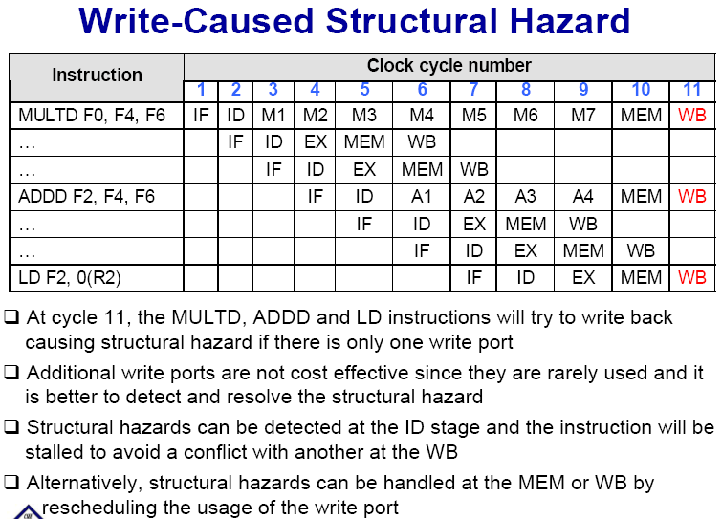

Slide 32
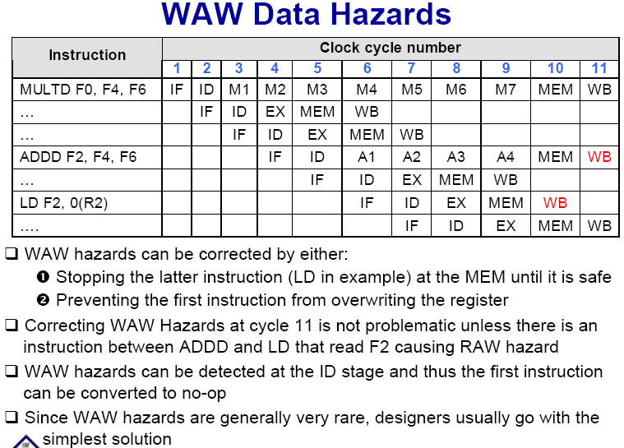

Slide 33
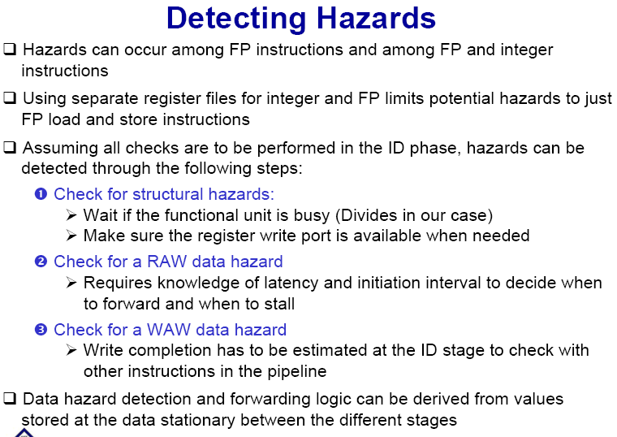

Slide 34
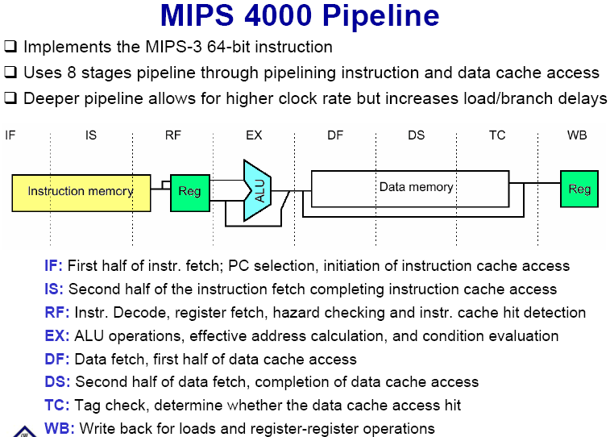

Slide 35
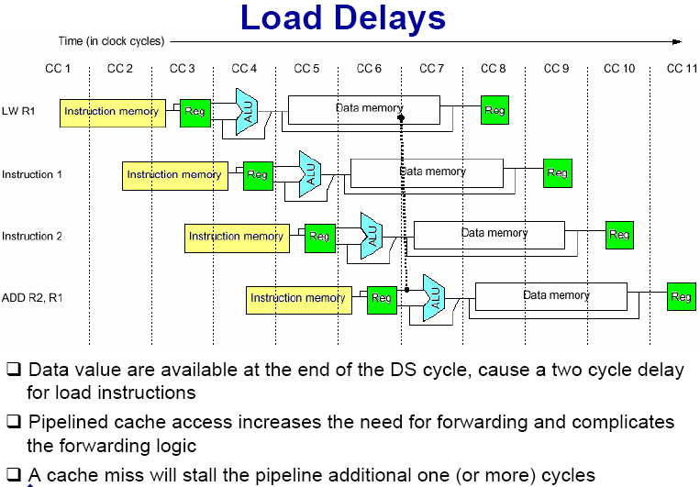

Slide 36
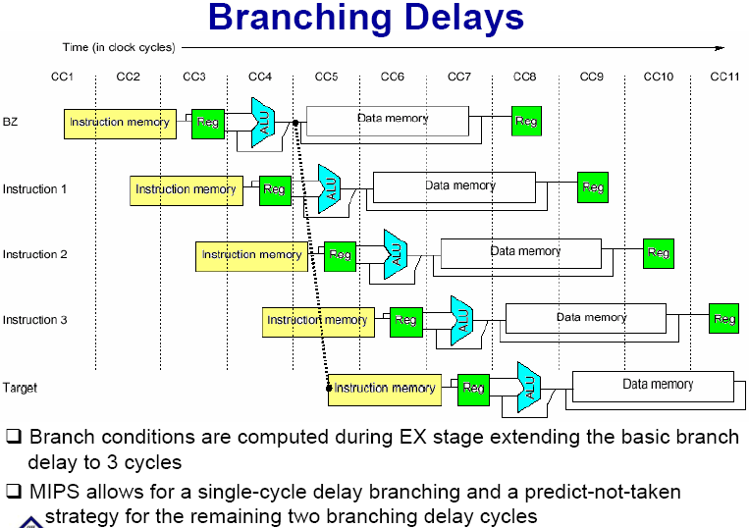

Slide 37

THANK YOU
THANK YOU

