Slide 1

高级计算机体系结构
陈文智
浙江大学计算机学院
chenwz@zju.edu.cn

Slide 2
有几种竞争？
结构竞争有几种情况？如何解决
数据竞争有几种情况？如何解决
控制竞争如何解决？如何解决？
多周期以后引进何种新竞争？

Slide 3
3.5 Instruction-Level Parallelism: Concepts and Challenges
3.5.1 提高流水线性能的思路
直观思路: 缩小流水线的CPI
CPIunpipelined
因为Speedup= -----------------------------
CPIpipelined
CPI_{pipelined}
= Ideal pipeline CPI+ pipelined stall cycles per instruction
=1+ Structual stalls + RAW stalls + WAR stalls
+ WAW stalls + Control stalls

Slide 4
所以:
缩小CPIpipelined的途径就是:
→减少各种竞争造成的停顿周期数
→或者减少理想CPI

Slide 5
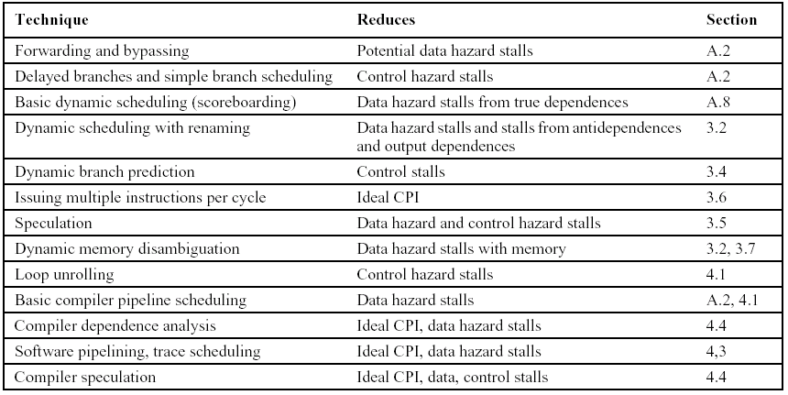
各种高级流水线技术及其作用对象:
4TH
A.2
A.2
A.7
2.4
2.3
2.7,2.8
2.6
2.4,2.6
2.2
A.2,2.2
G.2, G.3
G.4,G.5

Slide 6
3.5.2 Instruction-Level Parallelism
Basic Block ILP is quite small
程序基本块： 指不包括转入（除程序入口）和转出（除程序出口）指令的连续代码序列，通常由6-7条指令组成。
根据统计,在整数程序中动态转移的概率为15%~25%，即程序中一对转移指令之间仅含4~7条指令）
考虑到基本块内指令之间存在各种相关性，所以程序基本块内可重叠执行的指令数远少于6条。

Slide 7
必须研究多个基本块代码之间的可重叠执行性，即ILP。最常见，也是最简单的一种多个基本块之间的并行行为：
循环多次迭代之间的并行性，称为循环级并行性（loop-level parallelrism--LLP)。
[例] for (i=1; I<=1000; i=i+1;)
x[i] = x[i] + y[i];
loop内指令无重叠执行可能性，
loop的每一次迭代可重叠执行。

Slide 8
如何将此类LLP转化为ILP?
首先把loop按每次迭代代码序列展开，
再根据代码指令指令之间相关性进行调度。

Slide 9
3.5.3 Data Dependence and Hazards
一、True Data Dependence:
Instr_{J} is data dependent on Instr_{I} Instr_{J} tries to read operand before Instr_{I} writes it
or Instr_{J} is data dependent on Instr_{K} which is dependent on Instr_{I}
Caused by a “True Dependence” (compiler term)
If true dependence caused a hazard in the pipeline, called a Read After Write (RAW) hazard
I: add r1,r2,r3
J: sub r4,r1,r3

Slide 10
Name dependence
when 2 instructions use same register or memory location, called a name, but no flow of data between the instructions associated with that name;
Anti-dependence
Instr_{J} writes operand before Instr_{I} reads it
called an “anti-dependence” by compiler writers. This results from reuse of the name “r1”
If anti-dependence caused a hazard in the pipeline, called a Write After Read (WAR) hazard
I: sub r4,r1,r3
J: add r1,r2,r3
K: mul r6,r1,r7

Slide 11
Output dependence
Instr_{J} writes operand before Instr_{I} writes it.
Called an “output dependence” by compiler writers This also results from the reuse of name “r1”
If out-dependence caused a hazard in the pipeline, called a Write After Write (WAW) hazard
I: sub r1,r4,r3
J: add r1,r2,r3
K: mul r6,r1,r7

Slide 12
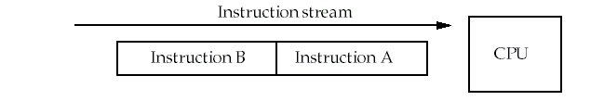
三、 Types of data hazards
Consider two instructions, A and B. A occurs before B.
RAW( Read after write) true dependence
Instruction A writes Rx，instruction B reads Rx
WAW(Write after write) output dependence，NAME DEP
Instruction A writes Rx，instruction B writes Rx
WAR( Write after read) anti-denpendence,NAME DEP
Instruction A reads Rx，instruction B writes Rx

Slide 13
3.6 Overcoming Data Hazards with Dynamic Scheduling( 4TH:2.4)
3.6.1 Key idea:
Allow instructions behind stall to proceed
DIVD F0,F2,F4 ADDD F10,F0,F8 SUBD F12,F8,F14
Enables out-of-order execution and allows out-of-order completion
Will distinguish when an instruction begins execution and when it completes execution; between 2 times, the instruction is in execution
In a dynamically scheduled pipeline, all instructions pass through issue stage in order (in-order issue)

Slide 14
Advantages of Dynamic Scheduling
Handles cases when dependences unknown at compile time
(e.g., because they may involve a memory reference)
It simplifies the compiler
Allows code that compiled for one pipeline to run efficiently on a different pipeline
Hardware speculation, a technique with significant performance advantages, that builds on dynamic scheduling

Slide 15
Dynamic Scheduling Step
Simple pipeline has 1 stage to check both structural and data hazards: Instruction Decode (ID), also called Instruction Issue
Split the ID pipe stage of simple 5-stage pipeline into 2 stages:
Issue—Decode instructions, check for structural hazards
Read operands—Wait until no data hazards, then read operands

Slide 16
3.6.2 Dynamic Scheduling with a Scoreboard
Scoreboarding
Named after CDC6600 scoreboard
Allowing instructions to execute out of order when there are sufficient resources and no data dependences.
In-order issue
Out-of order completion
Executing an instruction as early as possible

Slide 17
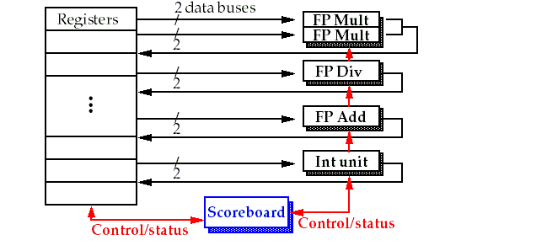
Basic structure of a pipelined processor with a scoreboard

Slide 18
The pipeline stages with scoreboard
The Five stages: IF, ID, EX, MEM, WB
IF: the same for all instructions
ID: split into two stages: issue and read operands
EX: no change
MEM: omitted for only concentrating on the FP operations
WB: no change
So, the stages are:
(IF), IS, RO, EX,(MEM),WB.

Slide 19
Pipeline stage description
Issue: a instruction is issued when
The functional unit is available and
No other active instruction has the same destination register.
Avoid strutural hazard and WAW hazard
Read Operands (RO)
The read operation is delayed until the operands are available.
This means that no previously issued but ncompleted instruction has the operand as its destination.
This resolves RAW hazards dynamically
Execution (EX)
Notify the scoreboard when completed so the functional unit can be reused.
Write result (WB)
The scoreboard checks for WAR hazards and stalls the completing instruction if necessary.

Slide 20
The scoreboard algorithm
Scoreboard-takes full responsibility for instruction issue and execution
Create the dependence records
Decide when to fetch the operand
Decide when to enter execution
Decide when the result can be written into the register file
Three data structure
Instruction status:
which of the four steps the instruction is in
Functional unit status: buzy,op,Fi, Fj,Fk,Qj,Qk ,Rj,Rk
Register result status:
which functional unit will write that register

Slide 21
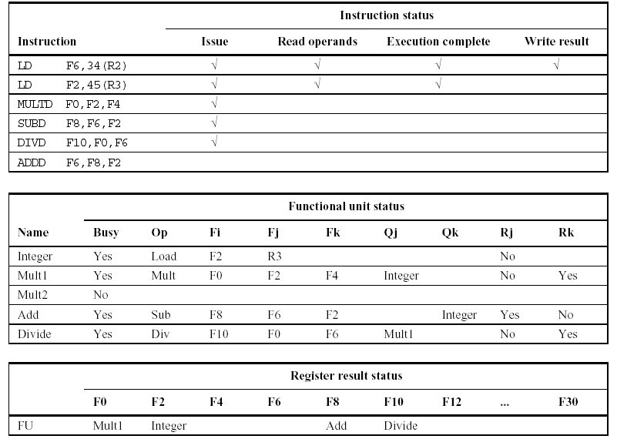

Slide 22
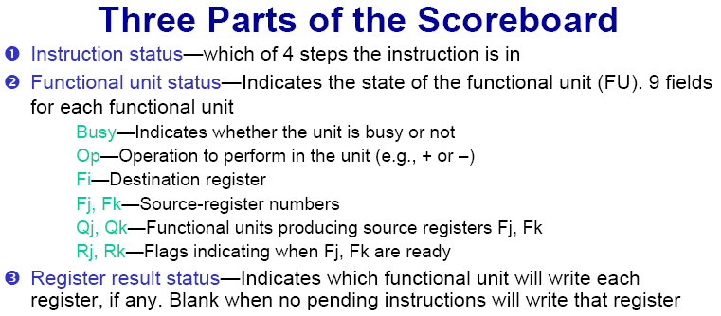

Slide 23
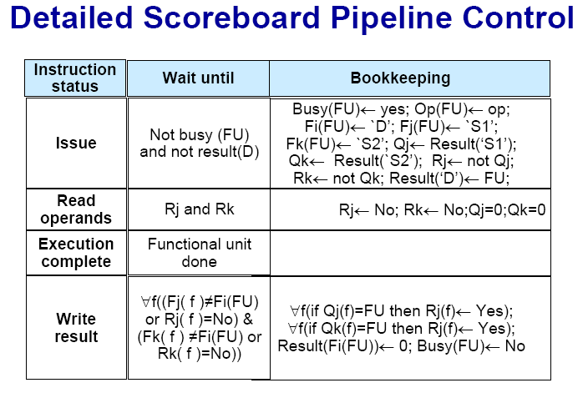

Slide 24
Vf(( Fj(f) ≠Fi(FU) or Rj(f) = No ) & (Fk(f) ≠ Fi(FU) or Rk(f) = No))
F_{j}(f) = F_{i}(FU)
R_{j}(f) = NO
F_{j}(f) = F_{i}(FU)
R_{j}(f) ≠ NO
F_{j}(f) ≠ F_{i}(FU)
R_{j}(f) = NO
F_{j}(f) ≠ F_{i}(FU)
R_{j}(f) ≠ NO
F_{k}(f) = F_{i}(FU)
R_{k}(f) = NO
F_{k}(f) = F_{i}(FU)
R_{k}(f) ≠ NO
F_{k}(f) ≠ F_{i}(FU)
R_{k}(f) = NO
F_{k}(f) ≠ F_{i}(FU)
R_{k}(f) ≠ NO

Slide 25
Example: Instruction status
LD F6, 34(R2)
LD F2, 45(R3)
MULTD F0, F2, F4
SUBD F8, F6, F2
DIVD F10, F0, F6
ADDD F6, F8, F2
MULTD : 10CC
DIVD : 40CC
ADDD/SUBD : 2CC

Slide 26
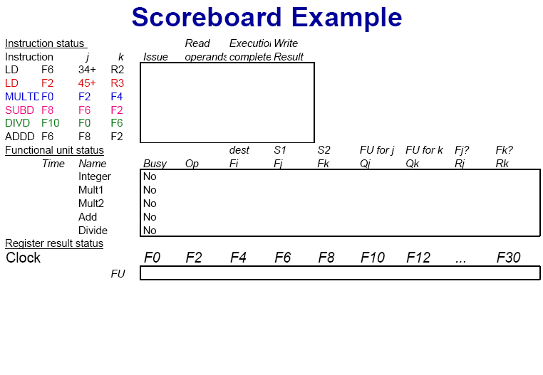

Slide 27
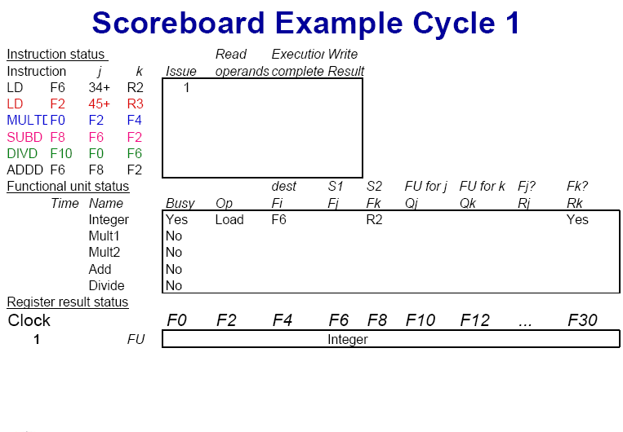
IMM34
Yes

Slide 28
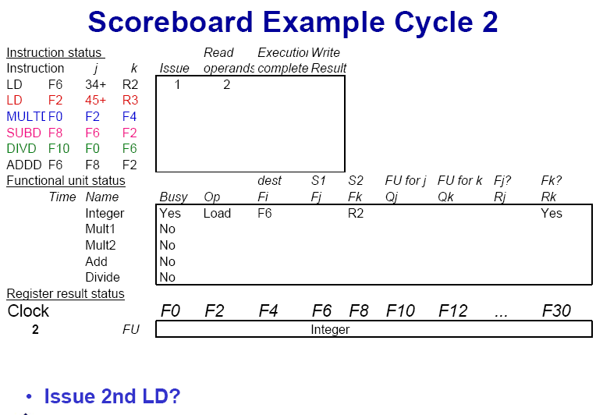
IMM34
Yes

Slide 29

IMM34
Yes

Slide 30
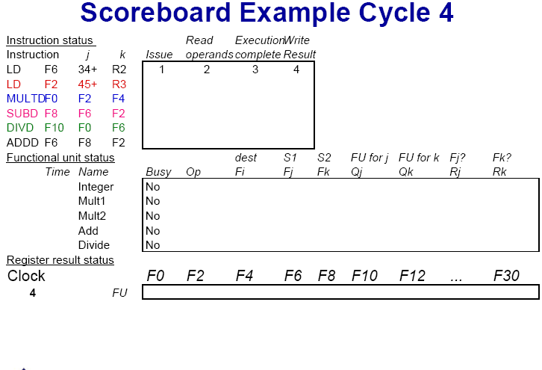

Slide 31
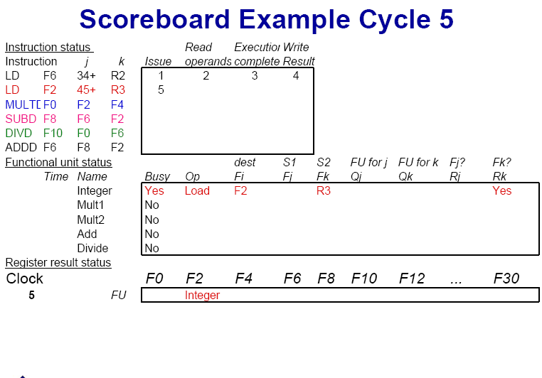

Slide 32
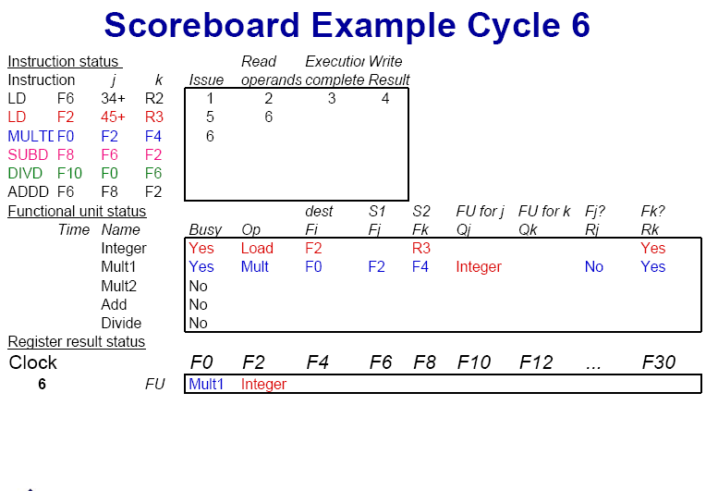

Slide 33
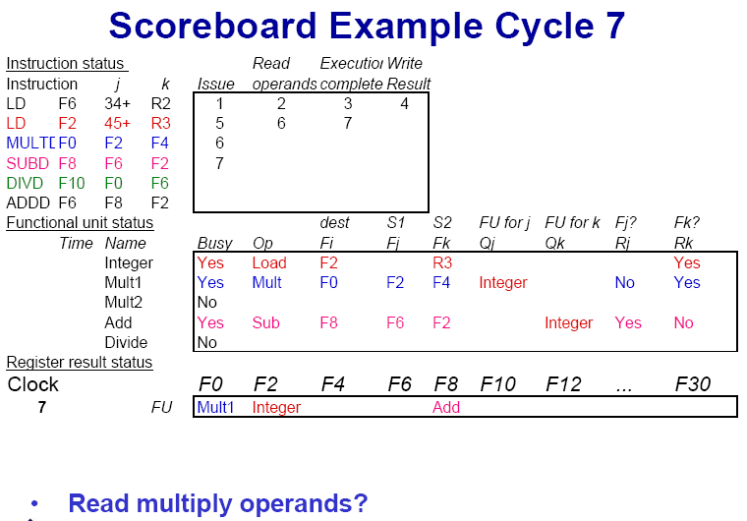

Slide 34
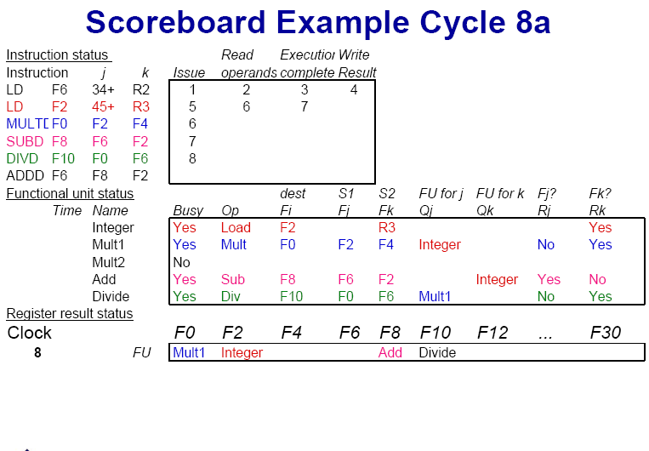

Slide 35
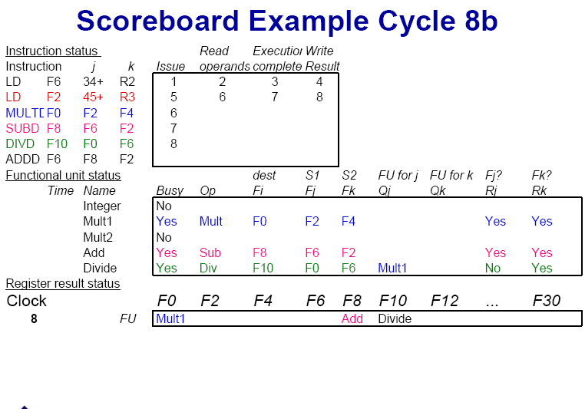

Slide 36
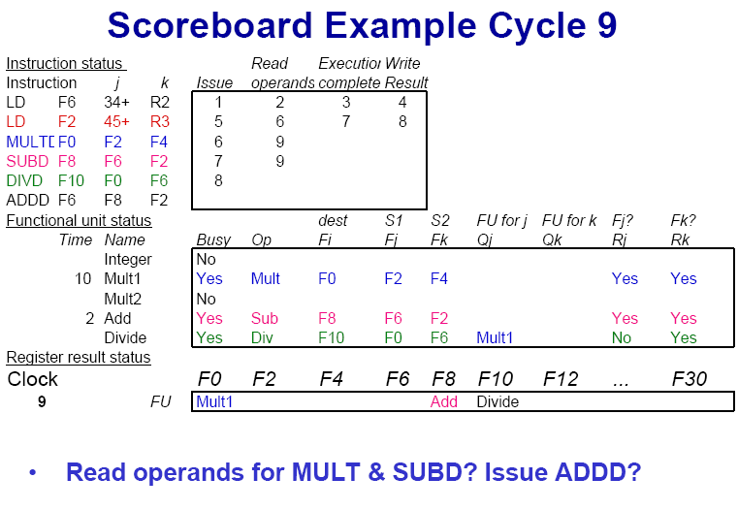

Slide 37
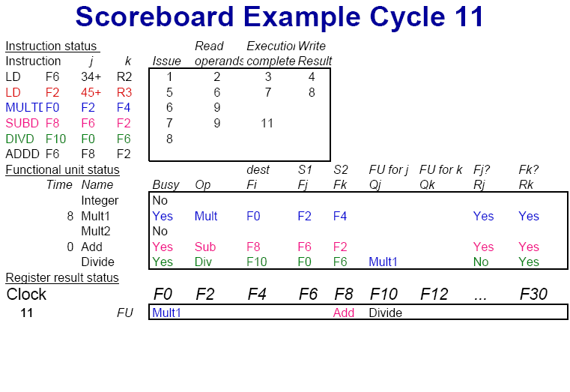

Slide 38
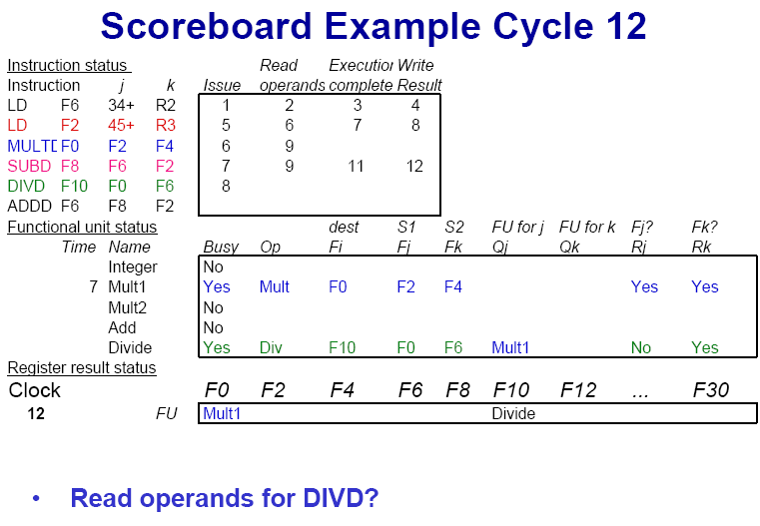

Slide 39
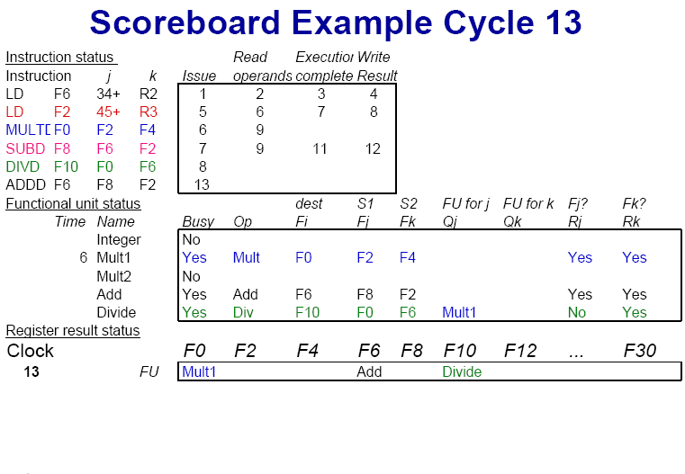

Slide 40


Slide 41
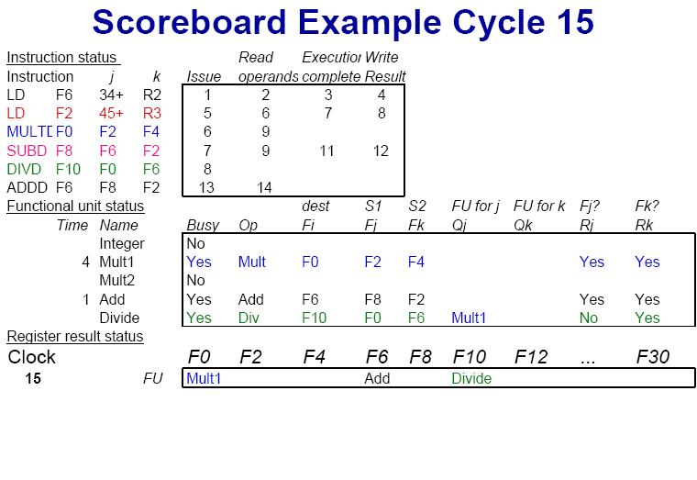

Slide 42
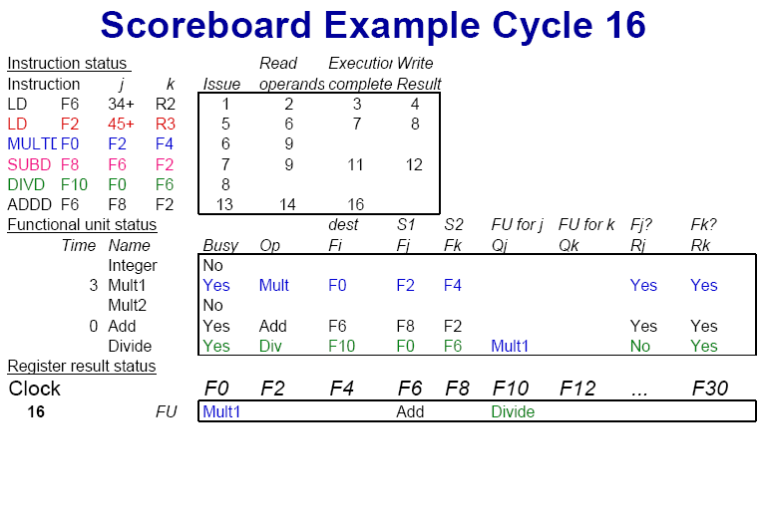

Slide 43
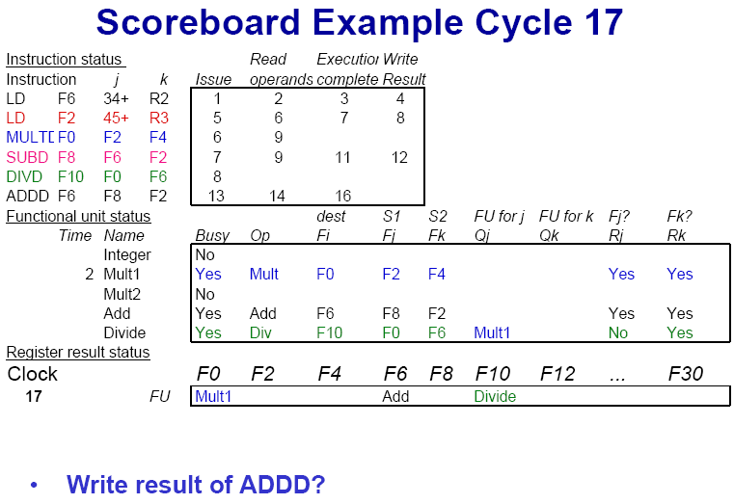

Slide 44
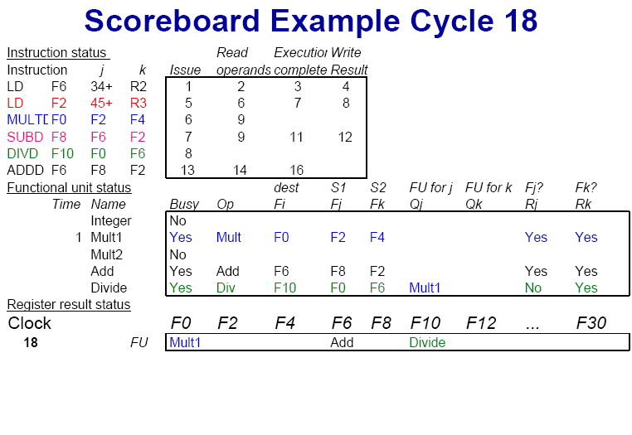

Slide 45


Slide 46
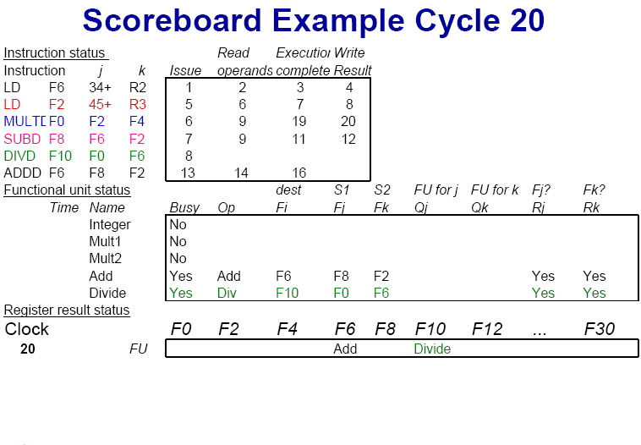

Slide 47
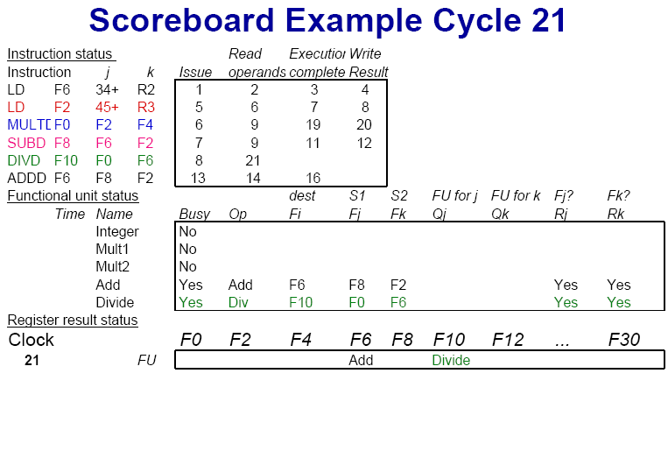

Slide 48
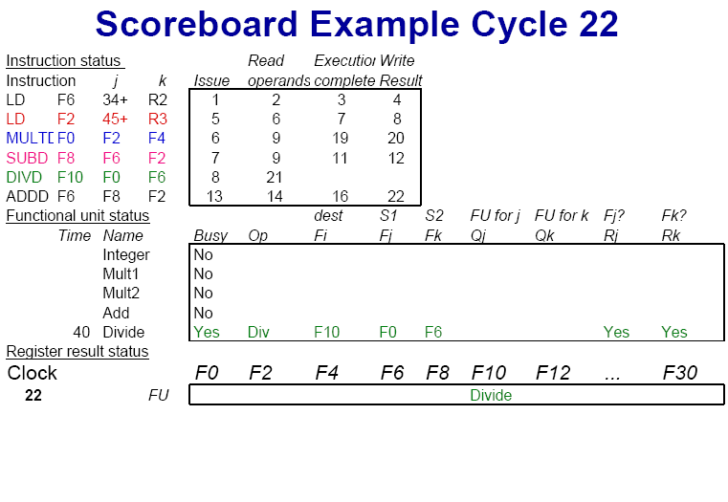

Slide 49
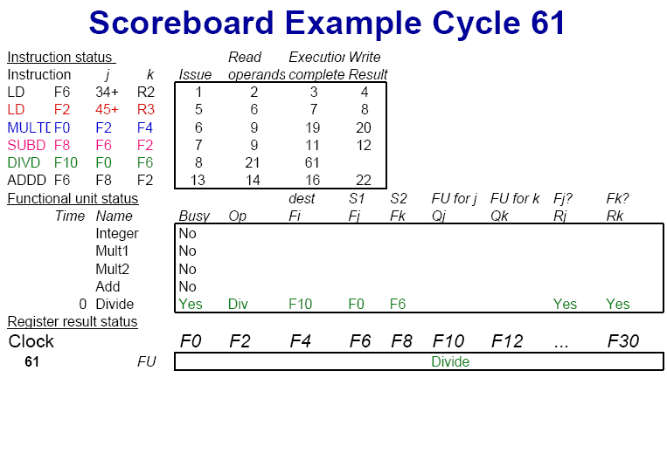

Slide 50
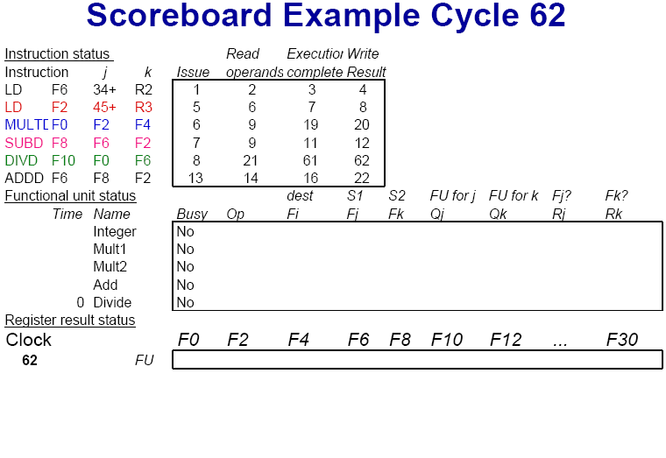

Slide 51
Limitations of Scoreboard-1
ILP
If we can't find independent instructions to execute, scoreboard (or any dynamic scheduling scheme for that matter) helps very little.
Size of the "issued" queue
This determines how far ahead the CPU can look for instructions to execute in parallel.
It's called the window.
For now, we assume that a window can not span a branch.
In other words, the window includes instructions only within basic blocks.

Slide 52
Limitations of Scoreboard-2
Number, types, and speed of the functional units
This determines how often a structural hazard results in stall.
The presence of anti-dependences and output dependences
WAR and WAW hazards limit the scoreboard more than RAW hazards, lead to WAR and WAW stalls.
RAW hazards are problems for any technique.
But WAR and WAW hazards can be solved in ways other than scoreboards.

Slide 53

THANK YOU
THANK YOU

