Slide 1

高级计算机体系结构
陈文智
浙江大学计算机学院
chenwz@zju.edu.cn

Slide 2
3.3 The Major Hurdle of Pipelining—Pipeline Hazards
本科回顾------- Appendix A.2
3.3.1 Taxonomy of hazard
3.3.2 Performance of pipeline with Hazard
3.3.3 Structural hazard
3.3.4 Data Hazards
3.3.5 Control Hazards

Slide 3
3.3.1 Taxonomy of hazard
A hazard is a condition that prevents an instruction in the pipe from executing its next scheduled pipe stage
Structural hazards
These are conflicts over hardware resources.
Data hazards
Instruction depends on result of prior computation which is not ready (computed or stored) yet
Control hazards
branch condition and the branch PC are not available in time to fetch an instruction on the next clock

Slide 4
Hazards can always be resolved by Stall
The simplest way to "fix" hazards is to stall the pipeline.
Stall means suspending the pipeline for some instructions by one or more clock cycles.
The stall delays all instructions issued after the instruction that was stalled, while other instructions in the pipeline go on proceeding.
A pipeline stall is also called a pipeline bubble or simply bubble.
No new instructions are fetched during a stall .

Slide 5

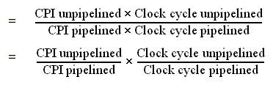
3.3.2 Performance of pipeline with stalls
Recall the speedup formula:

Slide 6

Assumptions for calculation
The ideal CPI on a pipelined processor is almost always 1.
So
Ignore the overhead of pipelining clock cycle.
Pipe stages are ideal balanced.

Slide 7


Clock cycle unpipelined = Clock cycle pipelining
CPl unpipelined = pipeline depth

Slide 8
3.3.3 Structural hazard
Structural hazards
Occurs when two or more instructions want to use the same hardware resource in the same cycle
Causes bubble (stall) in pipelined machines
Overcome by replicating hardware resources
Multiple accesses to the register file
Multiple accesses to memory
some functional unit is not pipelined.
Not fully pipelined functional units

Slide 9
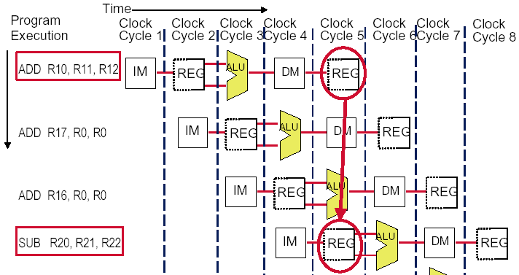
一、Multi access to the register file
Simply insert a stall , speedup will be decreased.
We have resolved it with “ double bump”

Slide 10
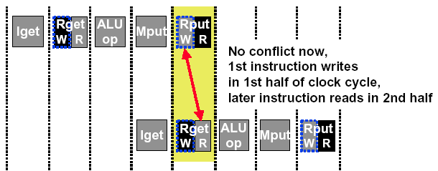
Double Bump Works !

Slide 11
二、Multi access to Single Memory
Time (clock cycles)
I
n
s
t
r.
O
r
d
e
r
Ld/St
Mem
Reg
ALU
Mem
Reg
Instr 1
Mem
Reg
ALU
Mem
Reg
Instr 2
Mem
Reg
ALU
Mem
Reg
Instr 3
Mem
Reg
ALU
Mem
Reg
Insert stall
provide another memory port
split instruction memory and data memory
use instruction buffer

Slide 12
Insert Stall
Time (clock cycles)
I
n
s
t
r.
O
r
d
e
r
Ld/St
Mem
Reg
ALU
Mem
Reg
Instr 1
Mem
Reg
ALU
Mem
Reg
Instr 2
Mem
Reg
ALU
Mem
Reg
Stall
Bubble
Bubble
Bubble
Bubble
Bubble
Instr 3
Mem
Reg
ALU
Mem
Reg

Slide 13
Split instruction and data memory
Time (clock cycles)
I
n
s
t
r.
O
r
d
e
r
Ld/St
IM
Reg
ALU
DM
Reg
Instr 1
IM
Reg
ALU
DM
Reg
Instr 2
IM
Reg
ALU
DM
Reg
Instr 3
IM
Reg
ALU
DM
Reg
Split instruction and data memory / multiple memory port / instruction buffer means:
fetch the instruction and data inference using different hardware resources.

Slide 14
三、Not fully pipelined function unit

Slide 15
四、Why allow machine with structural hazard ?
To reduce cost .
i.e. adding split caches, requires twice the memory bandwidth.
also fully pipelined floating point units costs lots of gates.
It is not worth the cost if the hazard does not occur very often.
To reduce latency of the unit.
Making functional units pipelined adds delay
(pipeline overhead -> registers.)
An unpipelined version may require fewer clocks per operation.
Reducing latency has other performance benefits, as we will see.

Slide 16
Example: impact of structural hazard to performance
Example
Many machines have unpipelined float-point multiplier.
The function unit time of FP multiplier is 6 clock cycles
FP multiply has a frequency of 14% in a SPECfp benchmark
Will the structural hzard have a large performance impact on the SPECfp benchmark?

Slide 17
Answer to the example
In the best case: FP multiplies are distributed uniformly.
There is one multiply in every 7 clock. 1/(14%)
Then there will be no structural hazard,then there is no performance penalty at all.
In the worst case: the multiplies are all clustered with no intervening instructions.
Then every multiply instruction have to stall 5 clock cycles to wait for the multiplier be released.
The CPI will increase 70% to 1.7, if the ideal CPI is 1.
Experiment result:
This structural hazard increase execution time by less than 3%.

Slide 18
3.3.4 Pipelining Data Hazards
Taxonomy of Hazards
Structural hazards
These are conflicts over hardware resources.
Data hazards
Instruction depends on result of prior computation which is not ready (computed or stored) yet
Control hazards
branch condition and the branch PC are not available in time to fetch an instruction on the next clock

Slide 19
一、Data hazard
Data hazards occur when the pipeline changes the order of read/write accesses to operands comparing with that in sequential executing .
Let’s see an Example
DADD R1, R1, R3
DSUB R4, R1, R5
AND R6, R1, R7
OR R8, R1, R9
XOR R10, R1, R11

Slide 20
Data hazard
Basic structure
An instruction in flight wants to use a data value that’s not “done” yet
“Done” means “it’s been computed” and “it’s located where I would normally expect to go look in the pipe hardware to find it”
Basic cause
You are used to assuming a purely sequential model of instruction execution
Instruction N finishes before instruction N+k, for k >= 1
There are dependencies now between “nearby” instructions (“near” in sequential order of fetch from memory)
Consequence
Data hazards -- instructions want data values that are not done yet, or in the right place yet

Slide 21
Coping with data hazards:example

Slide 22
二、Somecases “Double Bump” can do !

Slide 23
三、Proposed solution— STALL
Proposed solution
Don’t let them overlap like this…?
Mechanics
Don’t let the instruction flow through the pipe
In particular, don’t let it WRITE any bits anywhere in the pipe hardware that represents REAL CPU state (e.g., register file, memory)
Let the instruction wait until the hazard resolved.
Name for this operation: PIPELINE STALL

Slide 24
How do we stall ? ——Insert nop by compiler
Bubble
Bubble
Bubble
Bubble
Bubble
Bubble
Bubble
Bubble
Bubble

Slide 25
How do we stall? ——Add hardware Interlock !
Add extra hardware to detect stall situations
Watches the instruction field bits
Looks for “read versus write” conflicts in particular pipe stages
Basically, a bunch of careful “case logic”
Add extra hardware to push bubbles thru pipe
Actually, relatively easy
Can just let the instruction you want to stall GO FORWARD through the pipe…
…but, TURN OFF the bits that allow any results to get written into the machine state
So, the instruction “executes” (it does the work), but doesn’t “save”

Slide 26
Interlock: insert stalls
Bubble
Bubble
Empty slots in the
pipe called bubbles;
means no real
instruction work
getting saved here

Slide 27
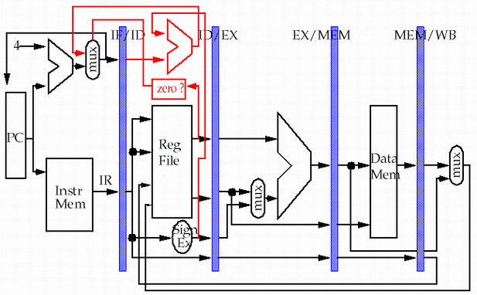
Detect: Data Hazard Logic
Rs =? Rd
Rt =? Rd
between IF/ID and
ID/EX, EX/MEM Stages
Rs
Rt
Rd
Rd
Rd

Slide 28
四、Forwarding
If the result you need does not exist AT ALL yet,
you are out of luck, sorry.
But, what if the result exists, but is not stored back yet?
Instead of stalling until the result is stored back in its “natural” home…
grab the result “on the fly” from “inside” the pipe, and send it to the other instruction (another pipe stage) that wants to use it

Slide 29
Forwarding
Generic name: forwarding ( bypass, short-circuiting)
Instead of waiting to store the result, we forward it immediately (more or less) to the instruction that wants it
Mechanically, we add buses to the datapath to move these values
around, and these buses always “point backwards” in the datapath, from later stages to earlier stages

Slide 30
Forwarding: reduce data hazard stalls
Data may be already computed - just not in the Register File
EX/MEM.ALUoutput → ALU input port
MEM/WB.ALUoutput → ALU input port

Slide 31
Hardware Change for Forwarding
NextPC
ID/EX
EX/MEM
MEM/WR
Registers
mux
ALU
Data
Memory
mux
mux
Immediate
EX/Mem.ALUoutput → ALU input
MEM/WB.ALUoutput → ALU input
MEM/WB.LMD → ALU input

Slide 32
Forwarding path to other input entry
store
load
MEM/WB.LMD → DM input

Slide 33
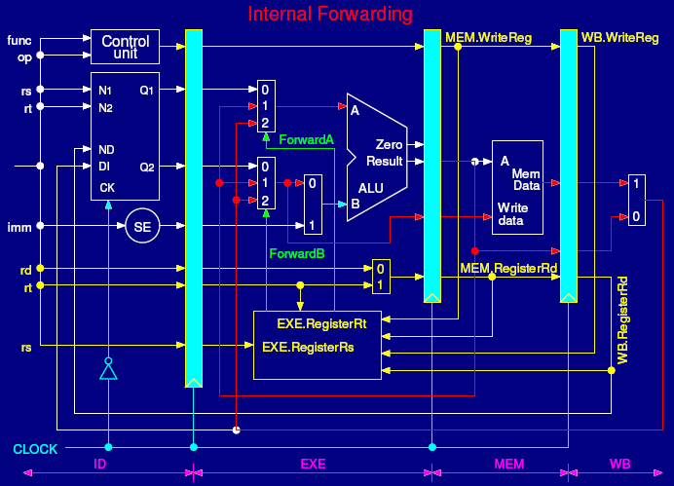

Slide 34
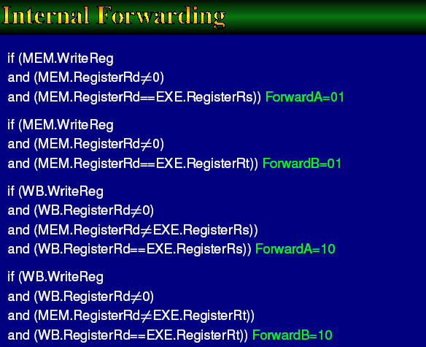

Slide 35
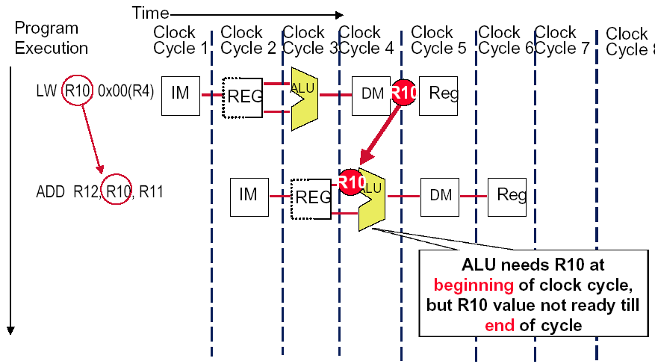
Forwarding isn’t Always availability

Slide 36
So we have to insert stall: Load stall
Time (clock cycles)
I
n
s
t
r.
O
r
d
e
r
lw r1, 0(r2)
Ifetch
Reg
ALU
DMem
Reg
Bubble
sub r4,r1,r6
Ifetch
Reg
ALU
DMem
Reg
Bubble
and r6,r1,r7
Ifetch
Reg
ALU
DMem
Reg
or r8,r1,r9
Bubble
Ifetch
Reg
ALU
DMem

Slide 37
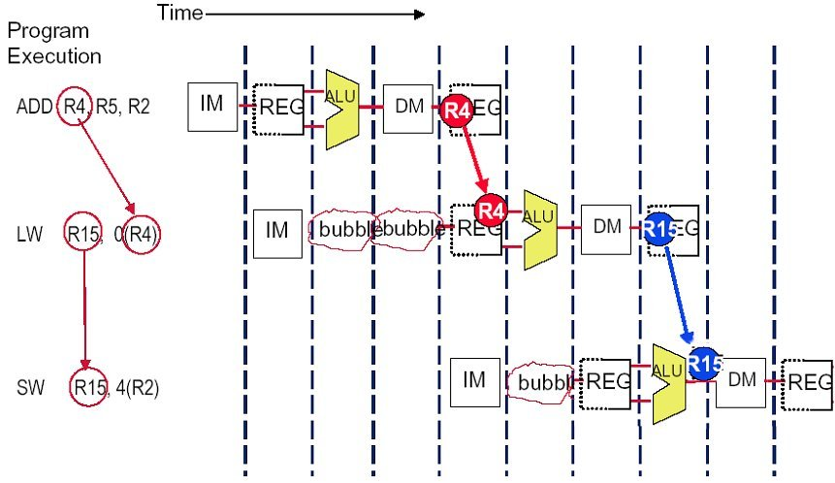
Solution (without forwarding)

Slide 38
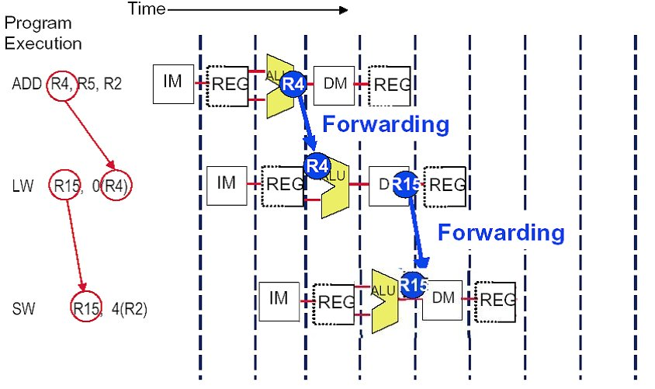
Solution (with forwarding)

Slide 39
The performance influence of load stall
Example
Assume 30% of the instructions are loads.
Half the time, instruction following a load instruction depends on the result of the load.
If hazard causes a single cycle delay, how much faster is the ideal pipeline ?
Answer
CPI = 1+30%×50% ×1=1.15
The performance decrease about 15% due to load stall.

Slide 40
Fraction of load that cause a stall

Slide 41
五、Instruction reordering ——by compiler to avoid load stall
Try producing fast code for
a = b + c;
d = e – f;
assuming a, b, c, d ,e, and f in memory.
Slow code:
LW Rb,b
LW Rc,c
ADD Ra,Rb,Rc
SW a,Ra
LW Re,e
LW Rf,f
SUB Rd,Re,Rf
SW d,Rd
Fast code:
LW Rb,b
LW Rc,c
LW Re,e
ADD Ra,Rb,Rc
LW Rf,f
SW a,Ra
SUB Rd,Re,Rf
SW d,Rd

Slide 42
3.3.5 Pipelining Control Hazards
Taxonomy of Hazards
Structural hazards
These are conflicts over hardware resources.
Data hazards
Instruction depends on result of prior computation which is not ready (computed or stored) yet
OK, we did these, Double Bump, Forwarding path,
software scheduling, otherwise have to stall
Control hazards
branch condition and the branch PC are not available in time to fetch an instruction on the next clock

Slide 43

THANK YOU
THANK YOU

