Slide 1
Team 5
CTIP
고예은 201410373, 김수현 201411266, 김아름 201411268
ALLPPT.com _ Free PowerPoint Templates, Diagrams and Charts

Slide 2
Table of Contents
CTIP
IDE
Unit Test
Build

Slide 3
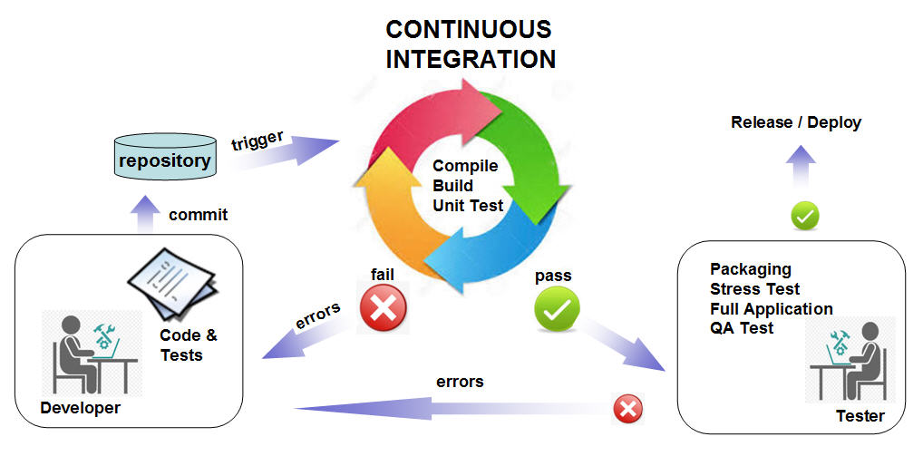
What is CTIP
Continuous Test & Integration Platform
http://www.imperas.com/continuous-integration-using-jenkins-and-virtual-platforms
Notes:
Ctip 필요성
우리가 하려는 것의 목표를 뚜렷히 하고 시작한다.

Slide 4
IDE (Integrated development environment)
Comparison
- Widest used IDE
- Designed to fit the needs of large development projects
- Database support (Java DB, MySQL, PostgreSQL, and Oracle)
- Support for a variety of languages
- enterprise edition of IntelliJ
Notes:
Plugins (Subversive, Eclipse Color Theme, Android Dev…) – eclipse
- User written Plugins (947 + 55) - IJ

Slide 5
IDE
Install Eclipse in Windows 10
Install JDK
Java Runtime Environment(JRE)
The Java Development Kit
interpreter/loader (java)
compiler (javac)
Environment variable
Install Eclipse
PATH
specifying a set of directories

Slide 6
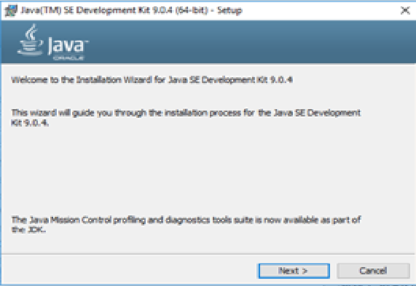
IDE
Install JDK(Java Development Kit)
http://www.oracle.com/technetwork/java/javase/downloads/index.html
Download
Install
Check!

Slide 7
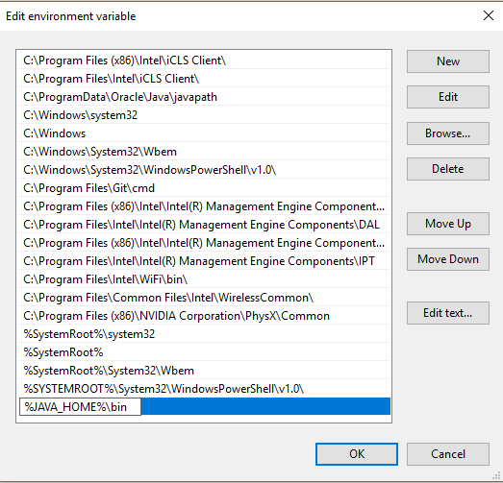
IDE
System Environment
Edit the system environment variables
Environment Variables
System variables
Path

Slide 8
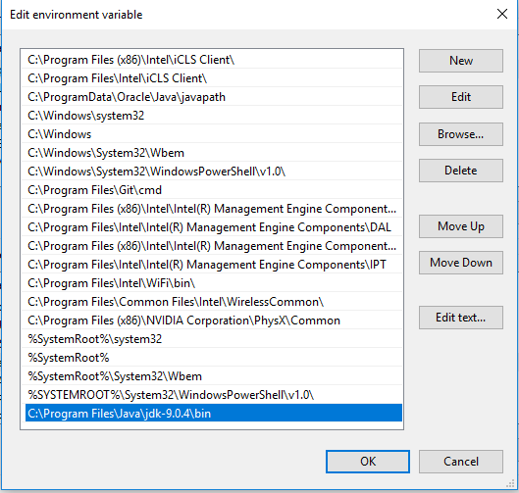
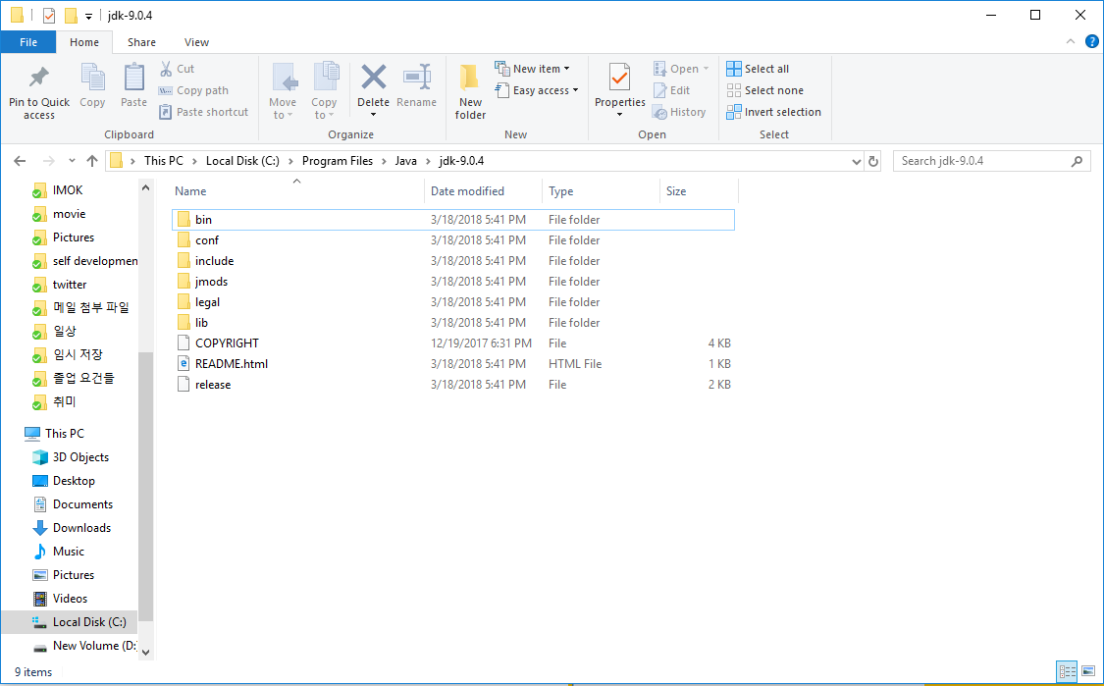
IDE
System Environment
Edit environment variables
Add path “C:\...\Java\jdk…\bin”
cmd “javac –version”

Slide 9
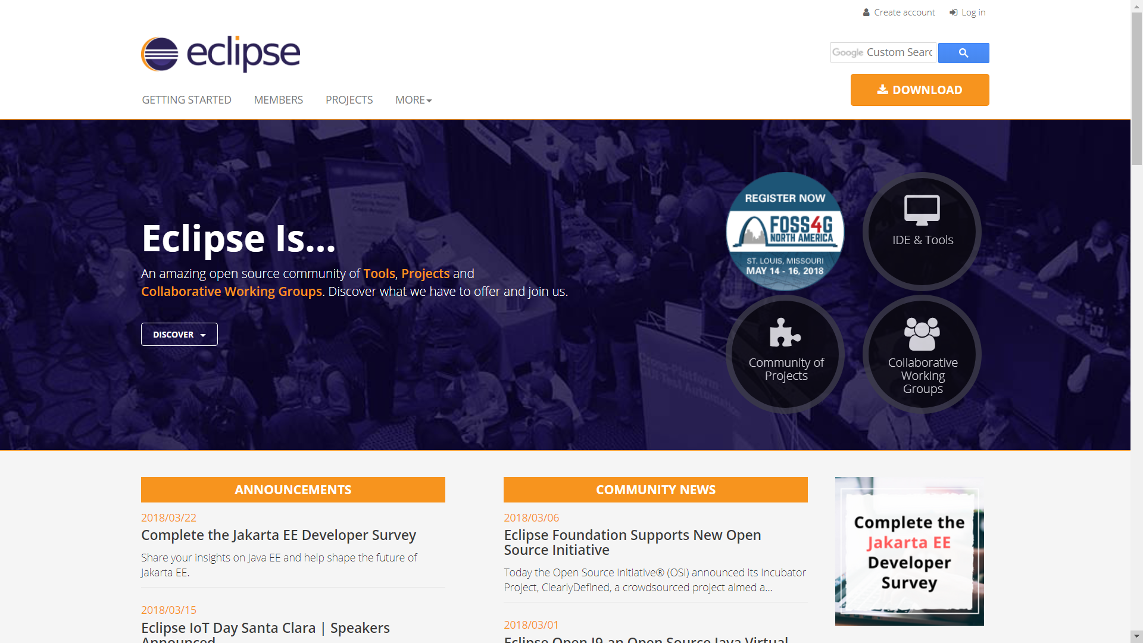
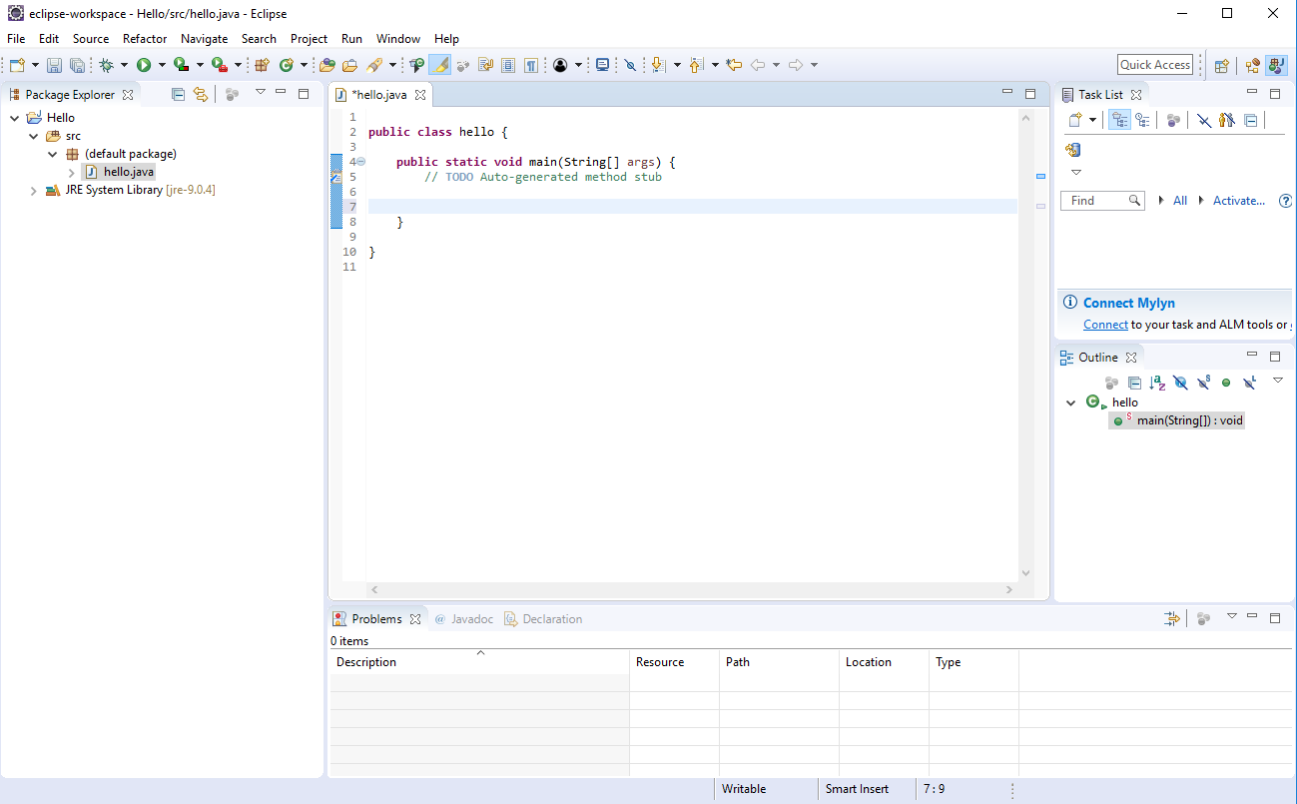
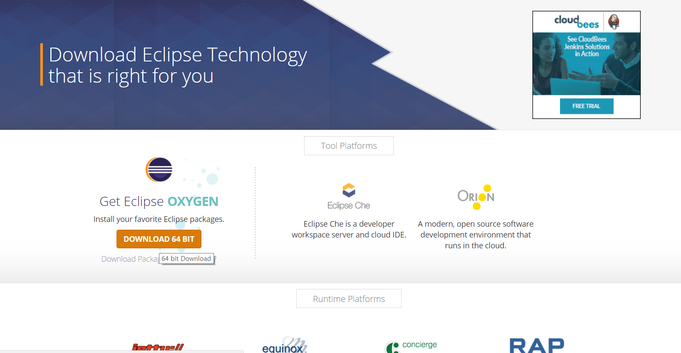
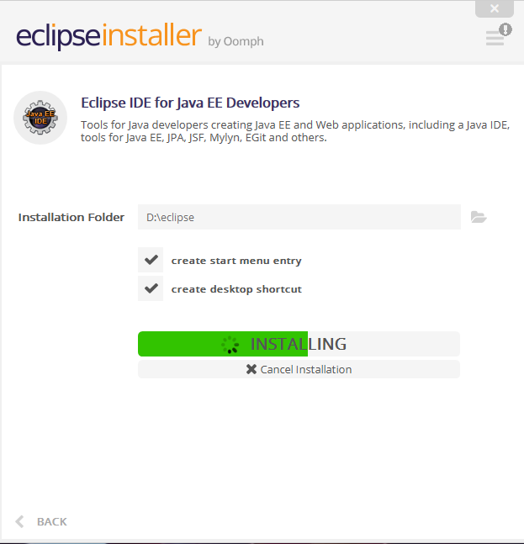
IDE
Install Eclipse
https://www.eclipse.org/
Download
Install
Check!
Notes:
Enterprise Edition

Slide 10
Install

