Slide 1
Digital Portfolio
STUDENT NAME: SHAHIDHA AFROSE.A
REGISTER NO: 212401031
NMID: asunm161212401031
DEPARTMENT: BCA
COLLEGE: PRINCE SHRI VENKATESHWARA ARTS & SCIENCE COLLEGE

Slide 2
PROJECT TITLE:
EXPENSE
TRACKER
(WITH CHARTS)

Slide 3


AGENDA
Problem Statement
End Users
Tools and Technologies
Project Overview
Portfolio design and Layout
Features and Functionality
Results and Screenshots
Conclusion
Github Link
3/21/2024 Annual Review

Slide 4

PROBLEM STATEMENT:
The task is to develop a web-based application that enables users to efficiently track their daily expenses and incomes. The system should allow users to input financial transactions with details such as amount, date, and category. It must provide an easy-to-use interface for managing and categorizing expenses to help users understand their spending habits. The application should also generate clear, visual reports and charts to offer insights into income versus expenditure trends, helping users make informed budgeting decisions and maintain financial control.

Slide 5

PROJECT OVERVIEW:
The Expense Tracker project is a web-based application designed to help users efficiently manage their personal finances by tracking daily income and expenses. It provides users with an intuitive interface to add, edit, and categorize their financial transactions. The application offers features such as summarizing expenses, visualizing spending patterns through charts, and generating reports to support better budgeting decisions. By automating and simplifying expense management, the project aims to reduce the errors and time consumption typically associated with manual tracking and to empower users to maintain clearer control over their financial health.

Slide 6
WHO ARE THE END USERS?
The end users of the Expense Tracker project are individuals who want to manage their personal finances more effectively. This includes students, working professionals, freelancers, and homemakers who need a simple and efficient way to track daily income and expenses. These users seek an intuitive tool to help them categorize spending, monitor budgets, and gain insights into their financial habits to make informed decisions. Additionally, small business owners or entrepreneurs who want to keep a close eye on operational costs and personal spending can benefit from this application. Overall, the project targets anyone looking for a user-friendly solution to simplify financial management and improve money control.

Slide 7
TOOLS AND TECHNIQUES:
Tools:
Front-End Technologies (HTML, CSS, JavaScript)
Front-End Frameworks (React.js, Vue.js)
Data Visualization Libraries (Chart.js, D3.js)
Storage Solutions (LocalStorage, IndexedDB)
Version Control Systems (Git, GitHub)
Development Environments (VS Code, IDEs)
Techniques:
Responsive Design
Form Handling and Validation
State Management
Data Visualization
CRUD Operations
User Experience (UX) Design

Slide 8
POTFOLIO DESIGN AND LAYOUT:
1. Project Title and Introduction
Clear project name (e.g., "Expense Tracker")
Brief one-liner summary about the project purpose
2. Problem Statement
Concise paragraph describing the financial tracking problem you aim to solve
3. Project Overview
Summary of key features and functionalities offered by the application
4. Tools and Technologies Used
List of front-end technologies, frameworks, and libraries employed
5. Screenshots and Visuals
Multiple clean screenshots showing the UI design (landing page, dashboard, form for adding expenses, charts)
Optionally, embed a short demo video or GIF showcasing key interactions
6. Features Highlight
Bullet points or icon-based highlight of main features like:
Expense input with categories
Visual expense reports and charts
Responsive design for mobile and desktop
7. Code and Deployment Links
Links to GitHub repository and, if deployed, live demo URL
8. Challenges and Learning
Short paragraph about challenges faced and key takeaways from the project
9. Call to Action
Invitation to explore the project source or contact for collaboration
8

Slide 9
FEATURES AND FUNCTIONALITY
Add, Edit, and Delete Expenses: Users can easily input, modify, or remove their financial transactions with detailed information like amount, date, and category.
Categorization of Expenses: Transactions are categorized into types such as food, transportation, bills, entertainment, etc., enabling better organization and analysis.
Budget Management: Users can set weekly or monthly budgets and track their spending against these limits to avoid overspending.
Visual Reports and Charts: Interactive dashboards display spending patterns and summaries using charts (pie charts, bar graphs), giving insights into income and expenses.
Expense Filtering and Search: Users can filter expenses by date, category, or amount for easy retrieval and tracking.
Data Storage and Persistence: Expenses are stored locally (using LocalStorage or IndexedDB) or synced with cloud storage to safeguard data and allow access across sessions.
Responsive Design: The application works seamlessly on different devices and screen sizes, including mobiles and desktops.
User-friendly Interface: Simple and clean UI for quick entry and easy navigation.
Export Options: Ability to export expense data and reports in formats like CSV or PDF for record-keeping or sharing.

Slide 10
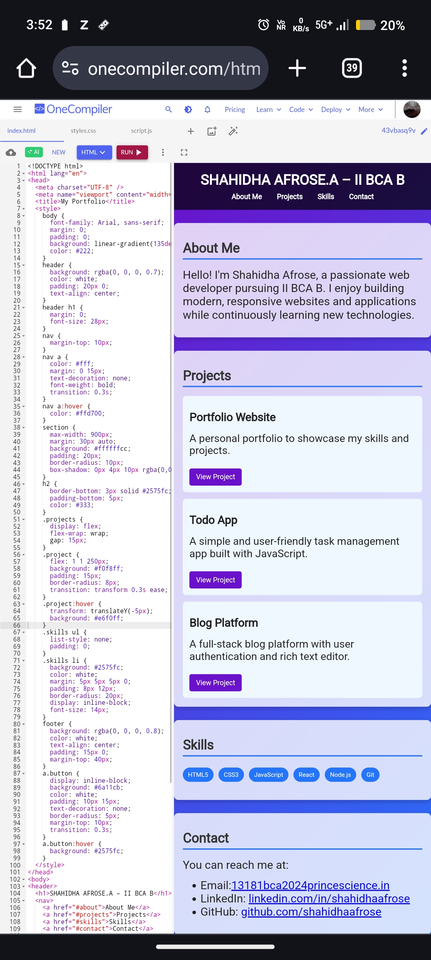
RESULTS AND SCREENSHOTS
10

Slide 11
CONCLUSION:
The Expense Tracker project successfully addresses the challenge of managing personal finances by providing a simple, intuitive tool to monitor daily income and expenses. It eliminates the errors and inefficiencies of manual tracking by automating the recording, categorization, and visualization of financial data. Through its user-friendly interface and insightful reports, the application empowers users to make informed budgeting decisions, control their spending habits, and improve their overall financial health. This project demonstrates the practical application of front-end development skills while delivering a valuable solution that meets a common real-world need.
11

