Slide 1
For reference
Method of analysis in the “Journey Map”
*ネット・プロモーター®、ネット・プロモーター・システム®、ネット・プロモーター・スコア®及び、NPS®は、
ベイン・アンド・カンパニー、フレッド・ライクヘルド、サトメトリックス・システムズの登録商標です。

Slide 2
Questionnaire design
With the following questionnaire design, you would be able to use EmotionTech system to analyze your customer journey.
NPS
How likely is it that you would recommend “●●●” to a friend or a colleague? （Using a 0-10 scale）
Important factors in
CX
Based on your experience in “●●●”, how would you evaluate the following items?
（Using 3/5/7 satisfaction scale）
Neither satisfied nor dissatisfied
Dissatisfied
Slightly dissatisfied
Slightly satisfied
Satisfied
○
⦿
○
○
○
Before entering the restaurant
○
⦿
○
○
○
When selecting dishes
○
○
⦿
When ordering food
○
○
⦿
When paying the bill
○
○
○
○
○
○
○
⦿
Staff overall services
○

Slide 3
Multiple regression (Type 1)
▶For a given result (response = NPS in this case), this analysis shows which of the multiple factors (predictors = CX in this case) significantly influences the result and to what extent this result is affected.
*数量化Ⅰ類…重回帰分析と同様、多変量解析の一種。重回帰分析は「金額」「人数」などの量的変数を説明変数にするのに対し、 数量化Ⅰ類は「満足／不満」などの質的変数を説明変数にする
Predictor A
Experience before entering the restaurant
Predictor B
Response
Experience when selecting dishes
NPS
(Recommendation level)
Predictor C
Experience when ordering food
Predictor D
Experience when paying the bill
Degree of impact
・・・

Slide 4




The “degree of impact” in multiple regression
▶When a CX’s satisfaction level has the same data pattern as the NPS (recommendation level), i.e. the satisfaction level and NPS move in tandem, we would conclude that the CX has strong impact on NPS (recommendation level).
Example: Starbucks
◎：Satisfied
○：Slightly satisfied
△：Slightly dissatisfied
×：Dissatisfied
CX | Absolutely not recommended | Not recommended | Recommended | Highly recommended | Impact on recommendation level
Before entering the restaurant | △ | △ | ○ | ◎ | Middle
When selecting dishes | × | △ | ○ | ◎ | High
When ordering food | × | × | × | △ | Low
When paying the bill | × | △ | ○ | ○ | Middle
Staff overall services | △ | ○ | △ | ○ | Low

Slide 5
The “degree of impact” in multiple regression
▶This is an example with actual data.
▶A strong relationship(correlation) exists when a CX’s satisfaction level moves in one direction, the NPS moves significantly in the same or opposite direction.
Strong relationship between the CX’s satisfaction and NPS
＝High impact
Weak relationship between the CX’s satisfaction and NPS
＝Low impact
No relationship between the CX’s and NPS
＝No impact
NPS
CX’s satisfaction level

Slide 6
For reference
Details of calculation in the “Journey Map”
*ネット・プロモーター®、ネット・プロモーター・システム®、ネット・プロモーター・スコア®及び、NPS®は、
ベイン・アンド・カンパニー、フレッド・ライクヘルド、サトメトリックス・システムズの登録商標です。

Slide 7
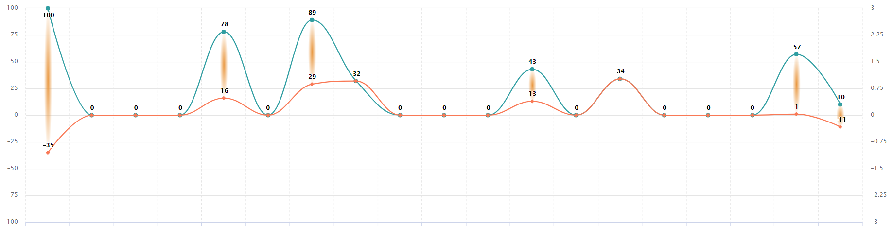
How to read journey map?
Which factors are important?
Which factor should be prioritized for improvement?
Which factors do they satisfy/dissatisfy? (Current situation)
Experience 1
Experience 2
Experience 3
Experience4
Experience 5
Experience 6
Experience 7
Experience 8
Experience 9
Experience 10
Experience 11
Experience 12
Experience 13
Experience 14
Experience 15
Experience 16
Experience 17
Experience 18
Experience 19
 | Meaning
Which factors are important? | The larger the value, the greater the impact on Net Promoter Score (NPS). A value of 0 indicates that there is no impact on the score.
Which factors do they satisfy/dissatisfy? | If the value is higher than 0, it indicates that, in average, people are satisfied with that factor. On the other hand, a lower than 0 value indicates that people are generally dissatisfied.
Which factors should be prioritized for improvement? | The higher the value, the more efficient at improving NPS.

Slide 8
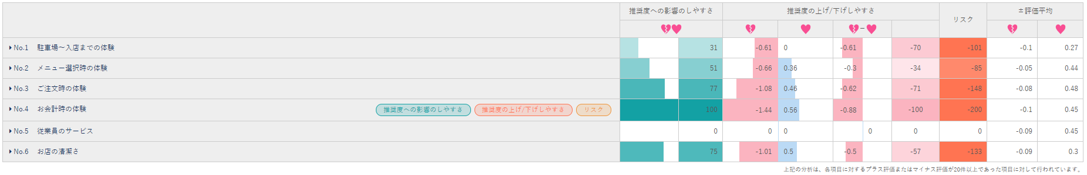
Calculations in the journey map Trend
③
④
①
②
⑤
⑥
⑦
No. | Items | Description
① | Tendency of lowering NPS | Multiple regression analysis with the minus side of the data Example: If a person is unsatisfied with “the experience from the parking lot to the store”, his/her NPS will decrease by 0.61 points.
② | Tendency of raising NPS | Multiple regression analysis with the plus side of the data Example: If a person is satisfied with “the experience when selecting dishes”, his/her NPS will increase by 0.36 points.
③ | Tendency of influencing NPS | The sum of absolute values of ① and ②
④ | Tendency of influencing NPS ※Index | Converting the numbers in ③ into index. The largest number in ③ becomes 100. ※These numbers is transformed into the green curve in the journey map.
⑤ | Difference between ease of lowering and raising NPS | Sum of ① and ②
⑥ | Tendency of raising/lowering NPS | Converting the numbers in ⑤ into index. The largest number in ⑤ becomes 100. ※These numbers is transformed into the orange curve in the journey map.
⑦ | Potential risk | Difference between ④ and ⑥ ※This is the potential risk of this journey.

Slide 9
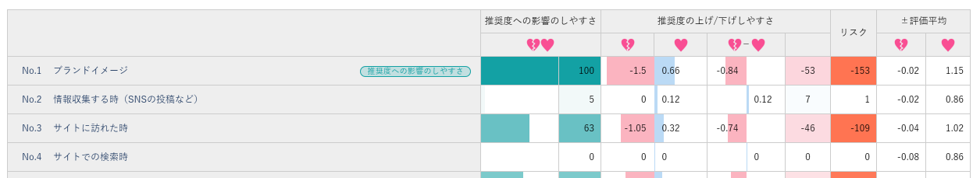

Ease of raising/lowering NPS
①
⑤
②
④
③
①
②
③
④
⑤
When the customer experience rating is lower, the NPS decreases significantly.
When the customer experience rating is lower, the NPS slightly decreases.
No positive/negative relationship between CX experience and NPS
When the customer experience rating is higher, the NPS slightly increases.
When the customer experience rating is higher, the NPS increases significantly.
10点
推奨度平均
0点
Very ldissatisfied
Dissatisfied
Slightly dissatisfied
Neutral*
Very ldissatisfied
Dissatisfied
Slightly dissatisfied
Neutral*
Neutral*
Slightly satisfied
Satisfied
Very satisfied
Neutral*
Slightly satisfied
Satisfied
Very satisfied
*その他の評価…「影響しなかった」および対極の各段階の評価
Notes:
このバーの幅は
ややプラスに影響した と回答した人が、
一段上がって、プラスに影響した と回答したときの
推奨度平均の上り幅になります
つまり、1改善したときの推奨度平均の上り幅となり、
バーの幅が長いほど傾斜が大きくなり、推奨度へ与える影響が大きくなります。

Slide 10
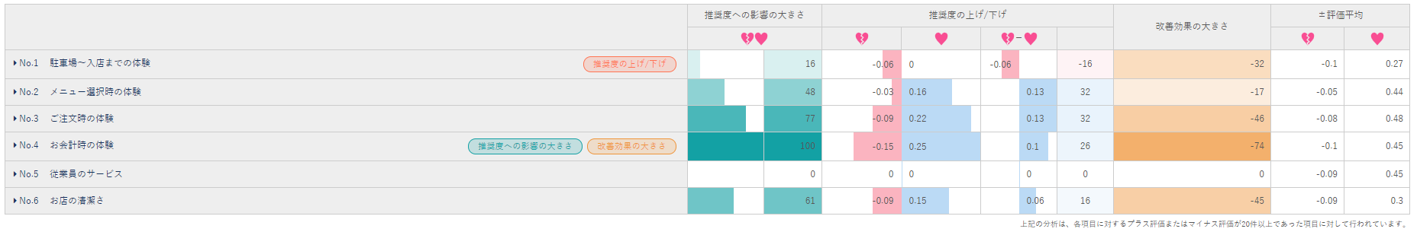
Calculations in journey map Actual situation
⑤
④
③
④
⑦
⑧
⑨
①
②
No. | Items | Description
① | Average CX points（minus） | Taking an average of the minus side of the data ※（For 5-point scale）Taking the data between -2 and０
② | Average CX points（plus） | Taking an average of the plus side of the data ※ (For 5-point scale）Taking the data between +2 and０
③ | Actual NPS being reduced | Tendency of lowering NPS multiplies ① Example： “Experience when selecting dishes” lowers the NPS by 0.03 points.
④ | Actual NPS being improved | Tendency of raising NPS multiplies ②のプラス平均を掛け合わせた数値 Example： “Experience when selecting dishes” raises the NPS by 0.16 points.
⑤ | Impact on NPS | The sum of the absolute values of ③ and ④
⑥ | Impact on NPS ※Index | Converting the numbers in ⑤ into index. The largest number in ⑤ becomes 100. ※These numbers is transformed into the green curve in the journey map.
⑦ | Increase/decrease of NPS | Sum of ③ and ④
⑧ | Increase/decrease of NPS ※Index | Converting the numbers in ⑦ into index. The largest number in ⑦ becomes 100. ※These numbers is transformed into the orange curve in the journey map.
⑨ | Effectiveness of improvement | Difference between ⑧ and ⑥ ※This is the gap.
＜Example: 5-point scale＞
Satisfied・・・＋2
Slightly satisfied・・・＋1
Not satisfied nor dissatisfied・・・0
Slightly dissatisfied・・・‐1
Dissatisfied・・・－2
Notes:
①②の「評価平均（マイナス・プラス）」は
体験の選択肢をスコア化した時の、
マイナス影響とプラス影響のそれぞれの平均値となります。
計算方法はマイナス回答だけでスコア化した、 -３～0とつけた回答の合計÷全回答者数
③推奨度の引き下げ と ④推奨度の押し上げは、
①②の「評価平均（マイナス・プラス）」に
傾向の際に利用した重回帰分析（数量化Ⅰ類）で出たマイナスとプラスの値を掛け合わせます。
（傾向に使用した①②）
これにより、実際に体験した人数の割合が加味されることになり、実際の影響度を見ることができます。
次に⑤推奨度への影響の大きさは
③と④を絶対値にして合わせたものになり
⑤の数値が大きいものを100として、その他の体験に割合をつけます。
これが緑の線の
良くも悪くも推奨度に影響を与えているポイントになります

Slide 11
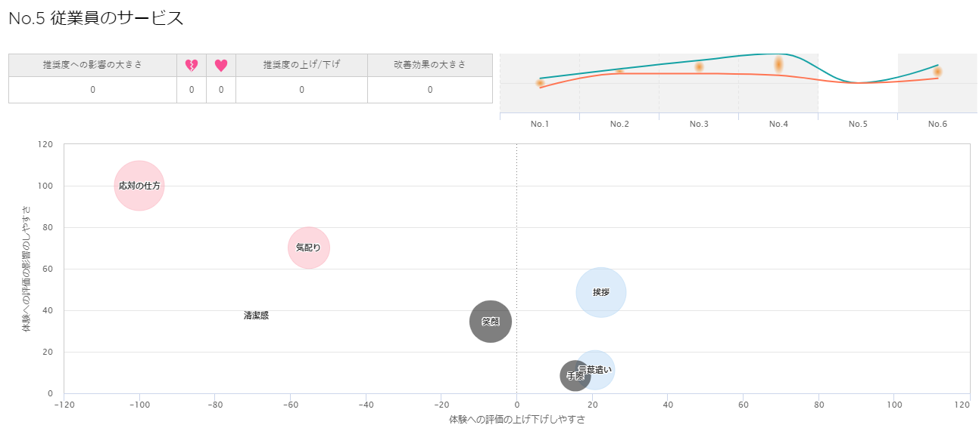
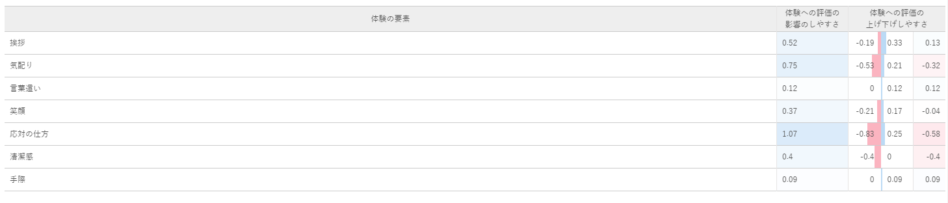
Explanation of mapping① Ex. Staff overall services
Size of the circle: frequency
Impact
How to response
Attentive
Greeting
Feeling of cleanliness
Happy face
Wordings
Skill
Negative experience
Positive experience

Slide 12
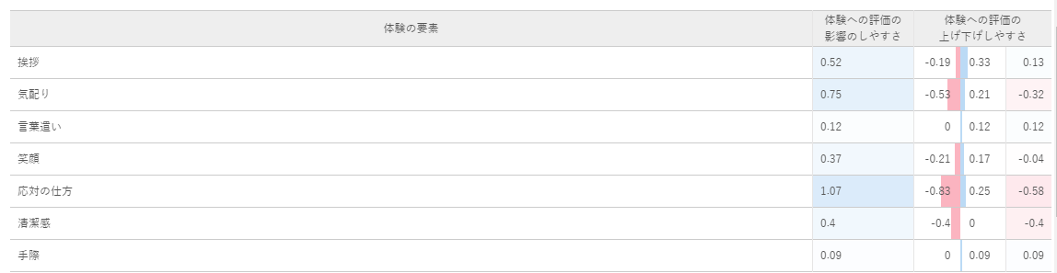
Explanation of mapping② Ex. Staff overall services
Elements in experience (Ex. Staff overall services)
③
①
②
④
Greeting
Attentive
Wordings
Happy face
How to response
Feeling of cleanliness
Skill
No. | Items | Description
① | Tendency of worsening the experience | It shows how much the NPS would decrease with a dissatisfied element. Example: If a person is dissatisfied with the staff overall services and states that “greeting” is the reason behind the dissatisfaction, the NPS decreases by 0.19 points.
② | Tendency of improving the experience | It shows how much the NPS would increase with a satisfied element. Example: If a person is satisfied with the staff overall services and states that “greeting” is the reason behind the satisfaction, the NPS decreases by 0.33 points.
③ | Tendency of making an impact on the experience | The sum of absolute values of ① and ② The higher the value, the bigger the impact it is on the experience.
④ | Difference between the tendency of worsening and improving the experience | Sum of ① and ② ※It decides whether an element is on the left/right hand side in the mapping.

