Slide 1
moose for dcs world setup guides

Slide 2
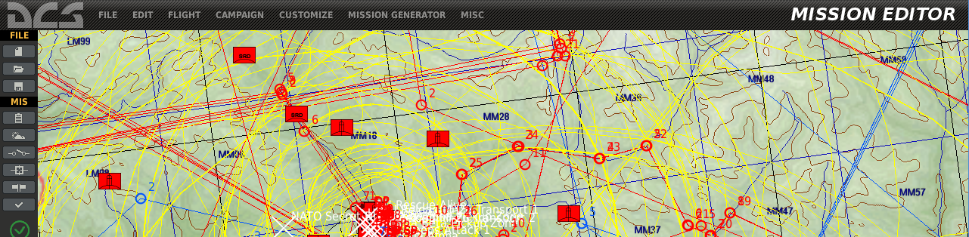
videos explaining how to setup your environment

Slide 3
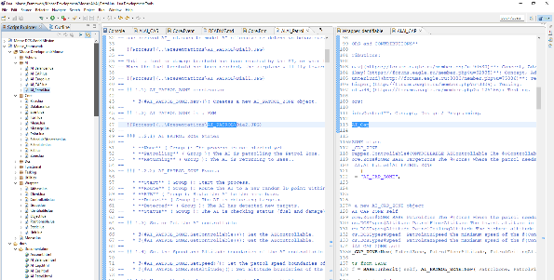
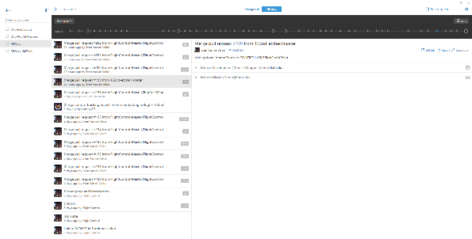
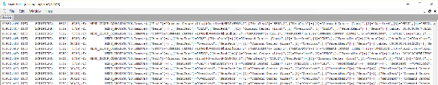
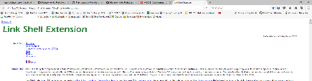

various tools augment the mission design experience
MISSION EDITOR
ECLIPSE ENVIRONMENT
GIT HUB DESKTOP
TOOLS
LOGGING TRAILING
UTILITIES …

Slide 4
ldt setup

Slide 5
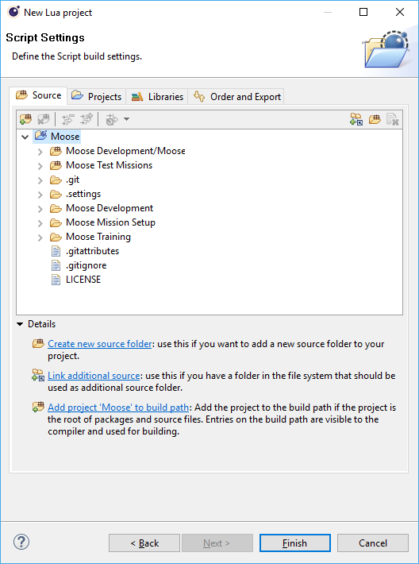
ldt setup

