Slide 1
STUDENT NAME: AJMAL A M
REGISTER NO AND NMID: 212400925 / A3840AD1FF948D488F948FFEA8F33ABD
DEPARTMENT: BCA
COLLEGE: PRINCE SHRI VENKATESWARA ARTS AND SCIENCE COLLEGE

Slide 2
PROJECT TITLE
DIGITAL PORTFOLIO

Slide 3
AGENDA
Problem Statement
Project Overview
End Users
Tools and Technologies
Portfolio design and Layout
Features and Functionality
Results and Screenshots
Conclusion
Github Link

Slide 4
PROBLEM STATEMENT
In today’s digital world, students and professionals need an online platform to present their skills, projects, and contact details. Without a portfolio, it is difficult for recruiters, peers, or collaborators to assess abilities effectively.

Slide 5
PROJECT OVERVIEW
This project is a personal portfolio website for Ajmal A M, a BCA student. It includes sections like About Me, Projects, Skills, and Contact, with smooth navigation, attractive designs, and interactive effects, built using HTML, CSS, and JavaScript.

Slide 6
WHO ARE THE END USERS ?
Students and freshers looking to display their work
Recruiters and employers evaluating skills and projects
Collaborators or peers exploring coding and design capabilities

Slide 7
TOOLS AND TECHNIQUES
Frontend: HTML5, CSS3, JavaScript
Styling: CSS gradients, hover effects, transitions, fade-in animations
Development: VS Code / CodePen
Optional Deployment: GitHub Pages or Netlify

Slide 8
PORTFOLIO DESIGN AND LAYOUT
Header: Name, designation, navigation bar linking to each section
Sections:
About Me → Introduction and academic background
Projects → Cards showing key projects with descriptions and links
Skills → List of technical skills
Contact → Email, LinkedIn, and GitHub links

Slide 9
FEATURES AND FUNCTIONALITY
Smooth scrolling navigation
Responsive grid layout for projects
Fade-in effect on scroll for sections
Hover effects on buttons and project cards
Scroll-to-top button for easy navigation
Organized skills and external contact links

Slide 10
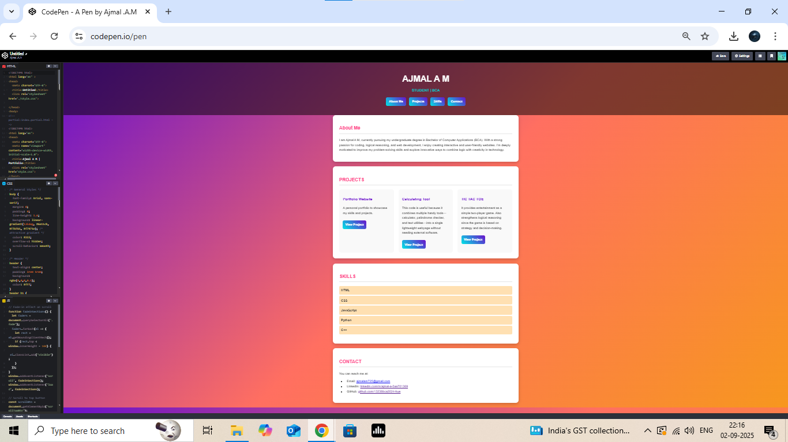
RESULTS AND SCREENSHOTS

Slide 11
CONCLUSION
The portfolio provides a professional online presence for Ajmal A M. It highlights coding, design, and problem-solving skills while offering a foundation for future enhancements like project demos or blog integration.

Slide 12
GITHUB LINK
https://13238bca2024-hue.github.io/TNSDC-FWD-DP-Ajmal-portfolio/

