Slide 1
US Road Accident Analysis Using Data Mining A classification and clustering approach to predict factors influencing accidents

Slide 2
Presented By: Saman Sajid & Faiq Abbasi
Date: 15-12-2024

Slide 3

Problem Description
Problem: Road accidents are a significant public safety issue in the United States, causing injuries, fatalities, and economic losses.
Objective: Analyze road accident data to identify patterns and factors contributing to accidents, such as weather conditions, time of day, and road type.
Importance: The insights gained from this analysis can help in urban planning, traffic management, policy development, and enhancing road safety measures.

Slide 4
Dataset Overview
Dataset: US Accidents Dataset from Kaggle contains over 2.8 million accident records across the U.S. (from February 2016 to March 2023).
Key features include location, weather conditions, accident severity, and timestamps.
Sample Size: 10,000 rows, focusing on 21 key features such as:
Weather, temperature, humidity, visibility, wind speed, and accident location.
Data Pre-processing: Handling missing values through imputation.
Label encoding for categorical variables and Min-Max scaling for numerical data.
One-hot encoding for categorical features.

Slide 5
Data Mining Approach
Chosen Technique: Classification (Random Forest Classifier)
Why Classification?: The problem involves predicting discrete categories, such as weather conditions (e.g., "Clear", "Rainy", etc.).
Why Random Forest?: Handles both numerical and categorical features well. Robust, interpretable, and does not require feature scaling. Provides feature importance insights.
Evaluation: Model evaluated using accuracy score and classification report (precision, recall, F1-score).

Slide 6
Model Implementation
Preprocessing:
Missing values handled by median imputation for numerical columns.
Categorical variables encoded using LabelEncoder and One-Hot Encoding.
Normalization applied to numerical features using Min-Max scaling.
Random Forest Model:
Trained on the preprocessed dataset.
Evaluated using test data, and metrics (accuracy, precision, recall, F1-score) were computed to assess performance.
Dimensionality Reduction:
Applied Principal Component Analysis (PCA) to reduce the feature space and retain 95% of variance for efficient model training.

Slide 7
Model Performance & Key Findings
Model Accuracy:
The Random Forest Classifier achieved an accuracy of [80%].
Key Insights:
Weather conditions significantly affect accident occurrences.
Certain locations (e.g., near airports or specific roads) are more accident-prone.
Time of day (e.g., nighttime or twilight) and weather (e.g., fog or rain) increase accident likelihood.
Feature Importance:
The most significant factors influencing accidents are temperature, visibility, and weather conditions.

Slide 8
Introduction to Clustering
Understanding Clustering
Definition: Clustering is a machine learning technique that groups similar data points together based on their features.
Purpose:
To find hidden patterns in data.
To enable data-driven decision-making.
Types of Clustering Techniques:
K-Means
DBSCAN (Density-Based Spatial Clustering of Applications with Noise)

Slide 9
Why Clustering in U.S. Accident Analysis?
Purpose:
Discover patterns in accident-prone regions.
Analyze severity trends and contributing factors like weather or road conditions.
Identify areas needing improved safety measures.
Benefits:
Helps prioritize resource allocation for accident prevention.
Facilitates better urban planning and infrastructure development.

Slide 10
Data Preparation for Clustering
Selected Features:
Latitude, Longitude: Accident location.
Severity: Level of accidents.
Weather Condition: Contributing factor.
Preprocessing Steps:
Encode categorical features (e.g., weather).
Standardize numerical features for uniform scaling.

Slide 11
K-Means Clustering Analysis
Overview:
Divides data into a fixed number of clusters (e.g., 3).
Groups accidents based on proximity and similarity of features.
Use Case:
Identify high-accident zones (e.g., hotspots).
Cluster visualization by accident location.

Slide 12
DBSCAN Clustering Analysis
Overview:
Density-based technique to find dense regions in data.
Automatically detects noise and outliers.
Use Case:
Capture irregular clusters that K-Means may miss.
Identify isolated accident zones.

Slide 13
Clustering Results and Insights
K-Means:
Highlighted accident-prone urban areas.
Clear differentiation between low, medium, and high accident density regions.
DBSCAN:
Detected outliers, such as rare accident events in remote areas.
Captured natural clusters around highways and urban zones.
Insights:
Strong correlation between severe accidents and certain weather conditions.
Urban zones showed higher accident densities.

Slide 14
GUI Demonstration
Key Features of the GUI:
Input Section: Allows users to input accident dataset.
Model Run Button: Users can run the prediction model based on input data.
Output: The predicted weather condition or accident severity is displayed on the screen.
Visualization: Interactive graphs or maps showing accident hotspots, weather correlations, etc.

Slide 15
Challenges & Solutions
Missing Data: Dealing with large missing values in critical features.
Solution: Used median imputation for numerical columns and the
mode for categorical data.
Dimensionality: High number of features due to one-hot encoding.
Solution: Used PCA for dimensionality reduction, improving model
efficiency.
Model Overfitting: Risk of overfitting due to many features.
Solution: Random Forest’s ensemble approach and PCA reduced
overfitting.
Insights Gained:
Data mining can uncover hidden patterns that inform road safety policies
and traffic management strategies.

Slide 16
Conclusion & Future Work
Conclusion:
Data mining provides powerful tools to analyze and predict factors influencing road accidents.
The Random Forest model offers robust and interpretable results that can guide safety measures.
Future Work:
Further enhance the model with more detailed weather data and real-time accident reporting.
Implement real-time prediction for accident-prone areas based on live data.

Slide 17
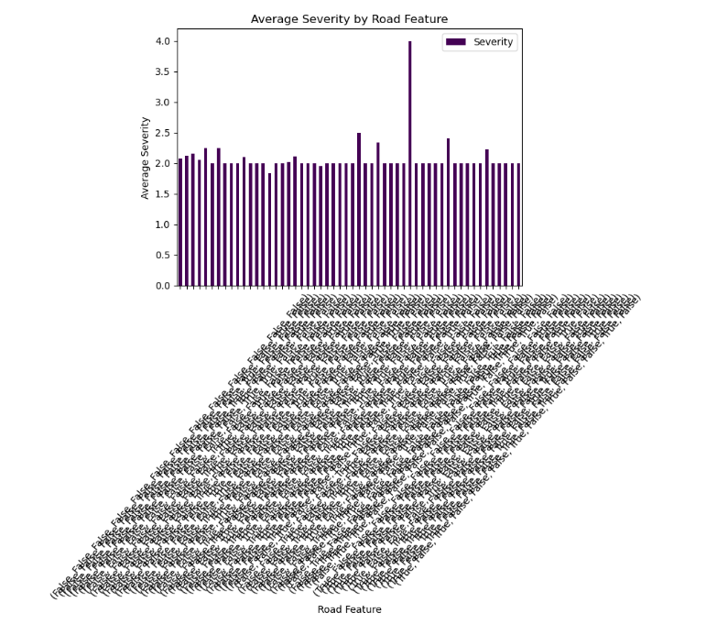
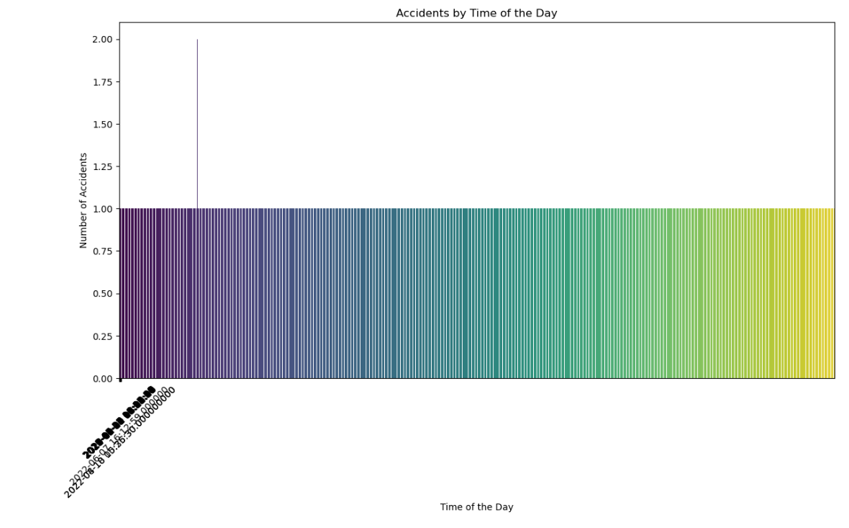
Graphs

Slide 18
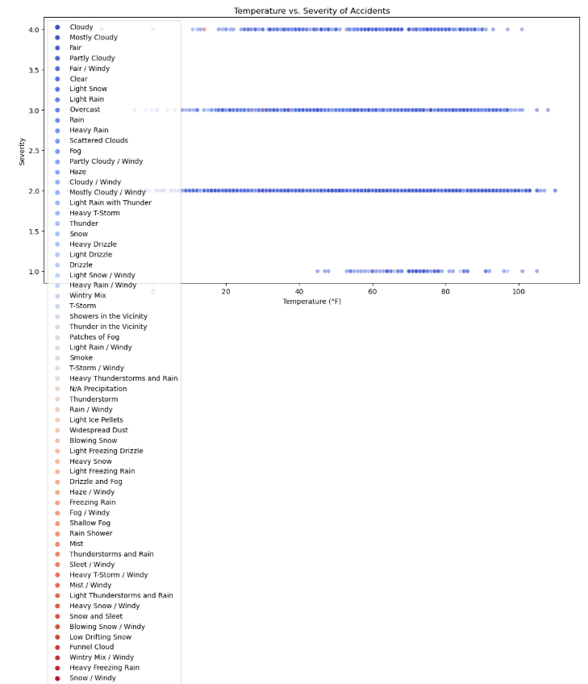

Slide 19
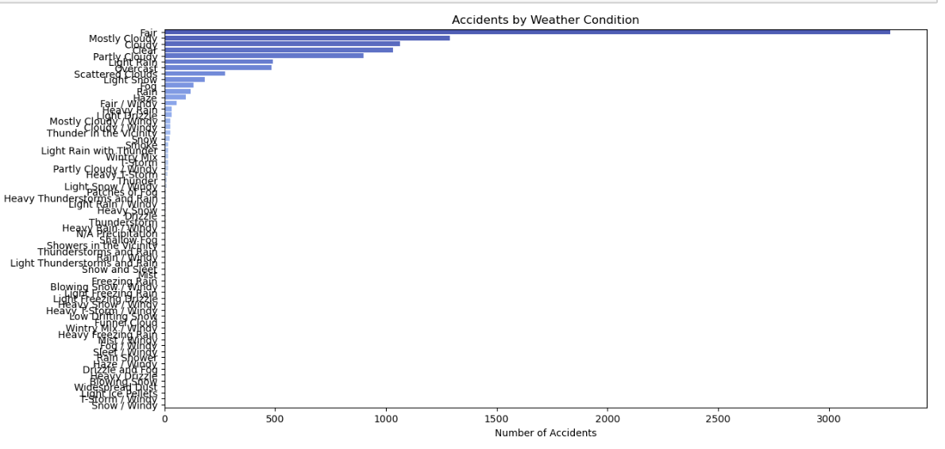

Slide 20
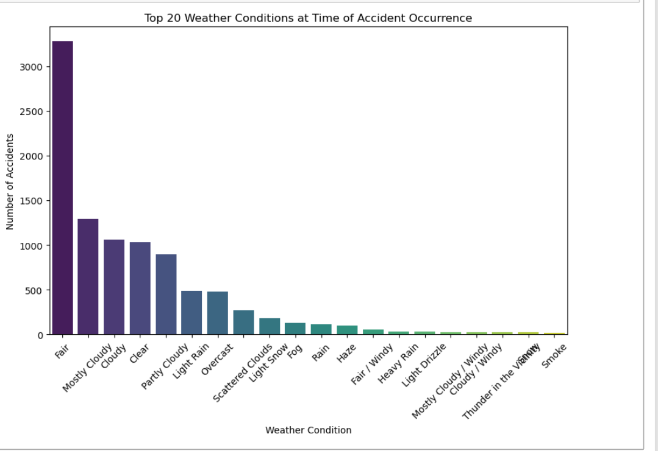

Slide 21
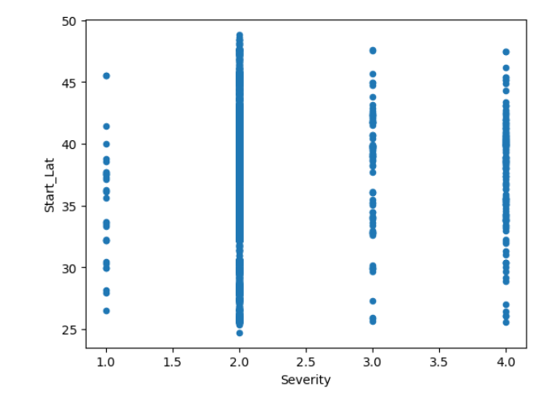

Slide 22
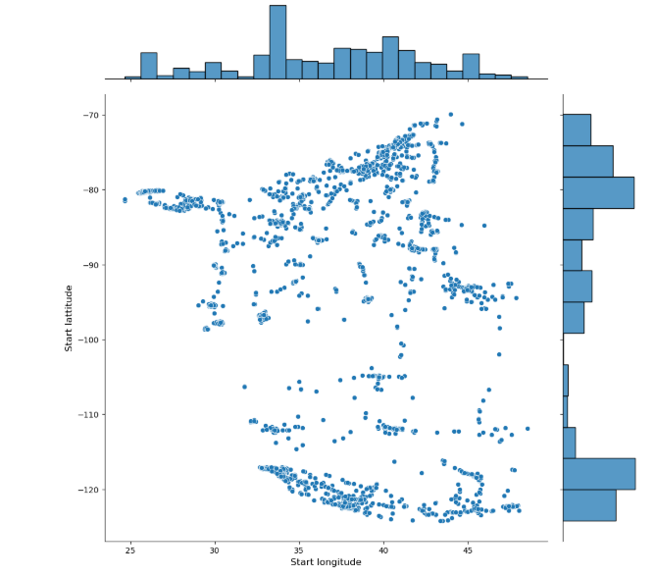

Slide 23
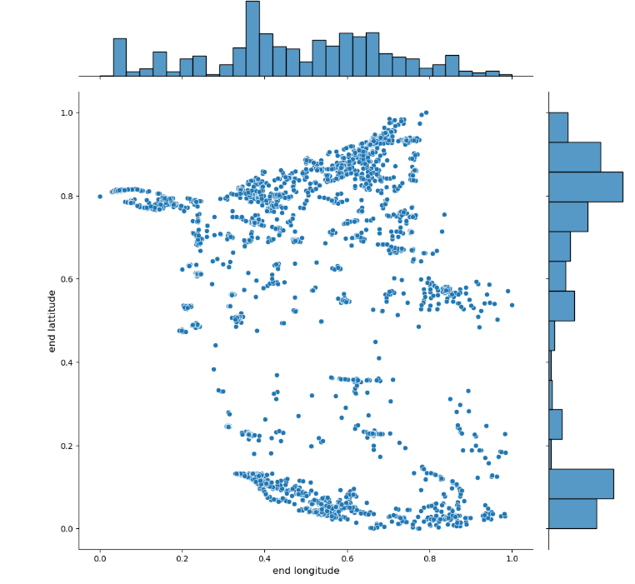

Slide 24
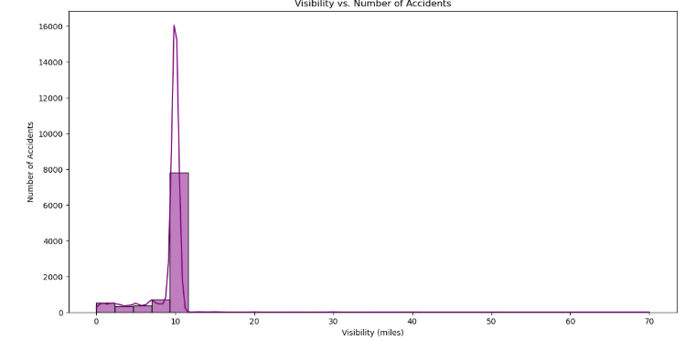

Slide 25
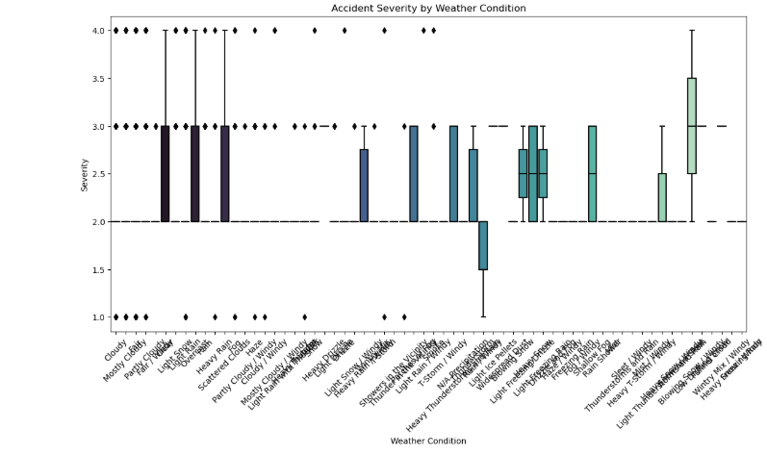

Slide 26
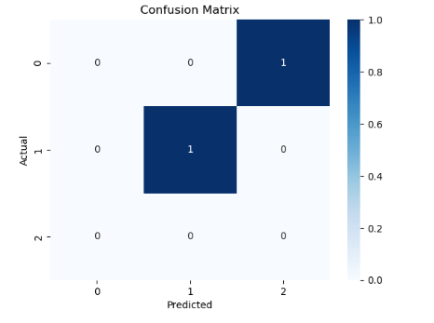

Slide 27
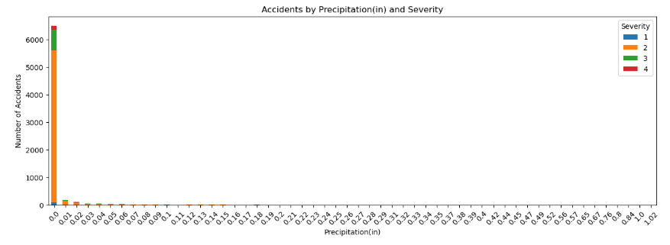

Slide 28
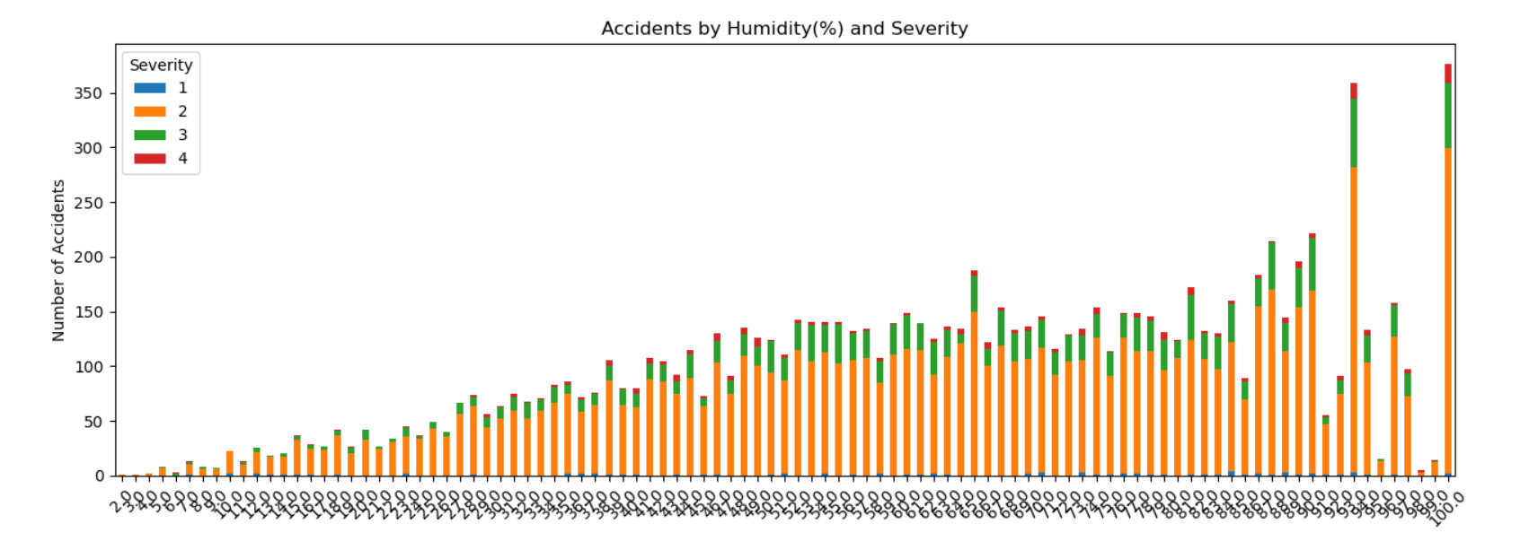

Slide 29
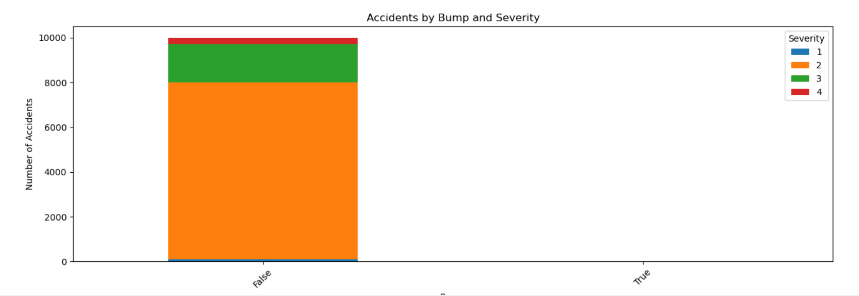

Slide 30
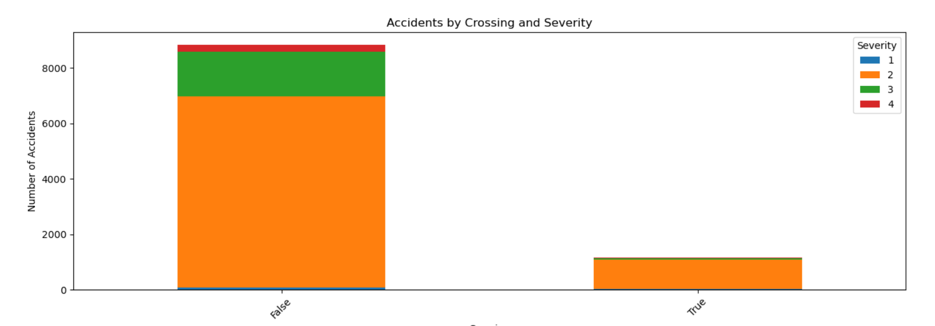

Slide 31
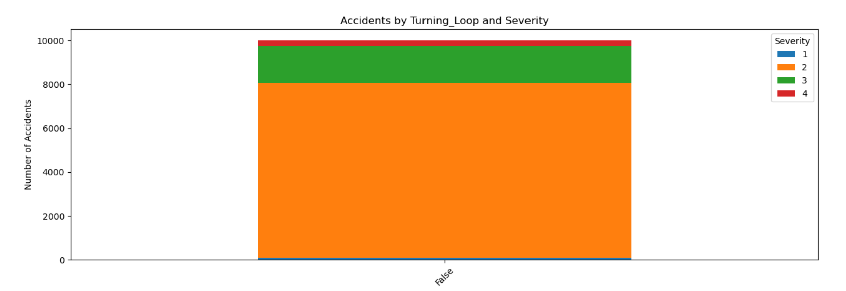

Slide 32
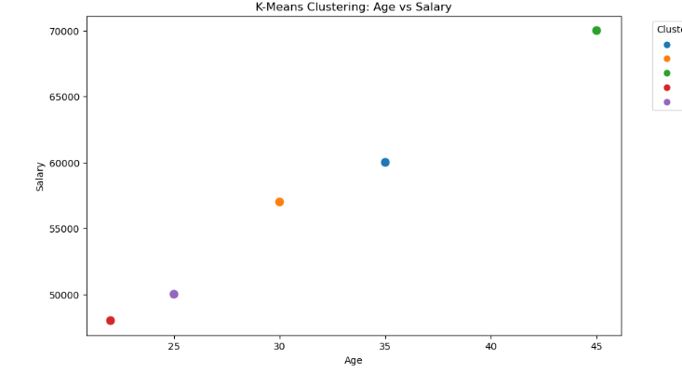

Slide 33
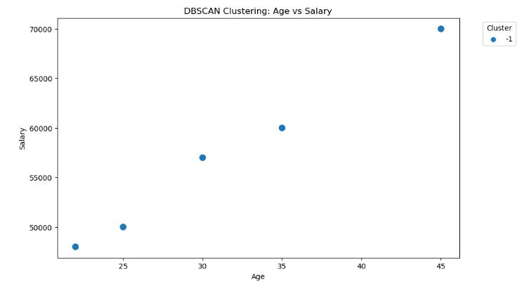

Slide 34

Any Questions???

Slide 35
Thank You!!!

