Slide 1
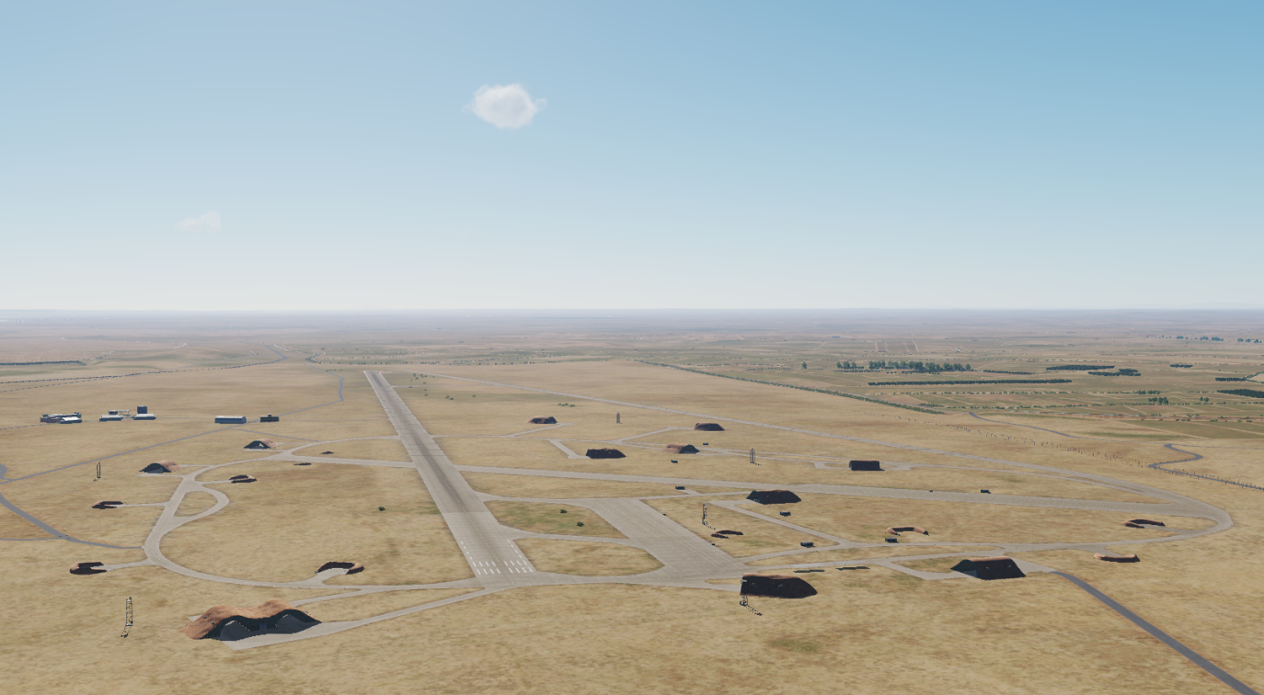
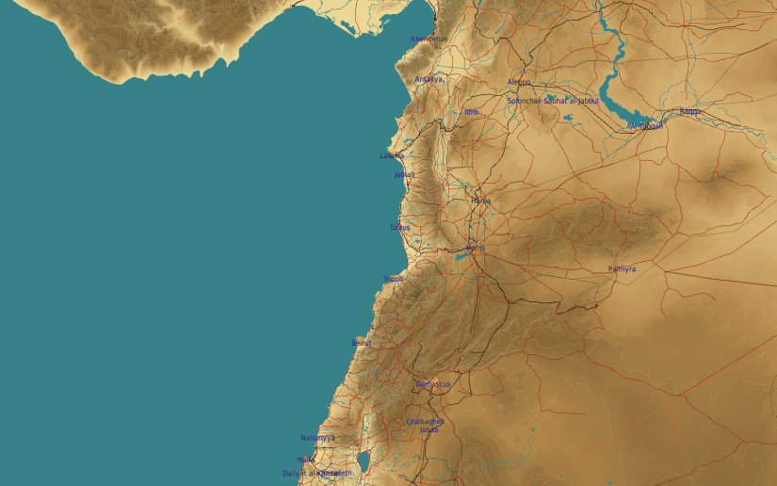
OPARTGT039 Jirah Airbase
N
39
WEAPONEERING
DPI1: Runway, 1x 500 Ibs bomb
DPI2: Runway, 1x 500 Ibs bomb
DPI3: Taxiway, 1x 500 Ibs bomb
DPI4: Fuel storage, 1x 500 Ibs bomb
DPI5: Primary ammo storage, 1x 500 Ibs bomb
DPI6: Secondary ammo storage, 1x 500 Ibs bomb
Jirah Airbase: The target complex is supported by 1 fuel storages and 2 ammo storages.
EFFECTS:
Runway: Hits on runway and taxiway will put the airbase out of action for 48 hours
Ammo storage: Hits on both storages will put the airbase out of action for 96 hours
Fuel storage: Hits on fuel storage will put the airbase out of action for 7 days.
4
5
6
7
8

Slide 2
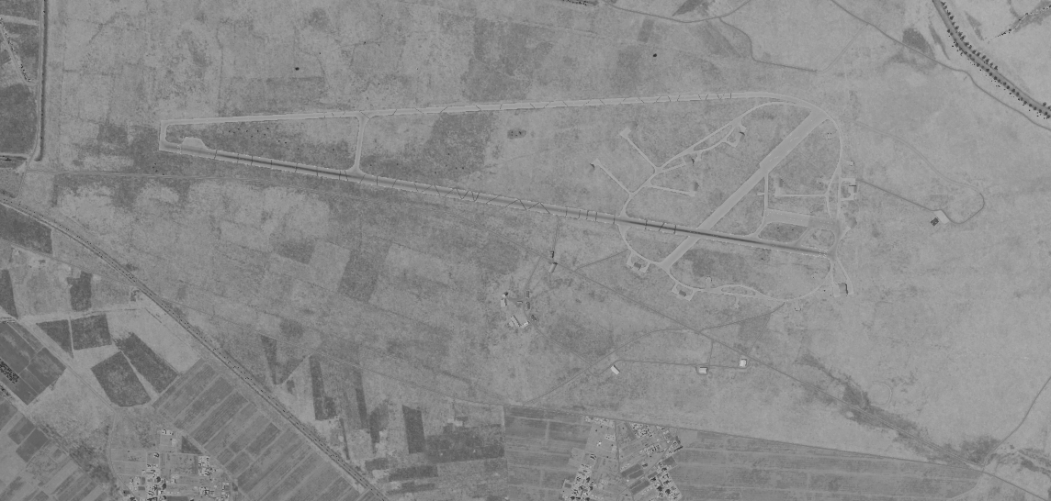
OPARTGT039 Jirah Airbase DPIs
WEAPONEERING
DPI1: N36 05.882 E037 55.748/1152ft
DPI2: N36 05.759 E037 56.558/1165ft
DPI3: N36 06.043 E037 56.373/1161ft
DPI4:N36 05.579 E037 56.192/1155ft
DPI5:N36 05.619 E037 56.279/1155ft
DPI6: N36 05.384 E037 56.530/1158ft
All coordinates TLE CAT 1
N
3
1
1
2
4
5
6

Slide 3
OPARTGT039 Jirah Airbase DPIs
WEAPONEERING
DPI1: N36 05.882 E037 55.748/1152ft
DPI2: N36 05.759 E037 56.558/1165ft
DPI3: N36 06.043 E037 56.373/1161ft
DPI4:N36 05.579 E037 56.192/1155ft
DPI5:N36 05.619 E037 56.279/1155ft
DPI6: N36 05.384 E037 56.530/1158ft
All coordinates TLE CAT 1
N
1

