Slide 1
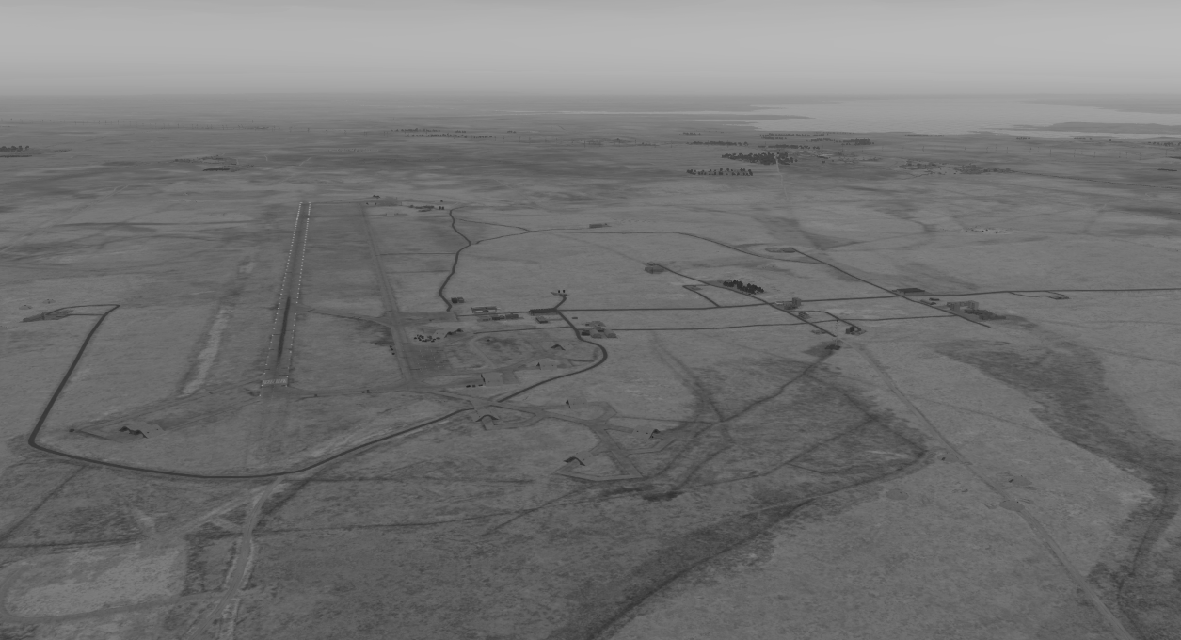
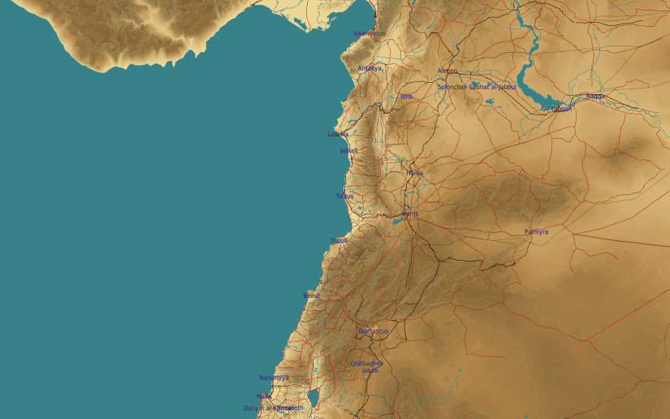
OPARTGT040 Tabqa Airbase
N
40
WEAPONEERING:
DPI 1: Runway, 1x 500 Ibs bomb
DPI2: Runway , 1x 500 Ibs bomb
DPI3: Runway , 1x 500 Ibs bomb
DPI4: Primary fuel storage , 1x 500 Ibs bomb
DPI5: Secondary fuel storage , 1x 500 Ibs bomb
DPI6: Flight ops building , 1x 500 Ibs bomb
DPI7 A: Ammo storage , 2x 500 Ibs bomb
DPI7 B: Ammo storage , 2x 500 Ibs bomb
DPI8: Ammo storage , 2x 500 Ibs bomb
DPI9: Ammo storage , 2x 500 Ibs bomb
DPI10: Engineer building , 1x 500 Ibs bomb
TABQA Airbase: The target complex is supported by 2 fuel storages and 4 ammo storages. Other target of interest is engineer building and flight operations building.
EFFECTS:
Runway: Hits on runway will put the airbase out of action for 48 hours
Ammo storage: Hits on all storages will put the airbase out of action for 96 hours
Fuel storage: Hits on primary fuel storage will put the airbase out of action for 5 days. Hits on both secondary and primary storage will put the airbase out of action for 7 days.
Flight operations building: Sortie generation rate will be reduced by 50%
Engineer building: Sortie generation rate will be reduced by 50%
4
5
6
7
8

Slide 2
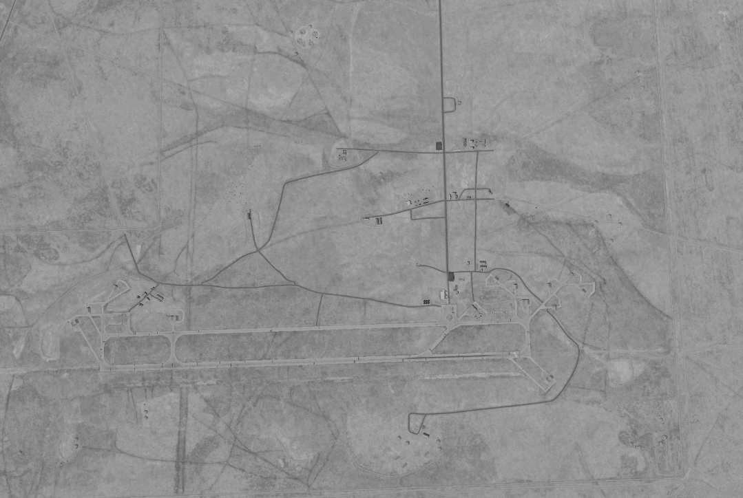
OPARTGT040 Tabqa Airbase
DPI’s relate to centre points of targets:
DPI 1: N35 45.304 E038 33.344, 1079ft
DPI2: N35 45.282 E038 33.986, 1066ft
DPI3:N35 45.263 E038 34.464, 1063ft
DPI4:N35 45.467 E038 34.523, 1063ft
DPI5:N35 45.875 E038 34.864, 1030ft
DPI6:N35 45.516 E038 34.665, 1063ft
DPI7 A:N35 46.081 E038 34.191, 1040ft
DPI7 B:N35 46.082 E038 34.182, 1047ft
DPI8: N35 45.858 E038 33.713, 1066ft
DPI9:N35 44.977 E038 34.465, 1056ft
DPI10: N35 45.551 E038 33.195, 1083ft
All coordinates TLE CAT 1.
N
7A/B
5
8
4
6
10
1
2
3
9
7
8

Slide 3
OPARTGT040 Tabqa Airbase
DPI’s relate to centre points of targets.
N
7
8

Slide 4
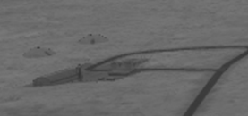
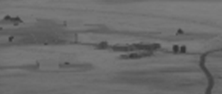
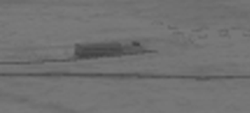
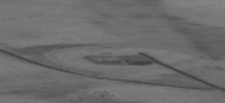
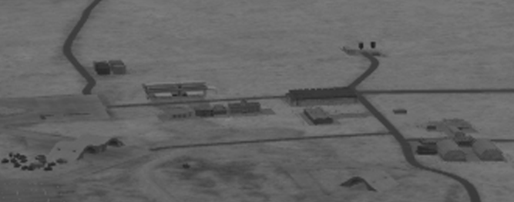
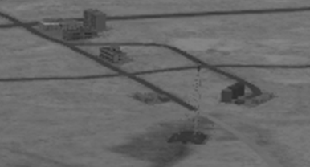
OPARTGT040 Tabqa Airbase
DPI’s relate to centre points of targets.
N
7
8

Slide 5
OPARTGT040 Tabqa Airbase
DPI’s relate to centre points of targets.
N
7
8

