Slide 1
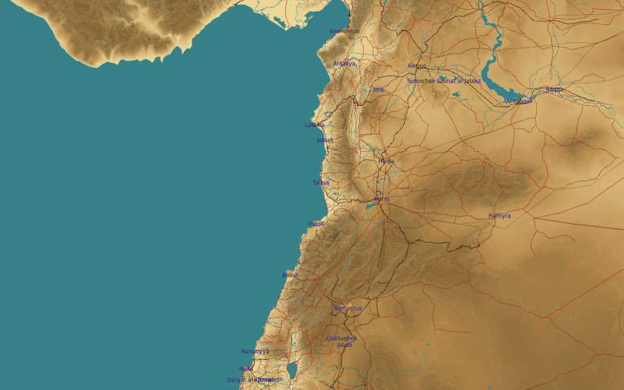
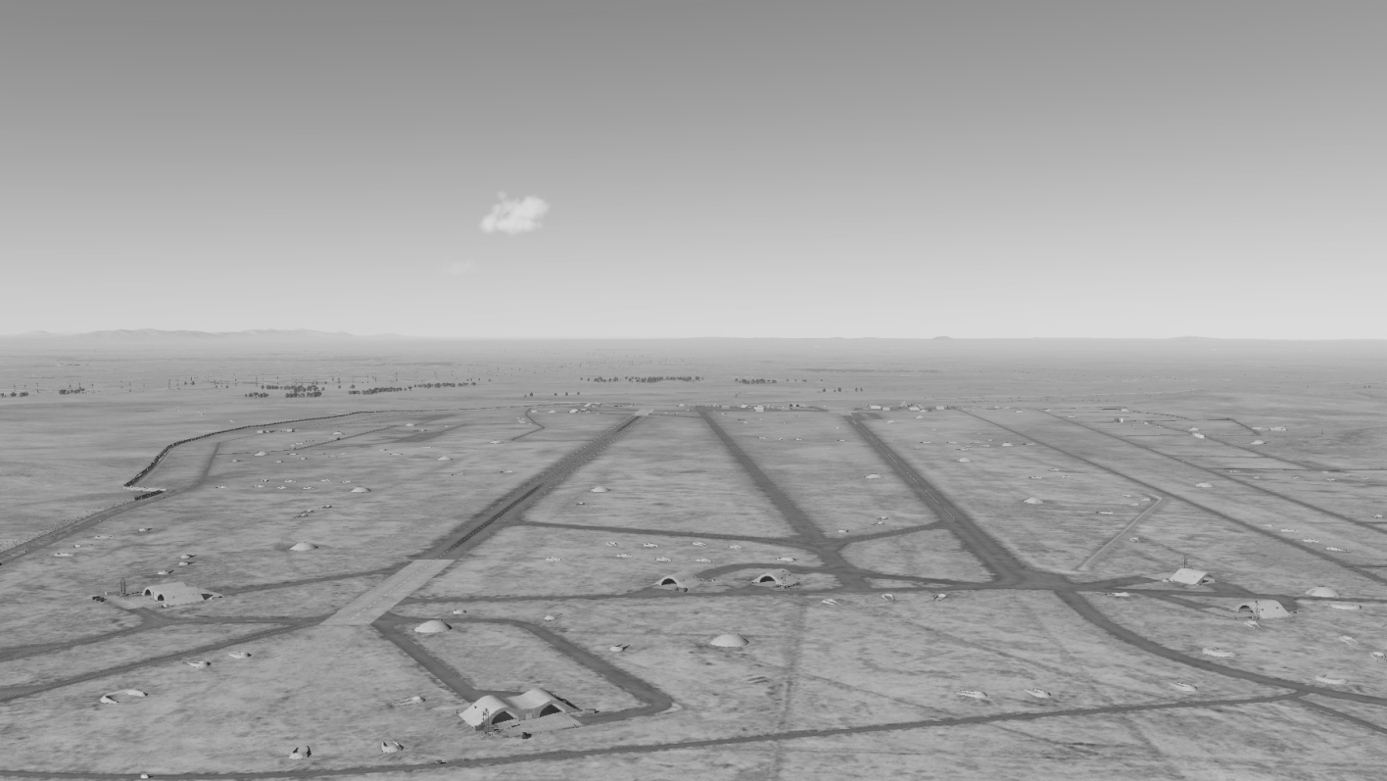
OPARTGT053 Marj Ruhayyil Airbase
N
53
3
2
DESCRIPTION OF THE DESIRED POINTS OF IMPACT WITH WPN TYPE:
OPARTGT053A – Southern Runway
DPI 1 N33 17.075 E036 27.568/2162ft/(500 Ibs bombs)
OPARTGT053B – Northern Runway
DPI 2 N33 17.344 E036 27.364/2161ft/(500 Ibs bombs)
OPARTGT053C – Central Taxiway
DPI 3 N33 17.217 E036 27.484/2162ft/(500 Ibs bombs)
Suggested weapons: Multiple MK82 dispersed along the DPI’s to destroy or disable.
1
4
5
6
DPI’s relate to centre of infrastructure requiring destruction.
7
8

