Slide 1
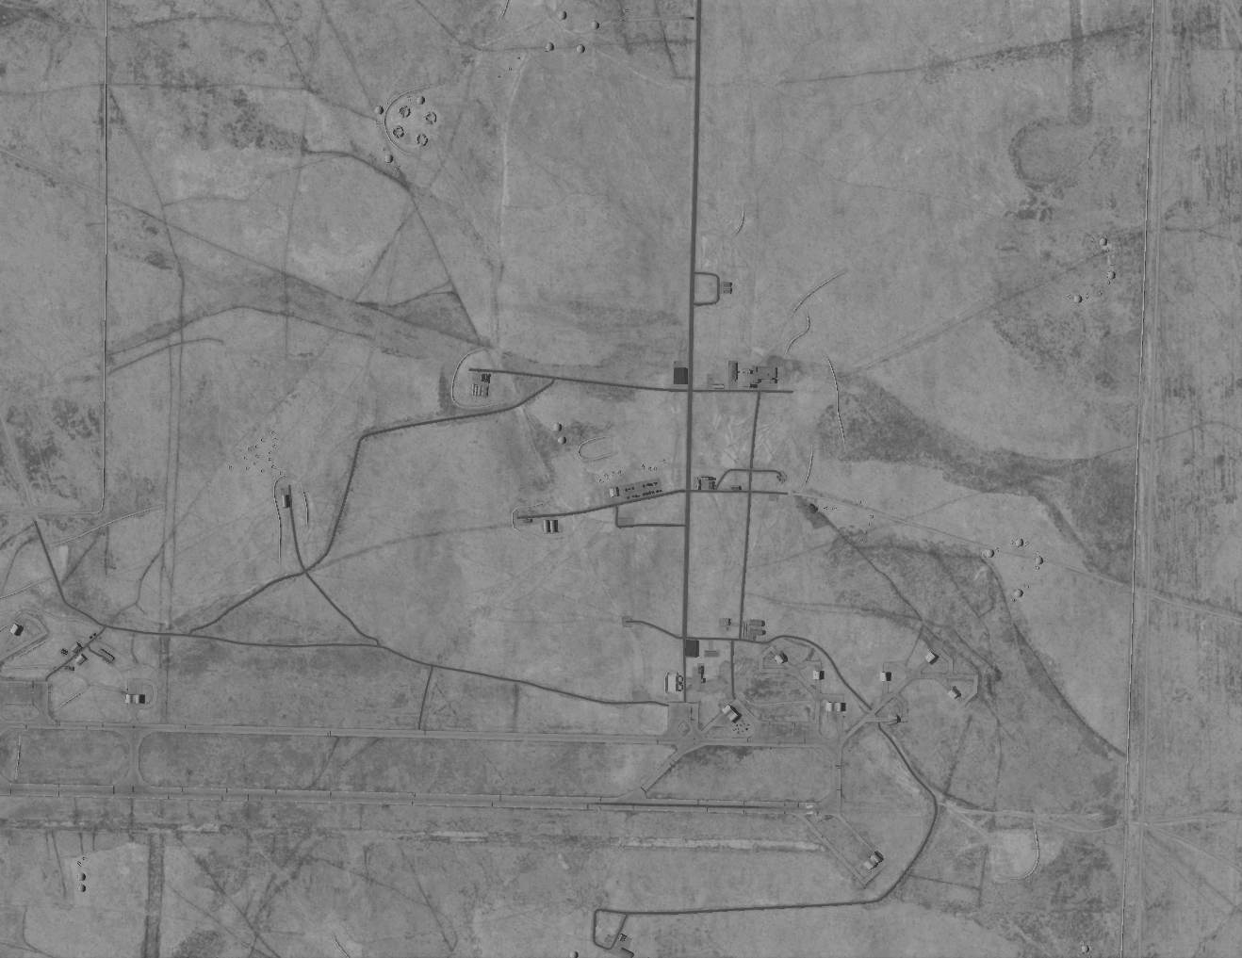
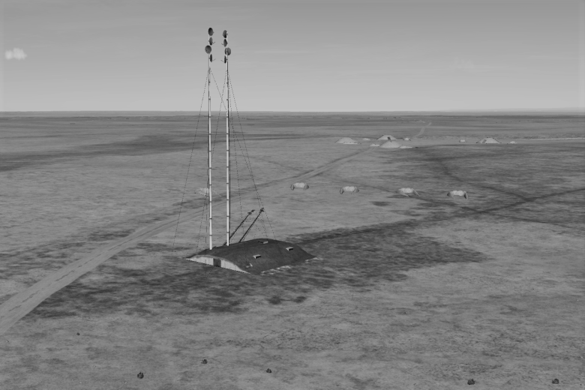
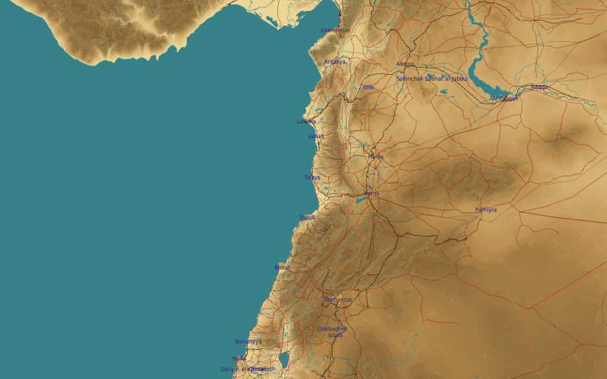
OPARTGT068 SCC EAST
N
N
68
1
DESCRIPTION OF THE DESIRED POINTS OF IMPACT WITH WPN TYPE:
OPARTGT068A – SCC East
DPI 1 N35 45.818 E038 34.937/1027ft/(2000 Ibs bomb)
OPARTGT068A – Reinforced poured concrete bunker covered with approximately 1m of earth. Requires delayed fuzing.
.
4
5
6
DPI lays within the boundaries of Tabqa Airfield.
7
8

