Slide 1
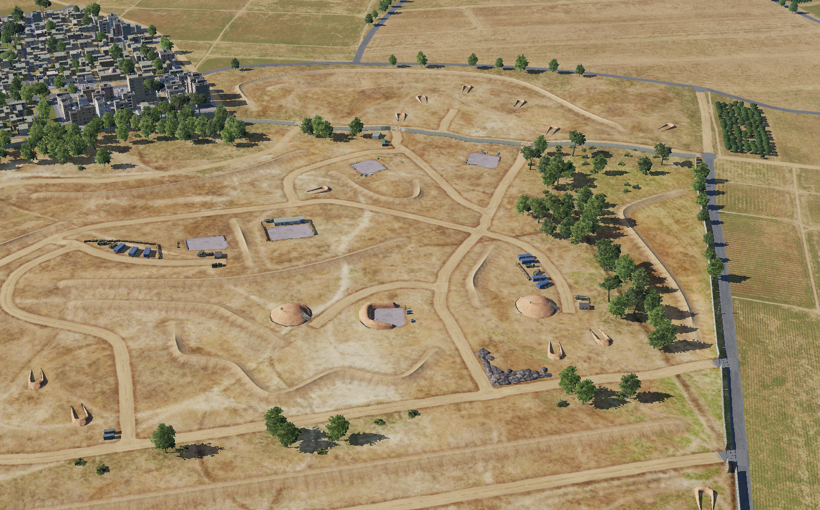
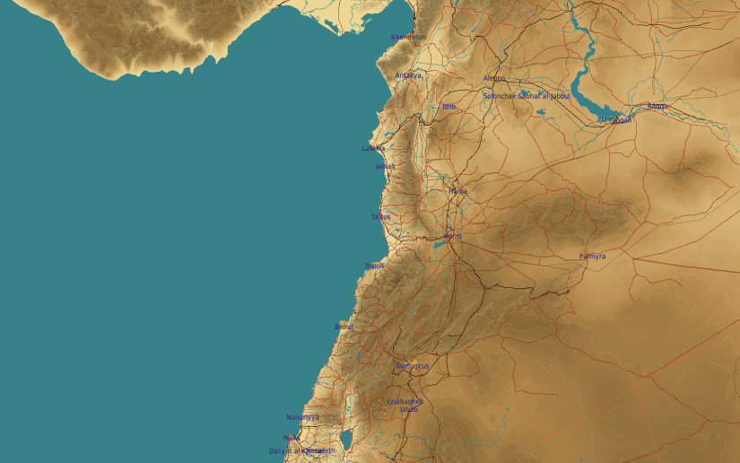
OPARTGT074 80th Air Division Headquarter
N
OPARTGT074B
OPARTGT074A
1
74
2
DESCRIPTION OF THE DESIRED POINTS OF IMPACT WITH WPN TYPE:
OPARTGT074A – Bunker Entrance West
DPI 1 N33 29.392 E036 28.551/2008ft/(2000 Ibs bomb)
OPARTGT074B – Bunker Entrance East
DPI 2 N33 29.382 E036 28.661/1998ft/(2000 lbs bomb)
3 storey bunkers made of reinforced concrete slab supported by reinforced concrete base and pillars, flat reinforced poured roof, covered with approximately 2m of earth. Requires delayed fuzing.
Suggested fuzing solution on DPIs 1-2 delayed fuzing to pierce through floors and affect building integrity and structure.
4
5
6
DPI’s relate to centre of infrastructure requiring destruction.
7
8

