Slide 1
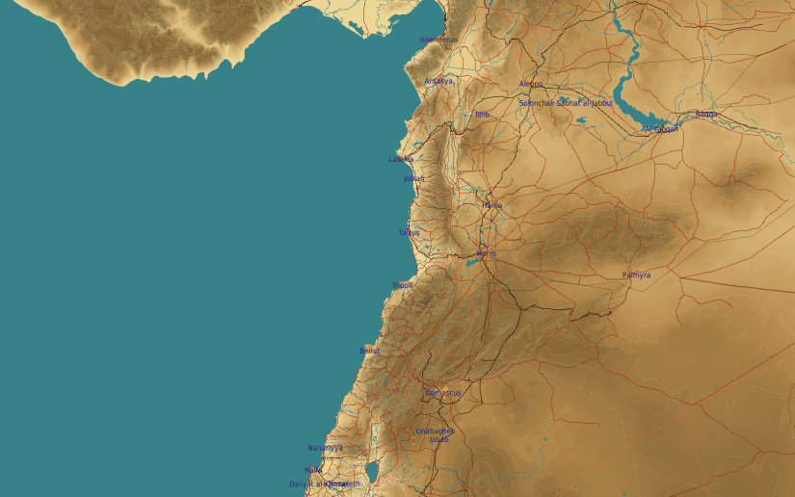
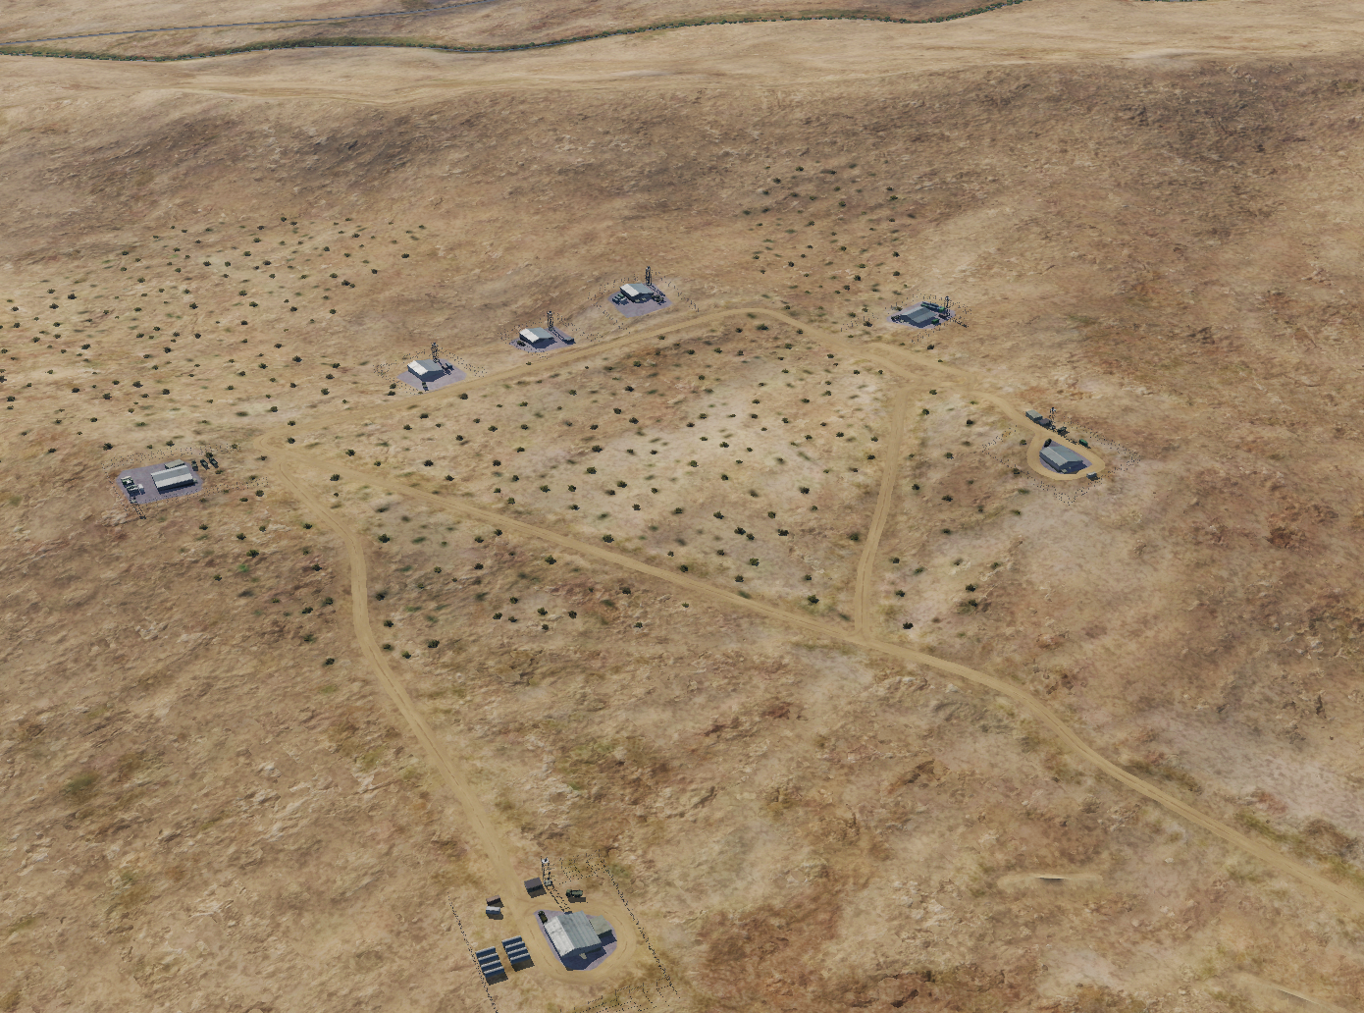
OPARTGT098 Ammunition storage
OPARTGT098C-E
N
OPARTGT098F
5
6
3
4
98
2
7
DESCRIPTION OF THE DESIRED POINTS OF IMPACT WITH WPN TYPE:
OPARTGT098A – Storage 1
DPI 1 N 33 41.383 E 036 43.524/2595ft/(500 Ibs bomb)
OPARTGT098B – Storage 2
DPI 2 N33 41.392 E 036 43.218/2631ft/(500 Ibs bomb)
OPARTGT098C – Storage 3
DPI 3 N 33 41.511 E 036 43.167/2549ft/(500 Ibs bomb)
OPARTGT098D– Storage 4
DPI 3 N 33 41.562 E 036 43.169/2546ft/(500 Ibs bomb)
OPARTGT098E – Storage 5
DPI 3 N 33 41.609 E 036 43.176/2598ft/(500 Ibs bomb)
OPARTGT098F – Storage 6
DPI 3 N 33 41.684 E 036 43.290/2602ft/(500 Ibs bomb)
OPARTGT098G – Storage 7
DPI 3 N 33 41.634 E036 43.436/2628ft/(500 Ibs bomb)
OPARTGT098B
OPARTGT098G
4
1
OPARTGT098A
5
6
OPARTGT098A-G – Single hall, walls made of slabs, poured roof supported by metal frame and reinforced concrete pillars. Requires delayed fuzing.
7
8

