Slide 1
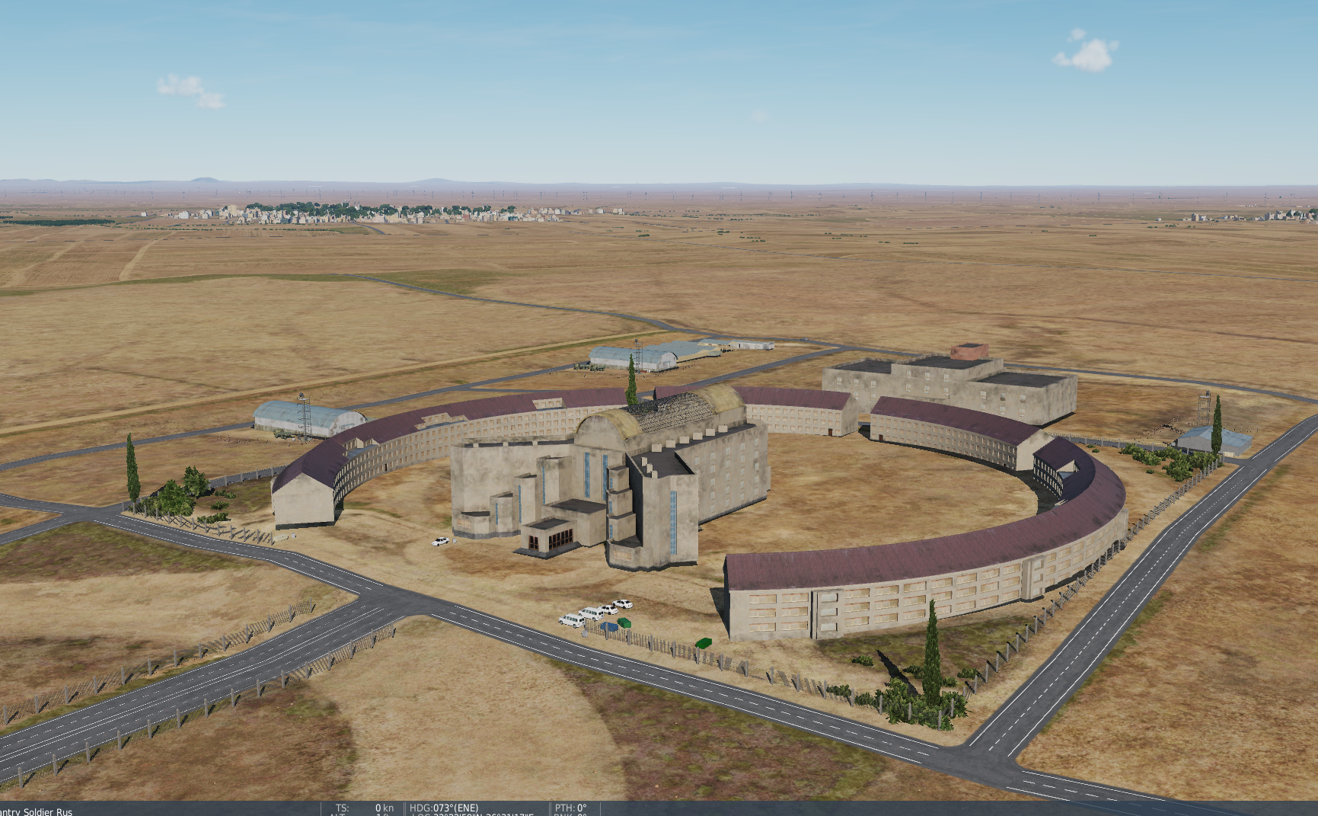
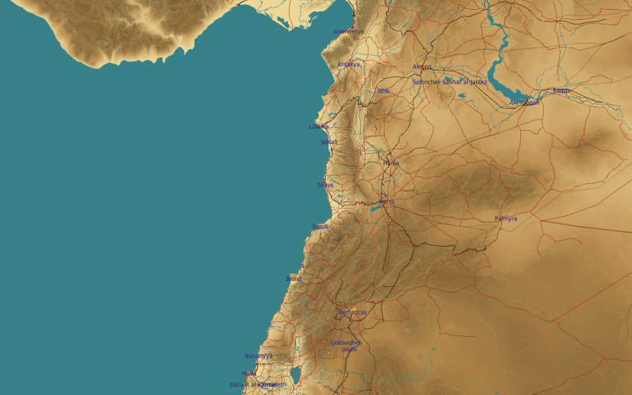
OPARTGT103 Syrian Air Force Headquarter
N
2
1
103
DESCRIPTION OF THE DESIRED POINTS OF IMPACT WITH WPN TYPE:
OPARTGT103A – Syrian Headquarter HQ
DPI 1 N33 22.998 E036 31.269/1972ft/(2x 2000 Ibs bomb)
OPARTGT103B – Headquarters Commcen
DPI 2 N33 22.924 E036 31.343/1969ft/(2000 Ibs bomb)
OPARTGT103A – 6 storey buildings made of concrete slab supported by reinforced concrete base and pillars, glass atrium roof, requires delayed fuzing.
OPARTGT103B – 3 storey buildings made of concrete slab supported by reinforced concrete base and pillars, poured concrete roof.
4
5
6
7
8

