Slide 1
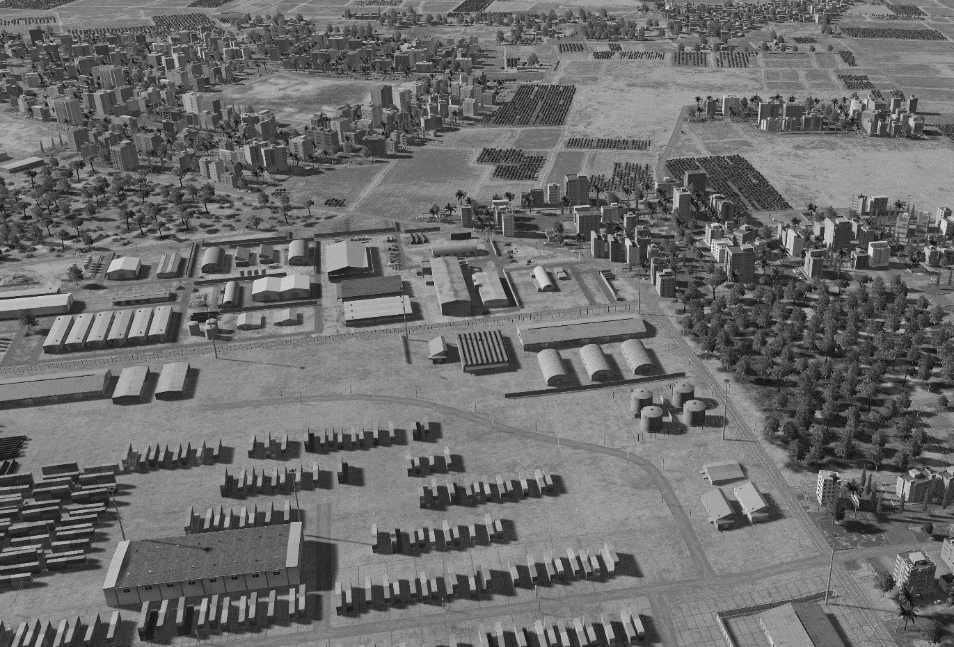
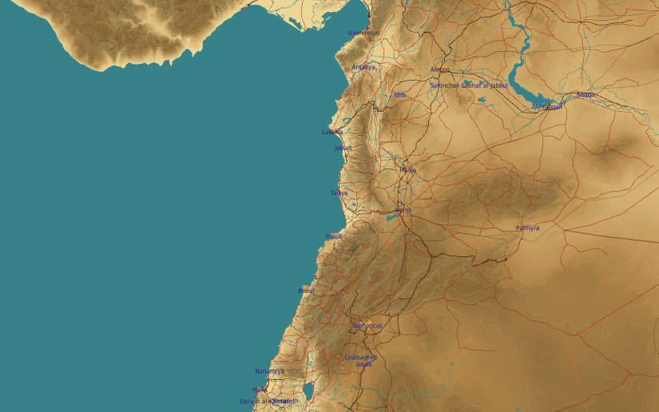
SYTGT006 SYR NAVY STORAGE
N
06
9
10
5
7
8
6
DESIRED POINT of IMPACT:
DPI 10 - N35 32.440 E 35 46.540 / 17ft / 500lb PGM
DPI 9 - N35 32.430 E 35 46.507 / 17ft / 500lb PGM
DPI 8 - N35 32.381 E 35 46.557 / 15ft / 500lb bomb
DPI 7 - N35 32.408 E 35 46.538 / 15ft / 500lb bomb
DPI 6 - N35 32.402 E 35 46.516 / 15ft / 500lb bomb
DPI 5 - N35 32.413 E 35 46.475 / 15ft / 500lb bomb
DPI 4 - N35 32.381 E 35 46.582 / 27ft/ 500lb PGM
DPI 3 - N35 32.376 E 35 46.563 / 27ft/ 500lb PGM
DPI 2 - N35 32.369 E 35 46.587 / 27ft/ 500lb PGM
DPI 1 - N35 32.364 E 35 56.190 / 27ft/ 500lb PGM
3
4
1
2
Civilian property within 100m NE of DPI10.

