Slide 1
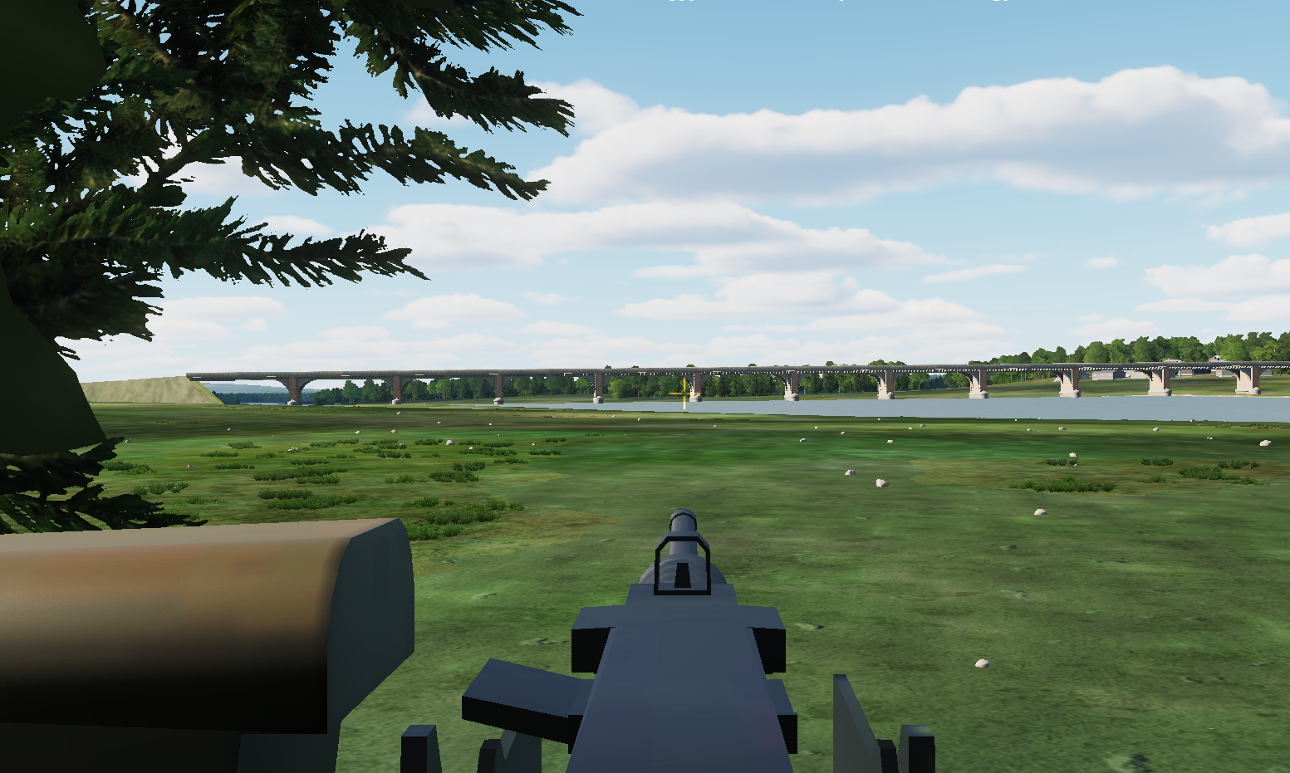
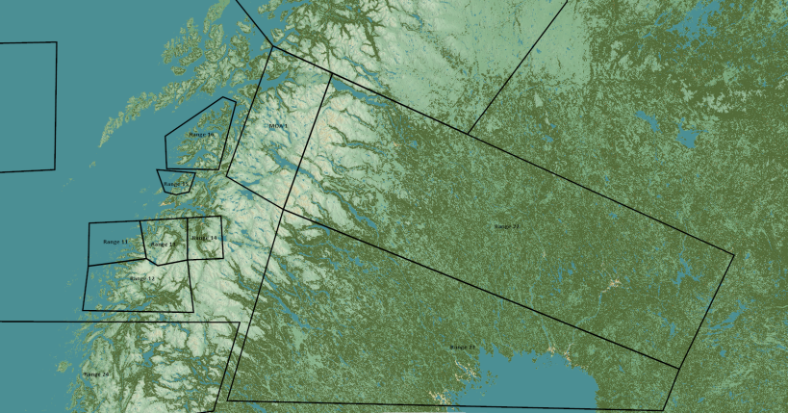
TRMATGT001 Bridge
N
22
1
1
DESCRIPTION OF THE DESIRED POINTS OF IMPACT WITH WPN TYPE:
TRMATGT001 – Bridge
DPI 1: N65 22.763 E021 17.885/17ft/2000 Ibs bomb
Residential area EAST of bridge.

