Slide 1
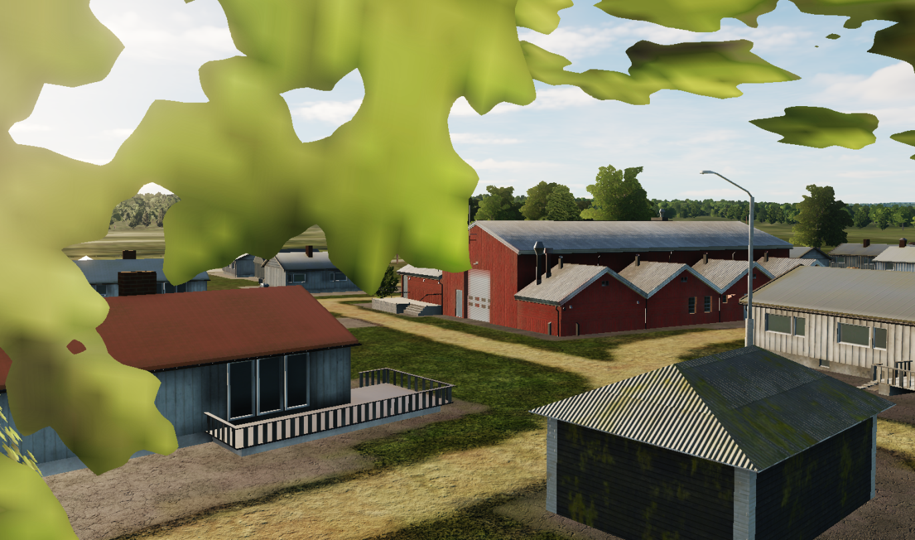
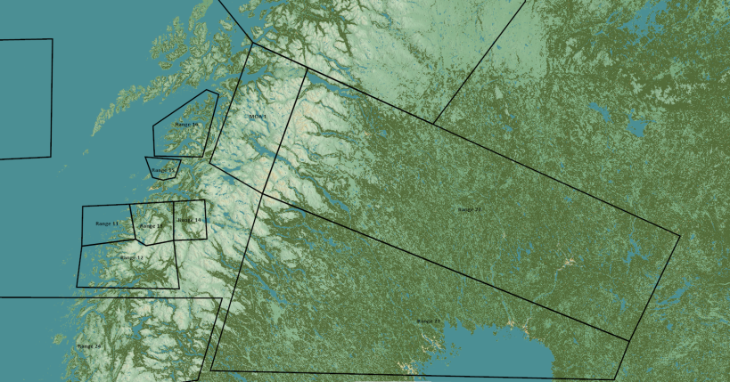
TRMATGT002 Military Storage
N
TRMATG002B
2A
002
DESCRIPTION OF THE DESIRED POINTS OF IMPACT WITH WPN TYPE:
TRMATGT002A – Military Storage
DPI 1: N66 05.241 E020 54.175 / Elevation: 61ft
Weaponeering:
2x 500Ibs bomb or 1x 1000Ibs bomb.
Due to collateral damage risk surrounding target PGM is needed.
TRMATGT002 Military storage is a covert storage facility for REDLAND SCUDs that are part of the chemical weapon program. The SCUD launchers are prepared to load warheads with chemical weapons.
Target 2A and 2B must be attacked at the same time due to risk of enemy withdrawing high value targets within the military storage.

Slide 2
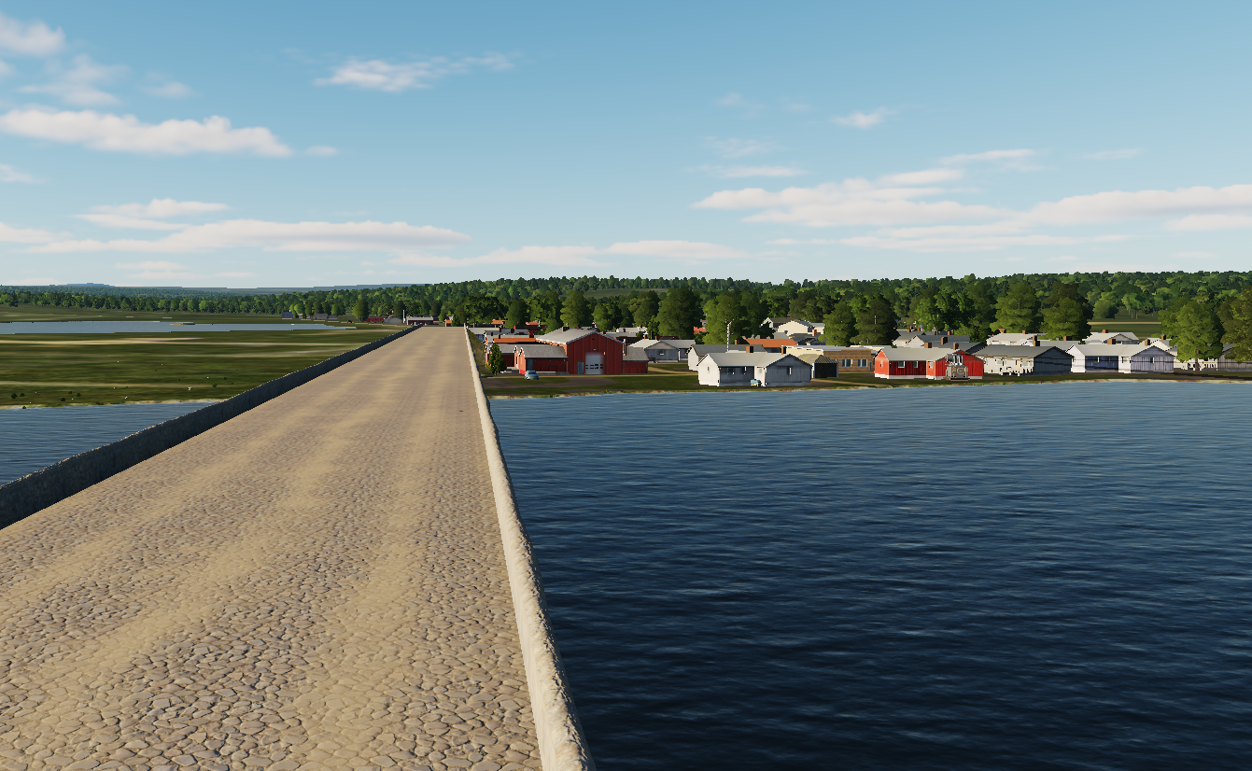
TRMATGT002 Military Storage
N
TRMATG002A
002
2B
DESCRIPTION OF THE DESIRED POINTS OF IMPACT WITH WPN TYPE:
TRMATGT002B – Military Storage
DPI 1: N66 05.460 E020 55.133/ Elevation: 52ft
Weaponeering:
2x 500Ibs bomb or 1x 1000Ibs bomb.
Due to collateral damage risk surrounding target PGM is needed.
TRMATGT002 Military storage is a covert storage facility for REDLAND SCUDs that are part of the chemical weapon program. The SCUD launchers are prepared to load warheads with chemical weapons.
Target 2A and 2B must be attacked at the same time due to risk of enemy withdrawing high value targets within the military storage.

