Slide 1
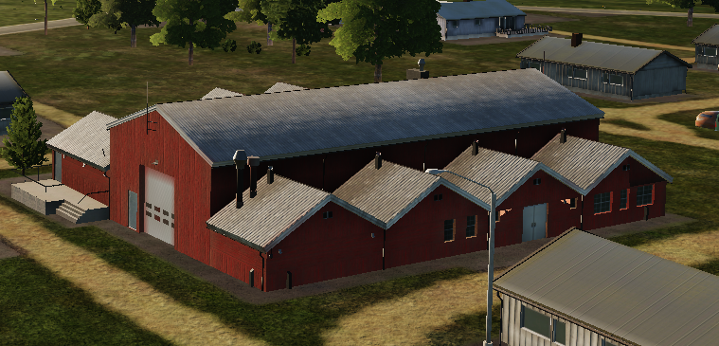
 | 500 IBS | 1000 IBS | 2000 IBS
1x Bomb
2x Bombs
4x Bombs

