Slide 1
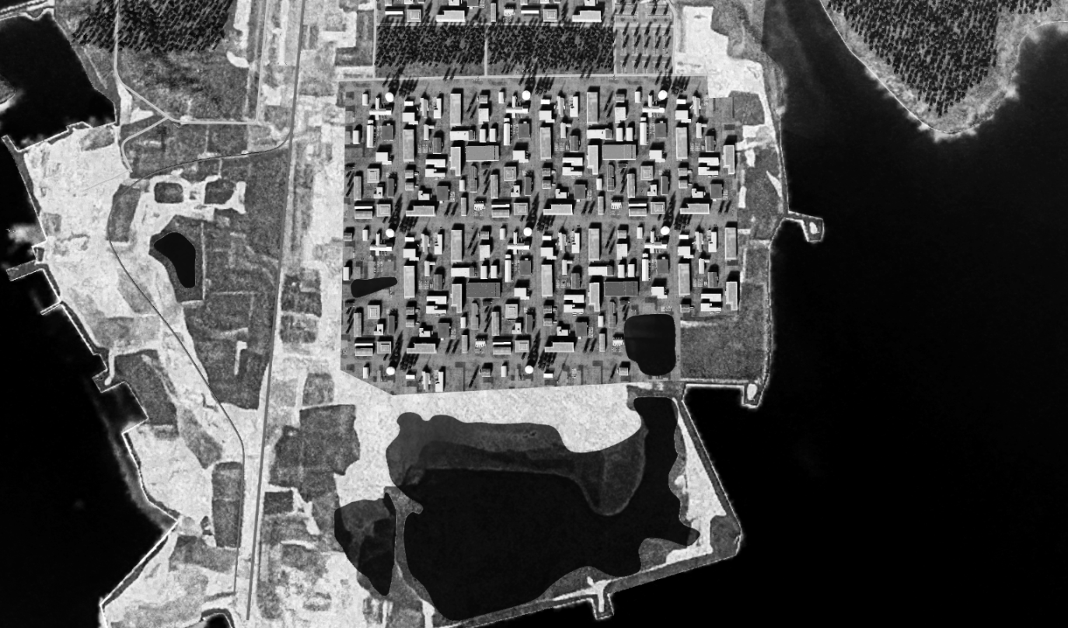
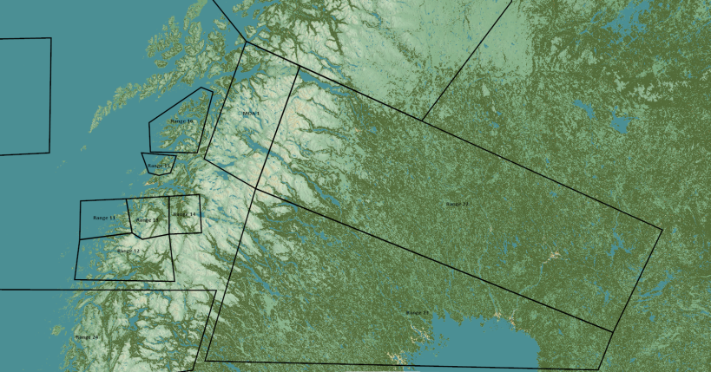
TRMATGT003 Military Research Facility
N
TRMATG003C
003
TRMATG003D
DESCRIPTION OF THE DESIRED POINTS OF IMPACT WITH WPN TYPE:
(TLE CAT 1 Coordinates)
TRMATGT003A – Military Research Facility
DPI 1: N65 45.779 E024 10.347/ Elevation: 29ft
TRMATGT003B – Military Research Facility
DPI 1: N65 45.778 E024 10.899/ Elevation: 17ft
TRMATGT003C – Military Research Facility
DPI 1: N65 45.864 E024 10.484/ Elevation: 28ft
TRMATGT003D – Military Research Facility
DPI 1: N65 45.862 E024 11.035/ Elevation: 27ft
Weaponeering:
1x GBU 31(V)3/B Penetrator bomb.
Function delay: 60ms
In order to completely destroy the servers stored in hardened facilities underground, the penetrator bomb is needed with a delay of 60ms.
TRMATG003A
TRMATG003B
TRMATGT003 Military Research Facility is a covert researcg facility for REDLAND Chemical Weapon program.
Target 3A, 3B,3C and 3D must be attacked at the same time due to risk enemy beeing able to flee the targets and recover harddrives with information from the CW program.

Slide 2
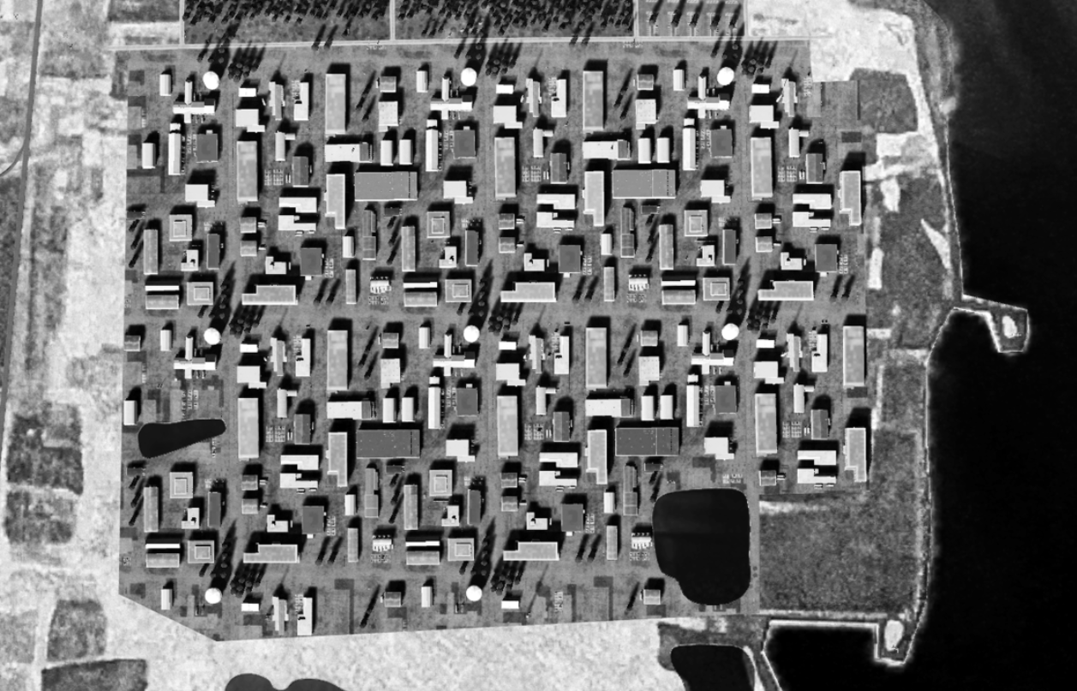
TRMATGT003 Military Research Facility
N
3C
3D
3A
3B

