Slide 1
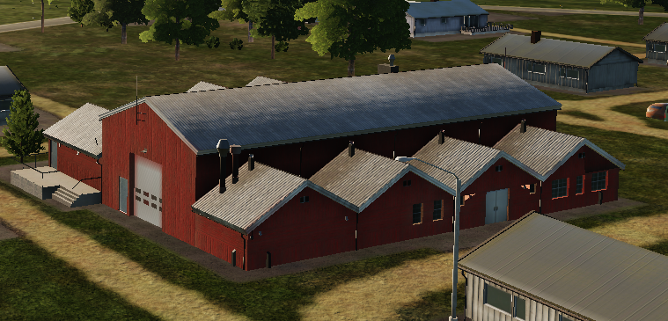
 | 500 IBS | 1000 IBS | 2000 IBS
1x Bomb
2x Bombs
4x Bombs

Slide 2
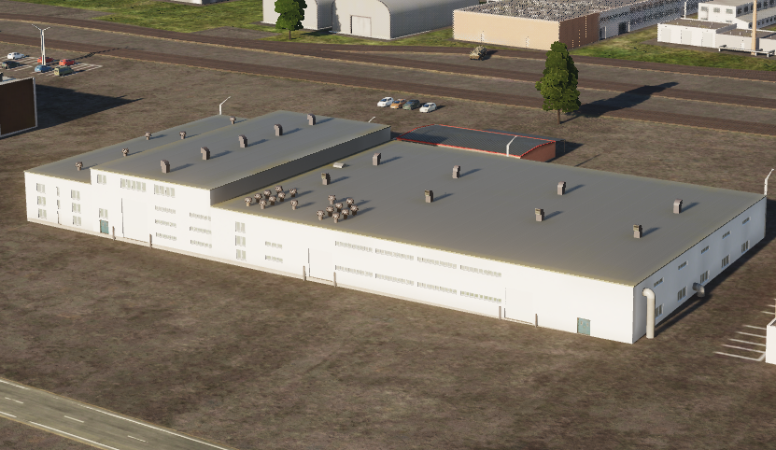
 | 500 IBS | 1000 IBS | 2000 IBS
1x Bomb
2x Bombs
4x Bombs

Slide 3
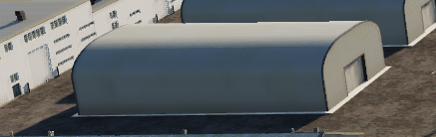
 | 500 IBS | 1000 IBS | 2000 IBS
1x Bomb
2x Bombs
4x Bombs

Slide 4
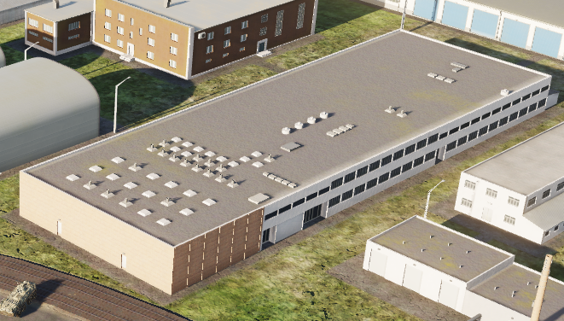
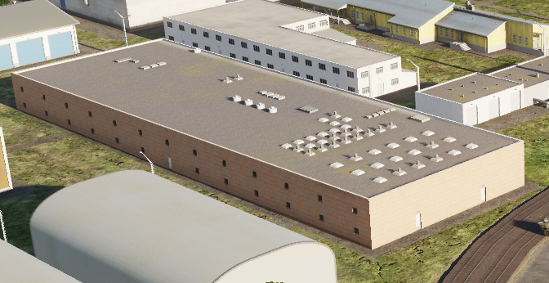
 | 500 IBS | 1000 IBS | 2000 IBS
1x Bomb
2x Bombs
4x Bombs

Slide 5
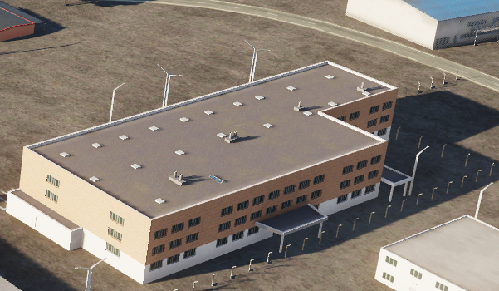
 | 500 IBS | 1000 IBS | 2000 IBS
1x Bomb
2x Bombs
4x Bombs

Slide 6
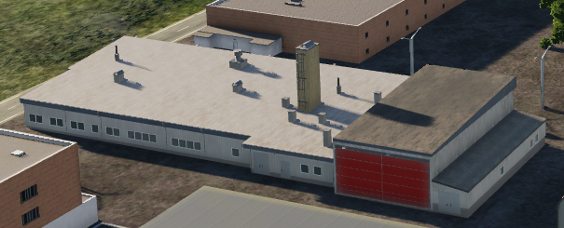
 | 500 IBS | 1000 IBS | 2000 IBS
1x Bomb
2x Bombs
4x Bombs

Slide 7
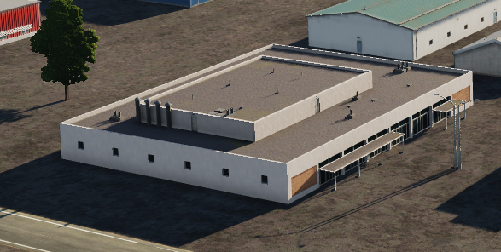
 | 500 IBS | 1000 IBS | 2000 IBS
1x Bomb
2x Bombs
4x Bombs

Slide 8
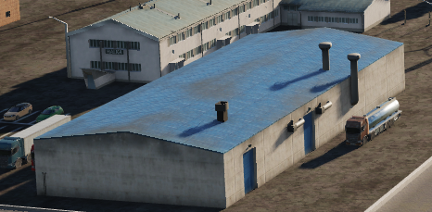
 | 500 IBS | 1000 IBS | 2000 IBS
1x Bomb
2x Bombs
4x Bombs

Slide 9
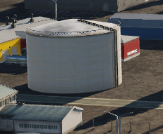
 | 500 IBS | 1000 IBS | 2000 IBS
1x Bomb
2x Bombs
4x Bombs

Slide 10
 | 500 IBS | 1000 IBS | 2000 IBS
1x Bomb
2x Bombs
4x Bombs

