Slide 1
Student name: prajan.b.t register no and nmid:21240096/9E083E86A935DCEB4684F17521F3BB79 Department:bca college: prince shri Venkateswara arts and science College

Slide 2
Project title
DIGITAL PORTFOLIO

Slide 3
Agenda
Problem statement
Project overview
End users
Tools and technologies
Portfolio design and Layout
Features And functionality
Results and screenshots
Conclusion
GitHub link

Slide 4
Problem statement
In today’s digital world, students and professionals Need an Online platform to Present their skills, projects, and contact details Without a portfolio It Is difficult for recruiters,peers,or collaborators to assess abilities effectively.

Slide 5
Project overview
This project is a personal portfolio website for PRAJAN.B.T, a BCA student. It includes sections like About Me, Projects, Skills, and Contact, with smooth navigation, attractive designs, and interactive effects, built using HTML, CSS, and JavaScript.

Slide 6
Who are end users ?
Students and freshers looking to display their work
Recruiters and employers evaluating skills and projects
Collaborators or peers exploring coding and design capabilities

Slide 7
Tools and techniques
Frontend: HTML5, CSS3, JavaScript
Styling: CSS gradients, hover effects, transitions, fade-in animations
Development: VS Code / CodePen
Optional Deployment: GitHub Pages or Netlify

Slide 8
Portfolio and design layout
Header: Name, designation, navigation bar linking to each section
Sections:
About Me → Introduction and academic background
Projects → Cards showing key projects with descriptions and links
Skills → List of technical skills
Contact → Email, LinkedIn, and GitHub links

Slide 9
Features and functionality
Smooth scrolling navigation
Responsive grid layout for projects
Fade-in effect on scroll for sections
Hover effects on buttons and project cards
Scroll-to-top button for easy navigation
Organized skills and external contact links

Slide 10
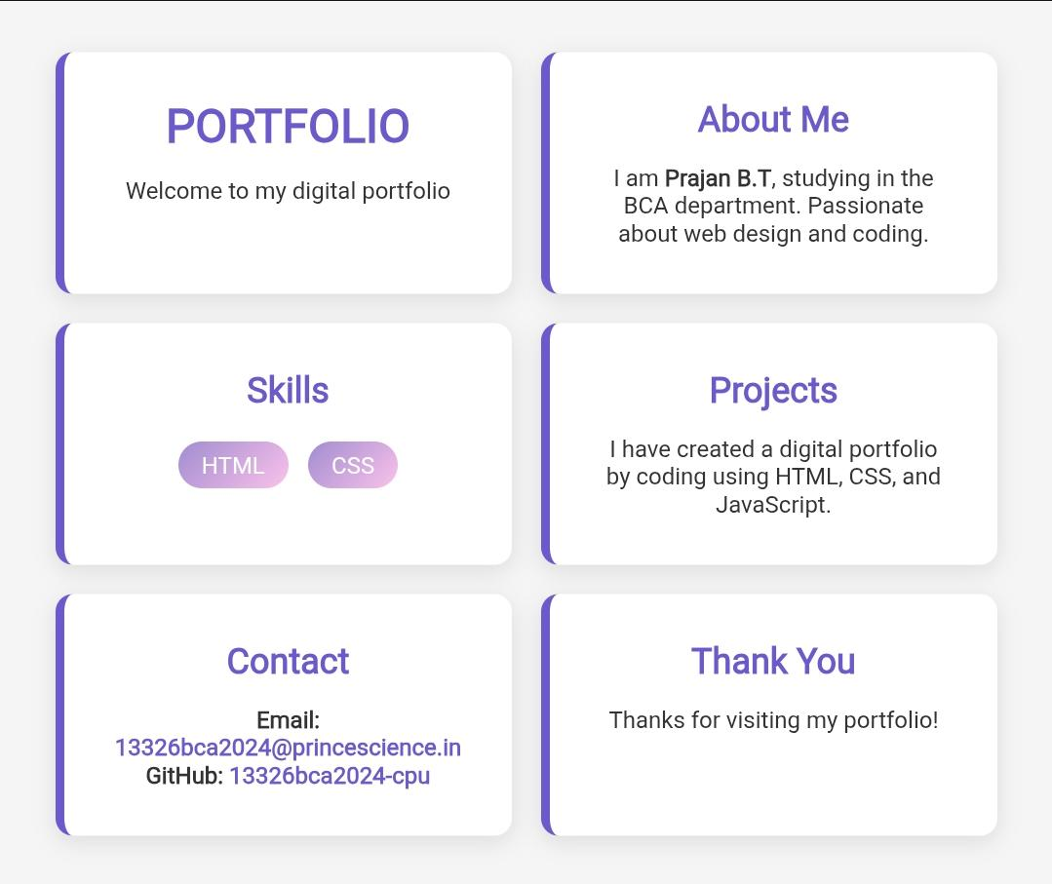
Result and screenshot

Slide 11
Conclusion
The portfolio provides a professional online presence for PRAJAN.B.T. It highlights coding, design, and problem-solving skills while offering a foundation for future enhancements like project demos or blog integration.

Slide 12
GitHub link
https://13326bca2024-cpu.github.io/TNSDC-FWD-DP-PRAJAN/

