Slide 1
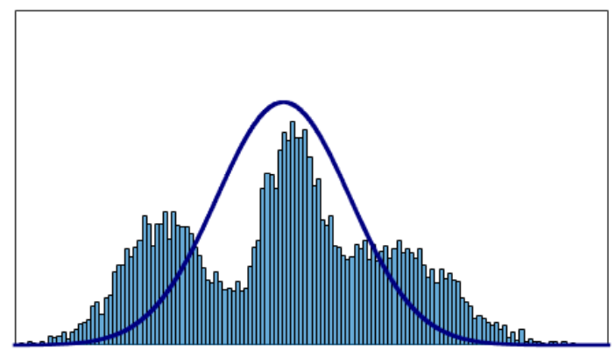
Limitations of Single Gaussian
Single Model
Symmetric

Slide 2
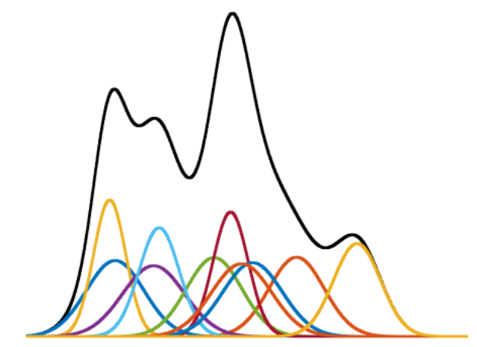
Gaussian Mixture Model
Mixture(=Sum) of Gaussians

Slide 3
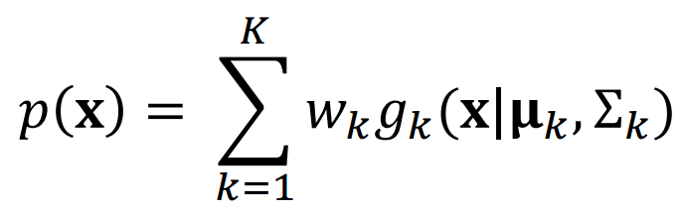
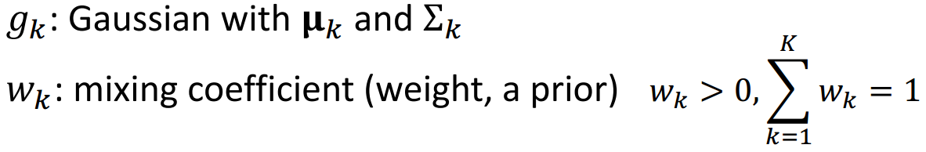
Gaussian Mixture Model
Mixture of Gaussians

Slide 4
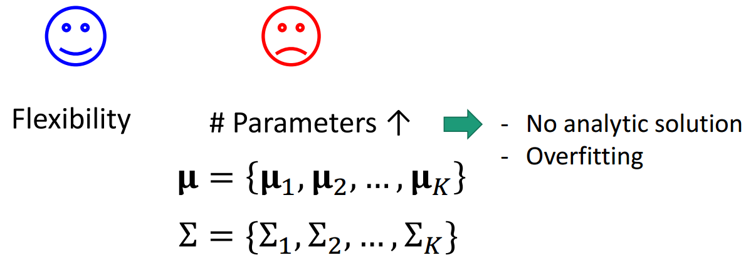
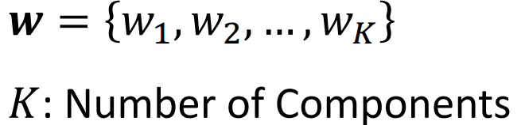
Using GMM

Slide 5
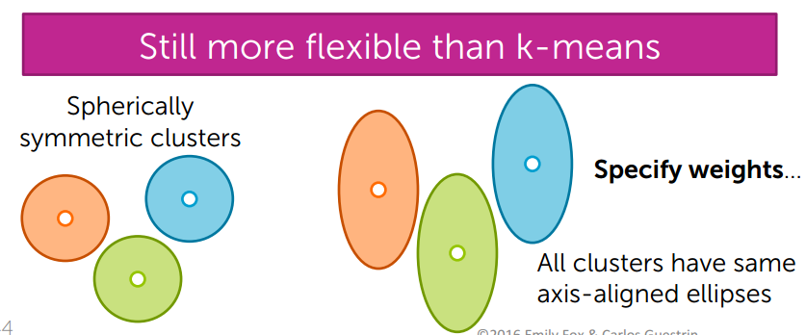

Slide 6
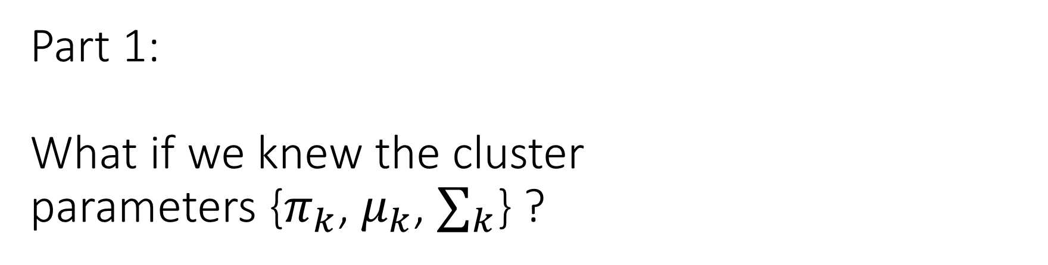
Part 1: What if we knew the cluster parameters {$π_{k}$, $μ_{k}$, $∑_{k}$} ?

Slide 7

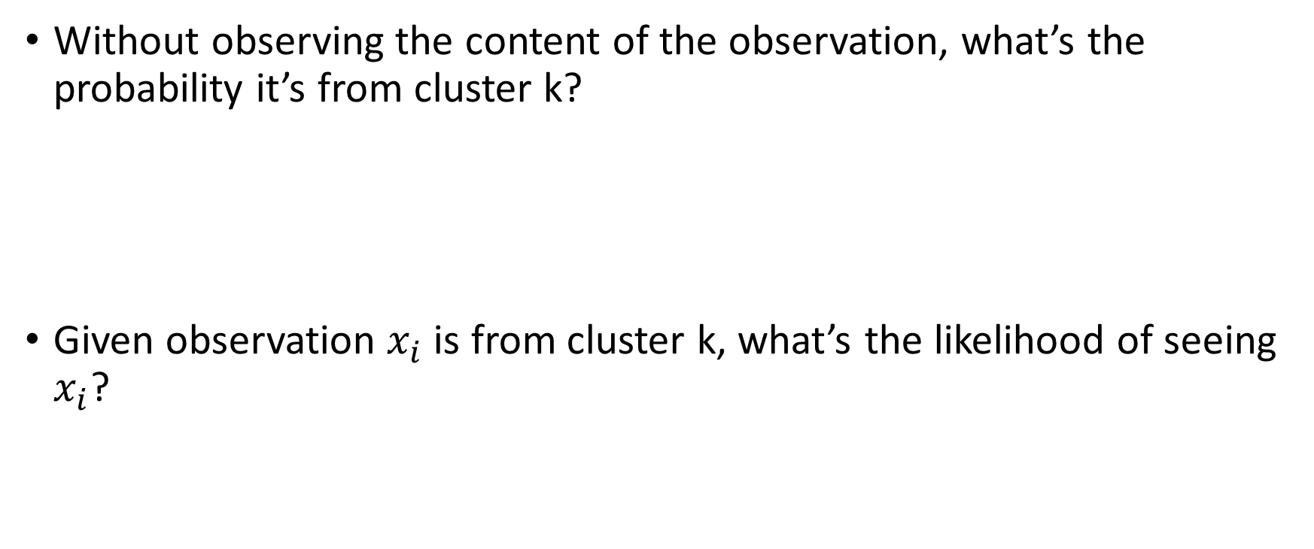
According to the model…
Without observing the content of the observation, what’s the probability it’s from cluster k?
Given observation $x_{i}$ is from cluster k, what’s the likelihood of seeing $x_{i}$?

Slide 8
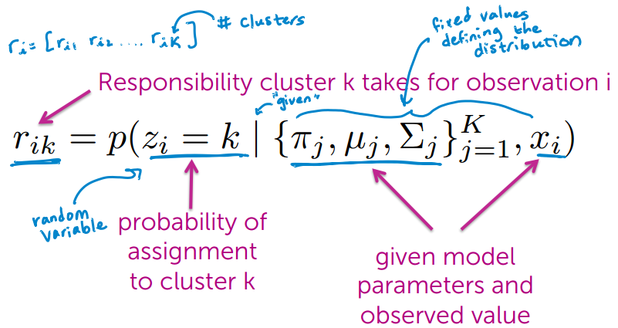
Compute responsibilities

Slide 9
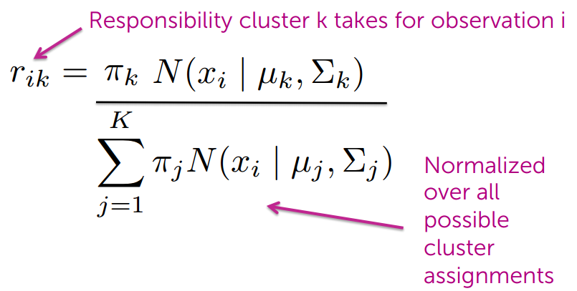
Responsibilities in equations

Slide 10
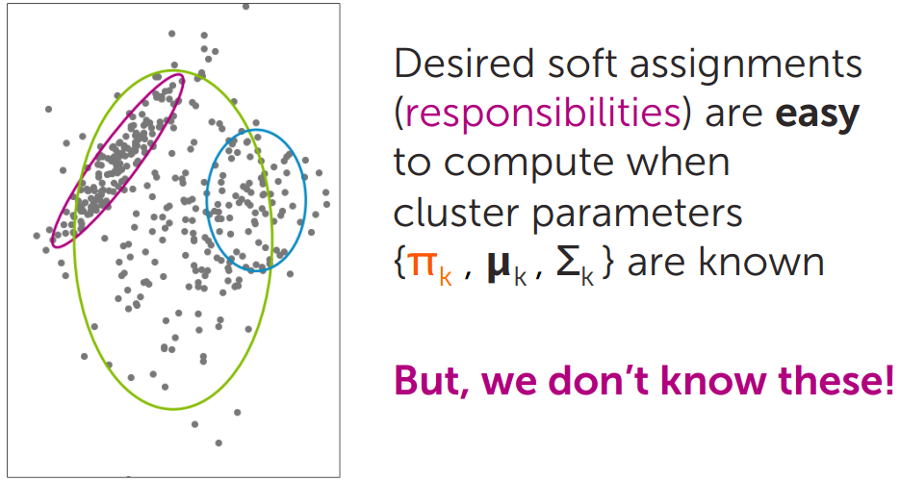
Part 1 summary

Slide 11
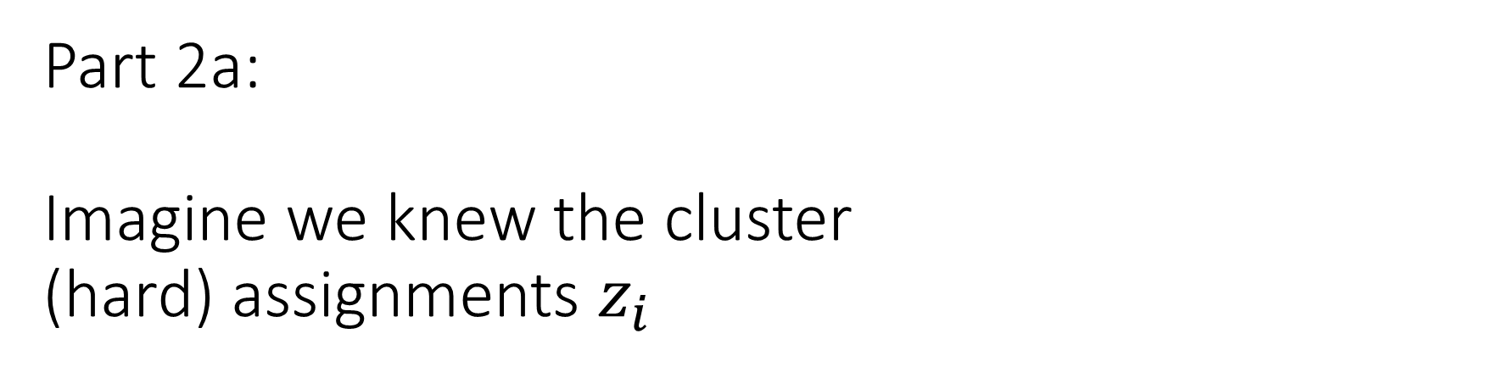
Part 2a: Imagine we knew the cluster (hard) assignments $z_{i}$

Slide 12
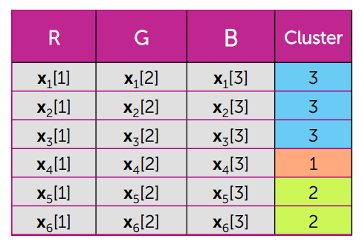
Estimating cluster parameters

Slide 13
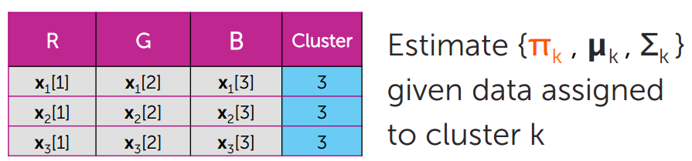
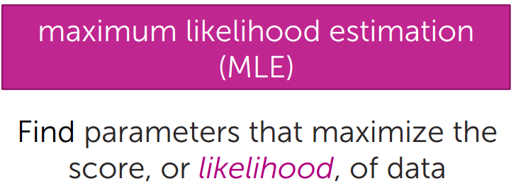
Maximum likelihood estimation

Slide 14
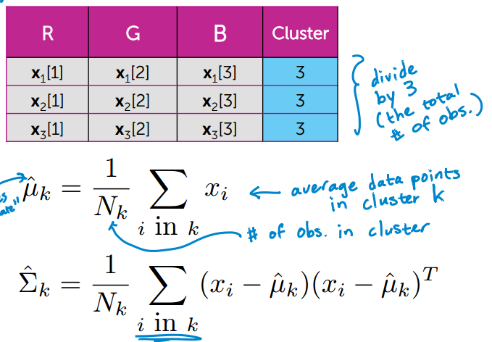
Mean/covariance MLE

Slide 15
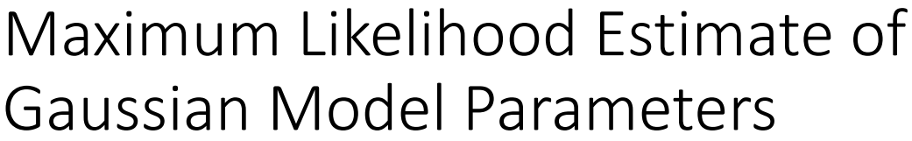
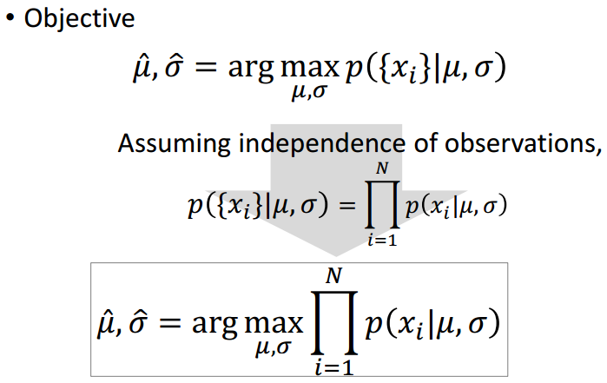

Slide 16

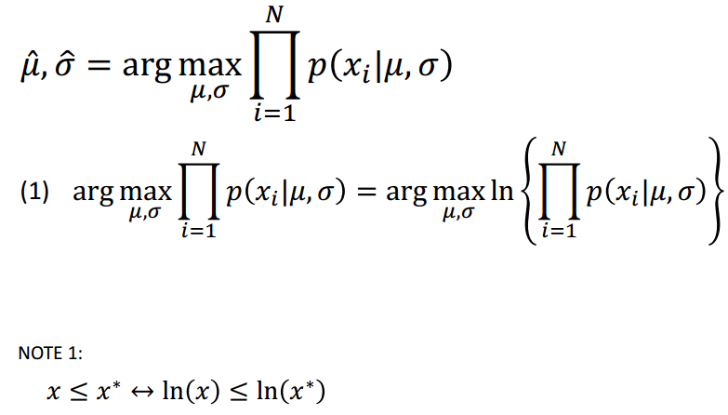

Slide 17
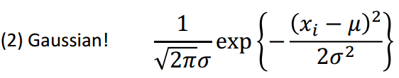
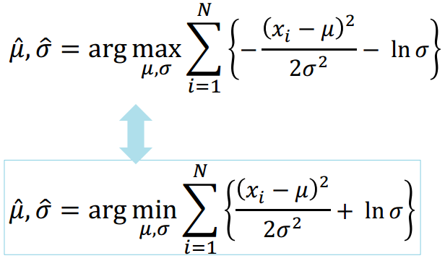

Slide 18
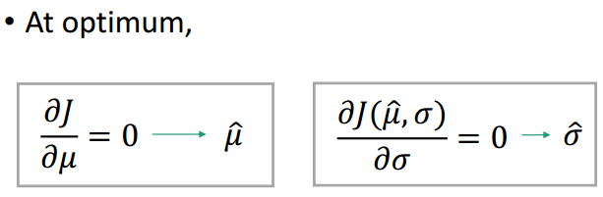
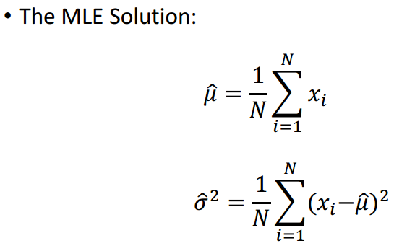

Slide 19
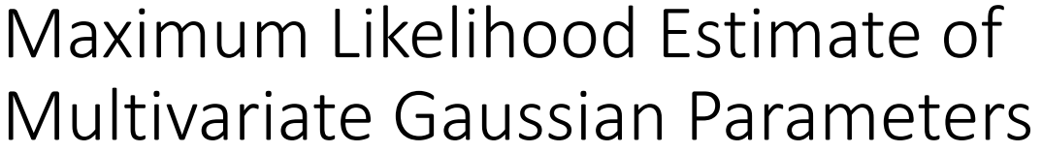
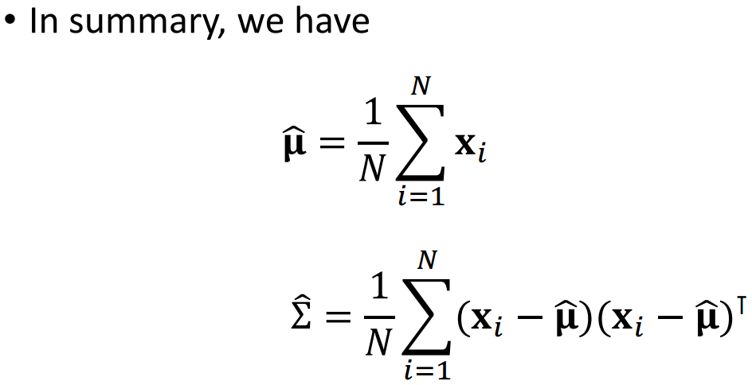

Slide 20
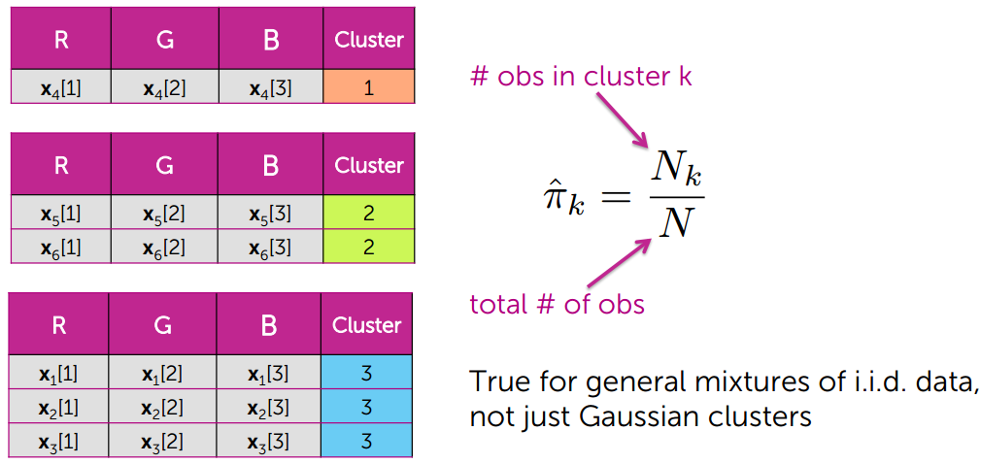
Cluster proportion MLE

Slide 21
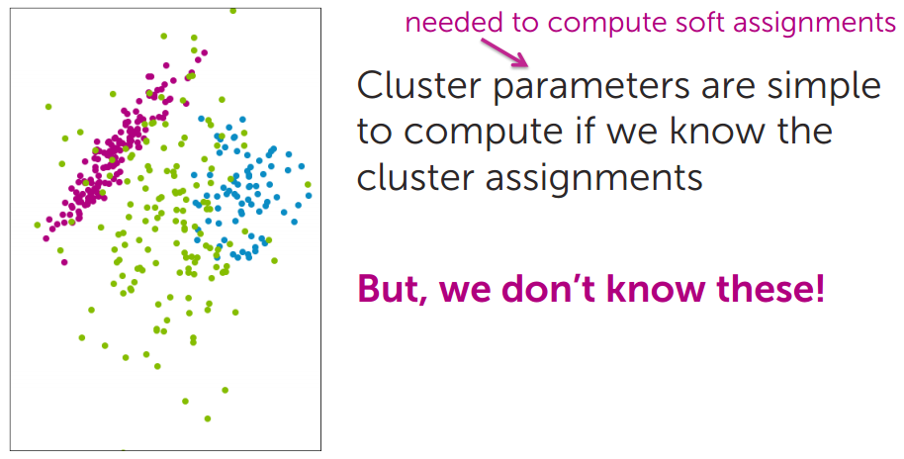
Part 2a summary

Slide 22
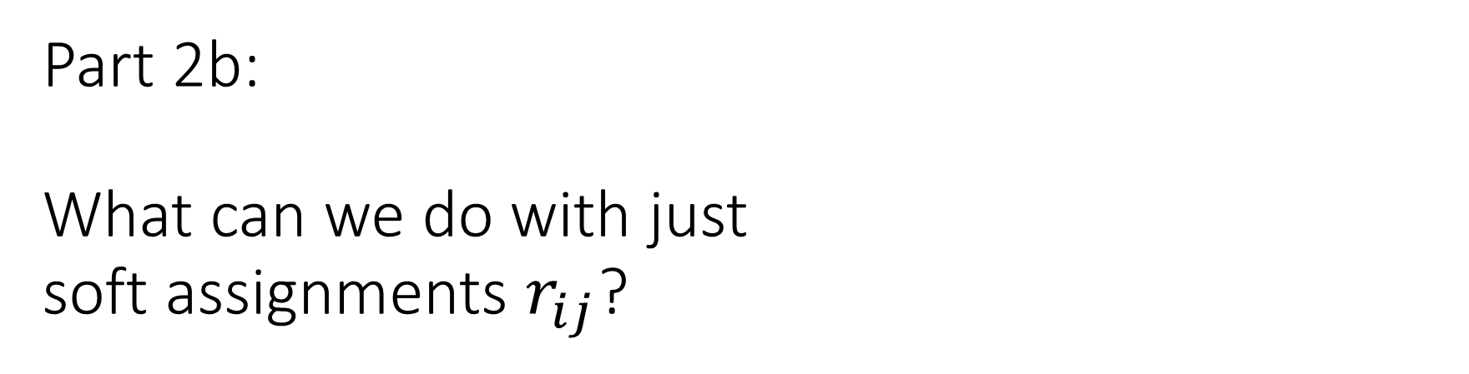
Part 2b: What can we do with just soft assignments $r_{ij}$?

Slide 23
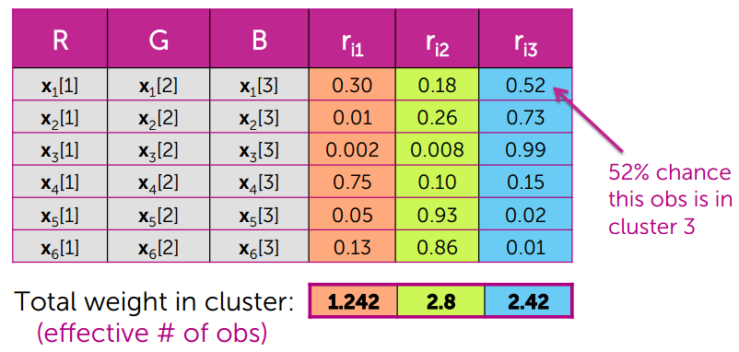
Maximum likelihood estimation from soft assignments

Slide 24
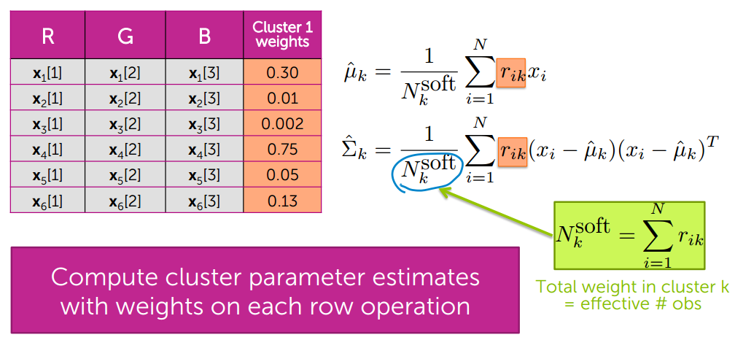
Cluster-specific location/shape MLE

Slide 25
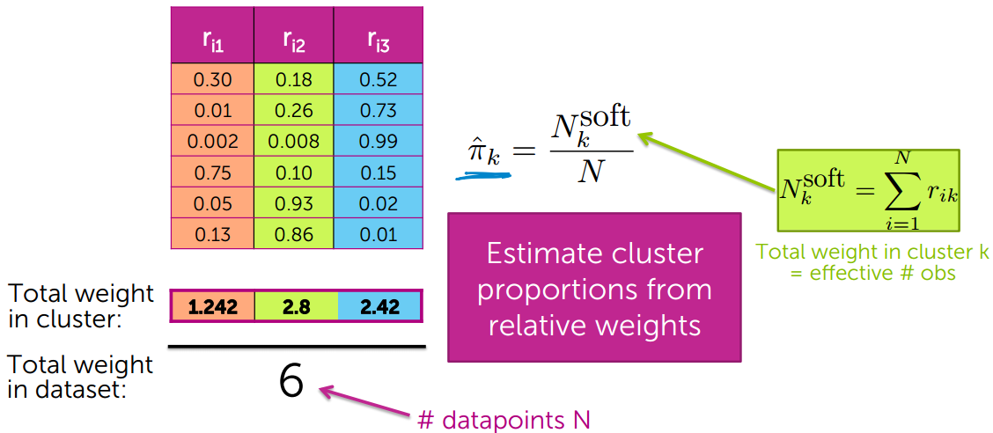
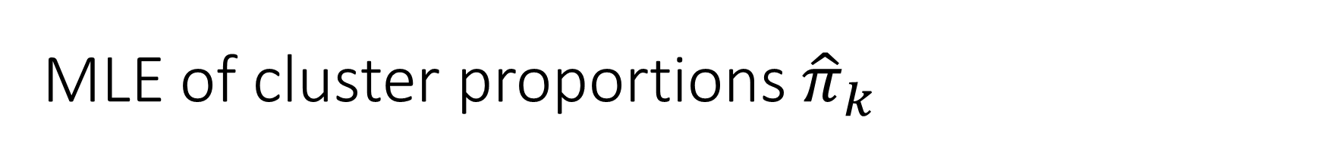
MLE of cluster proportions ${\hat{π}}_{k}$

Slide 26
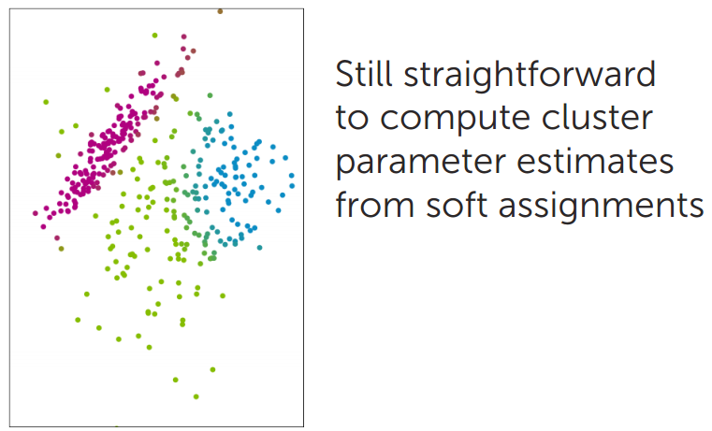
Part 2b summary

Slide 27
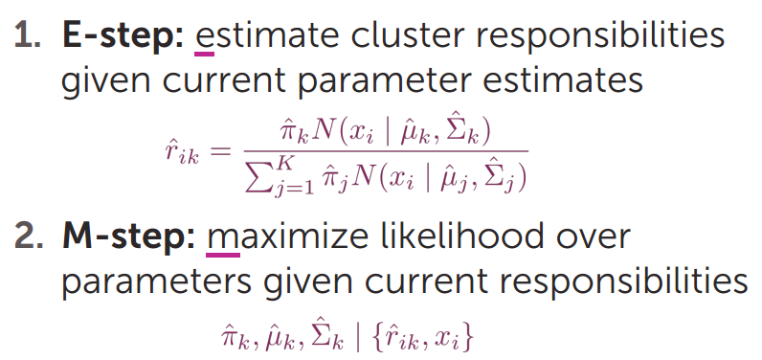
Expectation maximization (EM): An iterative algorithm
Motivates an iterative algorithm:

Slide 28
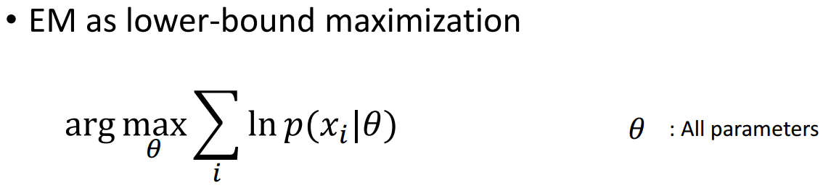
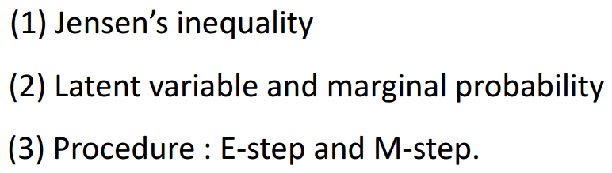
Expectation-Maximization (EM)

Slide 29
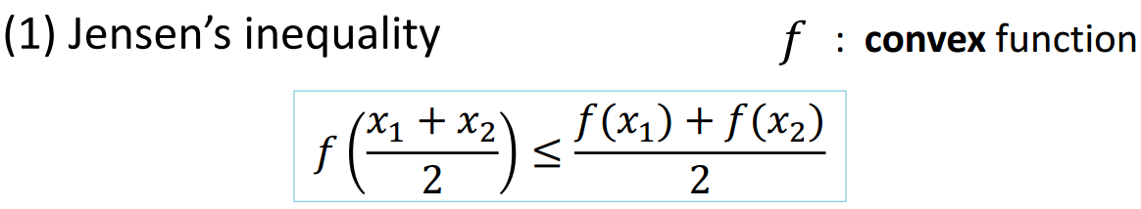
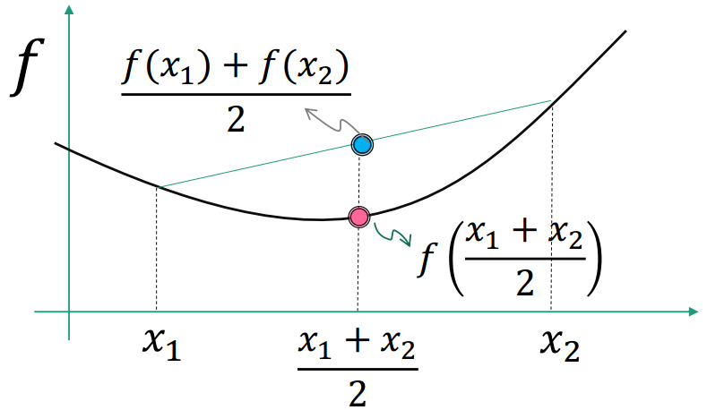
Expectation-Maximization(EM)

Slide 30
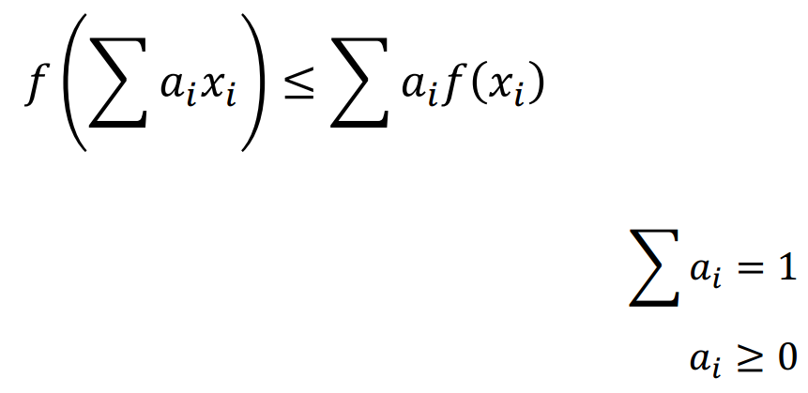
Expectation-Maximization(EM)

Slide 31
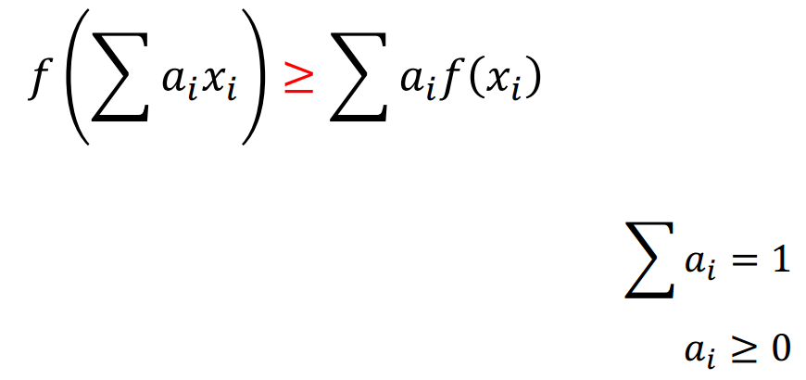
Expectation-Maximization(EM)

Slide 32
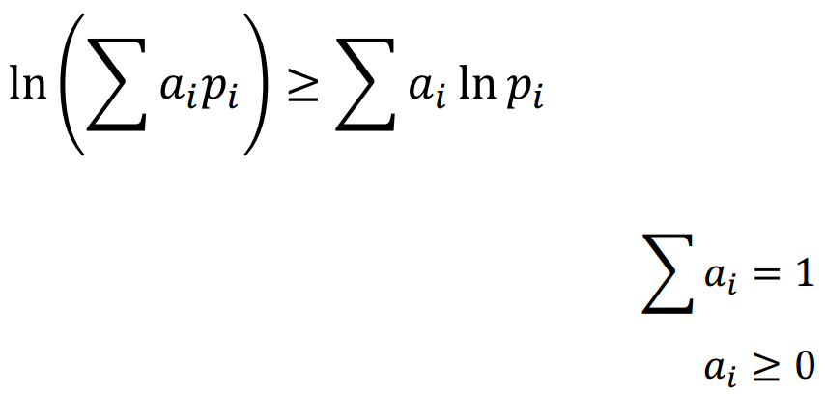
Expectation-Maximization(EM)

Slide 33
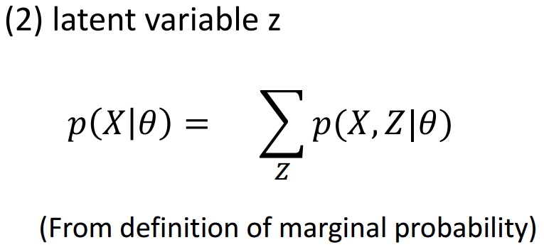
Expectation-Maximization(EM)

Slide 34

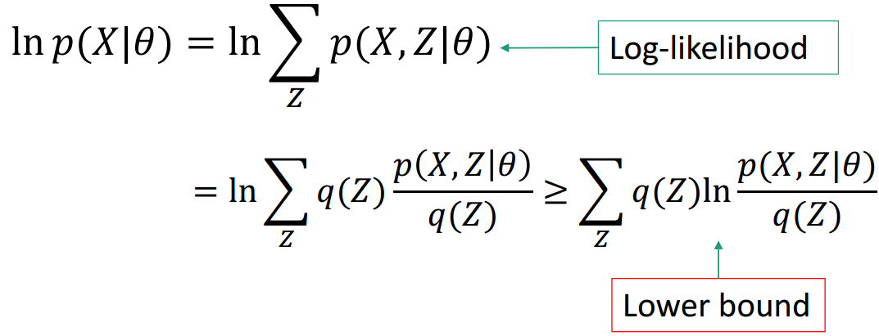
Expectation-Maximization(EM)

Slide 35
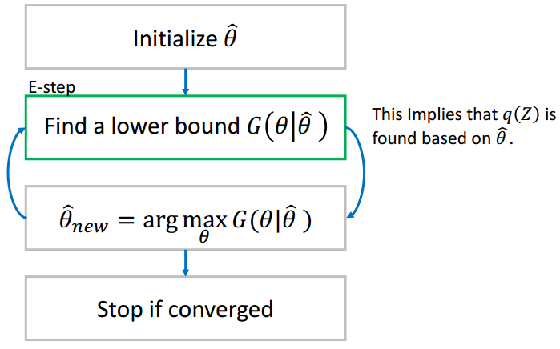
Expectation-Maximization(EM)

Slide 36
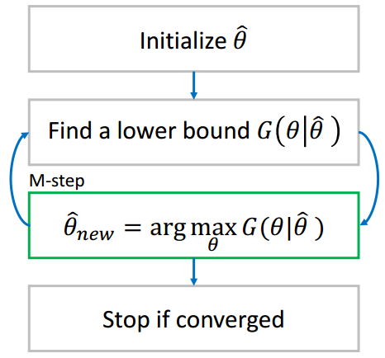
Expectation-Maximization(EM)

Slide 37
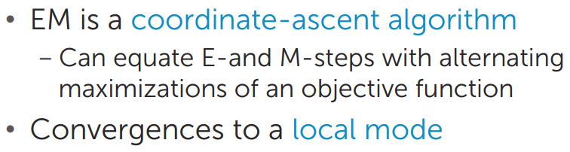
Convergence of EM

Slide 38
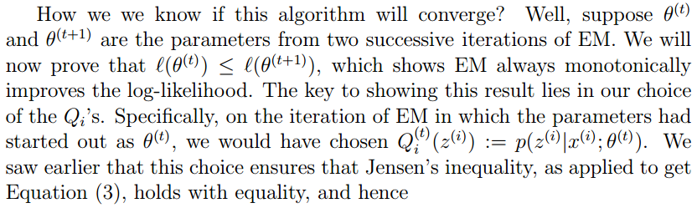
Convergence of EM

Slide 39

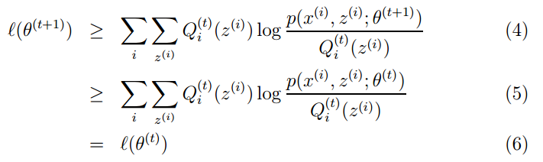
Convergence of EM

Slide 40
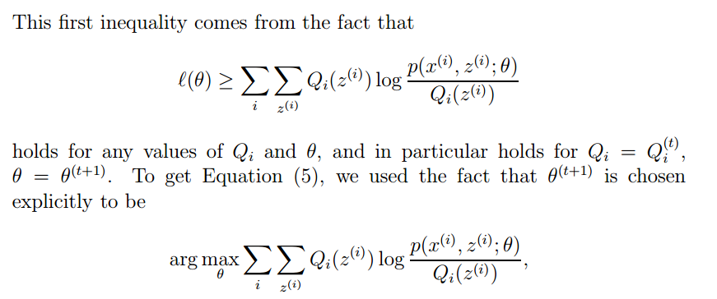

Slide 41


Slide 42


Slide 43


Slide 44


Slide 45


Slide 46

Initialization
Many ways to initialize the EM algorithm
Important for convergence rates and quality of local mode found

