Slide 1
CS2040 Lab 1 Java Introduction

Slide 2
Self Introduction
Louiz Kim-Chan
Telegram: @LouizK
Email: louiz.kc@u.nus.edu
Major/Specialization: Computer Science/Computer Graphics and Games
Lim Kai Le
Telegram: @kaile1997
Email: e0321492@u.nus.edu
Major: Business Analytics

Slide 3
Lab Introduction
2-hour session every Friday
Intended to provide hands-on experience with programming
Involves one-day assignments, and take-home assignments
One-day assignments (solving 1 problem) should ideally be completed within the lab itself. The actual duration of the deadline is 8am on Friday to 8am on Saturday, but the assignment is “doable” within the duration of the lab.
Take-home assignments (solving 2 problems) should be completed before the deadline (2 weeks per take-home assignment)
Telegram group link: https://t.me/joinchat/SddAXTHNk3ZESboU (in case you missed the email)

Slide 4
Lab Structure
1st part of labs (max. 30 min): short lesson
Cover answers for the previous session’s assignments (one-day, and take-home, where applicable)
Cover relevant Java API for the session’s given topic
Brief discussion of the one-day assignment
2nd part of labs: solving the one-day assignment (graded)
The first 20-30 minutes of this part will be used for students to plan how to solve the assignment, and express it in terms of pseudocode
Allowed to discuss at algorithm level with other students, but no discussing/sharing of code
Type out the pseudo-code for your solution, which has to be shown to the TAs
Can continue working on the assignment after the lab if necessary

Slide 5
Kattis Introduction
Online platform used for submitting and grading assignments
Found at https://nus.kattis.com/

Slide 6
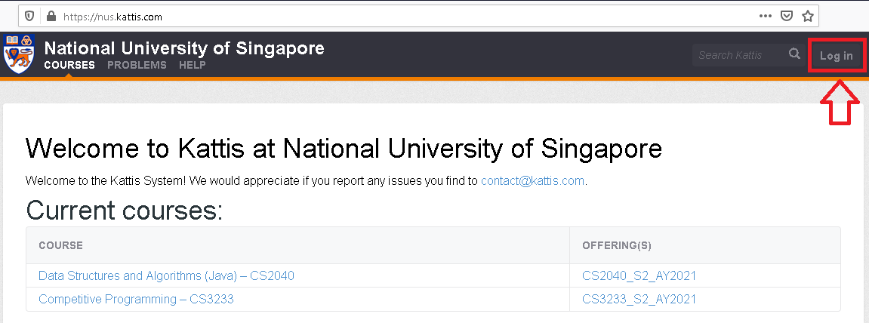
Kattis Introduction – Signing Up

Slide 7
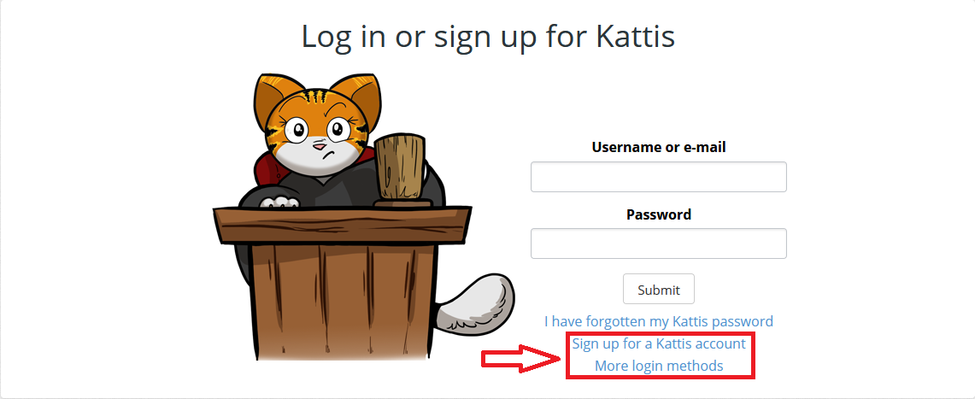
Kattis Introduction – Signing Up

Slide 8
Kattis Introduction – Signing Up
Can sign up using email, or through linking to Facebook/Google/LinkedIn
For name, please use your name as on LumiNUS, but only capitalize the first letter
Eg. if your name on Luminus is “CHEN JIN XIONG, RYAN” (not a real student, as far as I can tell) then use “Chen Jin Xiong, Ryan” (ie, do not change the ordering)
There is currently no way to edit an account name once it has been created, so be careful

Slide 9
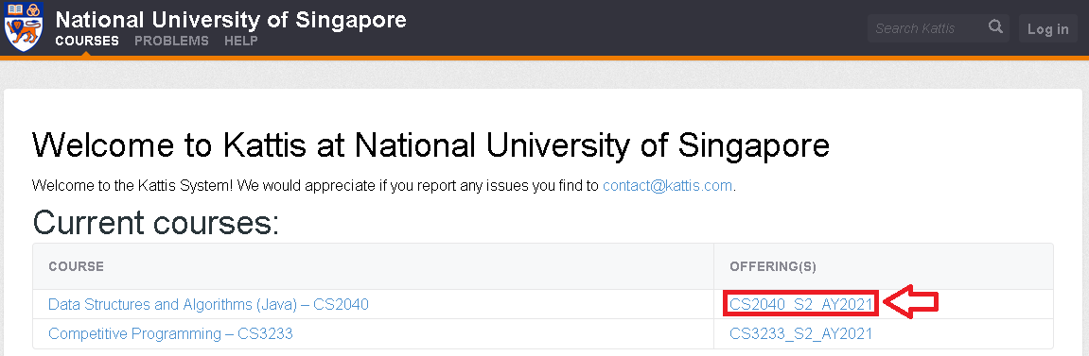
Kattis Introduction – Registering for CS2040

Slide 10
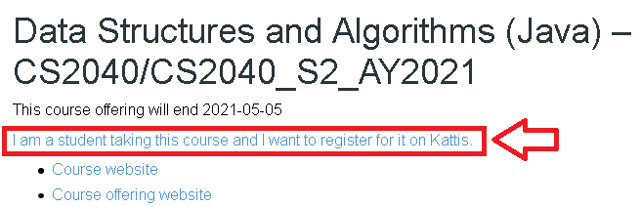
Kattis Introduction – Registering for CS2040
Registration Code = cs2040_2021_s2_ckf

Slide 11
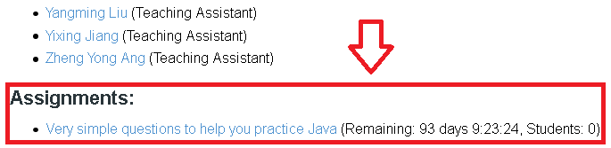
Kattis Introduction – Assignments
All problem sets will appear here (bottom of the course page)

Slide 12
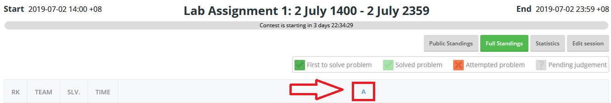
Kattis Introduction – Assignments
Click on the letter to access the problem (only visible when session opens)

Slide 13
Lab 1 – Runtime Analysis
In CS2040, sometimes having a program/algorithm give the correct answer may not be sufficient; it may be required that your program/algorithm should run quickly as well
Kattis provides the maximum running time for a program in the problem description on the right, under “CPU Time limit”
Generally, machines on Kattis can run close to 100 million operations a second
Try calculating whether your program can pass the time limit based off its time complexity
Eg for a problem where N <= 1000, and the time limit is 1 sec, at max value of N (1000): N³ = 1 billion = probably not okay (> 100 million), whereas N² = 1 million = okay

Slide 14
Lab 1 – Runtime Analysis
Also note that the methods provided by Java API may not run in O(1) time, and as such your program may run slower than intended if this is not taken into consideration
To fully understand the methods provided by the API, it is recommended to read up the documentation
The following slides are based off the Java 8 API documentation: https://docs.oracle.com/javase/8/docs/api/
Documentation of the later versions of Java (up to Java 10) follows the same idea, but uses a different layout by default. To view them in the same manner, click on “FRAMES” at the top of the page
Documentation from Java 11 onwards does not seem to support frames, requiring manual navigation of the packages (or just search for the class name via Google, or the search bar at the upper right of the Java API page)

Slide 15
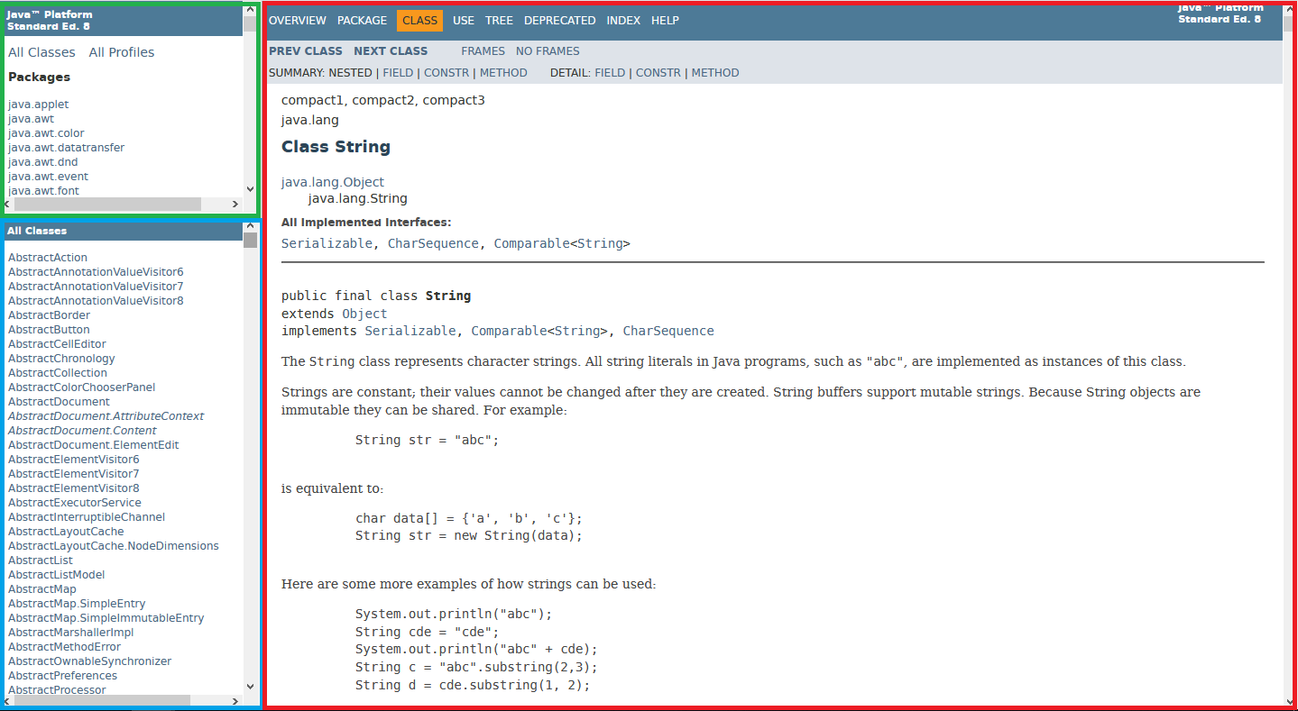
Lab 1 – Reading Java API
Package window: can click on them to view only classes from a single package
Main window: shows all the details of the selected class
Class window: click on one of them to view the full API of that class

Slide 16
Lab 1 – Reading Java API
For the package window, clicking on a package will switch the class window to show only the classes in that package
Frequently used packages are:
java.util
Almost everything that’s covered later in the module
java.lang
Strings and related classes
Wrapper classes
java.io
Buffered input/output (covered in a later lab)
For Java 9 onwards, these are found under the java.base package in the documentation (but retain the same package names otherwise)

Slide 17
Lab 1 – Reading Java API
For the main window, the contents tend to be sorted as follows:
1. Brief description of class
2. Fields, constructors and methods (short version, sorted alphabetically)
Click on an entry here to go to the relevant entry in section 3
3. Fields, constructors and methods (long version, may not be sorted)
The time complexity of a method will sometimes be stated in section 1 or 3

Slide 18
Lab 1 – Useful API
Scanner class – used for reading input
Found in the java.util package; need to use the following line to import:
import java.util.*;
Declare a new Scanner object with the following line (in main method):
Scanner sc = new Scanner(System.in);
Read in input using the methods found in Scanner:
int testCases = sc.nextInt();

Slide 19
Lab 1 – Scanner
Method name | Description | Time
.nextInt() | Reads the next token in the input as an integer | O(n)
.nextDouble() | Reads the next token in the input as a double | O(n)
.next() | Reads the next token in the input as a String | O(n)
.nextLine() | Reads until it reaches the end of the line | O(n)
n refers to the length of the input that is read
These slides covering API will cover the most frequently used (but not all) methods of a class;
for a full list, refer to the Java API documentation

Slide 20
Lab 1 – System.out (not really a class)
Method name | Description | Time
System.out.print(String str) | Prints str | O(n)
System.out.println(String str) | Prints str, followed by a newline character (‘\n’) | O(n)
System.out.printf(String format, Object… args) | Emulates the printf function from C | O(n)
n is the length of the output
Technical note: System.out is an instance of the PrintStream class, so you may refer to the API documentation on PrintStream (in java.io) to explore more methods

Slide 21
Lab 1 – Useful API
String class – contains several methods that could be of use
Found in the java.lang package; is imported by default
Can be constructed in various ways:
String str1 = new String("apple");
String str2 = "apple";
char[] arr = {'a', 'p', 'p', 'l', 'e'};
String str3 = new String(arr);

Slide 22
Lab 1 – String
Method name | Description | Time
.split(String delim) | Splits a String into an array of Strings, based off the characters found in delim | O(length of string)
.charAt(index i) | Returns the character at index i (0-based) | O(1)
.equals(String other) | Checks if this string has the same value as the value of String other Note: not the same as using == | O(length of shorter string)
.concat(String other) | Returns a new string which is this string + other Note: does not modify the original String (Strings are immutable in Java) | O(length of resulting string)
.length() | Returns the length of the string | O(1)
.substring(int start, int end) | Returns a new string, which contains the content of the original string from index start (inclusive) to index end (exclusive) (indices are 0-based) | O(length of resulting string)

Slide 23
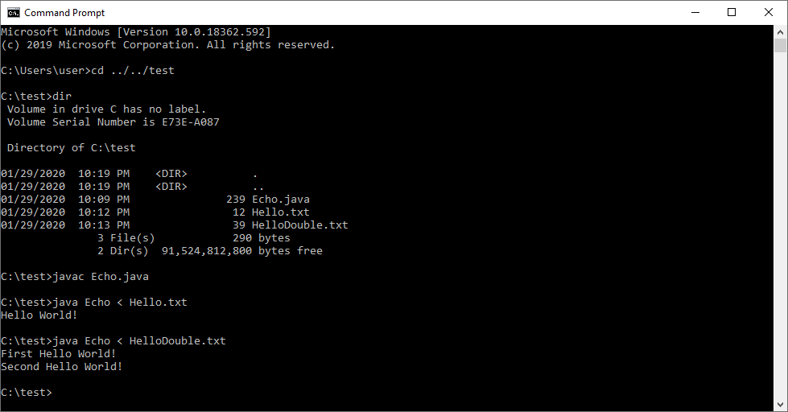
Lab 1 – Command Line/Terminal Usage
It is helpful to know how to compile and execute Java programs via command line (example below)

Slide 24
Lab 1 – Command Line/Terminal Usage
cd ../../test
“cd” is the command used to move between folders. “..” means to go up one folder
dir
Used to list the contents of a folder. Use “ls” (lowercase L, lowercase S) on Unix-like systems
javac Echo.java
“javac” is the command use to compile Java programs. The full file name (inclusive of “.java”) is required, and seeing no output is a good thing.
Each class in the Java file is compiled to its own “.class” file

Slide 25
Lab 1 – Command Line/Terminal Usage
java Echo < Hello.txt
java Echo < HelloDouble.txt
“java” is the command used to run compiled Java programs. No filename extension (.java, .class) should be provided
“<“ followed by the name of a file is used to provide input from a file (known as input redirection). Instead of having to type out your input manually; simply save your input in a file and use “<“ to avoid retyping input each time you test your program

Slide 26
One-Day Assignment 0 – Pea Soup
First one-day assignment; is ungraded
Found at https://nus.kattis.com/problems/peasoup
Future assignments will be found on the main Kattis course page at https://nus.kattis.com/courses/CS2040/CS2040_S2_AY2021 (at the bottom of the page).
Writing pseudocode for this assignment is not necessary, but will be required from the next one-day assignment onwards

Slide 27
One-Day Assignment 0 – Pea Soup
Given a list of restaurants, and their menus, determine the first restaurant appearing in the list that offers both “pea soup” and “pancakes”
Should be the exact strings “pea soup” and “pancakes”; even if a menu item contains the substring “pea soup” or “pancakes”, ignore it (see Sample Input 2)

Slide 28
Assignment Guidelines
Important: Include your name and student number in comments at the top of your code
Rehash of “IMPORTANT Rules for CS2040 Assignments” file:
If you discuss the problem with any other student(s), include their name(s) as collaborators in a comment at the top of your code
No usage of anyone else’s code (outside of code provided in lecture materials)
Directly using (eg. copy-paste) is not allowed
Using code as a reference is not allowed either

