Slide 1
DIGITAL PORTFOLIO
STUDENT NAME: SINDHUJA
REGISTER NO AND NMID: 212401034
DEPARTMENT: BCA
COLLEGE: PRINCE SHRI VENKATESWARA ARTS AND SCIENCE COLLEGE

Slide 2
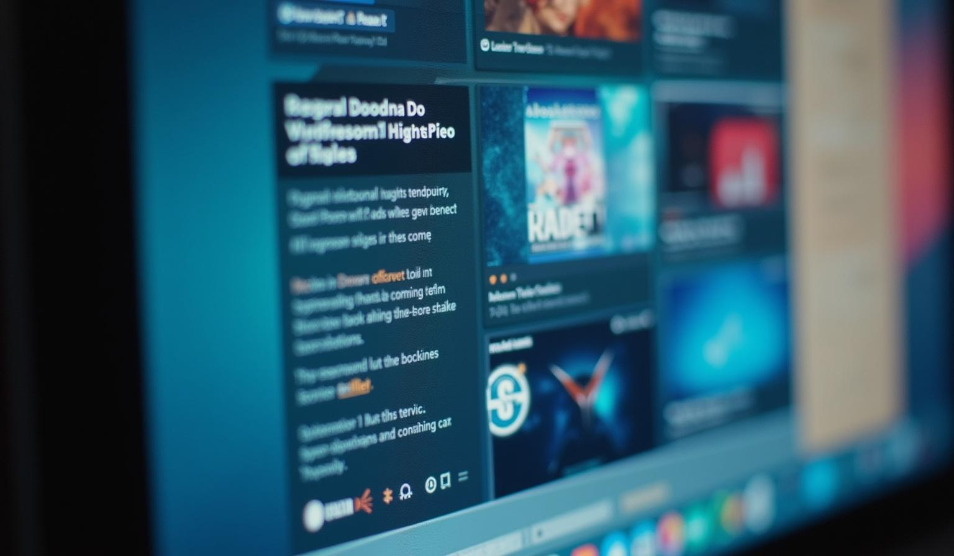
PROJECT TITLE
DIGITAL PORTFOLIO

Slide 3
AGENDA
1.Problem Statement
2.Project Overview
3.End Users
4.Tools and Technologies
5.Portfolio design and Layout
6.Features and Functionality
7.Results and Screenshots
8.Conclusion
9.Github Link

Slide 4
PROBLEM STATEMENT
Many students and beginners lack a proper platform to showcase their skills and projects.
Traditional resumes cannot highlight interactive web skills.
Need for a personal portfolio website to represent skills, projects, and contact details effectively.

Slide 5
PROJECT OVERVIEW
A clean and modern portfolio website.
Highlights my skills, projects, and contact details.
Built with HTML, CSS, JavaScript for responsive design.
Includes an interactive contact form.

Slide 6
WHO ARE THE END USERS ?
Recruiters & Hiring Managers: To quickly evaluate technical skills.
Peers & Faculty: For academic and collaborative project reviews.
Personal Branding: To showcase work to a wider audience.

Slide 7
TOOLS AND TECHNIQUES
Frontend: HTML, CSS, JavaScript
Programming: C, C++, Java, Python
Version Control: GitHub
Editor: VS Code

Slide 8
PORTFOLIO DESIGN AND LAYOUT
Navigation Bar: About, Skills, Projects, Contact
Hero Section: Name, title, and short tagline
Skills Section: Progress bars for programming & web dev
Projects Section: Portfolio website, mini projects
Contact Section: Form for easy communication

Slide 9

FEATURES AND FUNCTIONALITY
Responsive design (works on mobile & desktop)
Interactive skill progress bars
Contact form with validation
Organized project showcase
Clean and user-friendly UI

Slide 10
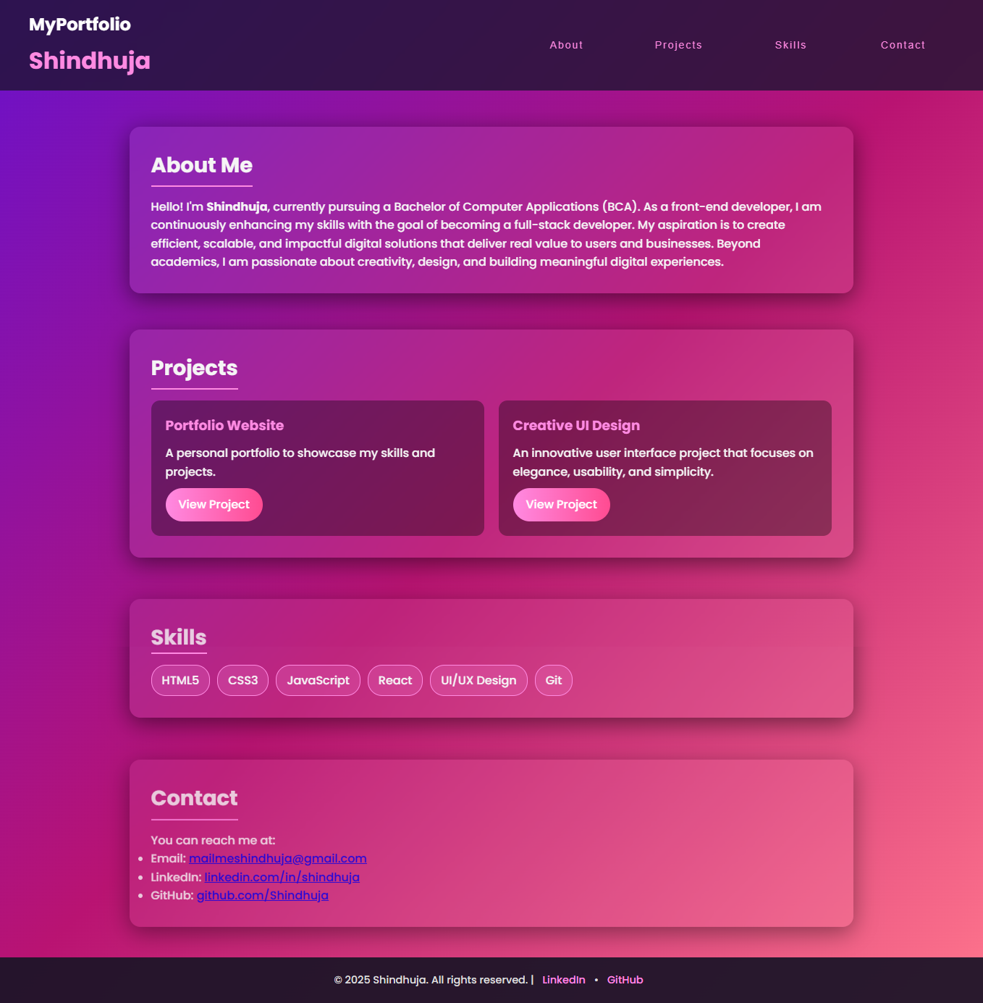
RESULTS

Slide 11
CONCLUSIONS
Portfolio serves as a digital resume.
Showcases technical skills and projects effectively.
Helps in academic evaluation and career opportunities.
Future scope: Add backend, more projects, blog section.

Slide 12
GitHub Link
https://13341bca2024-hash.github.io/My-portfolio/

