Slide 1
Digital Portfolio
STUDENT NAME: SANGAVI.S
REGISTER NO AND NMID: 212401028
DEPARTMENT: BCA
COLLEGE: PRINCE SHRI VENKATESWARA ARTS AND SCIENCE COLLEGE/ MADRAS UNIVERSITY

Slide 2
PROJECT TITLE
Digital portfolio

Slide 3


AGENDA
Problem Statement
Project Overview
End Users
Tools and Technologies
Portfolio design and Layout
Features and Functionality
Results and Screenshots
Conclusion
Github Link
3/21/2024 Annual Review

Slide 4
PROBLEM STATEMENT
Design and develop a personal portfolio website for Sangavi.S, a II BCA B student, to showcase her skills, background, and contact information. The portfolio should include the following sections: (1) About Me – a short introduction about Sangavi, (2) Skills – a list of technical skills such as HTML5, CSS3, JavaScript, React, Node.js, and Git, (3) Contact – ways to connect with her including email, LinkedIn, and GitHub. The website must be modern, responsive, and user-friendly.

Slide 5
PROJECT OVERVIEW
About Me – A brief introduction about Sangavi, her passion for web development, and her continuous learning mindset.
Skills – A structured list of her technical expertise, including HTML5, CSS3, JavaScript, React, Node.js, and Git.
Contact – Provides multiple ways to connect, such as Email, LinkedIn, and GitHub

Slide 6

WHO ARE THE END USERS?
Recruiters / Hiring Managers – People who want to quickly review your background, skills, and projects for internships or job opportunities.
Peers / Classmates / Faculty – Students, teachers, and mentors who may look at your work for academic or collaborative purposes.
Professional Network (LinkedIn, GitHub visitors, etc.) – Developers, professionals, and collaborators who may discover your portfolio via shared links.
You (the owner/developer) – As the website owner, you also benefit by using it as a personal branding tool and continuously updating it with new skills/projects

Slide 7
TOOLS AND TECHNIQUES
Tools:
Visual Studio Code (VS Code): Code editor used for writing and debugging HTML, CSS, and JavaScript.
Git & GitHub: Version control and collaboration platform for hosting the portfolio.
OneCompiler: Online compiler for testing and running code snippets.
Browser Developer Tools (Chrome/Edge): For inspecting elements, debugging styles, and testing responsiveness.
Techniques:
HTML5 & CSS3: For structuring content and styling the portfolio.
Responsive Design: Ensuring the portfolio works smoothly on desktop, tablet, and mobile devices.
JavaScript (ES6+): Adding interactivity and dynamic features.
React (optional if used): For building reusable and interactive UI components.
Node.js (optional if backend planned): For backend integration if expanding portfolio into a full-stack app.

Slide 8
POTFOLIO DESIGN AND LAYOUT
Header / Navbar
Keep your name and role at the top with a modern font.
Add a sticky navbar with smooth scrolling:
About Me
Skills
Projects (optional)
Contact
2. Hero Section
Add a profile image or avatar.
Include your name, role (Web Developer), and a tagline like:
"Passionate Frontend Developer | Creating modern, responsive websites."
Add a call-to-action button: "Download Resume" or "Contact Me".
3. About Me
Keep your intro text but format it nicely.
Use a two-column layout: left side with an image, right side with your text.
8

Slide 9
FEATURES AND FUNCTIONALITY
Features for Portfolio
Responsive Design
Works smoothly on mobile, tablet, and desktop.
Navigation bar turns into a hamburger menu on small screens.
Smooth Navigation
Sticky navbar.
Smooth scroll to sections.
Highlight active section in the navbar.
Functionalities for Portfolio
Interactivity
Smooth scroll animations when clicking navbar.
Hover effects on links, buttons, and project cards.
Dark/Light Mode Toggle 🌙☀️ (optional but modern).

Slide 10
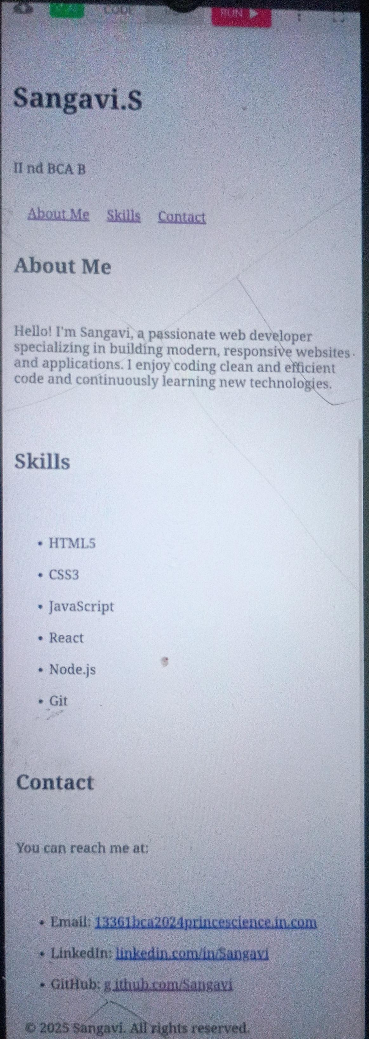
RESULTS AND SCREENSHOTS
3/21/2024 Annual Review
10

Slide 11
CONCLUSION
Thank you for visiting my portfolio! I am passionate about creating user-friendly and responsive websites while continuously improving my skills in modern web technologies. I look forward to collaborating on innovative projects and contributing my knowledge to build impactful solutions.
11

Slide 12
GitHub link
https://github.com/13361bca2024-stack/TNSDC-FWD-DP.git

