Slide 1
2020暑期pwn入门培训
栈溢出进阶
wxk@Lilac

Slide 2
catalog
ROP
stack pivotint
ret2libc
canary

Slide 3
1.ROP
Return Oriented Programing

Slide 4
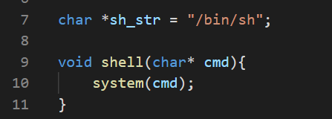
stack3.c
how to control the parament?

Slide 5
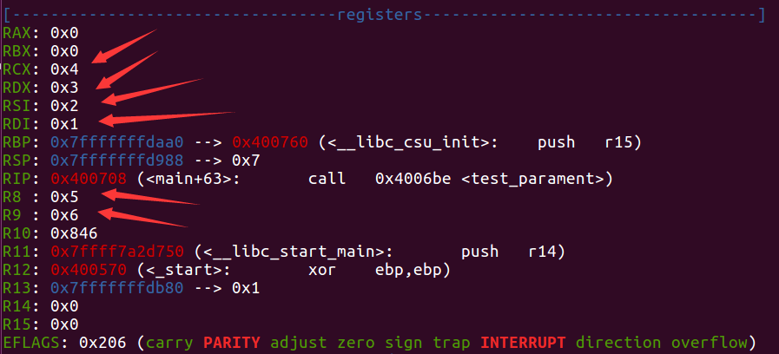
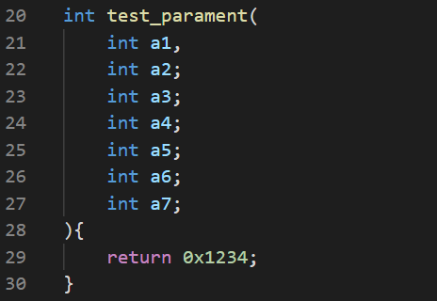
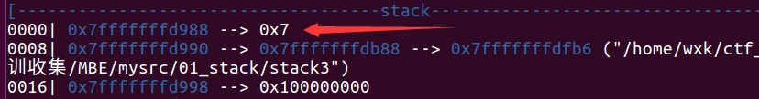
how function pass praments
rdi, rsi, rdx, rcx, r8, r9 + stack
linux && amd64!!!

Slide 6
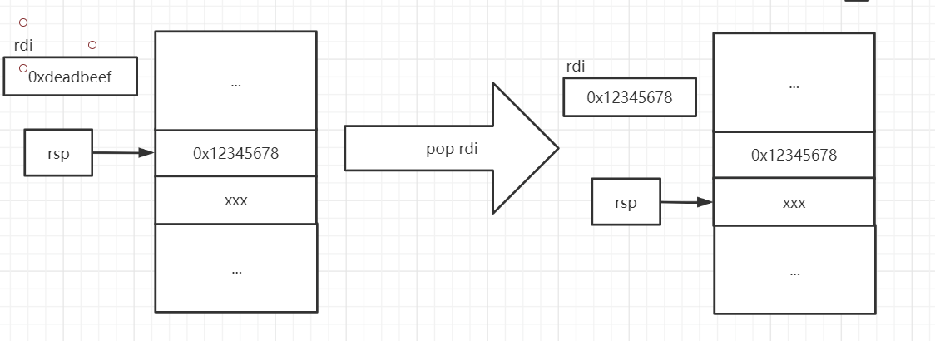
so, how to control rdi ?
pop rdi

Slide 7
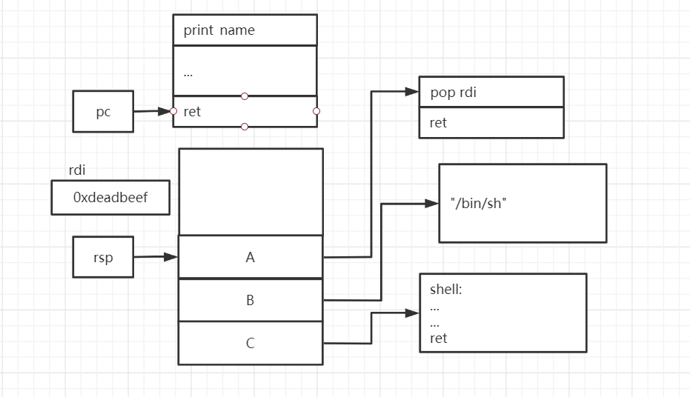
when return from print_name

Slide 8
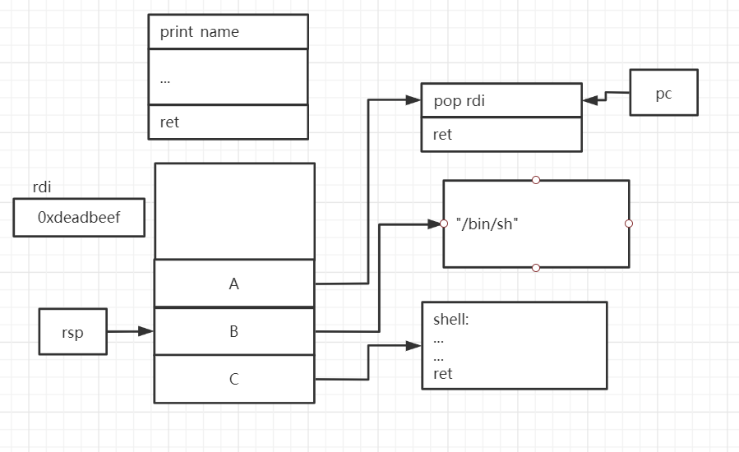
pop rdi

Slide 9
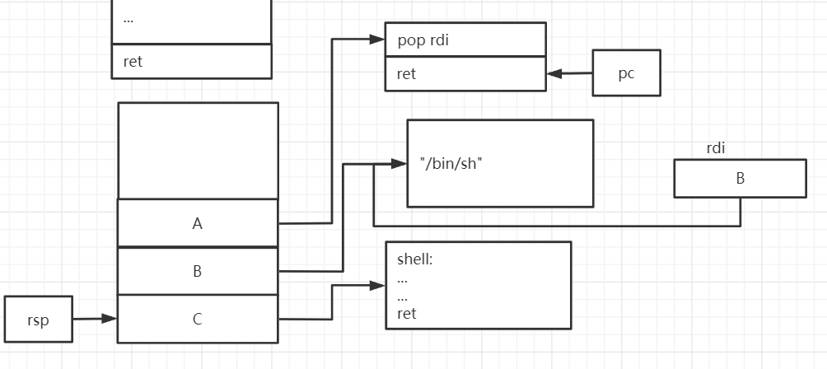
ret again

Slide 10
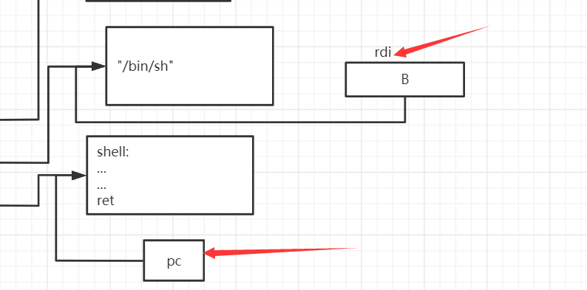
pwn !

Slide 11
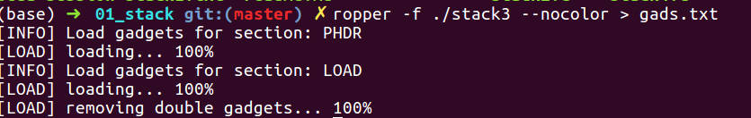
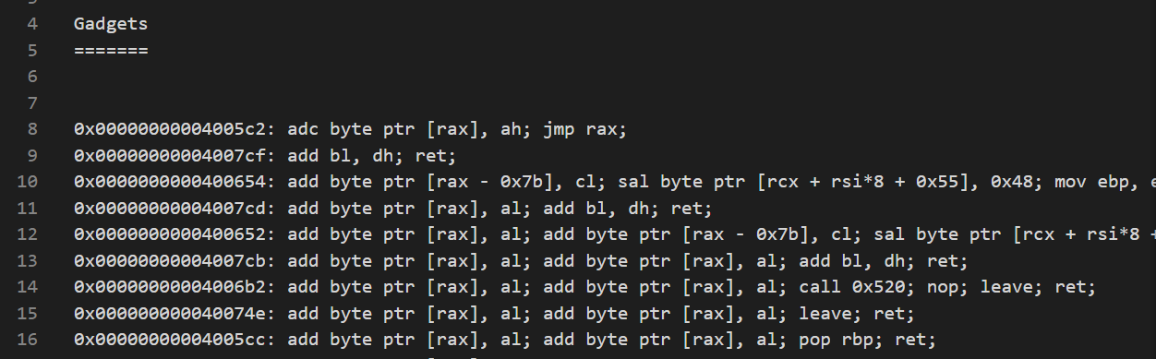
how to find gadgets
ropper -f binary

Slide 12
2. stack pivoting
no return address

Slide 13
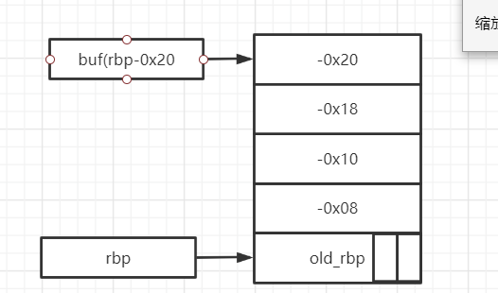
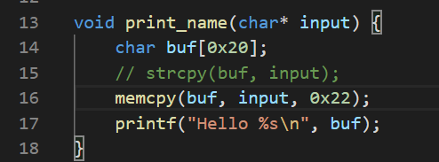
stack4.c
unable to overwrite return address

Slide 14
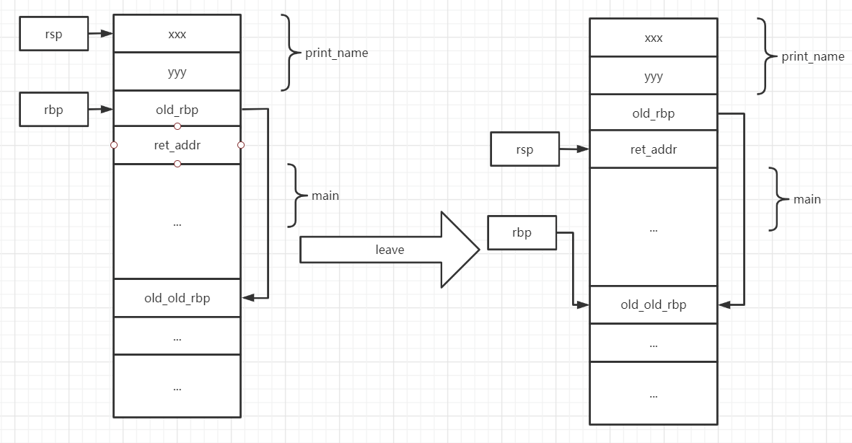
leave
rsp <- rbp
pop rbp

Slide 15
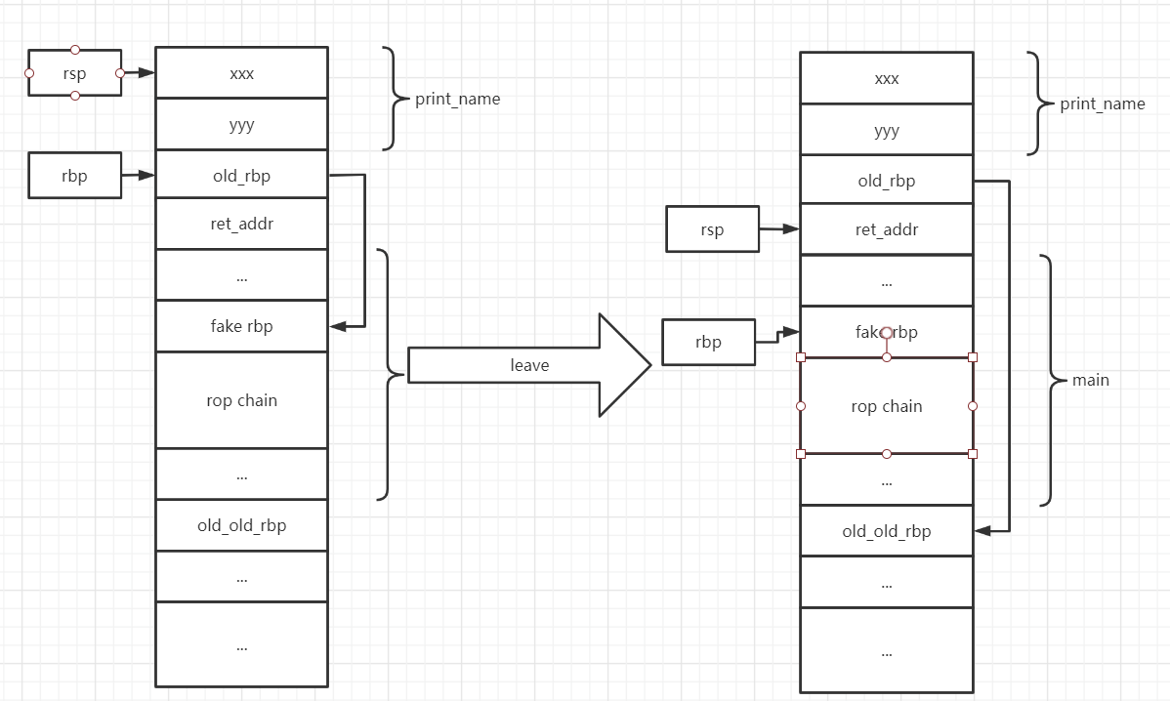
overwrite saved_rbp 栈帧 stack frame

Slide 16
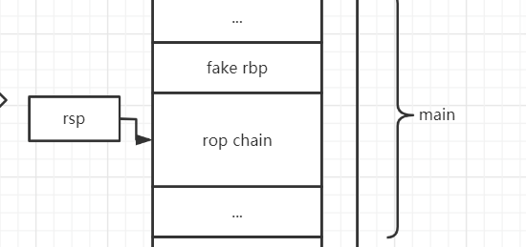
when main return
pwn !

Slide 17
3. ret2libc
no backdoor anymore
where to find system ?

Slide 18
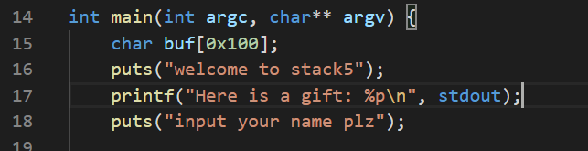
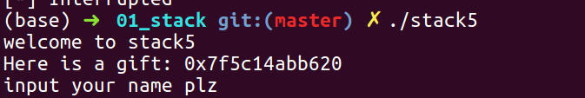
stack5.c
a gift
execute
a global variable in libc

Slide 19
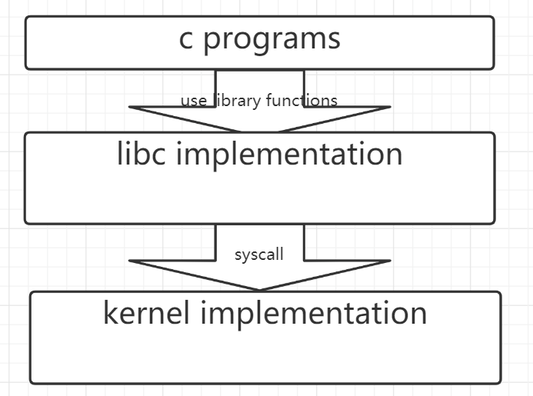
what is libc
c standard library
provide many useful functions
printf
puts
…
also, system
loaded to memory space
with random start address

Slide 20
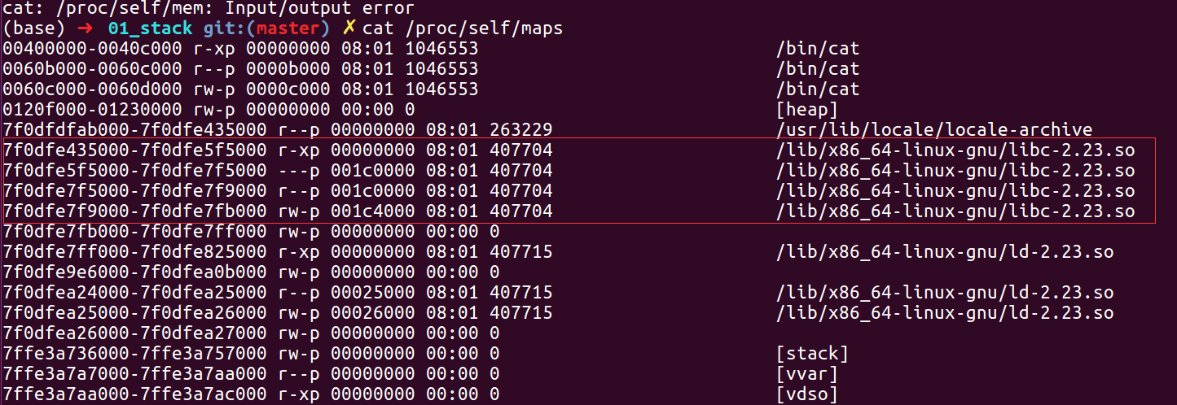
what is libc
c standard library
provide many useful functions
printf
puts
…
also, system
loaded to memory space
with random start address

Slide 21
what is libc
c standard library
provide many useful functions
loaded to memory space
with random start address
but inner offset is the same

Slide 22
then, how to get system address
debug to get the offset
then simple rop

Slide 23
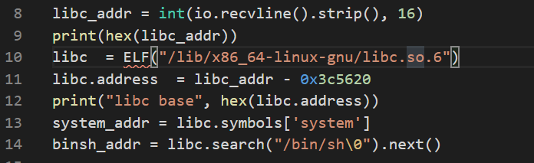
A more generic way
calc libc base
automate generate function/str address

Slide 24
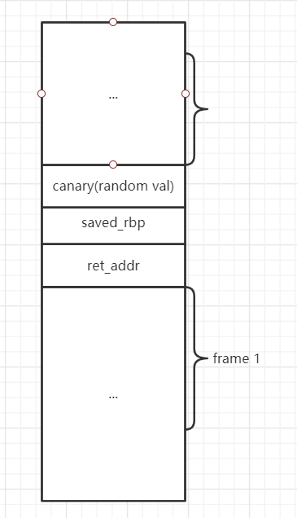
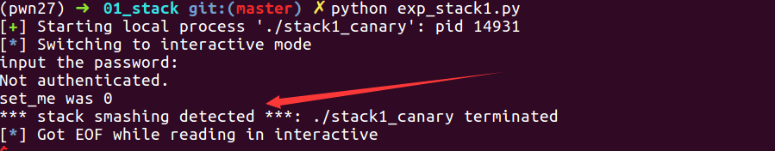
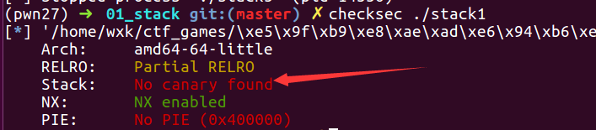
4. canary
A defender view
gcc -O0 -no-pie stack1.c -o stack1_canary
ssp leak

Slide 25
Q&A

