Slide 1
2020暑期pwn入门培训
shellcode
wxk@Lilac

Slide 2
catalog
intro to syscall
ret2shellcode
orw shellcode
seccomp
advanced shellcode
printable shellcode
side-way attack
defender view
reference

Slide 3
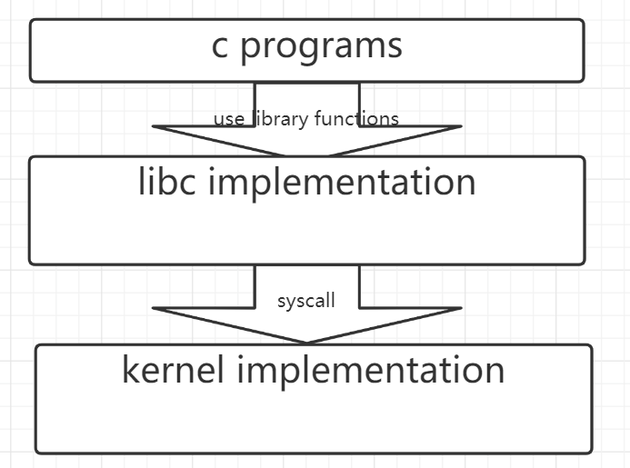
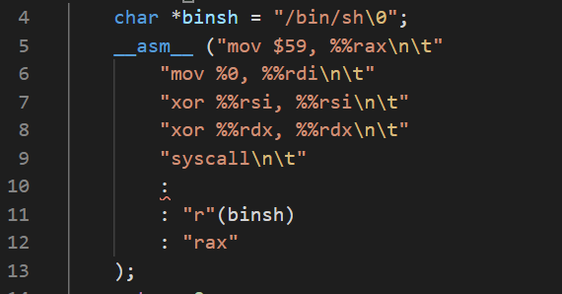
Get shell without system
use syscall
sc1.c
system(“/bin/sh”)

Slide 4
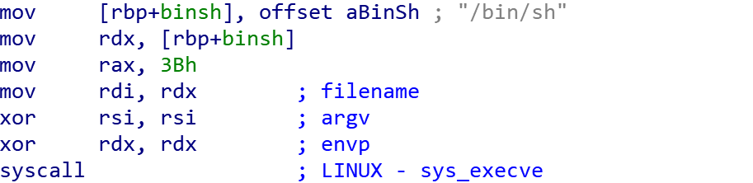
sc1

Slide 5
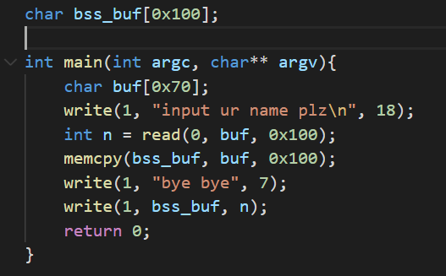
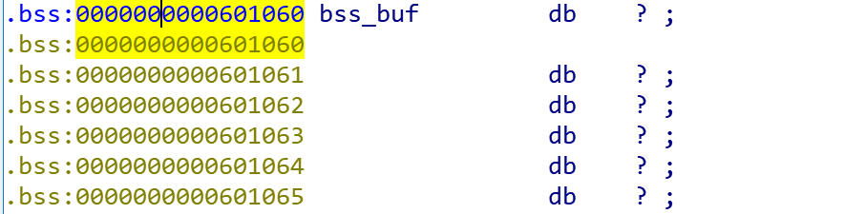
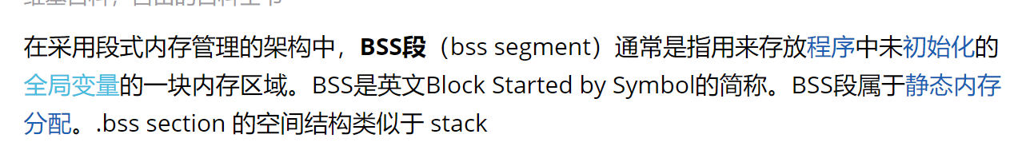
sc2.c
Best Saving Space

Slide 6
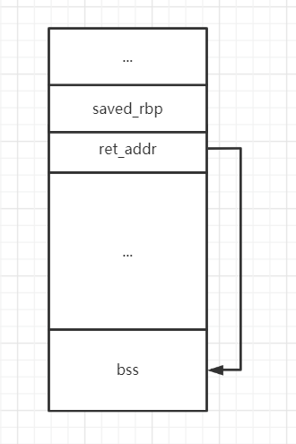
sc2.c
ret2shellcode

Slide 7
how to get shellcode
website: exploitdb
手写
pwntools, 永远滴神!
shellcraft.amd64.linux.sh()

Slide 8
intro to seccomp
syscall sandbox
use it to abandon syscalls
e.g. only open, read, write is allowed
secure computation

Slide 9
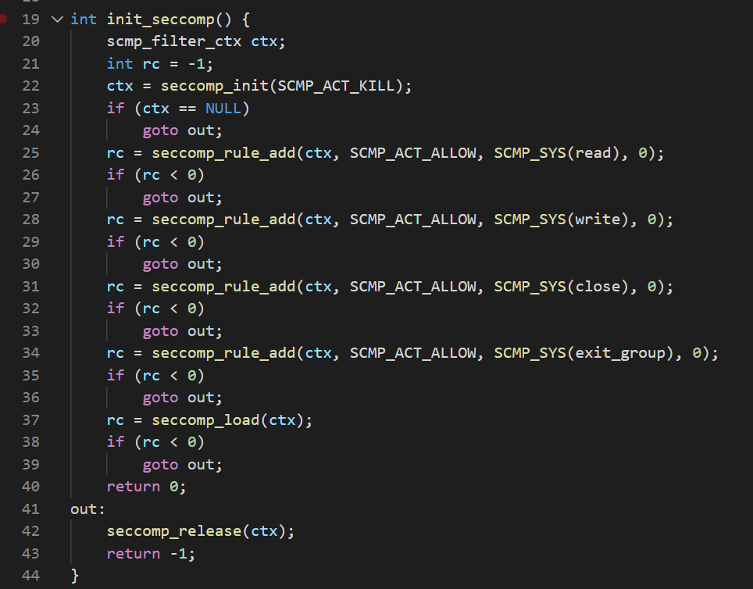
sc3.c

Slide 10
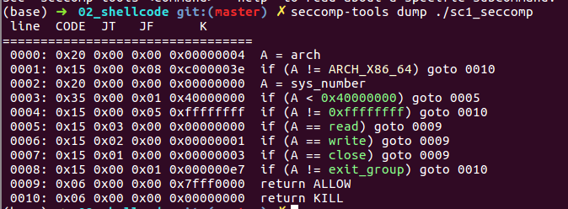
seccomp-tools
https://github.com/david942j/seccomp-tools
install ruby2.4: https://www.brightbox.com/blog/2017/01/13/ruby-2-4-ubuntu-packages/

Slide 11
orw shellcode
open(“flag”, O_RDONLY)
read(‘rax’, buf, 0x40)
write(1, buf, 0x40)

Slide 12
sc3.c
sc2.c + seccomp
no shell any more
how to get shellcode ?
查syscall-table + 手写
pwntools yyds!

Slide 13
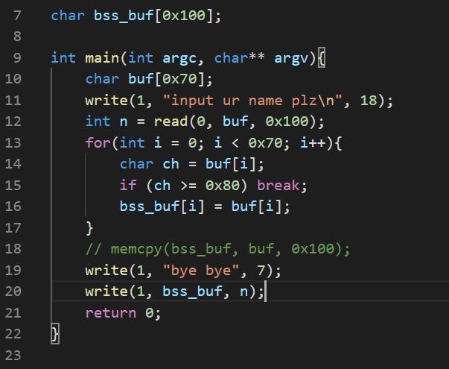
printable shellcode
shellcode中不能包含不可见字符
sc4.c
Alphanumeric shellcode

Slide 14
how to get printable shellcode
找现成的
手写: https://nets.ec/Alphanumeric_shellcode
使用alpha3 生成:
参考教程: https://www.jianshu.com/p/8ae8c055e35c

Slide 15
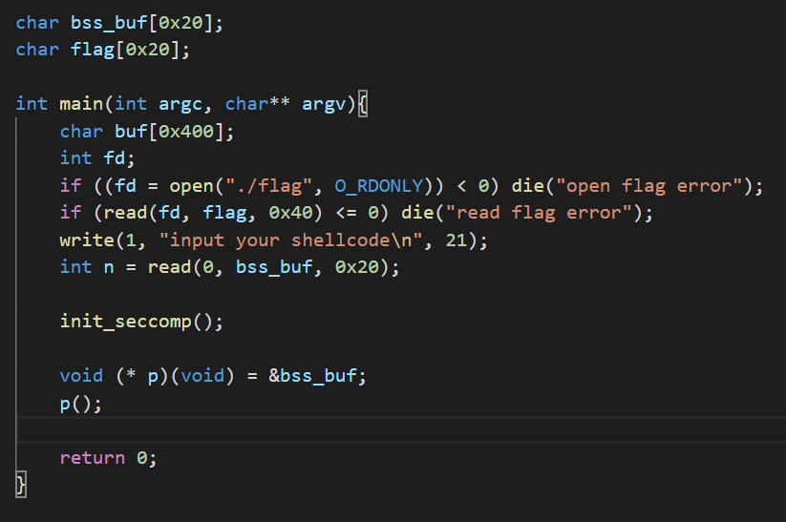
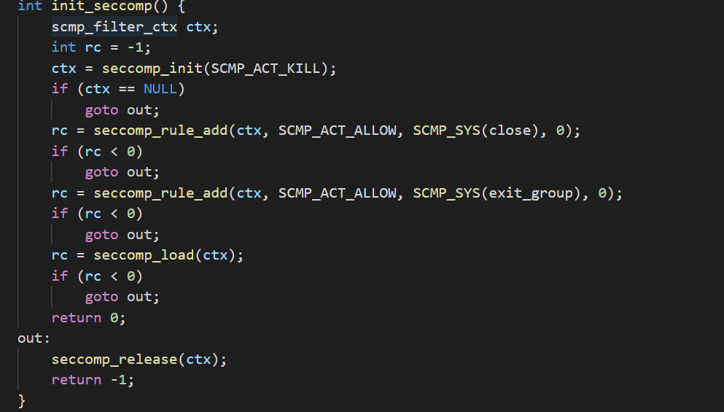
even no orw
sc5.c

Slide 16
side-way leak
依次爆破flag中每个字符
相同 => 死循环
不同 => 程序退出
io.connected()

Slide 17
no rwx segment
shellcode 利用的根本原因是代码段和数据段没有分开
明明是可读可写的数据段, 却可以当作代码段执行 (rwx)
只允许rw / rx. 禁用 rwx (gcc默认)
-z execstack

Slide 18
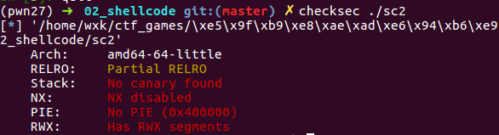
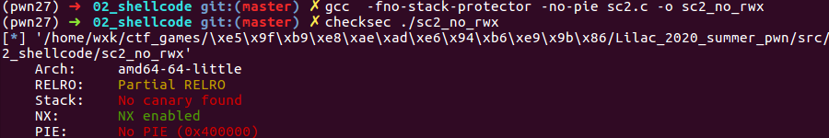
no rwx segment
gcc –z execstack
checksec

Slide 19
参考
内联汇编
linux amd64 syscall table

