Slide 1
Macbeth
William
Shakespeare

Slide 2
Context
1
Historical Background
2
Story of Macbeth
3
Quotes
4
Comment
Notes:
Introduce Macbeth With 4 steps

Slide 3
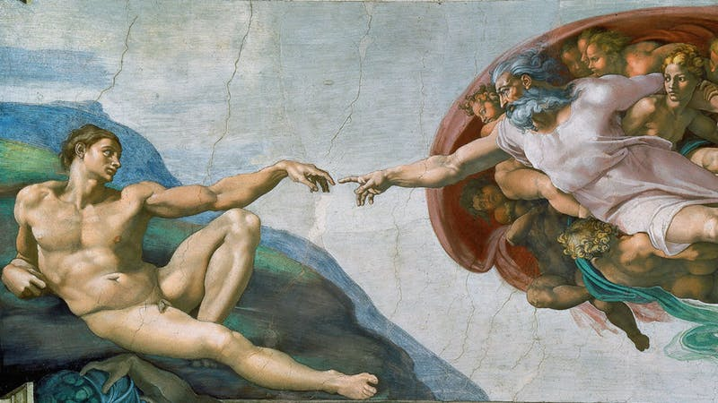
the Renaissance
the period of time in Europe between 14th and 17th centuries,
when art, literature, philosophy , and scientific ideas became very important
and a lot of new art was produced。
Notes:
To enjoy… social background

Slide 4
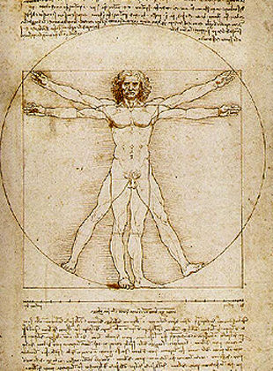
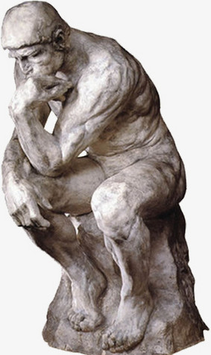

the Renaissance
Leonardo da Vinci
Michelangelo
Shakespeare
Notes:
At that time…

Slide 5

the Renaissance
The first period(1590－1600)
Shakespeare: was confident for that ideal could defeat social reality
Category: historical plays and comic plays
Style: optimistic, and advocates friendship, sincere love
The Merchant of Venice
Notes:
The styles of ....

Slide 6

the Renaissance
The second period(1601－1607)
Shakespeare : Realized that it was difficult to resolve conflicts between ideal and the social reality.
Category: Tragedy
Style: Pessimistic
Macbeth
Notes:
Most of his works

Slide 7

the Renaissance
The last period(1608－1613)
Shakespeare : Knew the ideal was hard to achieve and compromised
Category: Fancy works
The winters’ tale

Slide 8
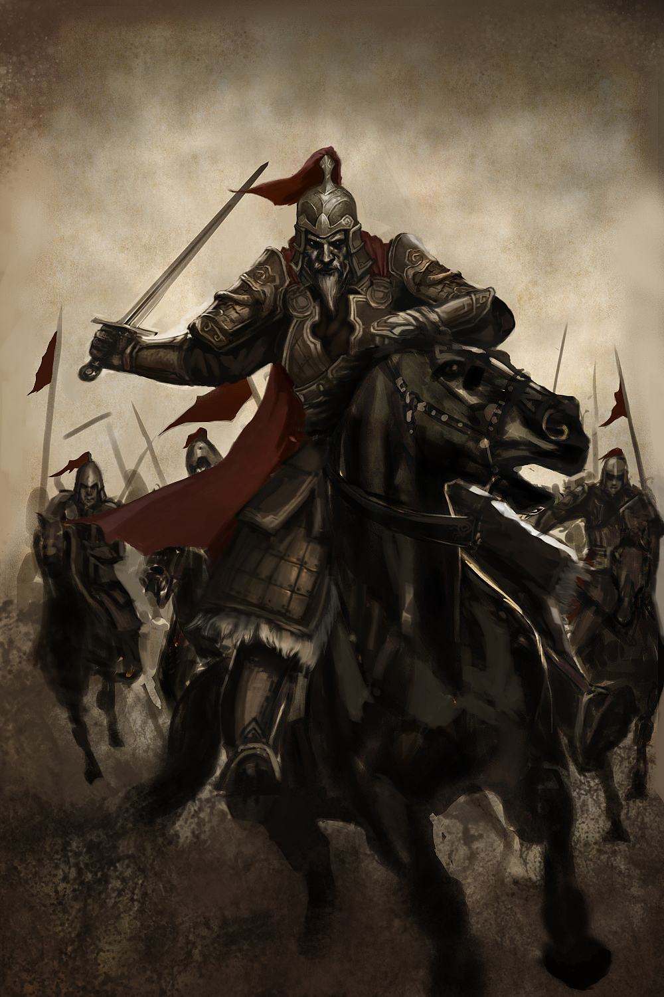
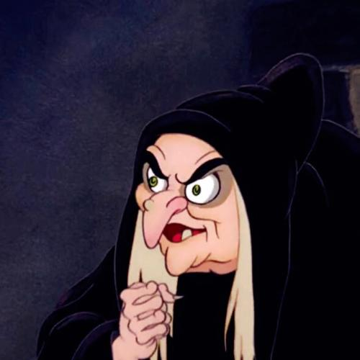
The story of Macbeth
Characters
The King
Macbeth
Banquo
(general)
(general )
General
3 witches
Witch
Notes:
Let’s get back to Macbeth,….. I would like to

Slide 9
The story of Macbeth
Act 1.
● Macbeth won the war and got back with Banquo, and they met 3 witches.
● The witches told Macbeth would get promote and even be a king, and Banquo’s son would also be a king.
● That was the position Macbeth could never get, so Macbeth didn’t believe it at first until the messager appointed by the King told him about this promotion.
● Macbeth started believing it and told his wife he would be the King when he got home.
Notes:
Macbeth tragedy 5acts retell

Slide 10
The story of Macbeth
Act 1.
● At this time, the King came to his home as a guest to appreciate for his protecting country.
● His wife tried to persuade him to kill the King so that he could become the new King.
● But the King was his brother, so Macbeth hesitated.
● His wife complained about his weakness in character and couldn’t follow his desire.
● Macbeth finally determined to kill the King.

Slide 11
Quotes
Act 1. Scene 7.
“Are you afraid to be the same in your own act and courage as you are in desire?
Would you have that which you want the most the ornament of life,
and live a coward in your own want, letting ‘I dare not’ wait for ‘I would’, Like the poor cat in the saying?“
A common saying in Shakespeare's time about a cat which loved fish but was afraid to get her feet wet.
Notes:
Have ambition know cruel woman

Slide 12
The story of Macbeth
Act 2.
● Lady Macbeth and Macbeth prepared for killing the King.
● But the appearance of the King reminded Lady Macbeth of her father, so she didn’t dare to kill him. Therefore Macbeth killed the King.
● After killing the King, Macbeth was scared and was not willing to pour blood on guard’s body.
● Lady Macbeth was angry, and she did so to let people regard the guards as murders .
● People found the King was dead the next morning.
● Macbeth tried to pretend to be innocent and then he became the new King due to the Prince’s escape.
Notes:
Let‘s came back to act 2

Slide 13
The story of Macbeth
Act 2. Scene2.
'Sleep no more!
Macbeth does murder sleep'
Notes:
What he said Scared couldn’t asleep

Slide 14
The story of Macbeth
Act 3.
● After Macbeth became the new King, he was worried about Banquo and his son.
● That is because three witches said Macbeth would be a King and Banquo’s Son would also be a King, so Macbeth was scared of being killed by Banquo’s son.
● So, he ordered three killers to kill Banquo and his son.
● Banquo was killed, but unfortunately, his son escaped, which made Macbeth worried a lot. At the party, Macbeth saw Banquo’s soul, and looked very pale(the color of face turns white)
● Macbeth couldn’t fall asleep and decided to ask witches for help again.

Slide 15
The story of Macbeth
Act 4.
● Under the witches’ warn, Macbeth planed to kill people who would threaten him.
● Many people escaped, but their wives and kids were killed.
● They were really angry and sad, so they gathered and talked about how to kill Macbeth.
Act 5.
● Lady Macbeth got crazy.
● She always felt guilty of killing the King, and doctor could do nothing.
● At the same time, the enemy was coming closed to Macbeth.
● Macbeth was scared and excited, he wore his armor, and decided to fight till death.
● Finally he was beaten and killed.

Slide 16

Comment
Desire is scaring, if we can’t conquer it, it will control us
Notes:
After reading it… Macbeth used to be outstanding hero

Slide 17
The end
Thanks for listening!

