Slide 1
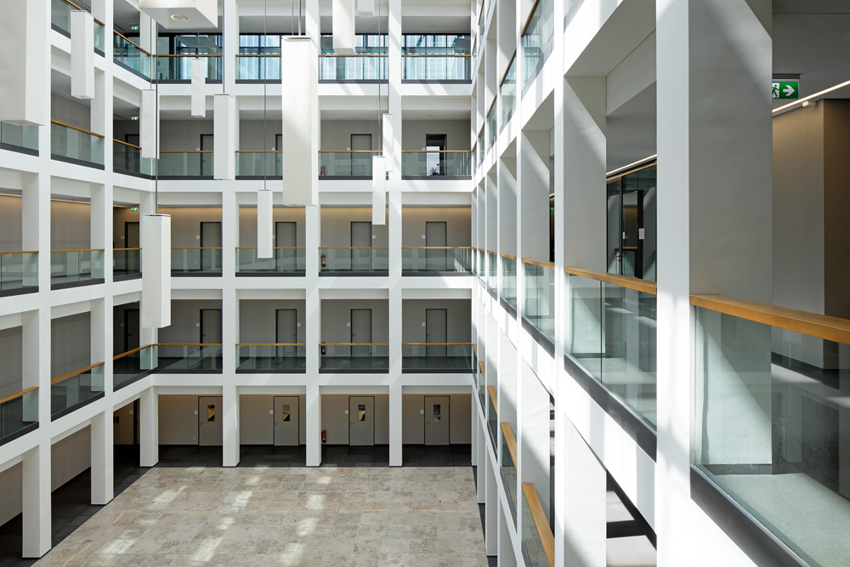
Hallway BOt
Jonathan Will, Sebastian Bräuer, Antonia Düker | Design Milestone Presentation | Networked Embedded Systems

Slide 2
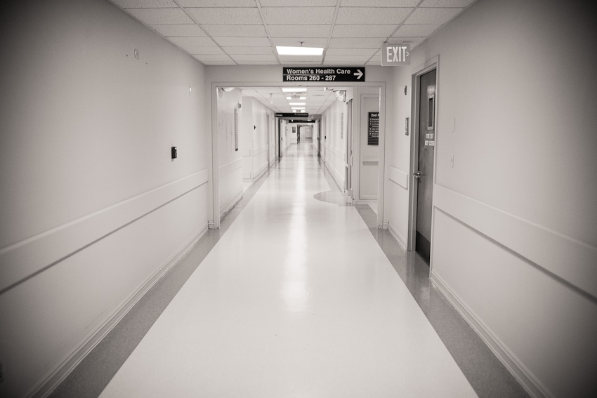
Outline
Project Idea
System Requirements
Functional Specification
Hardware Components
Communication Architecture
Timeline

Slide 3
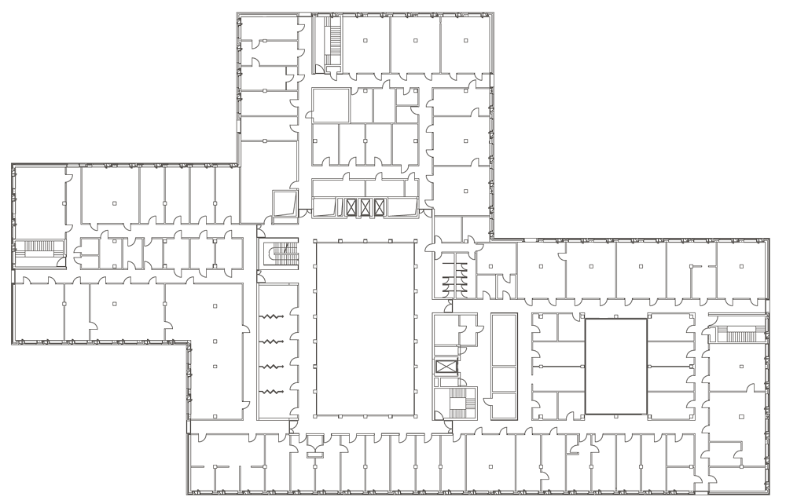
Building Guidance
Connection to one Entry Point
Blinking the way
Hand over to next lights
Lighting guides the way
Entry Points welcomes user
Embedded System
Connection to Internet
Voice Interface
Decentral Communication

Slide 4
System Requirements
The system should guide the user the way to the requested room.
There are at least two entry points at one floor.
At the entry point a user can call for guidance.
The user gets asked where he wants to go.
The system shows the user the right way

Slide 5
Functional Specification
Entry Points are connected to a network and connected to each other.
At each entry point a voice interface is realized.
The system has a wake word.
The users intention is analyzed.
The best route for the users request is calculated.
The lighting for the route is submitted to other affected entry points/control units
The lighting is showing the right way.

Slide 6
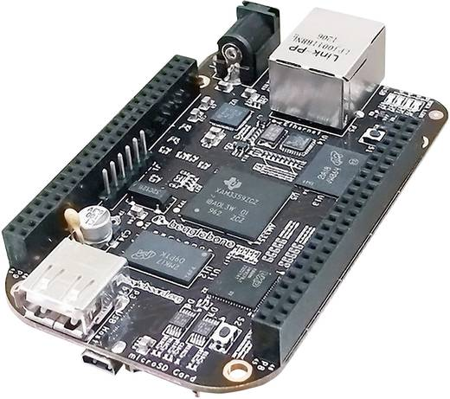
Hardware Components
Entry Points:
Beagle Bone Black
LED Stripes
Microphone
Speaker
Nodes:
Beagle Bone Black
BLE Module

Slide 7
Functional Overview

Slide 8
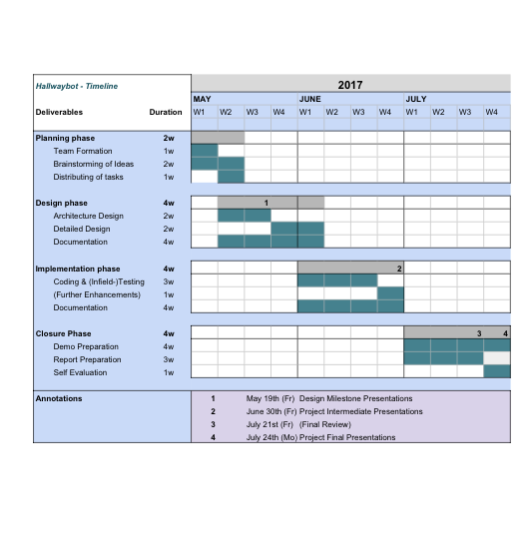
Timeline
Jonathan
User Routing
Architecture Design
Sebastian
BLE / User Authentication
Node Communication
Antonia
Alexa
LED control

