Slide 1
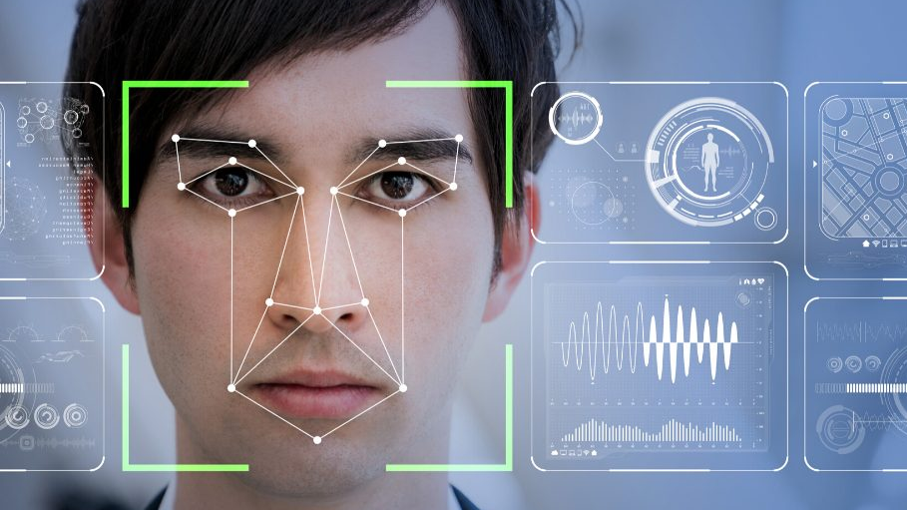
USE Case: Face recognition
Advanced machine learning

Slide 2
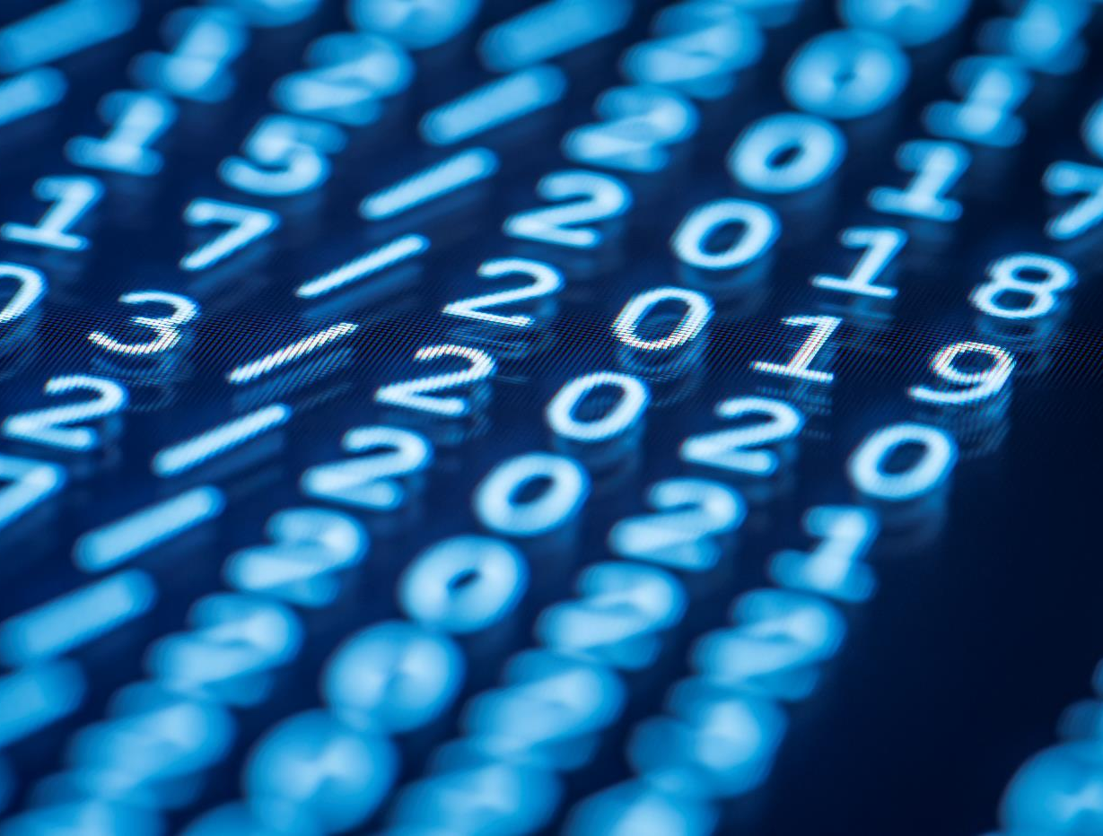
Vielen Dank
Andreas edte
Lennart fertig
Yannik hubrich
Felix hüsgen

