Slide 1
Matssyedch v1.0

Slide 2
Introduction to the Problem
Tourist Challenges:
Complex itinerary planning.
Inauthentic experiences and cultural disconnect.
Risks of scams and misleading information.
Overpricing and lack of local information.
Impact on Destination:
Decreased tourist satisfaction and repeat visits.
Damage to cultural image and trust.
Economic loss and underutilization of local resources.

Slide 3
Solution Overview
GenAI Application for Personalized Cultural+Sports Itineraries
Leverages:
Retrieval Augmented Generation (RAG)
Advanced Language Models (meta-llama/Meta-Llama-3-8B)
User Preferences and Conversation History
Blends Sporting Event Schedules with Curated Cultural Experiences
Provides Tailored Recommendations Based on:
User Interests
Real-Time Context
Authentic Local Attractions
Integrated Travel Planning and Booking Assistance

Slide 4
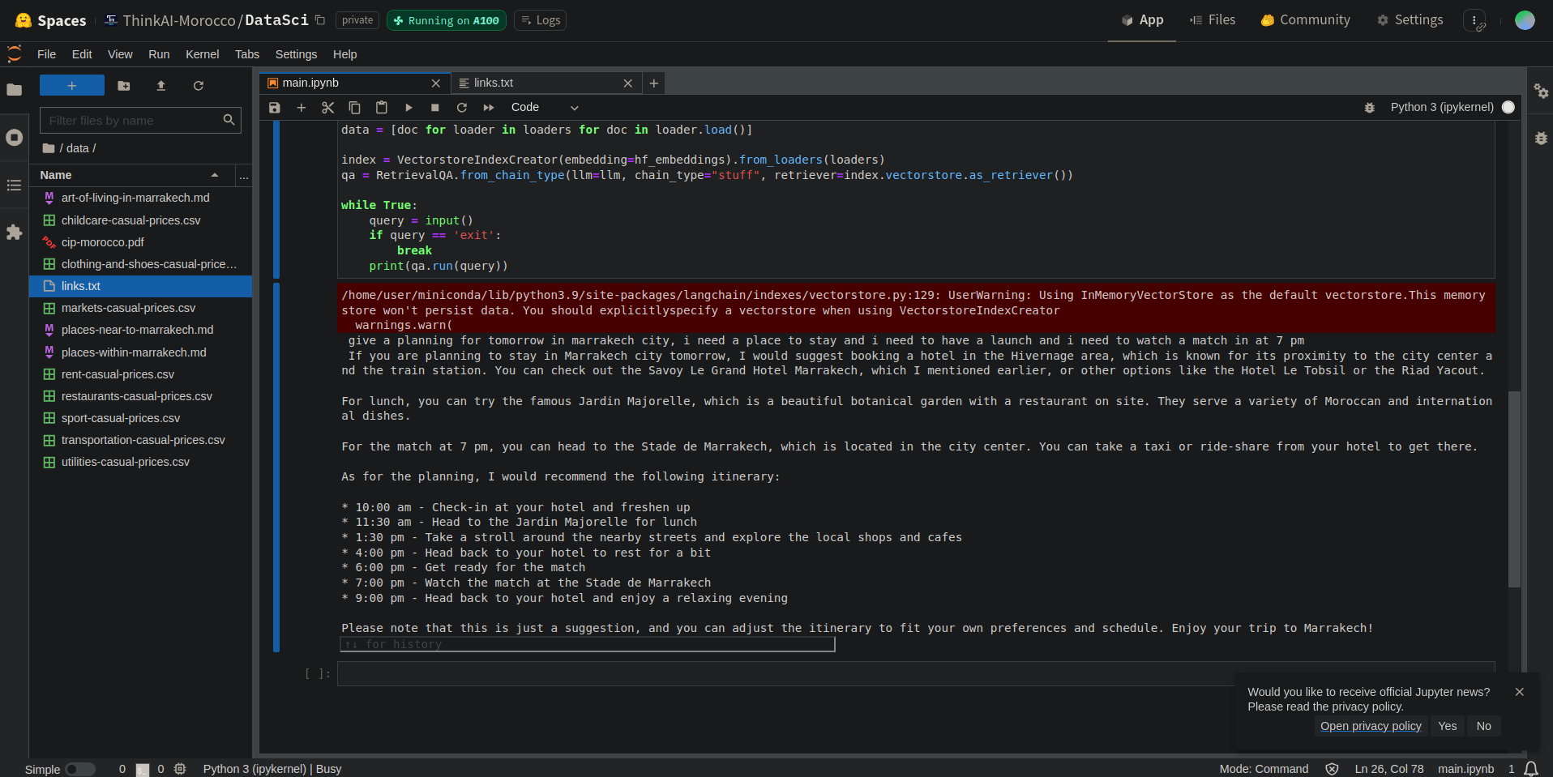
Solution Overview
GenAI Application for Personalized Cultural+Sports Itineraries
Leverages:
Retrieval Augmented Generation (RAG)
Advanced Language Models (meta-llama/Meta-Llama-3-8B)
User Preferences and Conversation History
Blends Sporting Event Schedules with Curated Cultural Experiences
Provides Tailored Recommendations Based on:
User Interests
Real-Time Context
Authentic Local Attractions
Integrated Travel Planning and Booking Assistance

Slide 5
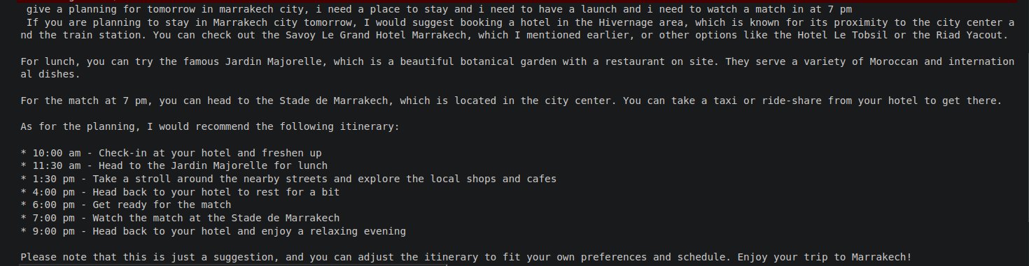
Example :

Slide 6
Key Components
RAG (Retrieval Augmented Generation)
Provides contextual information retrieval
Language Model: meta-llama/Meta-Llama-3-8B
Generates personalized responses and recommendations
Incorporates conversation history and user preferences
Hugging Face + langchain_huggingface
Integrates LLM, sets up pipeline
Efficient Vector Database storage and retrieval
JSON API
Supplies relevant data (menus, prices, etc.)
User Interface
Captures user preferences
Displays personalized itineraries

Slide 7
Impact and Future Expansion
Enhanced Tourist Experience:
Improved satisfaction and positive reviews
Increased spending and support for local businesses
Strengthened Cultural Image:
Promotes authentic cultural heritage
Encourages preservation of local traditions
Reduced scams and higher trust levels
Sustainable Growth:
Responsible tourism practices
Long-term economic benefits
Scalability and Innovation:
Expandable to other regions and event types
Future enhancements: multi-lingual support, social sharing, gamification , Virtual tours and online workshops.

Slide 8
Thank you
Our GenAI-powered application transforms the tourist experience by offering personalized, culturally-integrated itineraries.
It addresses common tourist complaints and enhances the country’s image, trust, and economic benefits.

