Slide 1

Tic Tac Toe (Arduino)
By: [REDACTED]

Slide 2
Our Invention
After brainstorming all the possible machines that could be made, we determined that we were going to create something that was interactive between two users.
We determined that we would make a tic tac toe board, that is controlled by an infrared remote. Instead of X's and O's, we would do two different colored LED lights.

Slide 3
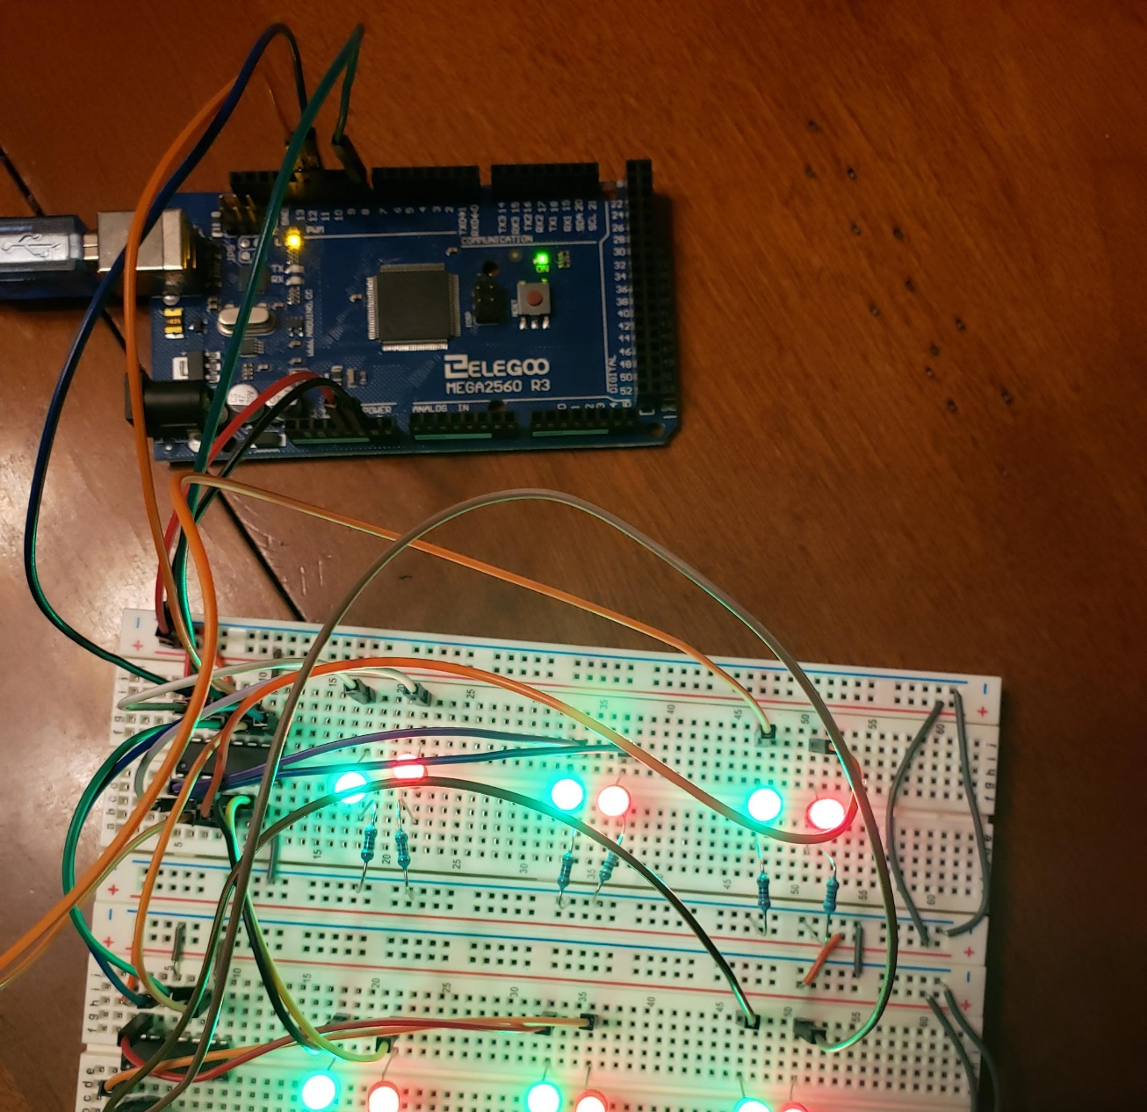
Prototype
Starting out working with LED lights, resistors, and shift registers.
Eventually there will be 20 LED lights.
Instead of using 20 output pins from the Arduino, we used only 3 outputs into three 74HC595 shift registers.
These shift registers allow us to convert 3 output pins into theoretically infinite outputs depending on how many 595 chips we use (n * 8 outputs where n = number of shift registers).

Slide 4
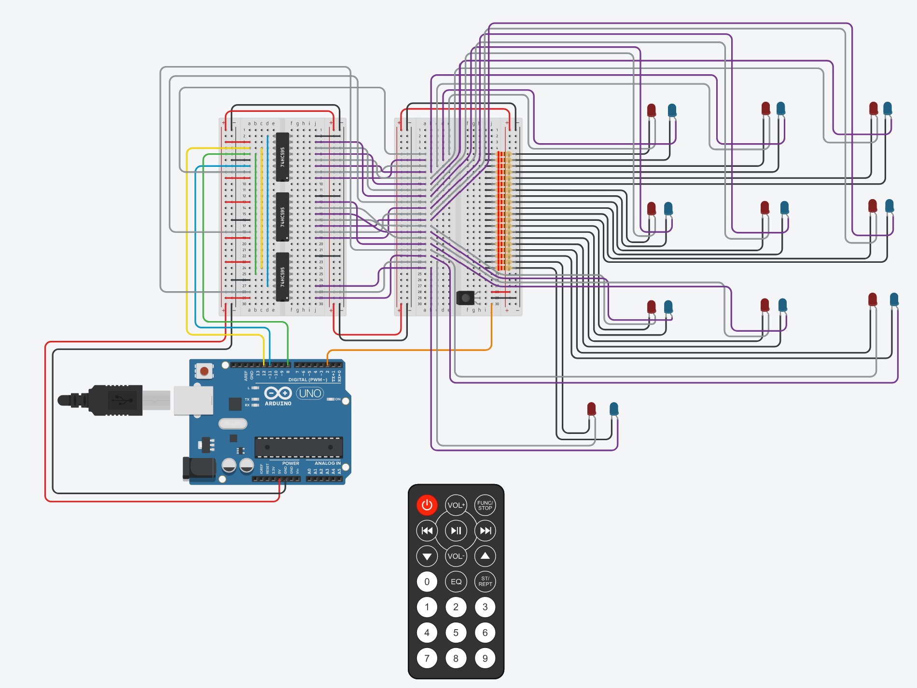
Tinker CAD
This Tinker CAD is a virtual version of the prototype.
Tinker CAD allowed us to take our idea and make a virtual simulation to assist in the real-world build.
https://www.tinkercad.com/things/gokXRAUv8Oz-tictactoe/editel?sharecode=MZv9XexcmKgdfNUHSCZAe5KjxIg9fdEABSqau1aWibA

Slide 5
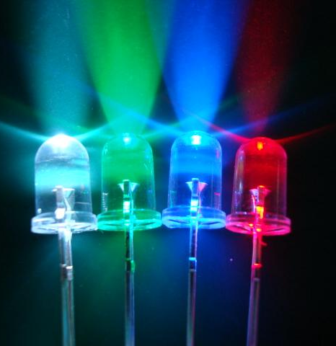
LED Light
LED or Light Emitting Diodes.
A diode is an electrical device that allows the flow of electrons in only one direction.
A LED has two types of semi-conducting materials in them, p-type and n-type.
The n-type pulls electrons from the p-type semi-conductor, leaving a gap to fill.
When a voltage source is applied, the electron “gap” are filled in which results in an emission of light at a certain wavelength.
This Photo by Unknown Author is licensed under CC BY-SA

Slide 6
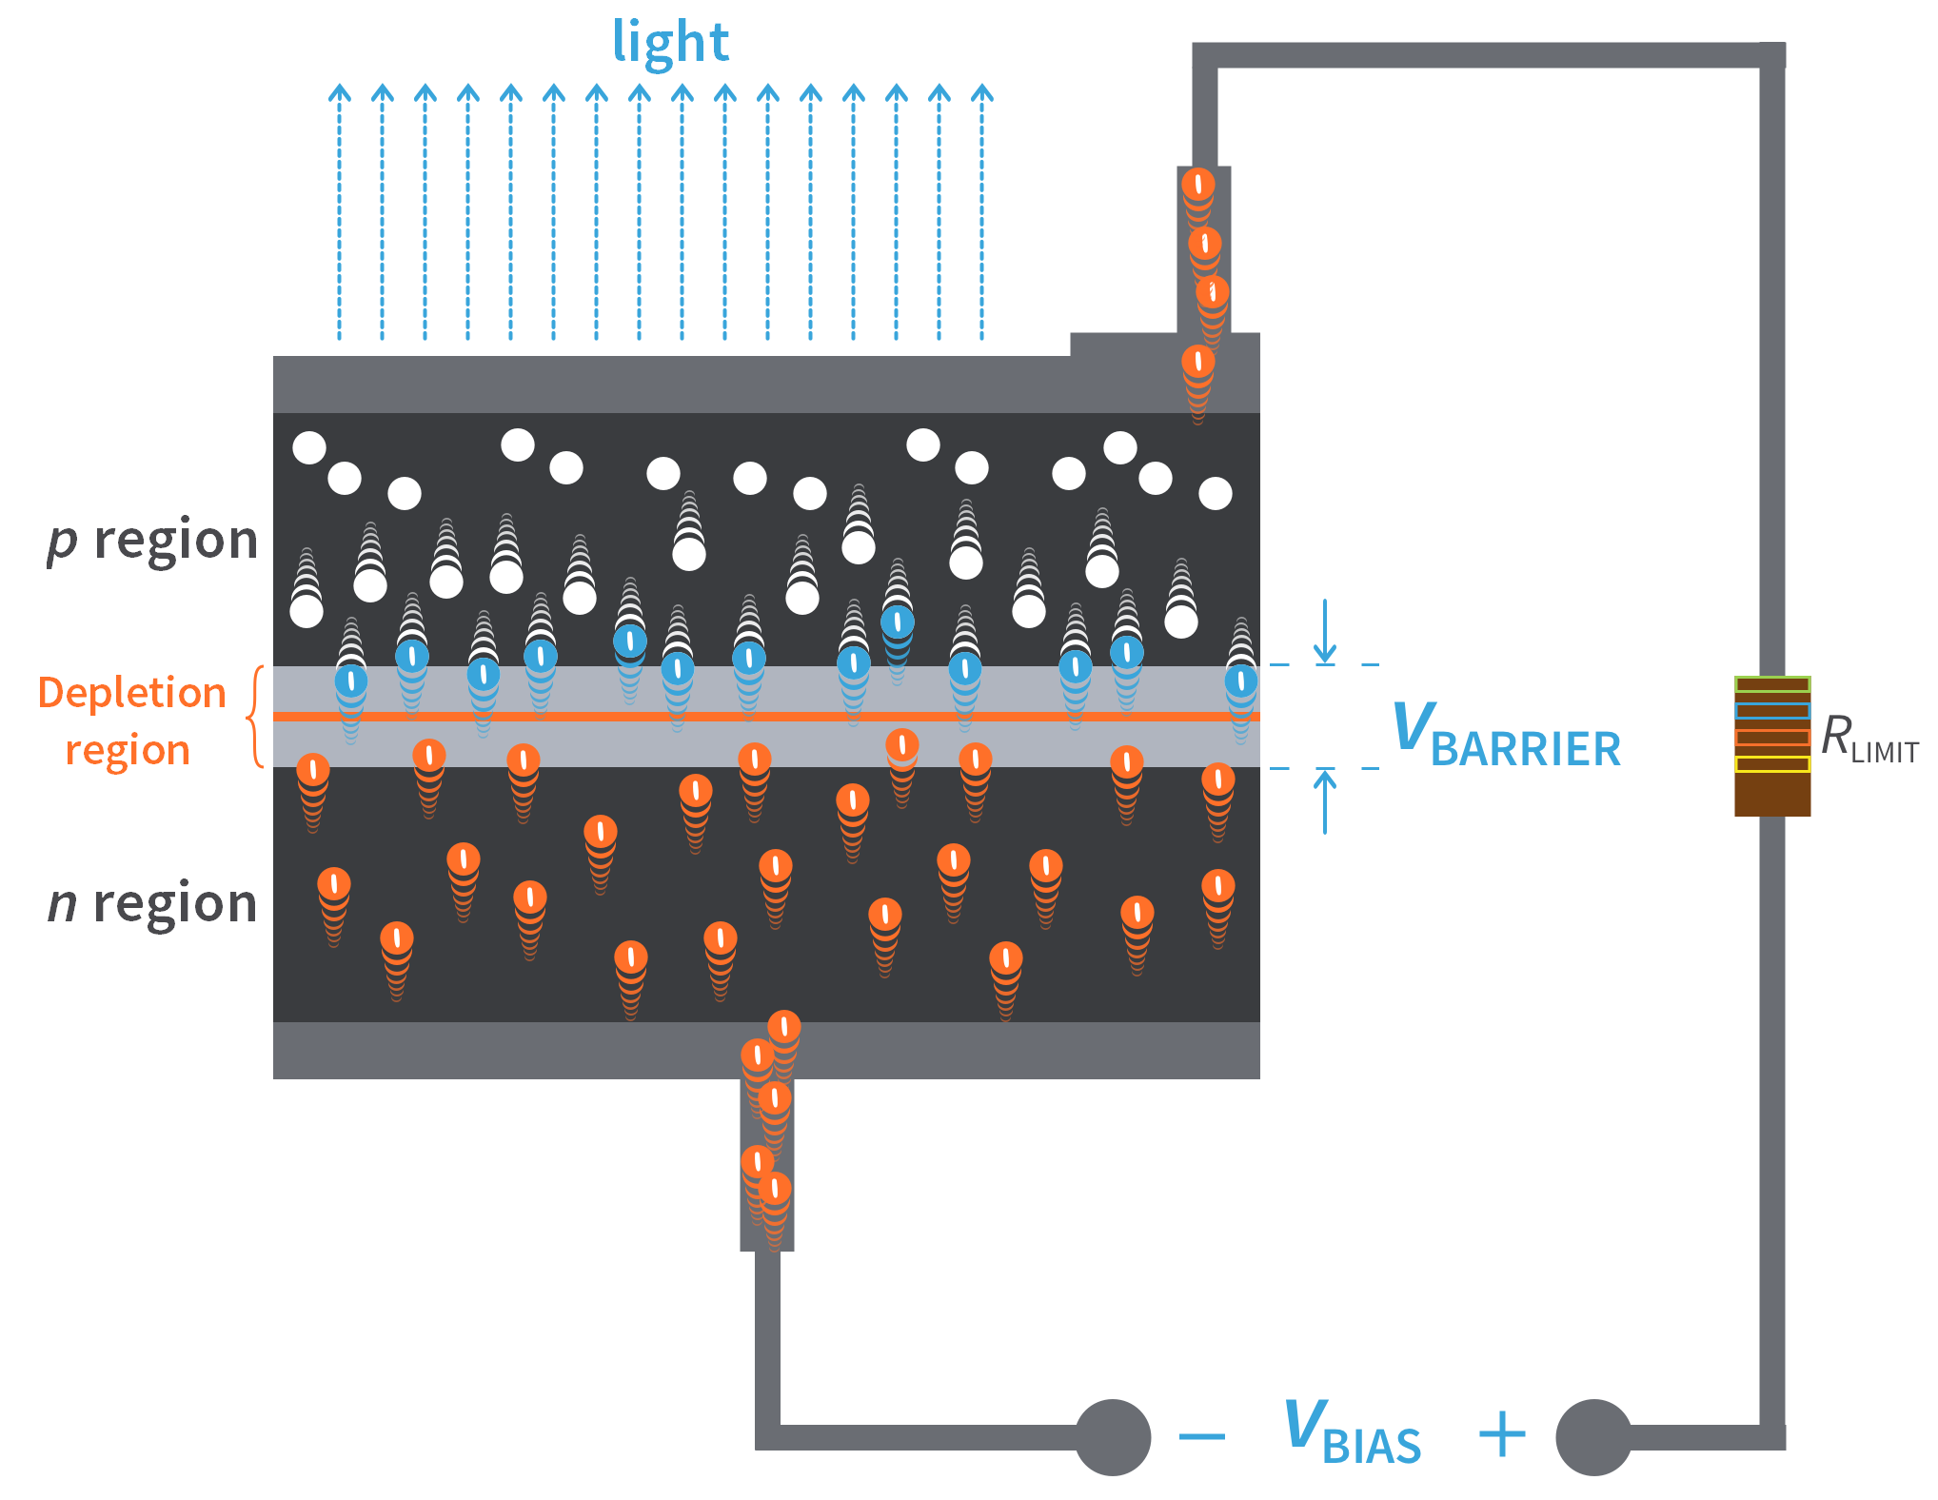
LED Light
This picture shows the movement of the electrons between the two semi-conducting “n” and “p” type regions.
Using different chemical elements inside the regions create different wavelengths.
The most common elements inside are Gallium and Aluminum mixed with either Phosphorus or Nitrogen.

Slide 7
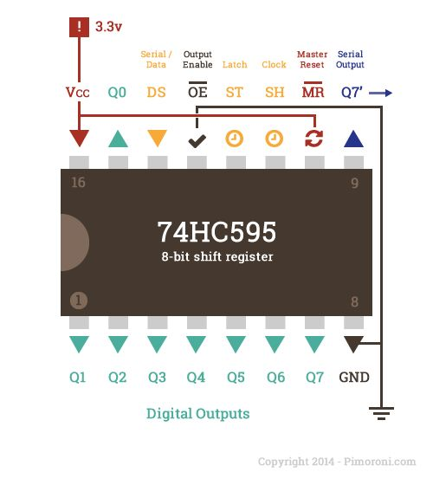
Shift Register Chip
Model number 74HC959.
This integrated chip (IC) allows for a serial input of 8 bits to be converted to 8 parallel outputs.
Multiple chips can be connected by using the data output from one chip to the input of the next.
This daisy chain of IC allows many outputs to be controlled through just three pins on an Arduino controller.

Slide 8
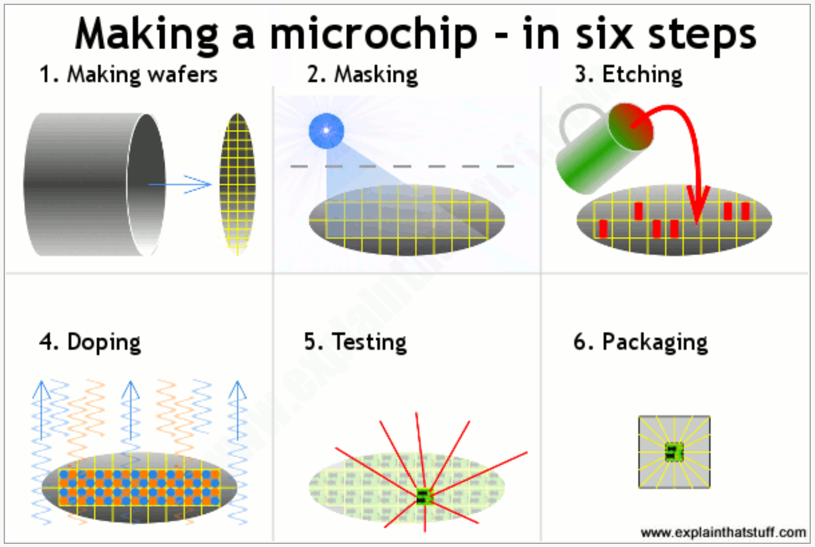
Shift Register Chip
Much like the LED, ICs use layers of p-type and n-type semi-conductors to store or release electrons depending on voltage applied.
Silicone that has been baked at high temperatures into a thin plate is the main element of the chip.
The chip is then etched with a road-like map to allow for the material to be applied.
A process called “doping” is then added to the etched path to allow for the n-type and p-type areas.

Slide 9
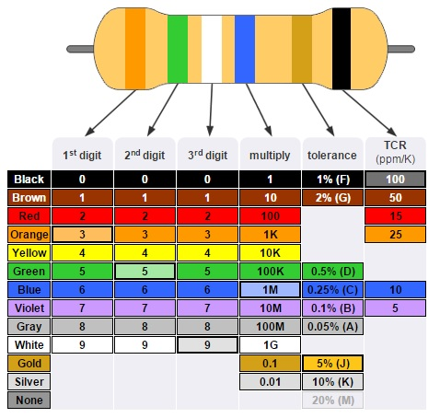
Simple Resistor
This project uses twenty 220 Ω resistors, one for each LED.
When a voltage is applied across a resistor, the semi-insulating material inside restricts the flow of electrons through the resistor.
When the current passes through the resistor, electric current is resisted, and the energy is transferred into heat.
The inexpensive resistors used by lower voltage electronics use a carbon film to resist the flow of electrons.

Slide 10
Infrared Transmitter (TX)
Uses IR LED, in the 740-760nm wavelength.
Button is pressed on the remote -> microchip will send a signal corresponding to that button in a pattern of flashes from the IR LED
Electricity flows from the battery to the IR LED in a high/low pattern -> IR light waves travel in the air.

Slide 11
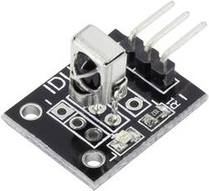
Infrared Receiver (RX)
Photodiode absorbs photons and generate an electric current corresponding to the pattern send by the TX (transmitter)
They use a series of modulation methods with analog filters to convert the sinusoid carrier signal into the original input signal
Carrier signal exists on specific frequency to prevent interference from other noise
Signal is then outputted from the RX, usually as an 8-byte hexadecimal code
Code in Arduino activates if appropriate hex code is detected

Slide 12
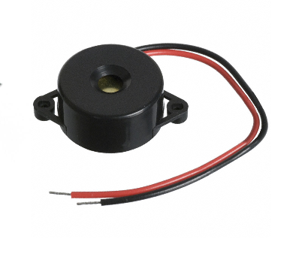
Piezo Buzzer
Uses a piezoelectric crystal or ceramic
Voltage applied to buzzer in oscillations
Results in vibration/stressing of piezoelectric crystal, which produces sound
The reverse can also be done, and the crystal can be used to detect vibrations and is so sensitive, it can be used as a mic

Slide 13
Code Flow Chart
Receive
Receive input from IR Remote control.
Process
Process input, make sure that box is not previously used.
Turn on LED
Turn on correct LED light for the player and box selected.
Check
Check for a winning Tic-Tac-Toe Pattern, if found show winner.
Move On
If no winner, move on to next player. Loop until win or tie.

Slide 14
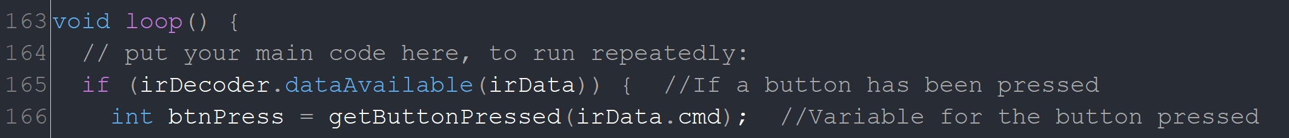
Code: Receive IR Input
For this project, we used a premade IR library that allowed for decoding the signal from the IR Remote.
This code sets a constant integer named IR_PIN and set the value to two. Using constants in code allows for better clarity and easier to update one line if something changes.
This code creates an IR decoder named “irDecoder” and sets the input pin to our pin constant = 2. The second line creates a variable “irData” that is used to store the received code from the IR receiver. The third line is in the set-up method that tells the Arduino that pin #2 will be used as input.
This code is in the loop method that will constantly run. The “if” statement will run when an IR code has been received. This code is then passed to a method called “getButtonPressed” that will return an integer of the number pressed on the IR Remote.

Slide 15
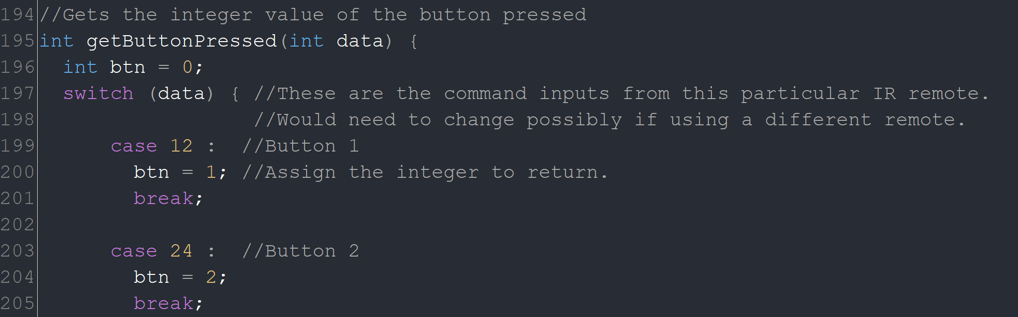
Code: Process Input
This method named “getButtonPressed” takes the data from the IR decoder and uses a switch/case call to take the decoded data and return an integer value of the number of the button pressed on the IR remote.

Slide 16
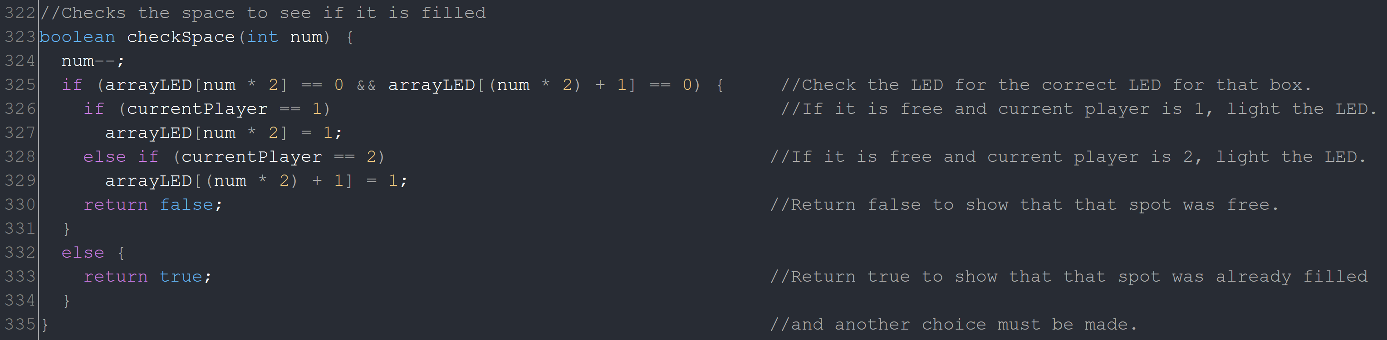
Code: Process Input
Once the remote data has been processed to find the button pressed by the user, the code calls the method “checkSpace” to make sure that the space selected is available or not.
The code uses a twenty-space integer array named “arrayLED” to keep track of which LED light is on or off using a one for on, and zero for off.
This routine checks the button pressed against the array to find whether that space is currently used. This method returns a Boolean false if the space is available and true if the space is taken.

Slide 17
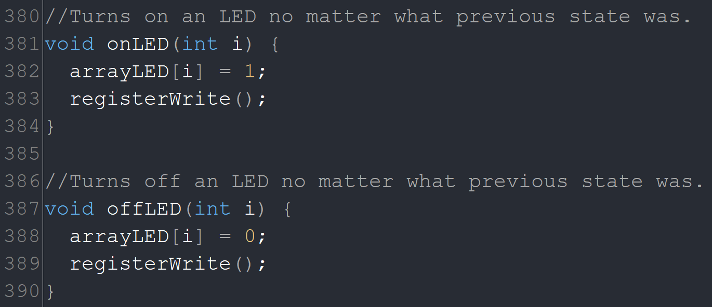
Code: Turn on LED
These two methods either turn on or off a specific LED light when an input of integer “i” is given.
The “registerWrite” calls a method that sends the data to the shift registers to then light up the correct LEDs.

Slide 18
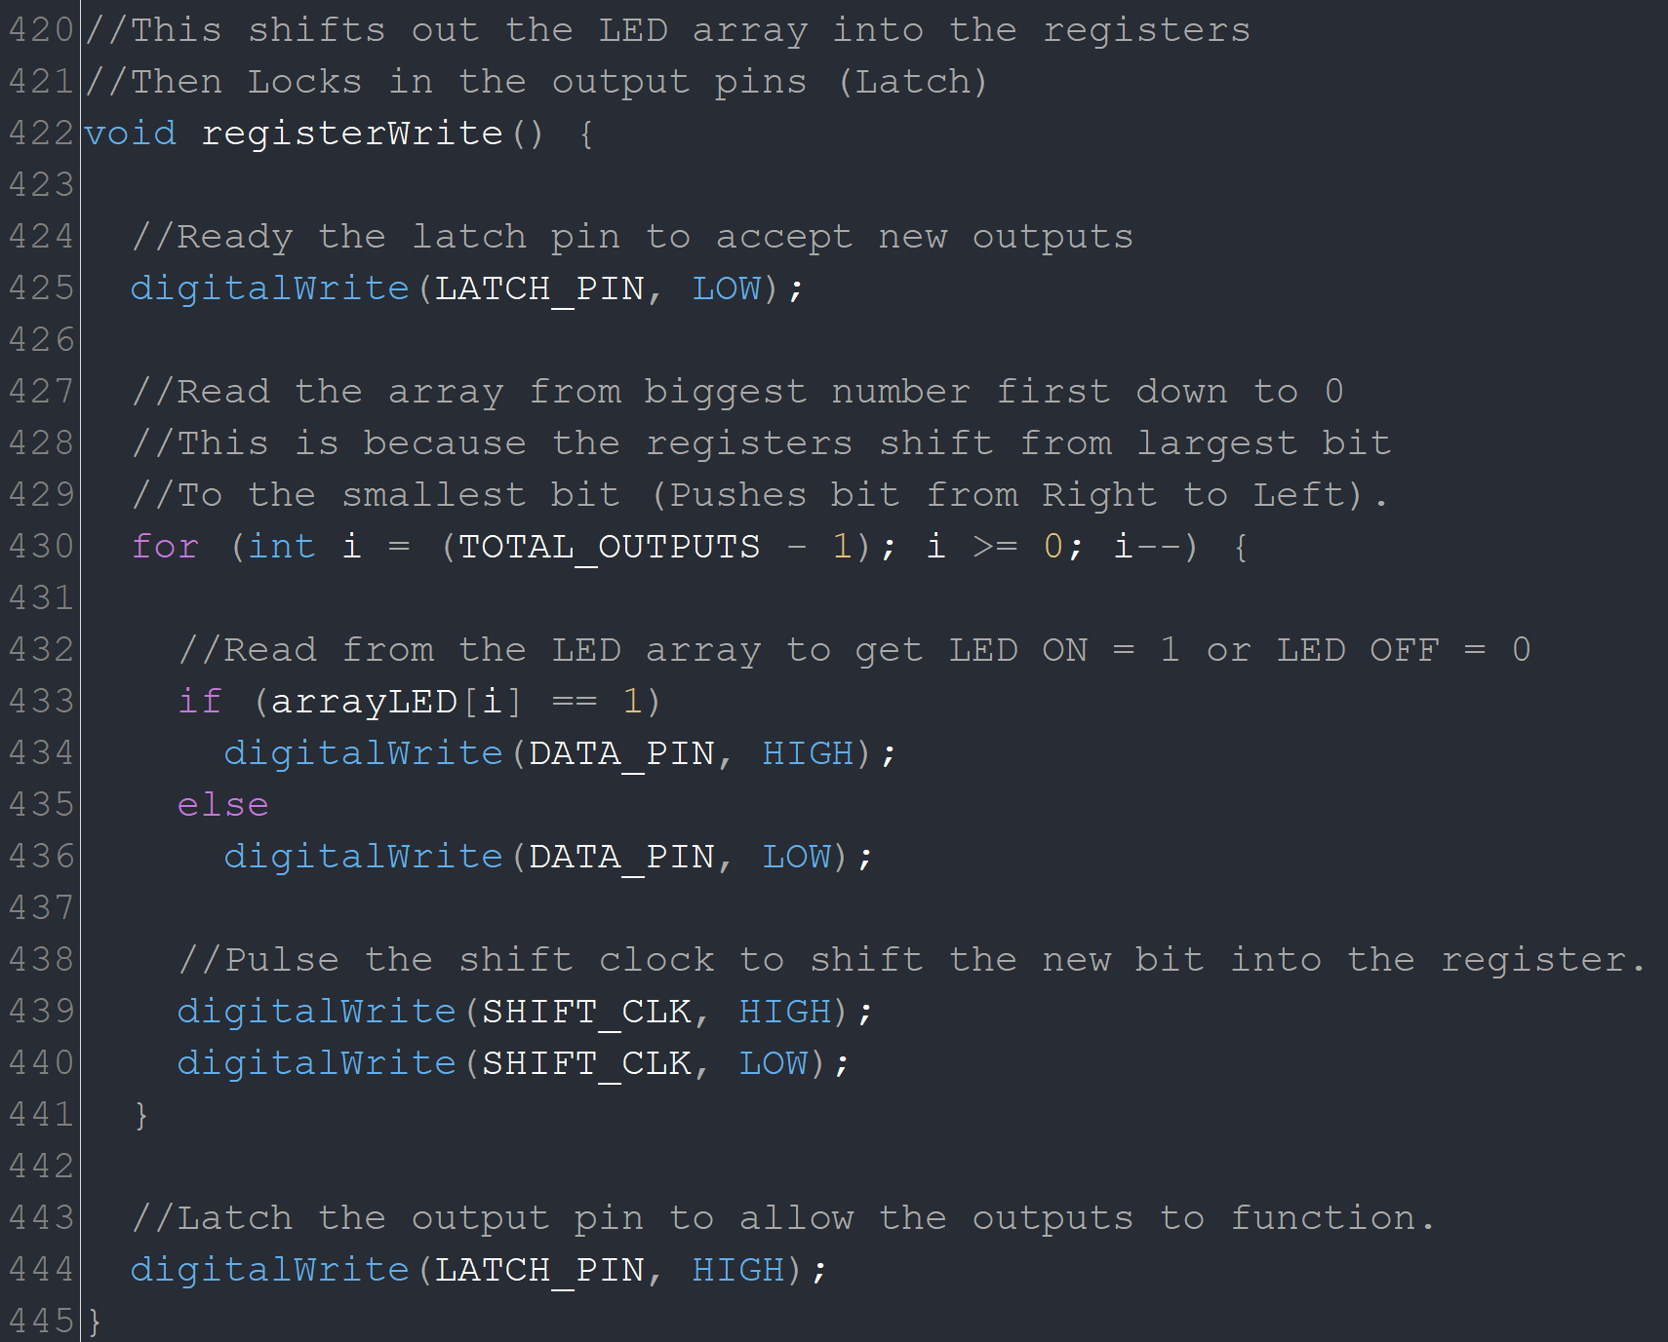
Code: Turn on LED
This method writes the bits to the shift registers and opens the outputs to allow the LEDs to turn on or off.
Shift registers take a serial input of one or zero each time the SHIFT_CLK on the chip goes from logic LOW to HIGH. (This is called the leading clock edge).
Each time the SHIFT_CLK is activated within the “for” loop, the bits inside the shift register move one space to the left and the new bit is inserted in the “0” position.
Finally, when all the bits have been received, the LATCH_PIN is set to logic HIGH and the outputs activate the LEDs.

Slide 19
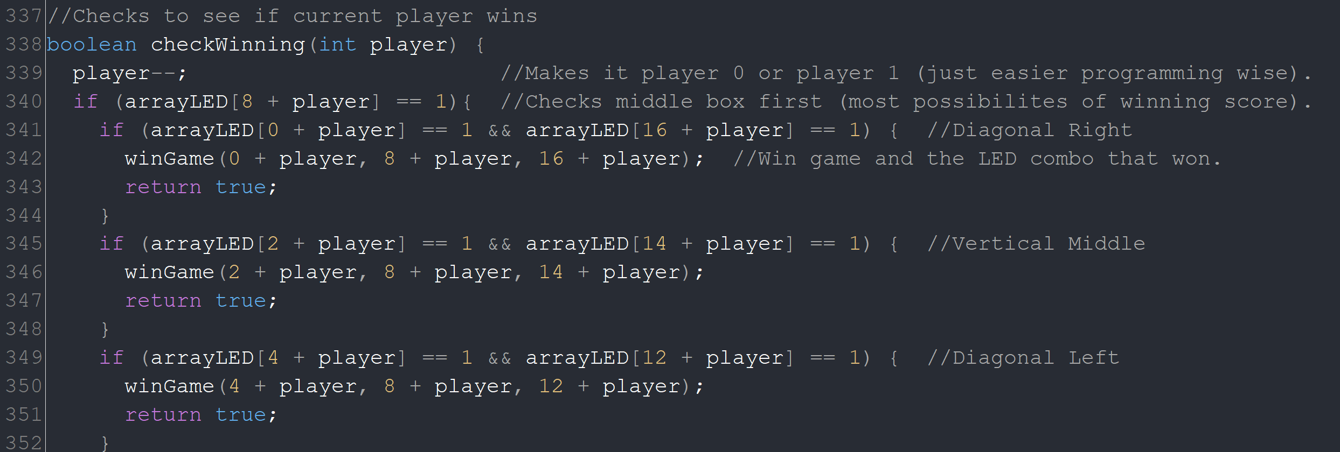
Code: Check for a Winner
This code calls a method named “checkWinning” with an integer input of the player number. The code here is only a portion of the full method. Each winning combination must be checked (vertical, horizontal, diagonal) and if a winning combination is found, the method returns a Boolean TRUE, else it returns FALSE.
If a winner is determined, the game plays a sound through a buzzer and flashes the winning combination.
The “power” button on the remote will reset the game.

Slide 20
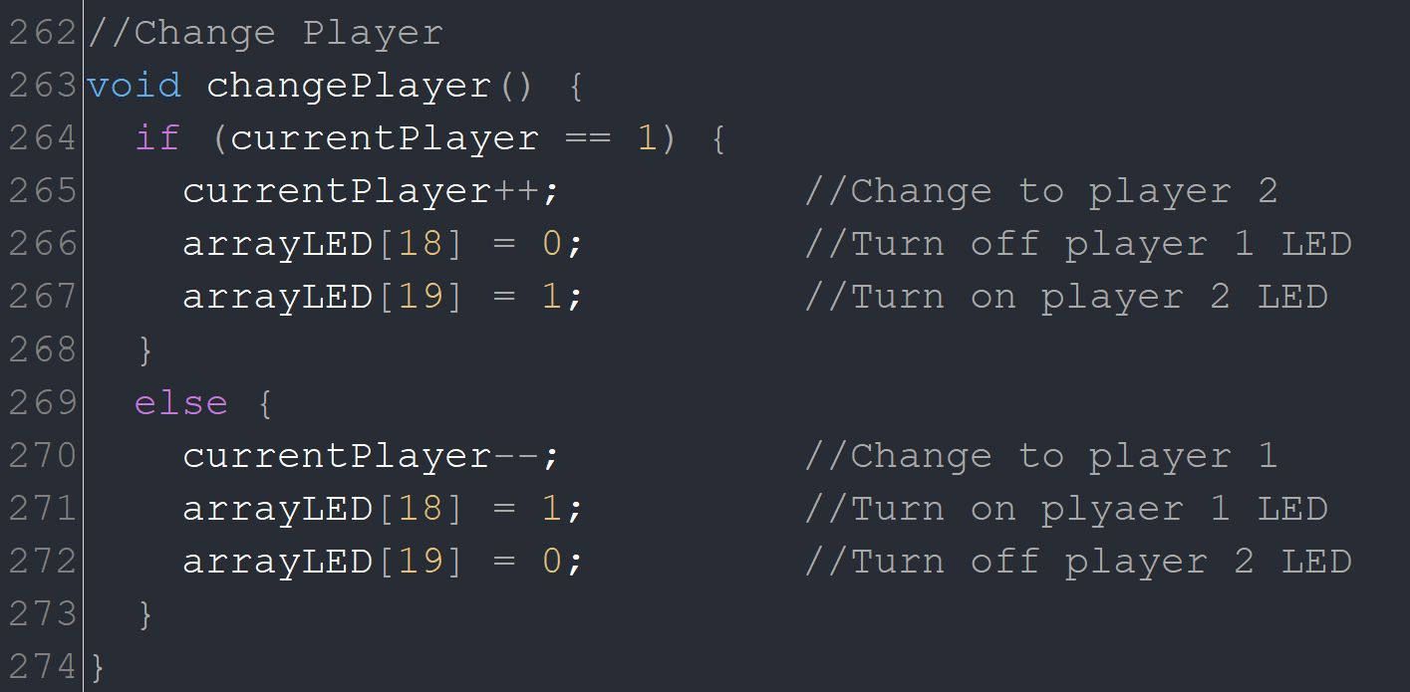
Code: Move On…Repeat
If no winning combination is found for a player, the “changePlayer” method is called that changes the integer “currentPlayer” to the next player. The method then tells the LED array to switch which LED needs to be lit (1 for on, 0 for off).
The shift register will then be updated to light the correct LED, and the “void Loop” process will start over and wait for a new input from the IR remote receiver. This loop will continue until a winner is found or a all spaces have been used (tie).

