Slide 1






2025-2026 FALL SEMESTER
MICROCONTROLLER BASED SYSTEM DESIGN GROUP PROJECT
ARDUINO CALCULATOR WITH KEYPAD
PROJECT PARTICIPANTS
23012613 – KEREM ARSLAN
23012008 – MEHMET FATİH TÜRKYILMAZ
23012082 – KEREM ÖNOL
23012109 – BURAK KÜRKLÜ
23012108 – SAMET ERHAN SARI
INSTRUCTOR: Doç.Dr. Selin ÖZÇIRA ÖZKILIÇ

Slide 2
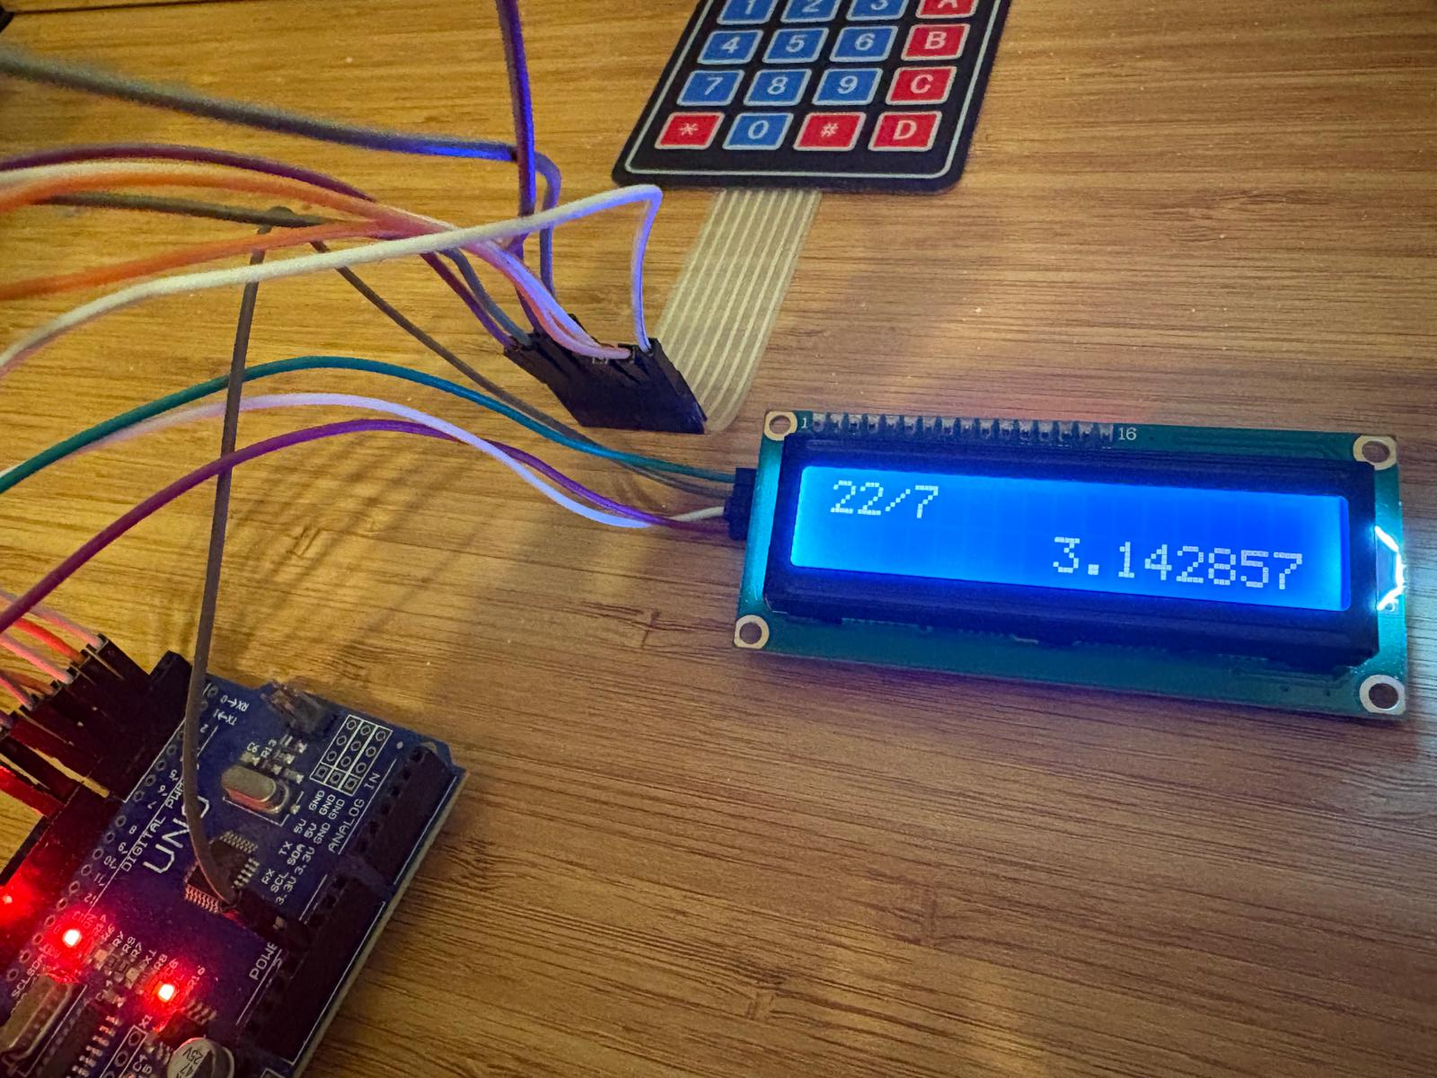
INTRODUCTION
Arduino-based systems are widely used in embedded
system applications due to their simplicity and flexibility.
In this project, an Arduino calculator is designed using
a 4x4 keypad for input and an LCD display for output.
The system performs basic arithmetic operations and
demonstrates the integration of hardware and software in
microcontroller-based designs.
MATERIALS WE USED:
Arduino UNO R3
4x4 Matrix Keypad
I2C 16x2 LCD Display

Slide 3
FRAMEWORK – SYSTEM WORKFLOW
The framework defines the overall operational flow of the system, describing how user inputs are processed, evaluated, and transformed into output results. It provides a high-level view of the interaction between hardware components and software logic within the Arduino-based calculator system.
1. User Input
The user enters numbers and arithmetic operators using a 4x4 keypad
Each key press is detected and transferred to the Arduino for processing
2. Expression Formation
Input characters are stored sequentially as a mathematical expression
The expression is updated in real time and shown on the LCD
3. Processing and Calculation
The Arduino parses the expression stored in memory
Arithmetic operations are evaluated according to operator precedence
Special conditions such as negative numbers and division by zero are handled
4. Output and Reset
The calculated result is formatted into a readable form
The result is displayed on the LCD screen
The system is then ready for a new calculation

Slide 4
METHODOLOGY
​1-) Hardware Configuration​
A 4x4 Matrix Keypad is connected to digital pins for user input.​An I2C 16x2 LCD Display is integrated via the SDA and SCL pins to provide a real-time visual interface for expressions and results.
​2-) Dynamic Function Mapping
​A Lookup Table using function pointers is established to map ASCII characters ('+', '-', '*', '/') directly to their corresponding mathematical functions (add, sub, mul, div).
3-) Expression Storage and Real-time Display
​User inputs are stored in a C-String (char array) buffer to allow for multi-digit numbers and multi-step expressions.​ The display logic includes an automatic scrolling feature that shifts the expression to the left if it exceeds the 16-character limit of the LCD.
4-) Mathematical Parsing and Logic
​The par() function utilizes a custom parsing algorithm to handle Operator Precedence.​ The system supports Unary Minus detection, allowing the calculator to process negative numbers correctly (e.g., "-5+3" or "5*-2").
​5-) Result Composition and Formatting
​The logic automatically switches between standard decimal and Scientific Notation for very large or very small values.​ Trailing zeros and unnecessary decimal points are dynamically trimmed to ensure the cleanest possible output on the screen.
​6-) Calculation Flow and Chain Operations
The calculation key is multi-purpose and also functions as the Ans key. When pressed after an operator or at the beginning of an expression, it inserts the latest valid result, allowing chained operations without re-entering values. This approach enables seamless continuation of calculations while maintaining a clear and predictable evaluation flow.

Slide 5
FEATURE SET
Beyond the core calculation logic, several additional design decisions were implemented to improve usability, robustness, and error tolerance. These features ensure that user input is handled safely and intuitively, even in edge cases, while maintaining a compact and efficient execution flow.
* Auto-adds 0 when the first key pressed is an operator (except for subtract)
* Allows negating numbers
* Replaces operators that are entered consecutively (except for subtract after divide or multiply) ("/-" and "*-" can also be replaced by a new operator)
* Allows the latest valid answer to be used anywhere in the expression
* Auto-handles the signature while adding the answer to the expression (e.g. replacing double negatives with a plus, or replacing plus with a minus)
* Allows up to 64 characters in the expression, and fits the expression to the screen
* Shows the result in scientific notation if needed
* Trims the trailing zeros in the mantissa
* Trims the decimal point if obsolete
* Trims the leading zeros in the exponent
* Removes gaps formed during trimming
* ⁠Trims the trailing operators in the expression
* ⁠Supports safe-divide
◇
◇
◇
◇
◇
◇
◇
◇
◇
◇
◇
◇
◇

Slide 6
DEFINITIONS
Arduino:
An open-source microcontroller platform used to create electronic projects by integrating hardware and software.
Microcontroller:
A compact integrated circuit designed to perform specific control-oriented tasks in embedded systems.
16x2 LCD (Liquid Crystal Display):
A crystal display module consisting of 16 columns and 2 rows, used to visually present calculations and results.
I2C (Inter-Integrated Circuit):
A serial communication protocol that allows the LCD to communicate with the Arduino using only two wires.
Membrane Keypad (4x4):
A keypad used as an input device for entering numbers and mathematical operators.
Function Pointers:
Programming technique that stores the memory addresses of functions and dynamically determines which mathematical operation (+, −, ×, ÷) will be executed at runtime.
Parsing:
The process of converting a text-based expression entered via the keypad into mathematical values and operators
Scientific Notation:
A method of representing very large or very small numbers using an exponent format with an “e” coefficient.
Operator Precedence:
The logical hierarchy in mathematical expressions that specifies multiplication and division are performed before addition and subtraction.

Slide 7
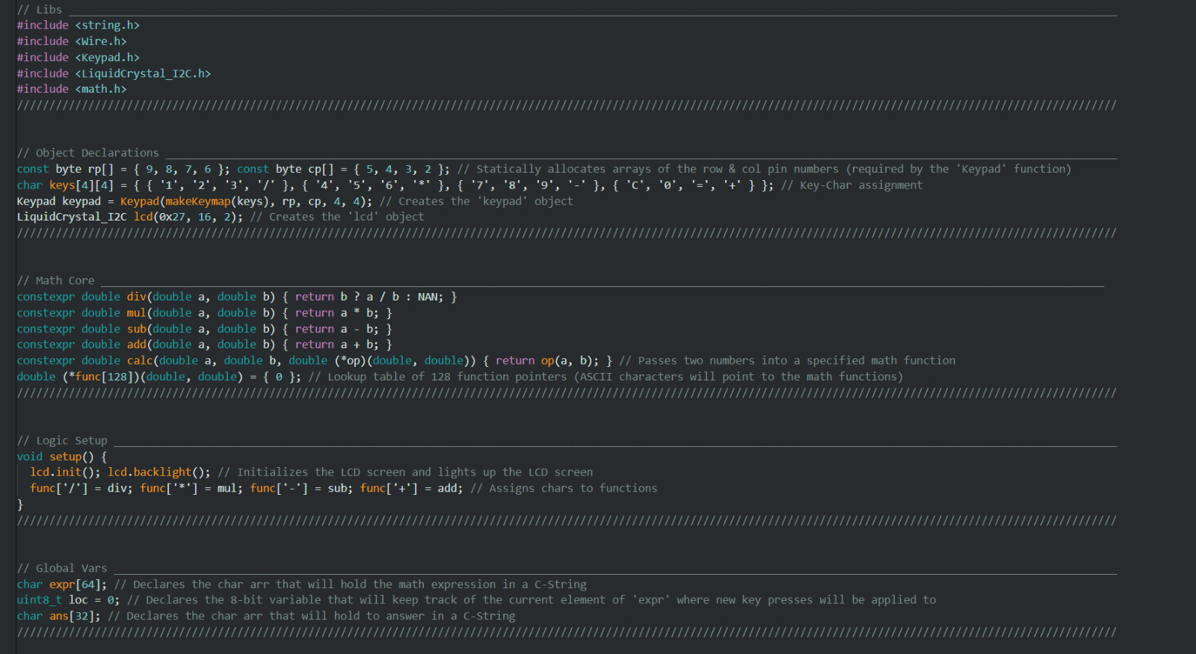
CODES AND EXPLANATIONS

Slide 8
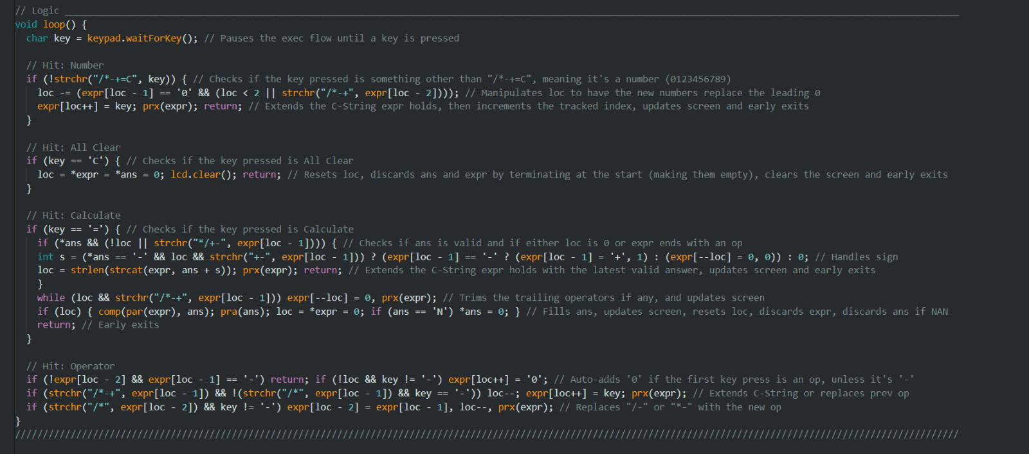

Slide 9
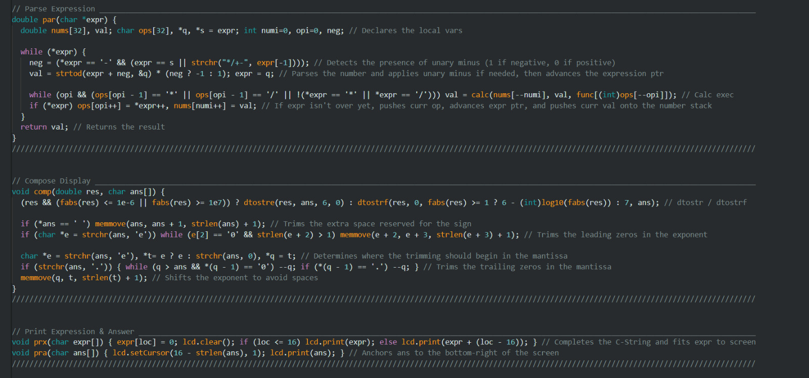

Slide 10
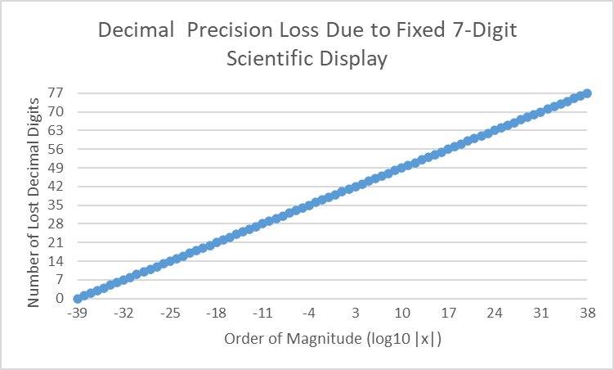
RESULTS
Display Precision vs. Numeric Limits
This figure illustrates the relationship between numeric magnitude and display precision under fixed formatting constraints.
The system displays a maximum of 7 significant digits per result.
For values exceeding this range, results are shown in scientific notation.
As the exponent increases, lower-order digits become unpresentable due to mantissa limitations.
The number of lost decimal digits increases linearly with the order of magnitude.
The behavior is symmetric for positive and negative values.
Values close to zero retain higher precision, reaching the smallest respresentable magnitude of ±2⁻¹⁴⁹.
Results exceeding ±(2¹²⁸ − 1) overflow and are displayed as ±inf.
Memory Utilization Overview
Program storage usage: 10,426 bytes (32%)
(Maximum available: 32,256 bytes)
Dynamic memory usage (global variables): 777 bytes (37%)
(Remaining for local variables: 1,271 bytes out of 2,048 bytes)

Slide 11
RESULTS
Discussion
The results demonstrate a clear and predictable relationship between numeric magnitude and display precision under fixed output constraints. As shown in the graph, the number of unrepresentable lower-order digits increases linearly with the order of magnitude. This behavior is a direct consequence of limiting the output to a fixed number of significant digits, which forces precision to be traded for range as values grow larger.
Near zero, the system achieves its highest precision, successfully representing values down to ±2⁻¹⁴⁹ using subnormal numbers. In contrast, for large magnitudes approaching ±(2¹²⁸ − 1), precision is progressively reduced, and values exceeding this range result in overflow and are displayed as ±inf. The symmetry observed between positive and negative values confirms that the loss of precision is independent of sign and solely governed by magnitude.
From a practical perspective, this trade-off is acceptable and expected in embedded systems with strict memory and formatting limitations. The chosen approach ensures readable and consistent output while preventing undefined behavior. Overall, the results confirm that the implemented display strategy provides a balanced compromise between numerical accuracy, usability, and hardware constraints.
In addition, the implementation demonstrates efficient use of both program storage and dynamic memory. Despite supporting complex expression handling and robust formatting logic, the system occupies only 32% of program memory and 37% of available dynamic memory, leaving sufficient headroom for stable execution. This indicates that the design achieves high functionality with a compact and resource-aware code structure, which is critical for embedded environments.
>
>

Slide 12
CONCLUSION
We aimed to keep the code visually simple, compact, and easy to understand while maintaining high performance. At the same time, we focused on ensuring a modular structure to support scalability and maintainability.
As opposed to the usual solution to this problem where if/else or switch statements are prominent, we chose to utilize lookup tables and callback functions to implement dynamic function dispatch. This expands on the program’s modularity as it stream-lines the process of adding new operators or other kinds of functions in the future.
Our program’s logic has the execution flow guard clauses with early exits to handle different actions. This method, unlike if/else branches, adds yet another layer of modularity as well as introducing new defensive-programming techniques.
The parsing algorithm in our program makes use of lexical parsing, stack-based evaluation, and single-pass evaluation to ensure operator precedence is handled efficiently. In this particular section we are also met with a demonstration of our function-pointer dispatch where it contributes to the efficiency of the algorithm with the modularity it provides.
Overall, the results confirm that the intended design goals were successfully achieved within strict hardware and memory constraints.

