Slide 1
.
STUDENT NAME: JOYAL. P
REGISTER NO AND NMID:
212400944/1534B682E5DEB93AD1D4901EEA045F40
DEPARTMENT : BCA
COLLEGE: PRINCE SHRI VENKATESHWARA ARTS AND SCIENCE

Slide 2
DIGITAL PROTFOLIO
PROJECT TITLE

Slide 3
TABLE OF CONTENTS
PROBLEM STATEMENT
PROJECT OVERVIEW
END USRES
TOOLS AND TECHNOLOGIES
PORTFOLIO DESIGN AND LAYOUT
FEATURES AND FUNCTIONALITY
RESULTS AND SCREENSHOTS
CONCULSION

Slide 4
PROBLEM STATEMENT
•Many students and aspiring developers face difficulties in showcasing their skills, projects, and learning progress effectively to potential employers or collaborators.

Slide 5
PROJECT OVERVIEW
•This project is a personal portfolio website designed to highlight academic background, skills, and completed projects. It serves as a digital resume and a platform to showcase creativity.

Slide 6
END USERS
•- Students wanting to present their skills
•- Recruiters searching for fresh talent
•- Peers and mentors reviewing academic growth
•- Potential collaborators

Slide 7
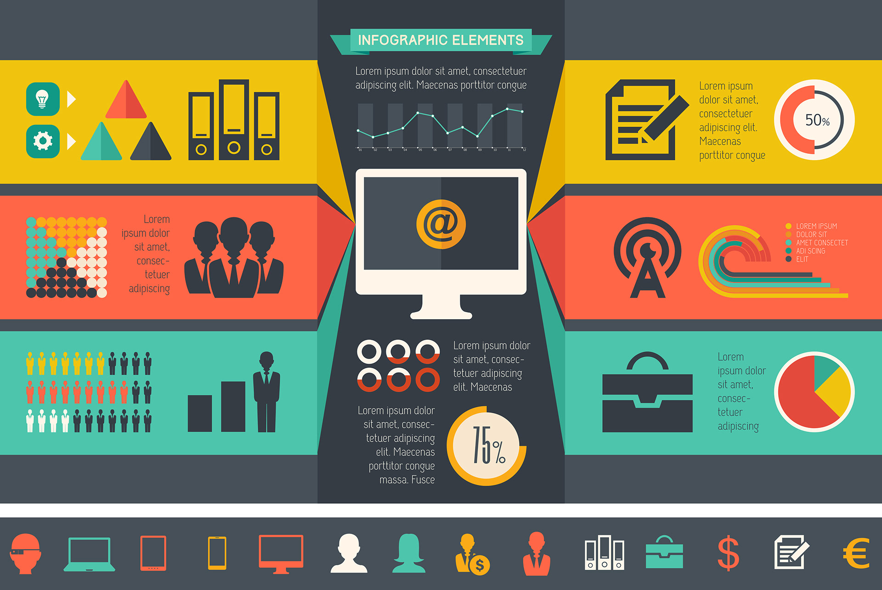
TOOLS AND TECHNOLOGIES
•- HTML5
•- CSS3
•- JavaScript
•- GitHub (for version control and hosting)

Slide 8
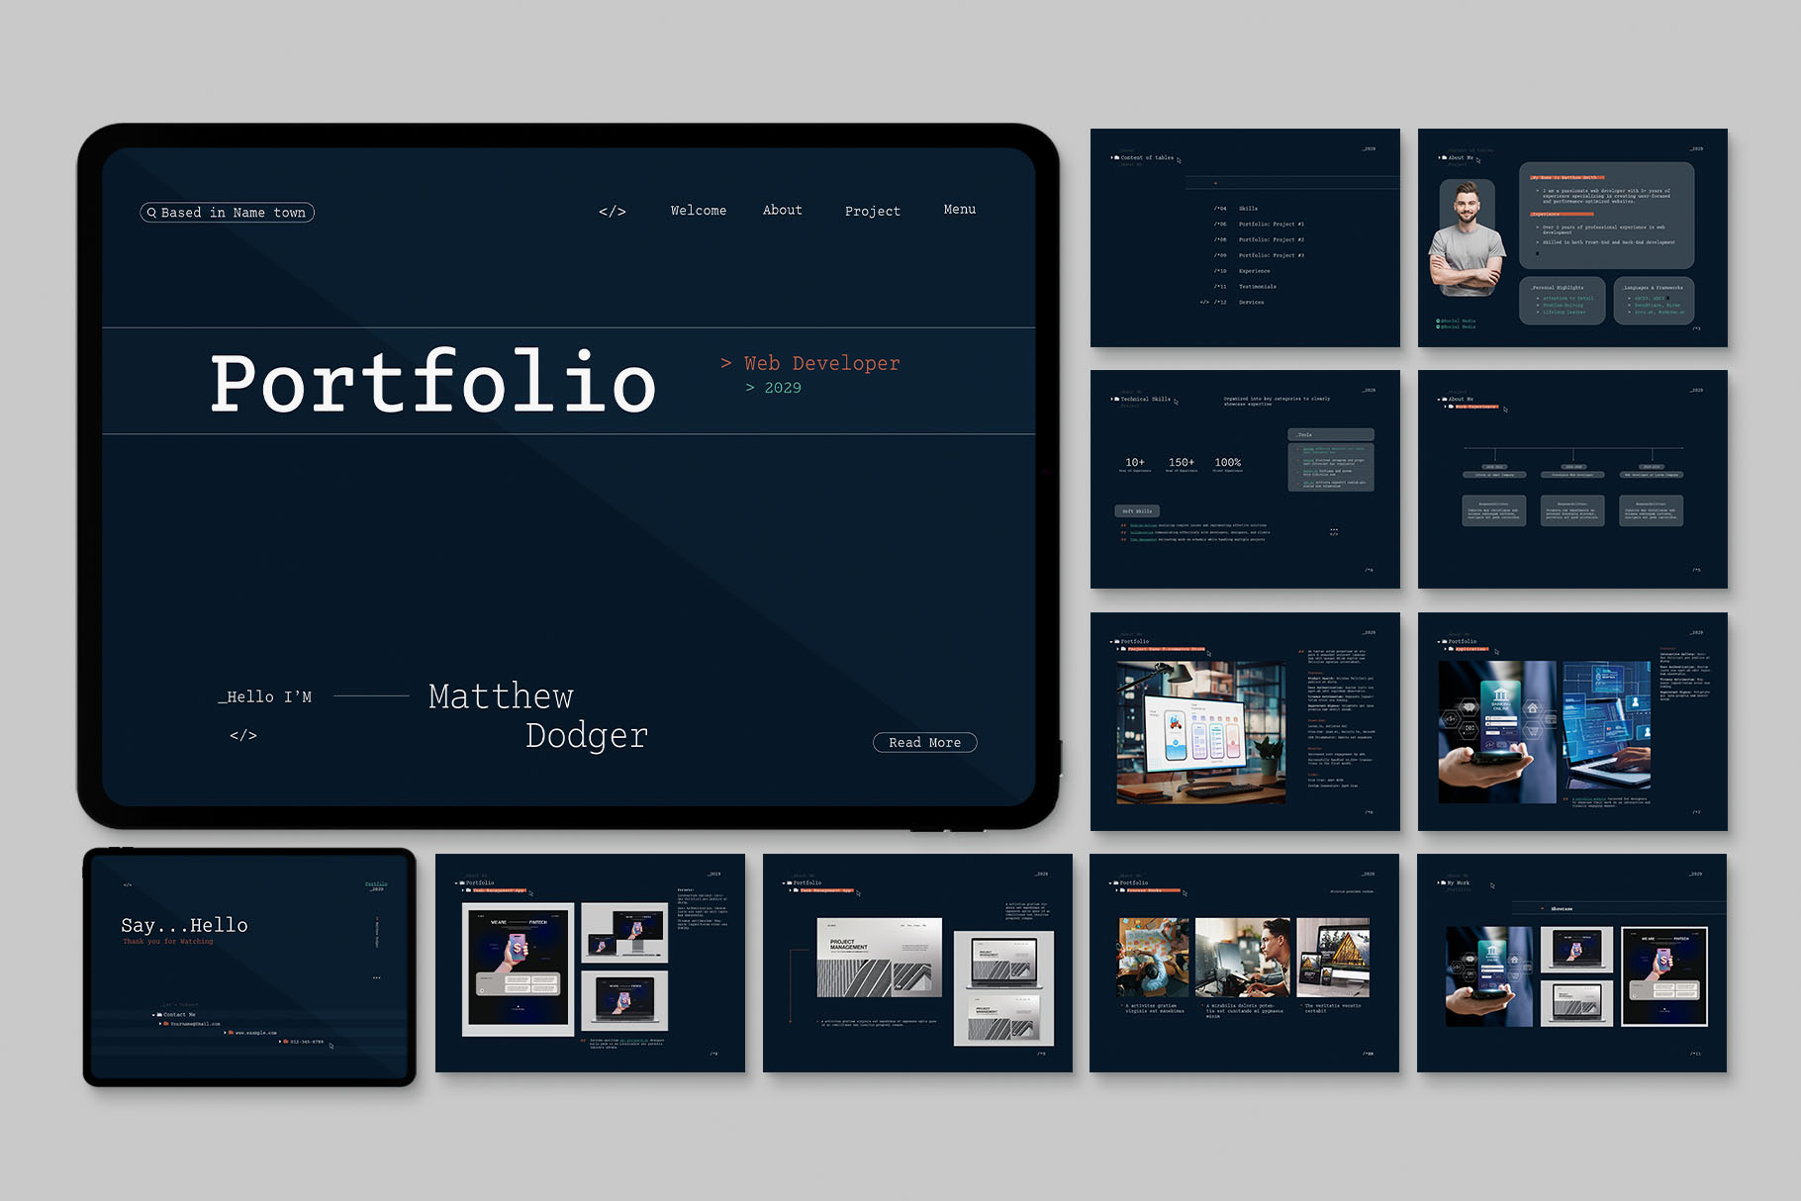
PROTFOLIO DESIGN AND LAYOUT
•The portfolio follows a clean, minimal, and modern design. Sections include About Me, Skills, Projects, and Contact Information. The layout is user-friendly and mobile responsive.

Slide 9
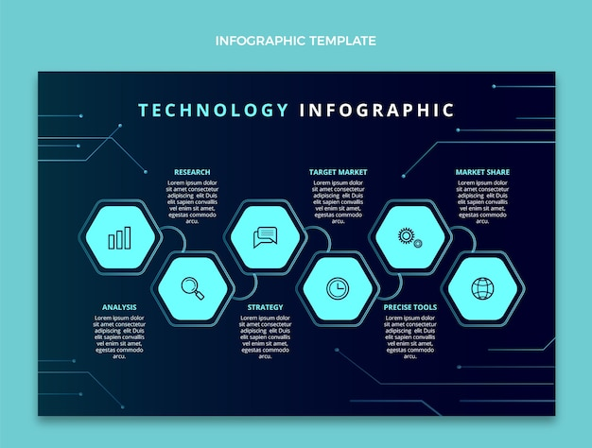
FEATURES AND FUNCTIONALITY
•- About Me: Brief introduction
•- Skills: Current learning progress
•- Projects: Highlights digital portfolio creation
•- Contact: Provides email and GitHub link

Slide 10
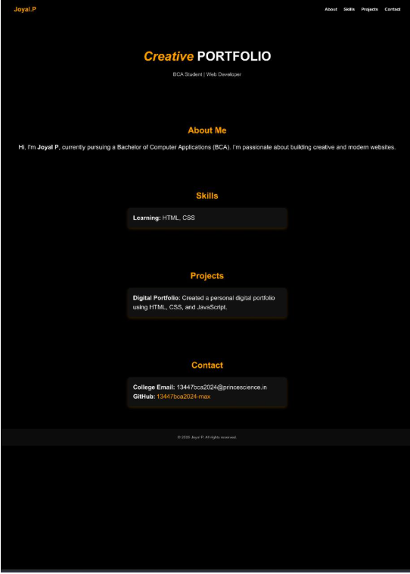
RESULTS AND SCREENSHOTS

Slide 11
CONCULSION
•The project demonstrates the ability to design and develop a personal portfolio using HTML, CSS, and JavaScript. It highlights creativity and technical growth, providing a foundation for future web development projects.

Slide 12
GITHUB LINK
•GitHub Repository: https://13447bca2024-max.github.io/My-portfolio-/

