Slide 2
尾句为主题句
Mini reading 2:On the night of the party Merlin rolled into the room playing his violin. Everyone was astonished to see him. There was just one problem. Merlin had no way to stop his roller skater. He rolled on and on. Suddenly he ran into a huge mirror that was hanging on the wall. Down fell the mirror, breaking to pieces. Nobody forgot Merlin’s grand entrance for a long time!
What is the main point the writer is trying to make in the paragraph?
A. The roller skates needed further improvement.
B. The party guests took Merlin for a fool!
C. Merlin succeeded beyond expectation.
D. Merlin got himself into trouble.
在很长一段时间里，没有人会忘记Merlin的入场！

Slide 3
Mini reading 3:Tom studied four years at the University of Paris and decided to leave before his graduation. He transferred to the University of Berlin and graduated with honors. Harvard Law School and, later, Boston College provided him with an excellent legal background. He is presently a corporation lawyer in Miami, Florida. The main idea of this paragraph is that ______. A. Tom, who had studied at Paris Universities for four years, moved to another university. B. Tom became a lawyer since his graduation from Harvard Law School and later from Boston College. C. Tom was an excellent student when he studied at Berlin university. D. Tom received an excellent education.
该段无明显主题句
综合细节的描述，可以概括出D正确

Slide 4
Mini reading 4:What causes traffic jams? Too many cars, right? No! Some Brits are now saying that traffic lights are to blame for much of the congestion（交通拥挤）. They suggest that traffic lights be removed at busy roads. They believe people are a better judge of when it’s safe to go, not a traffic light programmed by an absent regulator.
Which of the following is the best title?
A.Don’t Count On Traffic Lights
B.New Traffic Systems Needed
C.Turn Those Traffic Lights Off
D.Let People Have More Say In Traffic
段落中间句为主题句

Slide 5
Task 3 : Passage Practice

Slide 6
【1】If you don't want people to know too much about you, then you had better keep your fridge contents secret, according to a British market research document released last week. 【2】Researchers looked into the fridges of 400 people in Britain and compared the contents with the owners' lifestyles. They claim to be able to classify the nation's people by fridge contents. 【3】They say those people can be divided into five categories: "nutrition nerds", "food faddies", "strict mums", "fast food fanatics" and "restaurant regulars". 【4】"Nutrition nerds" care much about what they put into their bodies. Their fridges are stocked with fruit, vegetables and healthy meat. People in this category tend to be highly organized and usually work in law or accountancy. The vast majority are single, but if they have a partner, that person will be similar. 【5】A fridge full of vitamins-enriched juices implies its owner works in media or fashion. They tend not to eat the foods they buy. Known as the "food faddies",they just want to be seen as buying the latest important things. 【6】A fridge filled with everything from steak to frozen fish suggests the "strict mum". Her fridge tends to be stocked with every kind of product, except what she herself would want. This fridge hints at difficulty balancing family and work life. 【7】"Fast food fanatics" always buy mineral water for soda pop (汽水); the nearest they will get to fresh fruit is tomato sauce. Their fridges hint at someone who works hard and plays hard, also, someone who is not into long term planning. 【8】 Finally, a fridge filled with nothing more than a bottle of white wine and some sparkling mineral water implies an owner who is single, lives in a big city and enjoys the finer things in life. The fridge is empty because this person regularly eats in restaurants.

Slide 7
【1】If you don't want people to know too much about you, then you had better keep your fridge contents secret, according to a British market research document released last week. 【2】Researchers looked into the fridges of 400 people in Britain and compared the contents with the owners' lifestyles. They claim to be able to classify the nation's people by fridge contents. 【3】They say those people can be divided into five categories: "nutrition nerds", "food faddies", "strict mums", "fast food fanatics" and "restaurant regulars".
【4】"Nutrition nerds" care much about what they put into their bodies. Their fridges are stocked with fruit, vegetables and healthy meat. People in this category tend to be highly organized and usually work in law or accountancy. The vast majority are single, but if they have a partner, that person will be similar. 【5】A fridge full of vitamins-enriched juices implies its owner works in media or fashion. They tend not to eat the foods they buy. Known as the "food faddies",they just want to be seen as buying the latest important things. 【6】A fridge filled with everything from steak to frozen fish suggests the "strict mum". Her fridge tends to be stocked with every kind of product, except what she herself would want. This fridge hints at difficulty balancing family and work life. 【7】"Fast food fanatics" always buy mineral water for soda pop (汽水); the nearest they will get to fresh fruit is tomato sauce. Their fridges hint at someone who works hard and plays hard, also, someone who is not into long term planning. 【8】 Finally, a fridge filled with nothing more than a bottle of white wine and some sparkling mineral water implies an owner who is single, lives in a big city and enjoys the finer things in life. The fridge is empty because this person regularly eats in restaurants.
总
分

Slide 8
定位P1-P2
1.We can know from the first two paragraphs that _____.
A.some researchers are fond of staring at other people's fridges B.people don't want others to know about their secrets C.the food you put in the fridge has something to do with your personality D.there are mainly five kinds of lifestyles among British people
2.According to the passage, people who belong to "food faddies" _____.
A.don't care much about money when buying things B.will try their best to stay healthy C.often stay up late to finish their job D.prefer to ask others about what to do next
3.What will those who often dine out put in the fridge?
A.All kinds of food they like. B.Food rich in vitamins. C.Fruit, vegetables and meat. D.Only something to drink.
4.What might be the most suitable title for the text?
A.Keep your fridge a secret. B.You are what's in your fridge. C.What to put in the fridge? D.Be careful about your fridge
定位P5
定位P8
定位P1-P3

Slide 9

【4】Nutrition nerds" care much about what they put into their bodies. Their fridges are stocked with fruit, vegetables and healthy meat. People in this category tend to be highly organized and usually work in law or accountancy. The vast majority are single, but if they have a partner, that person will be similar. 【5】A fridge full of vitamins-enriched juices implies its owner works in media or fashion. They tend not to eat the foods they buy. Known as the "food faddies", they just want to be seen as buying the latest important things. 【6】A fridge filled with everything from steak to frozen fish suggests the "strict mum". Her fridge tends to be stocked with every kind of product, except what she herself would want. This fridge hints at difficulty balancing family and work life. 2.According to the passage, people who belong to "food faddies" _____.
A.don't care much about money when buying things B.will try their best to stay healthy C.often stay up late to finish their job D.prefer to ask others about what to do next

Slide 10
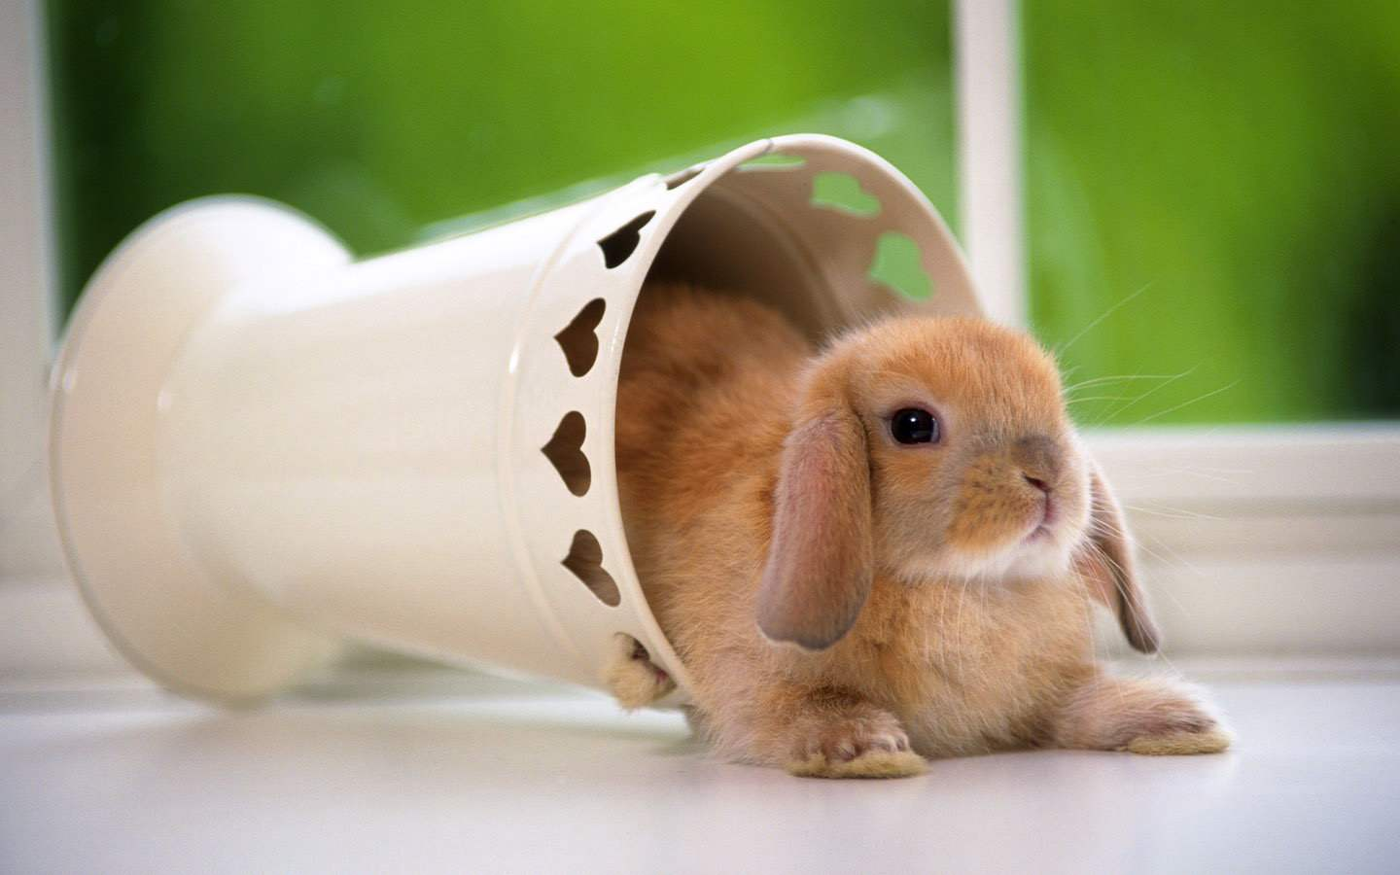
课后作业

Slide 11
【1】Easter (复活节) is still a great day for worship, candy in baskets and running around the yard finding eggs, but every year it gets quite a bit worse for bunnies.
【2】And no, not because the kids like to pull their ears. The culprit is climate change, and some researchers found that rising temperatures are having harmful effects on at least five species of rabbit in the US.
【3】Take the Lower Keys Marsh rabbit, for instance. An endangered species that lives in the Lower Florida Keys, this species of cottontail is a great swimmer -- it lives on the islands! -- but it is already severely affected by development and now by rising sea levels. According to the Center for Biological Diversity, an ocean level rise of only 0.6 meters will send these ~ys jumping to higher ground and a 0.9-meter rise would wipe out their habitat (栖息地) completely.
【4】The snowshoe hare, on the other hand, has a color issue. Most of these rabbits change their fur color from white in the wintertime to brown in the summer, each designed to give them better cover from predators (捕食者). As the number of days with snow decreases all across the country, however, more and more bunnies are being left in white fur during brown dirt days of both fall and spring, making them an easier mark for predators. Researchers know that the color change is controlled by the number of hours of sunlight, but whether the rabbit will be able to adapt quick enough to survive is a big question. The National Wildlife Federation has reported that hunters have noticed their numbers are already markedly down.
【5】American pikas or rock rabbits, a relative of rabbits and hares, might be the first of these species to go extinct due to climate change. About 7-8 inches long, pikas live high in the cool. damp mountains west of the Rocky Mountains. As global temperatures rise, they would naturally migrate (迁移) to higher ground -- but they already occupy the mountaintops. They can't go any higher. The National Wildlife Federation reports that they might not be able to stand the new temperatures as their habitat heats up.
【6】The volcano rabbit has the same problem. These rabbits live on the slopes of volcanoes in Mexico, and recent studies have shown that the lower range of their habitat has already shifted upward about 700 meters, but there are not suitable plants for them to move higher, so they are stuck in the middle. Scientists are concerned about their populations.
【7】Native to the US, pygmy rabbits weigh less than 1 pound and live in the American West. They are believed to be the smallest rabbits in the world. Their habitats have been destroyed by development. Several populations, such as the Columbia Basin pygmy, almost went extinct and were saved by zoo breeding programs. Pygmy rabbits also rely on winter cover by digging tunnels through the snow to escape predators, but lesser snowfall is leaving them exposed.
【8】All of this gives new meaning to dressing up in a giant bunny costume this Easter.

Slide 12
【1】Easter (复活节) is still a great day for worship, candy in baskets and running around the yard finding eggs, but every year it gets quite a bit worse for bunnies.
【2】And no, not because the kids like to pull their ears. The culprit is climate change, and some researchers found that rising temperatures are having harmful effects on at least five species of rabbit in the US.
【3】Take the Lower Keys Marsh rabbit, for instance.
【4】The snowshoe hare, on the other hand, has a color issue.
【5】American pikas or rock rabbits, a relative of rabbits and hares, might be the first of these species to go extinct due to climate change.
【6】The volcano rabbit has the same problem.
【7】Native to the US, pygmy rabbits weigh less than 1 pound and live in the American West.
【8】All of this gives new meaning to dressing up in a giant bunny costume this Easter.
本文主题句

Slide 13

【1】Easter (复活节) is still a great day for worship, candy in baskets and running around the yard finding eggs, but every year it gets quite a bit worse for bunnies.
【2】And no, not because the kids like to pull their ears. The culprit is climate change, and some researchers found that rising temperatures are having harmful effects on at least five species of rabbit in the US.
42. The word "culprit" (Paragraph 2) is closest in meaning to ______.
A. criminal B. judge C. victim D. producer

Slide 14

【3】Take the Lower Keys Marsh rabbit, for instance. An endangered species that lives in the Lower Florida Keys, this species of cottontail is a great swimmer -- it lives on the islands! -- but it is already severely affected by development and now by rising sea levels. According to the Center for Biological Diversity, an ocean level rise of only 0.6 meters will send these ~ys jumping to higher ground and a 0.9-meter rise would wipe out their habitat (栖息地) completely.
【4】The snowshoe hare, on the other hand, has a color issue. Most of these rabbits change their fur color from white in the wintertime to brown in the summer, each designed to give them better cover from predators (捕食者). As the number of days with snow decreases all across the country, however, more and more bunnies are being left in white fur during brown dirt days of both fall and spring, making them an easier mark for predators. Researchers know that the color change is controlled by the number of hours of sunlight, but whether the rabbit will be able to adapt quick enough to survive is a big question. The National Wildlife Federation has reported that hunters have noticed their numbers are already markedly down.
43. According to the passage, some rabbits can now be easily discovered by predators because they __.
A. are exposed to more skillful hunters
B. have moved to habitats with fewer plants
C. haven't adapted themselves to climate change
D. can't change their fur color into white in the fall and the spring

Slide 15
Thank you for listening

